Slide 1

Team Butterfly

Slide 2
Build Your Cloud!
There are too many options to pick!
Too many services
Too many options!
Too many choices!!
Is there a better way?

Slide 3
Tech Stack
React.js
Local Storage
GitHub, GitHub Actions
Going One Beyond for KISS!

Slide 4
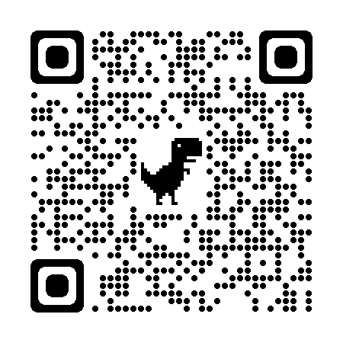
Try Build Your Cloud! Right now!

