Slide 1
Music Genre Classification
EEE498/591
Fall 2021
Naive Boyes: Dale, Zach, Adan, Jonah

Slide 2
Introduction
Music streaming services like Spotify have over 70 million tracks available in 184 markets
Spotify recommends tracks to its 172 million subscribers by classifying each track into certain music genres
An incentive exists to accurately classify tracks and make recommendations to users and encourage subscription to the service
We explore different ML algorithms and compare their performance in classifying tracks by measuring train/test accuracy and training time
Notes:
DALE: Music streaming services like Spotify, Apple Music, and others have over millions of tracks. What those streaming services does is they try to classify each tracks to certain genres and recommends them to its users. There exists an incentive to classify the music tracks accurately and recommend them to its users to encourage them subscribe to their service. We have explored different ML algos and compared their performance to each of them for the best accuracy and training time

Slide 3
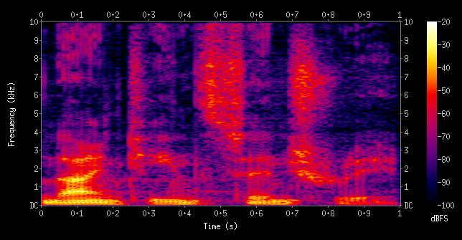
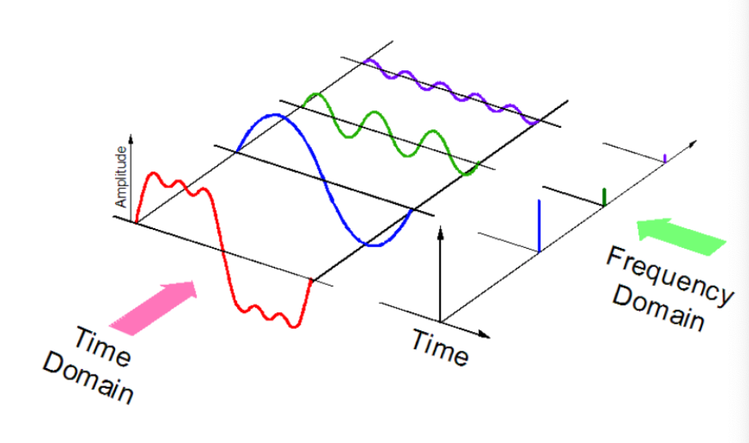
Theory
Sound can be represented as audio signals with parameters including frequency, bandwidth, and decibels.
These parameters are useful features for analysis
Songs within a genre have similar patterns that allow ML algorithms to train and classify songs
https://en.wikipedia.org/wiki/Spectrogram
Notes:
Zach: Research in audio processing showing that each of the features is useful for analyzing music and audio: shows timbre, rhythm.

Slide 4
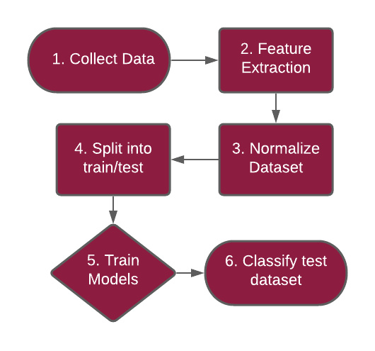
Methodology
GTZAN dataset contains 1000 audio tracks each 30 seconds long. It contains 10 genres, each represented by 100 tracks.
Zero crossing rate, spectral centroid, spectral rolloff, MFCCs, Chroma frequencies, spectral bandwidth, and root mean square.
Standard scaler and PCA
30% used as test dataset
KNN, SVM, Logistic Regression, Random Forest, MLP, Naive Bayes, Decision Tree, NN w/ dropout & L2 regularization
Accuracy metrics and confusion matrices
Notes:
Comparative analysis

Slide 5

Results
Algorithm | Test Accuracy | Train Accuracy | Training Time
KNN | 64% | 78% | 1.39s
SVM | 60% | 86% | 6.30s
Logistic Regression | 64% | 78% | .045s
Random Forest w/ parameter tuning | 67% | 100% | 73.32s
MLP | 59% | 100% | .22s
Naive Bayes | 57% | 70% | .002s
Decision Tree | 48% | 100% | .008s
NN w/ DO | 72% | 93% | 22.66s
Overfitting is prevalent
20~50% difference in training/testing
Notes:
NN w/ DO used 300 epochs
Training times are with an i7 9700k clocked at 5GHz so YMMV
High training accuracy and low test accuracy for random forest, MLP, and decision tree suggests strong overfitting

Slide 6
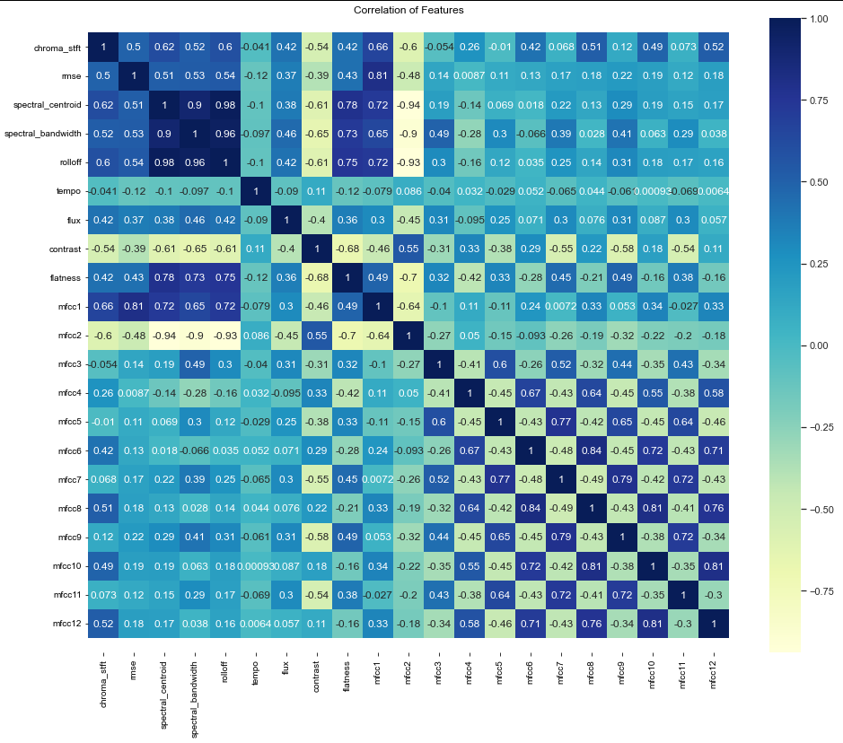
Correlation Matrix
Use this as feedback to determine if features are too dependent
Implement PCA
Drop MFCCs to reduce complexity

Slide 7
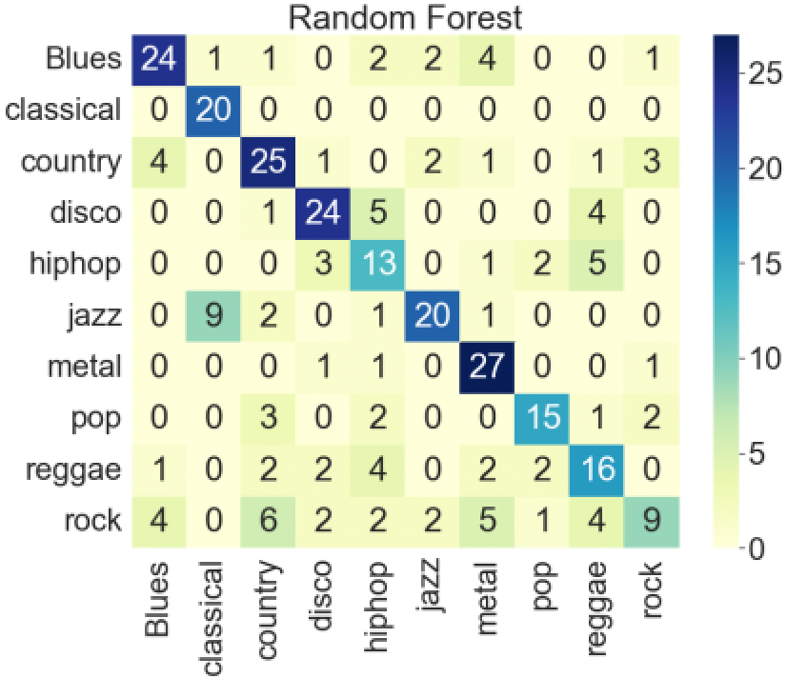
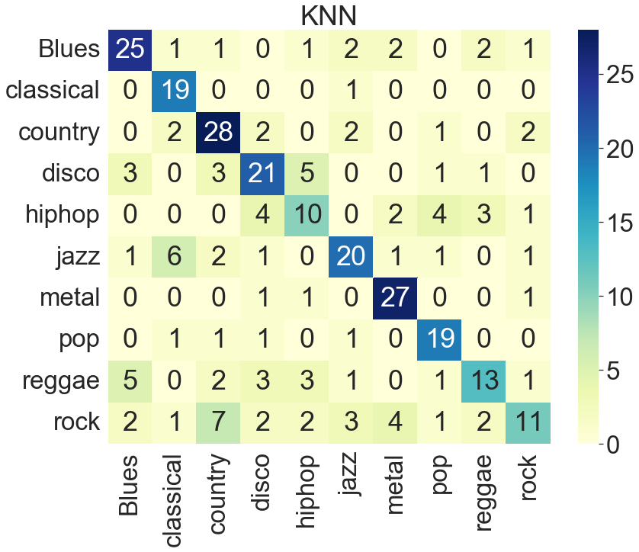
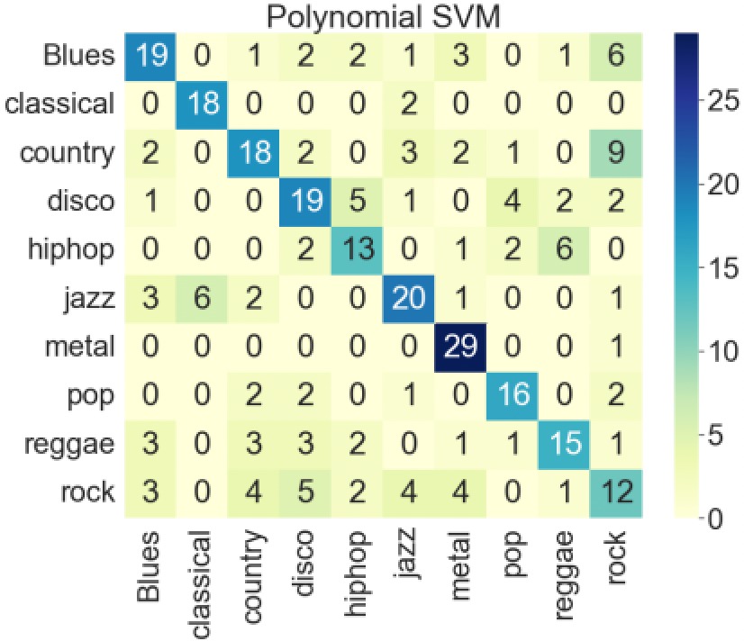
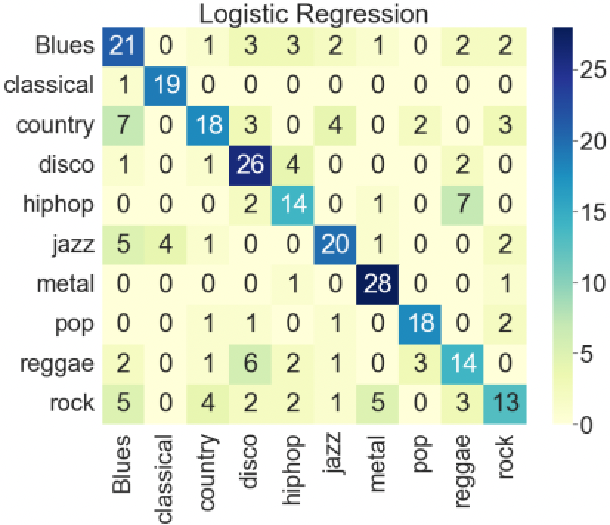
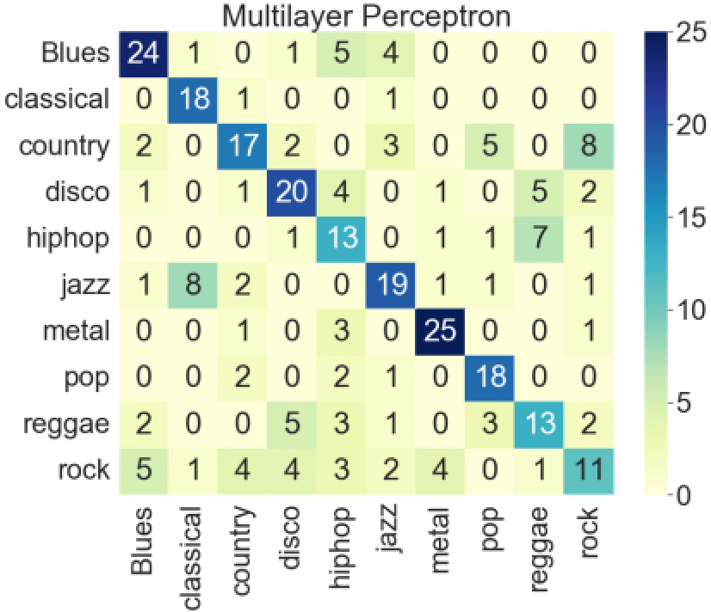
Model Confusion Matrices
Visualization of performance
Misclassification of similar genres

Slide 8
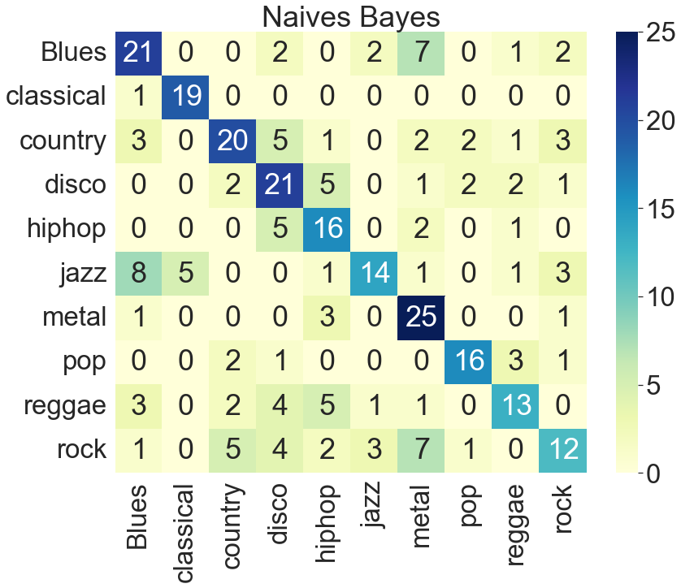
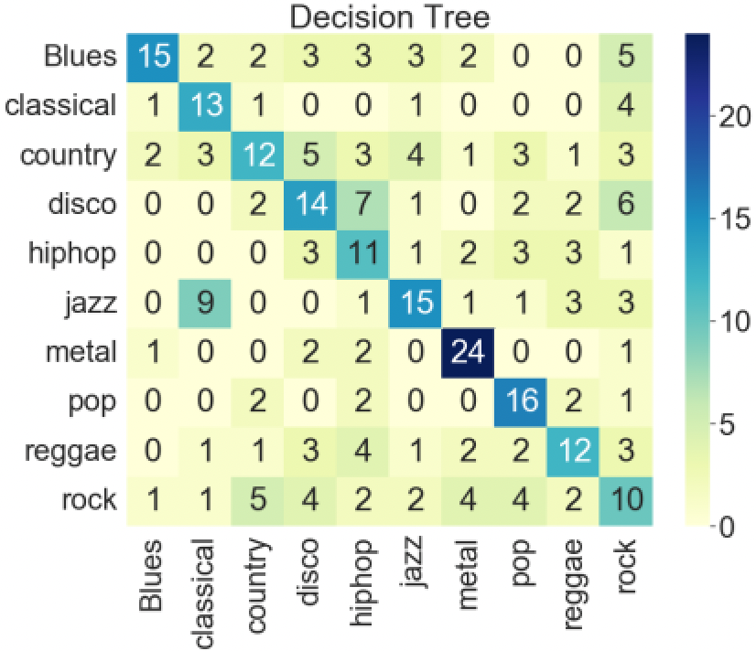
Worst Classifiers
Genre correlation adds to error
Naive bayes relies on independency = prediction error
Improve by adding more specific genre classifications

Slide 9
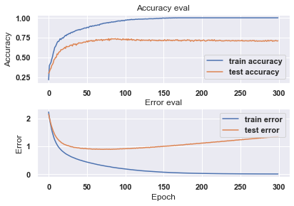
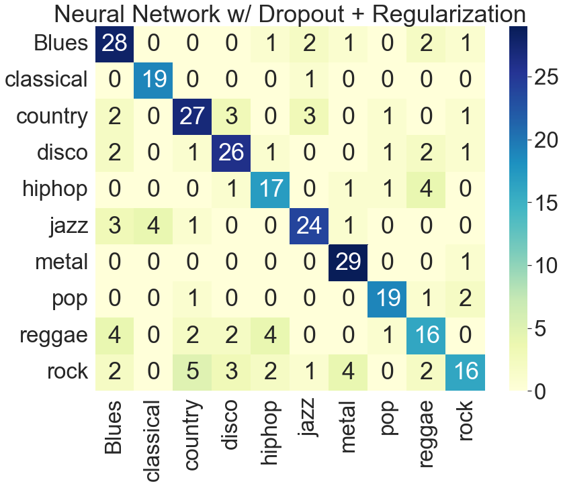
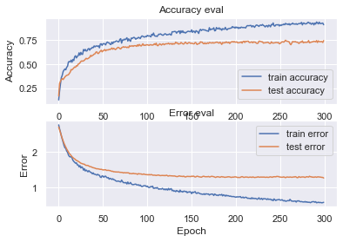
Neural Network Evaluation
Overfitting:
100% Training
~65% Testing
Dropout + Regularization:
92% Training
72% Testing

Slide 10
Conclusion
Classification models were prone to overfitting due to a relatively small amount of data with high variance
Out of all the classification algorithms, the Neural Network proved best with 69% Test Accuracy and 92% Training Accuracy
Adding in Regularization, Dropout, and PCA, overfitting was reduced
We can improve the accuracy by supplementing our model with more data or by implementing CNN with extracted spectrogram images

