Slide 1

Fictious Airways Aircraft Decommission Recommendations
Task: 2 Executive Summary
Student: Alan Danque
Class: DSC 640
Professor: Armstrong

Slide 2
Executive Summary Fictious Airways
Problem:
Solution:
Recommendation:
Airline safety concerns threaten the reputation of Fictious Airways
We have analyzed and identified which aircraft owned by Fictious Airways have the most fatalities
Publicly decommission the planes with less than 60% survival rate from service immediately.

Slide 3
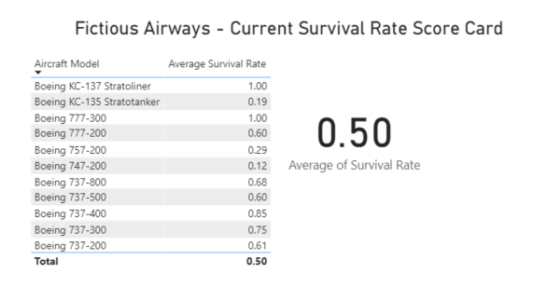
List of all aircraft owned and operated by Fictious Airways

Slide 4
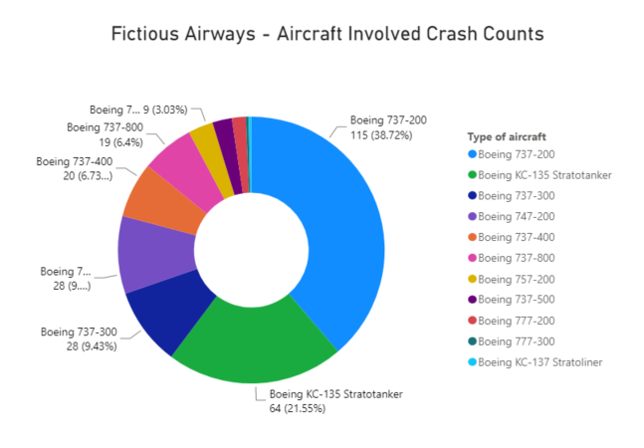

Slide 5
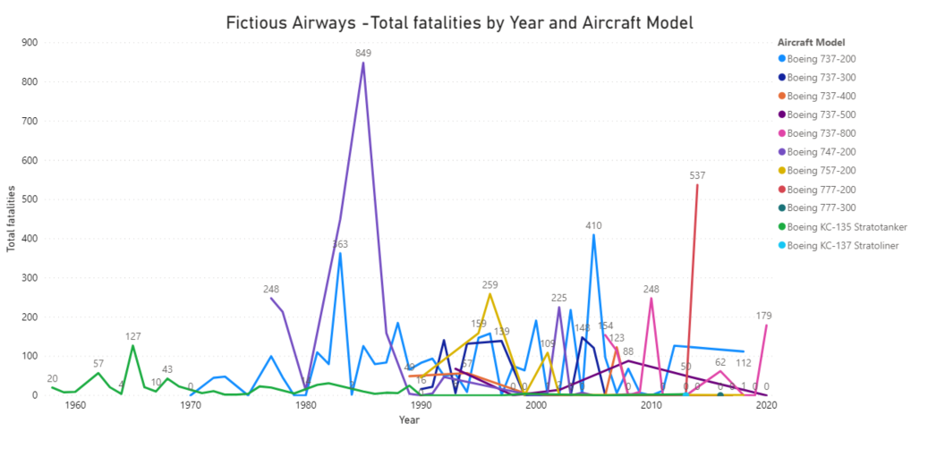

Slide 6
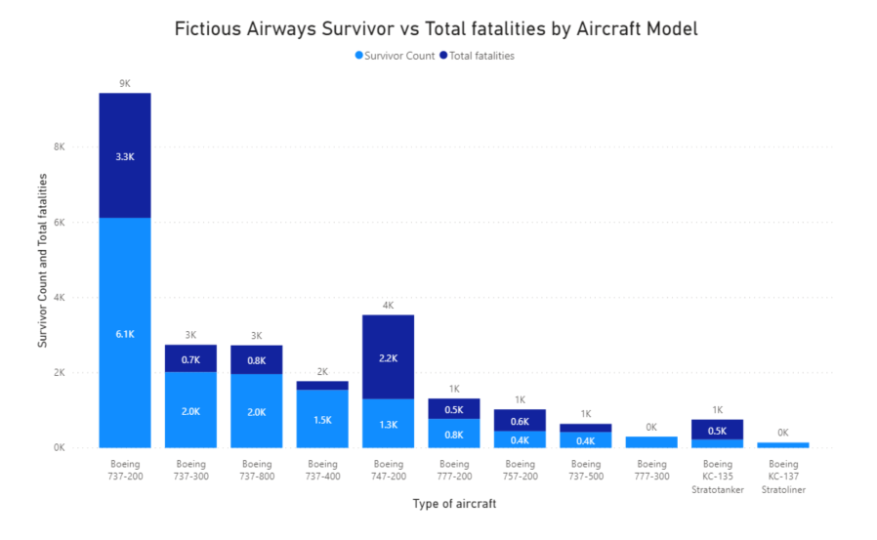

Slide 7
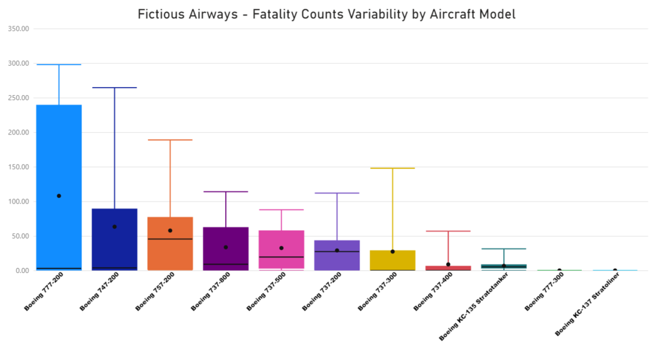

Slide 8
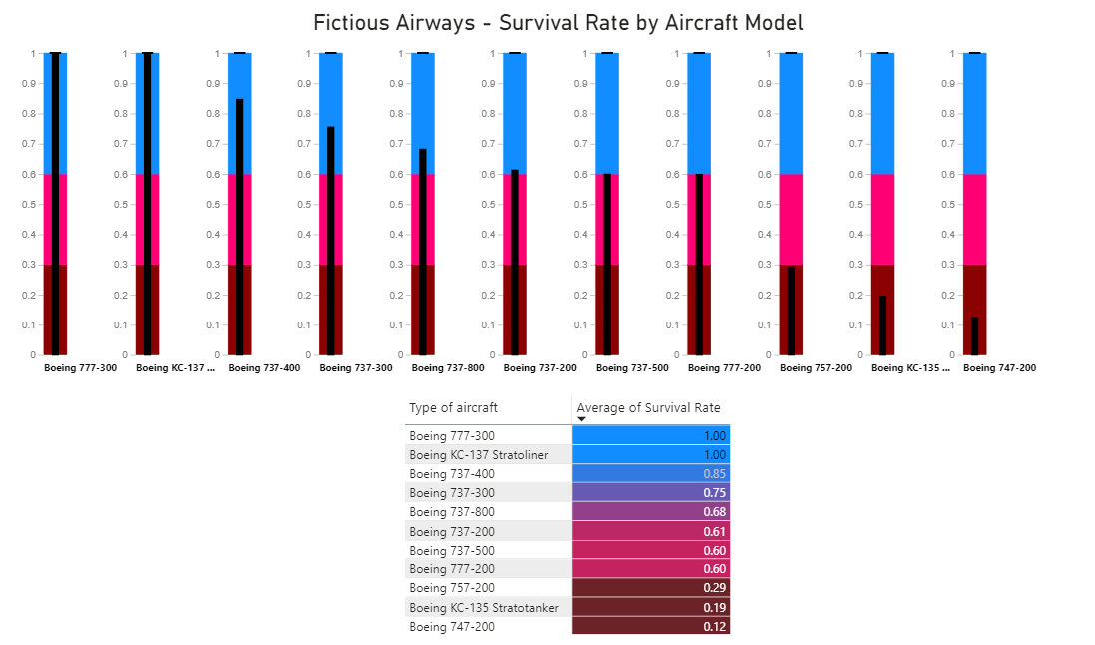

Slide 9
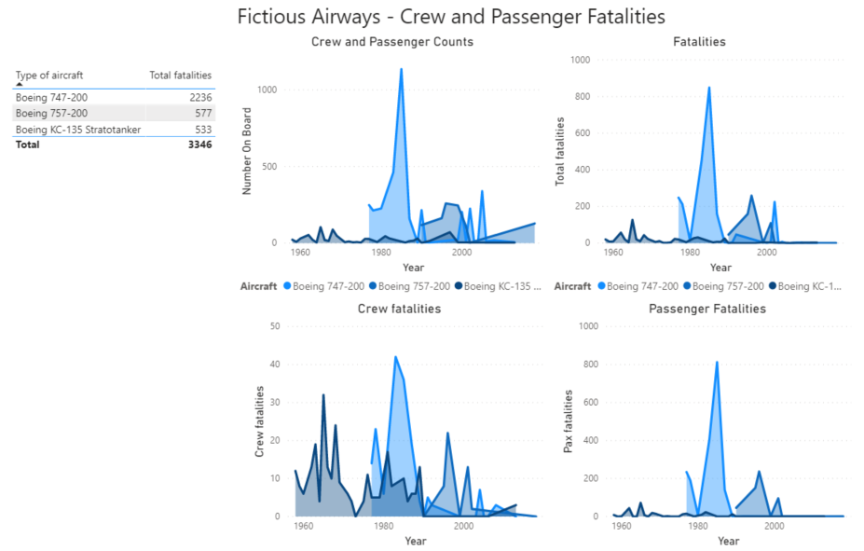

Slide 10
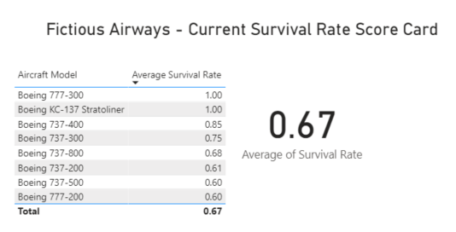
The Average Survival Rate after
decommissioning the following aircraft:
Boeing 757-200
Boeing KC-135 Statotanker
Boeing 747-200

Slide 11
Conclusion
Problem:
Recommendation Result:
Airline safety concerns threaten the reputation of Fictious Airways due a growing trend of fatalities.
By immediate public removal from service of all planes with less than 60% survival rate, the removal of these planes will increase Fictious Airways survival rate and therefore help improve the customer facing brand of Fictious Airways.

