Slide 1
Tertiary Government Spending
DSC 530
Alan Danque

Slide 2
Society Benefits from Education
Education is an important factor for any area and level of success. It helps improve one’s health, living conditions for societies and economic conditions for a country as a whole.
Striving for a higher education leads to a likeliness of higher pay and the creation of better products & services.
Leads to more opportunities, better jobs and thus a larger distribution of income over a country’s population. This type of growth increases the probability of societal activities such as “voting, volunteering, political interest and interpersonal trust.” (jackallenyehuda, 2016)

Slide 3
Hypothesis
How does Government Tertiary Spending affect the metrics of economic strength?
There are many measures of strength for a country. One important indicator of strength and growth is GDP per capita and at market prices. GDP or Gross Domestic Product is a standard measure of domestic economic output which is divided by its total population. For this measure I have always been curious about how a countries population growth and their spending on tertiary education would affect the GDP.

Slide 4
Questions:
Is GDP at capita affected by how much a country’s government has spent on tertiary student expenditures?
Is labor force affected by the amount rate of population change?
Does the amount of spend on tertiary student expenditures affect the population rate or gdp per capita?
Is GDP per capita affected by the amount of tertiary student expenditures?
Does the population rate of growth affect government expenditures for tertiary expenses?

Slide 5
Variables
Country – string value to indicate the country name.
Democratic - Is a boolean flag to indicate if the country is a democratic country or not.
Government expenditure per tertiary student US - Is a numeric value presenting the average general government expenditure per student for tertiary education.
Population total - Is a numeric value representing the total population of a country.
Labor force total - Is a numeric value representing the labor force total size for people ages 15 and older
GDP per capita current US - Is a numeric value representing the GDP per capita which is the sum of gross value by all resident producers divided by midyear population.
GDP at market prices current US - Is the sum of gross market value of products sold by resident producers minus government subsidies to assist the producers of these products.

Slide 6
Identified Data Issues, Outliers and How are they Handled
Large values that are from from others.
Kept these values in my analysis as are related to outperformers per largely populated performant countries including the US, Japan, China, Germany and more.
Missing years of data or 0 values
Have removed the years from my analysis.
Some countries do not have data or 0 values
Have removed the countries that do not have the metrics needed for this analysis.
Special characters in the data
Cleaned the data using regex techniques within Notepad++.

Slide 7
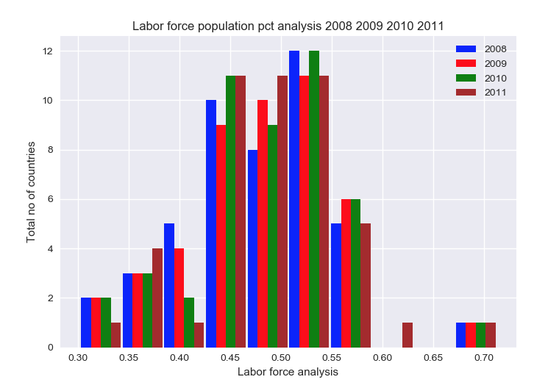
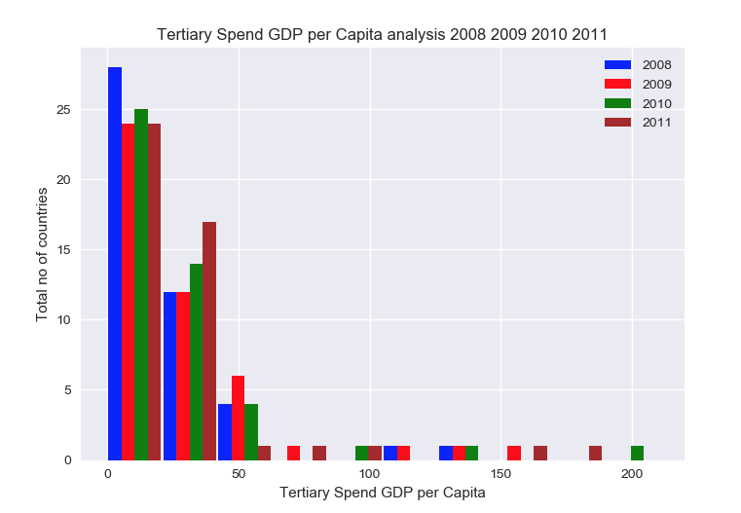
Histograms Labor Force % Population | Tertiary Spend GDP per Capita 2008 / 2009 / 2010 / 2011

Slide 8
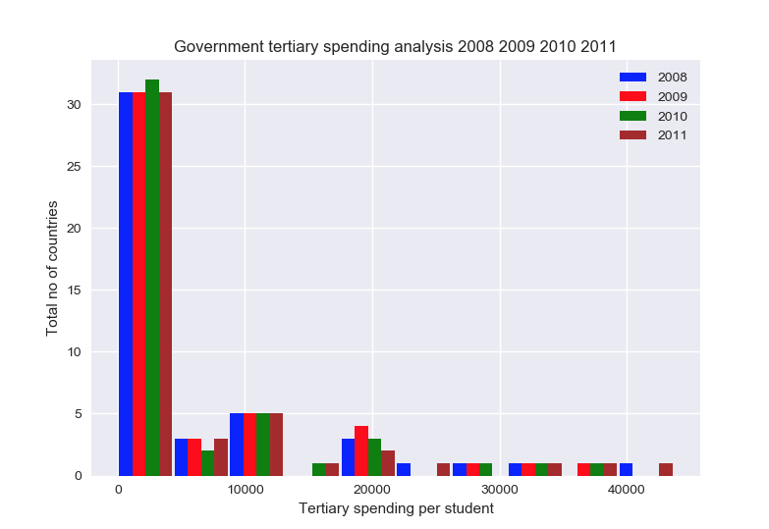
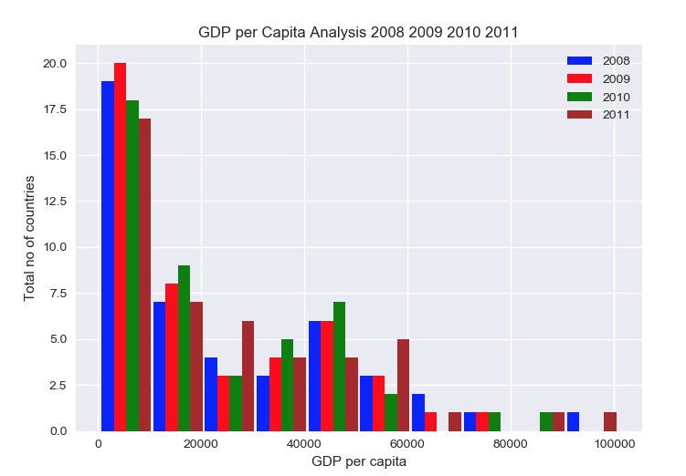
Histograms Government Tertiary spending | GDP per Capita 2008 / 2009 / 2010 / 2011

Slide 9
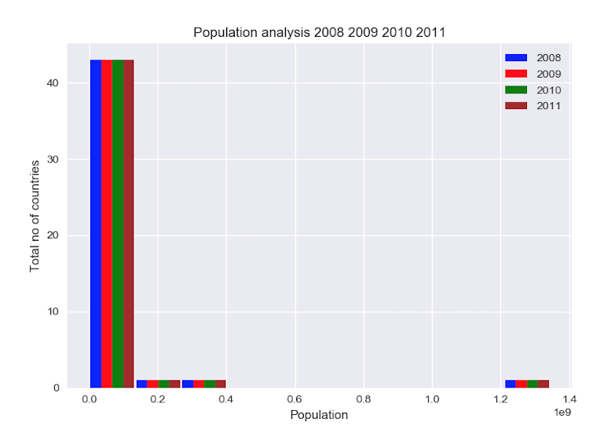
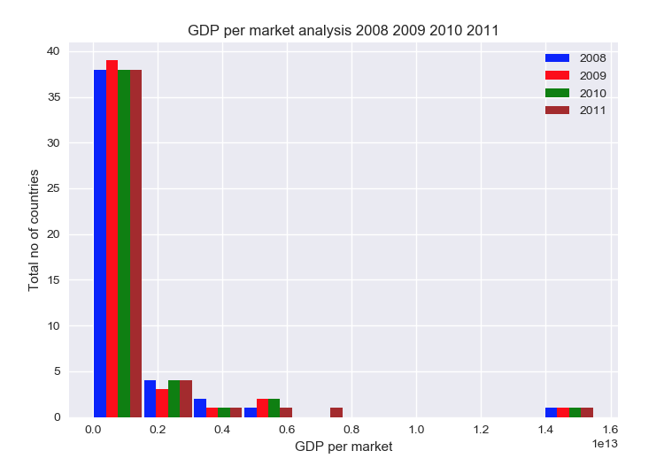
Histograms Population | GDP per market prices 2008 / 2009 / 2010 / 2011

Slide 10
Mean, Mode, Spread and Tails
Government tertiary spending analysis
For years:2008 2009 2010 2011
Histogram Mean and Variance (6217.804347826087, 97468778.63563322)
(5940.326086956522, 84059992.82844992)
(5871.760869565217, 82151331.09499055)
(6259.478260869565, 94649565.11909261)
Tails
Largest value: 43697.0
Smallest value: 0.0
Median: 1550.0
Mode is / are: 0.0
GDP per Capita Analysis
For years: 2008 2009 2010 2011
Histogram Mean and Variance for
(24412.804347826088, 550036616.7225899)
(21639.695652173912, 429079699.03780705)
(22650.739130434784, 461646752.2362949)
(25047.304347826088, 574655306.2117203)
Tails
Largest value: 97007.0
Smallest value: 470.0
Median: 17221.0
No mode found

Slide 11
Mean, Mode, Spread and Tails
GDP per market analysis
for years: 2008 2009 2010 2011
Histogram Mean and Variance
(1040285012552.7174, 5.532351357658548e+24)
(995362095986.3695, 5.404004633581112e+24)
(1075262578288.3043, 6.055407696149895e+24)
(1183381470862.152, 6.876600874153939e+24)
Tails
Largest value: 14700000000000.0
Smallest value: 3163416242.0
Median: 283000000000.0
No mode found
Population analysis
for years: 2008 2009 2010 2011
Histogram Mean and Variance
(63334054.02173913, 3.833958592822141e+16)
(63799507.93478261, 3.873234327754147e+16)
(64248837.95652174, 3.9118155474216936e+16)
(64656178.93478261, 3.950041124474017e+16)
Tails
Largest value: 1324655000.0
Smallest value: 409379.0
Median: 13042233.0
No mode found

Slide 12
Mean, Mode, Spread and Tails
Labor analysis
for years: 2008 2009 2010 2011
Histogram Mean and Variance
(33851994.89130435, 1.3062641144045952e+16)
(34075531.10869565, 1.312849505590181e+16)
(34211702.93478261, 1.3140519734199002e+16)
(34400155.45652174, 1.3221024829212986e+16)
Tails
Largest value: 777396382.0
Smallest value: 169639.0
Median: 5141665.5
No mode found
Tertiary Spend GDP per Capita analysis
for years: 2008 2009 2010 2011
Histogram Mean and Variance
(21.73913043478261, 758.5406427221172)
(28.717391304347824, 1232.3766540642716)
(25.891304347826086, 1344.8360113421552)
(26.369565217391305, 1318.79820415879)
Tails
Largest value: 143.0
Smallest value: 0.0
Median: 19.0
Mode is / are: 0.0

Slide 13
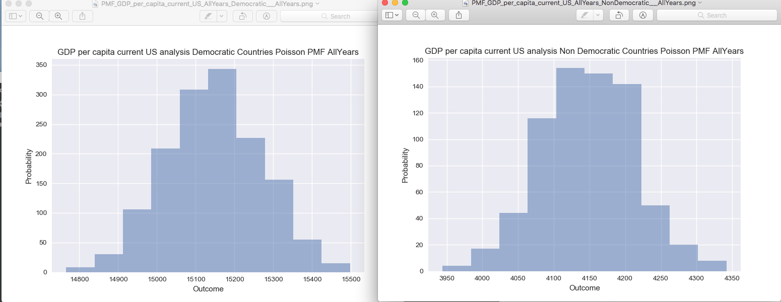
PMF GDP per Capita Current US using Democratic vs Non Democratic Countries

Slide 14
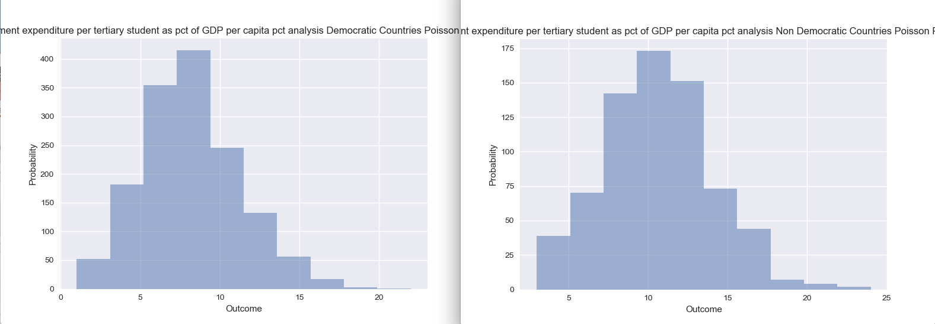
PMF Government expenditure per tertiary student as pct of GDP per capita using Democratic vs Non Democratic countries

Slide 15
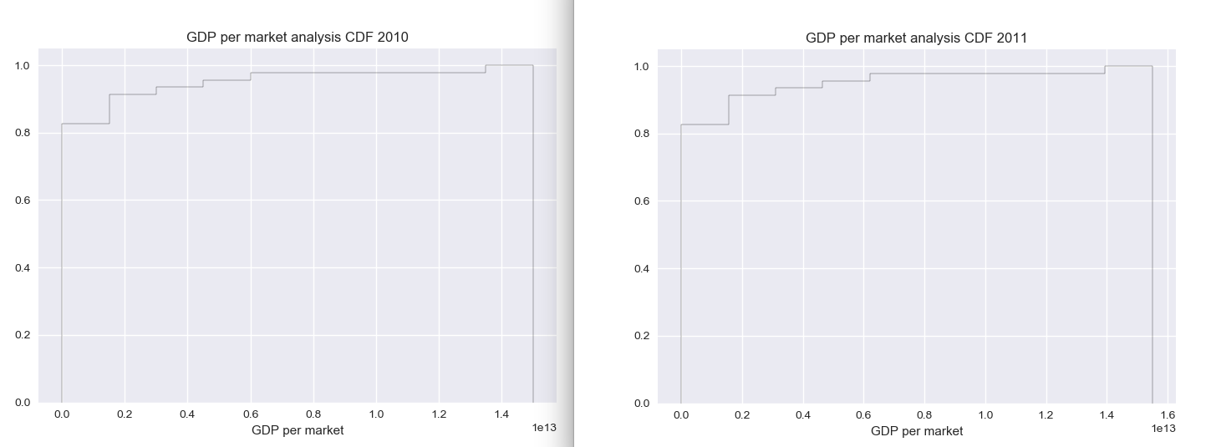
CDF using page 41-44 as your guide, what does this tell you about your variable and how does it address the question you are trying to answer(Chapter 4).

Slide 16
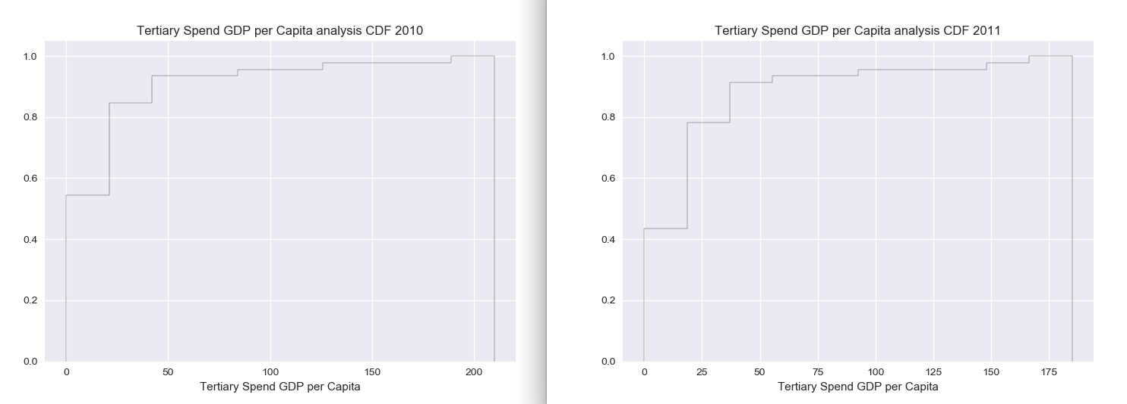
CDF

Slide 17
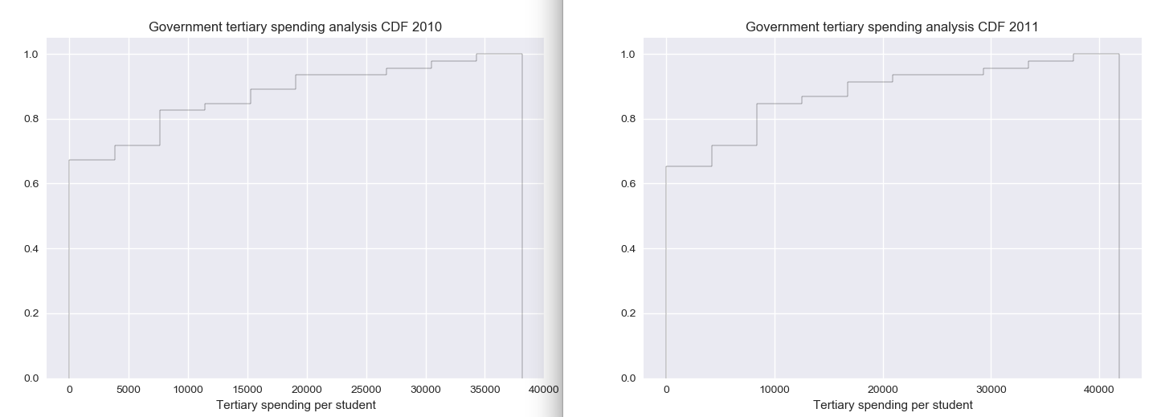
CDF

Slide 18
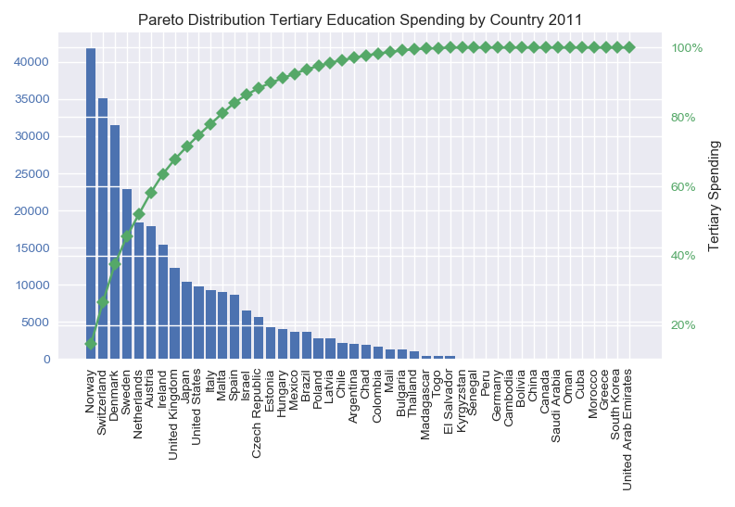
Pareto Distribution Analysis

Slide 19
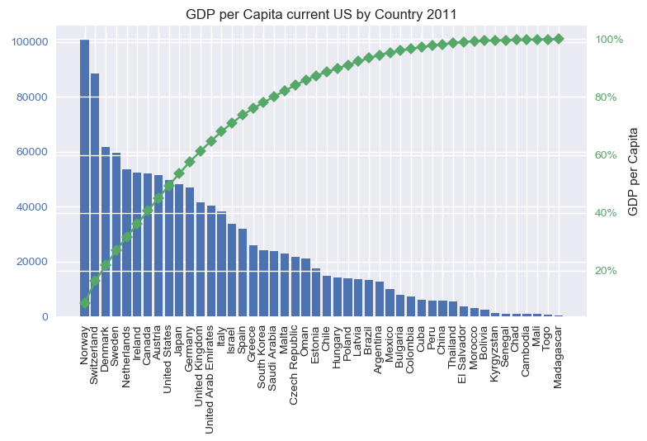
Pareto Distribution Analysis

Slide 20
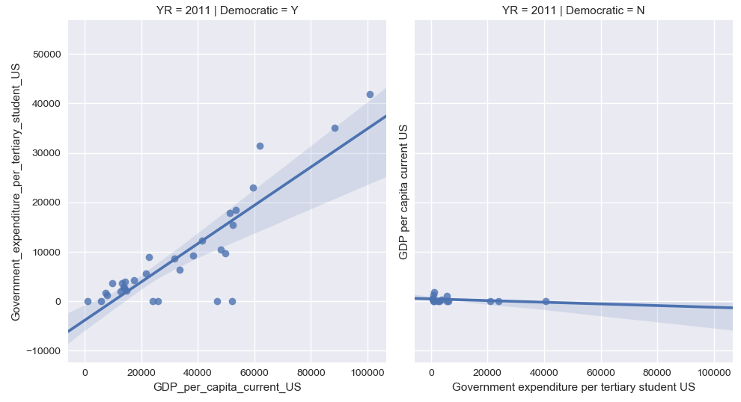
Scatter plot displays differences between Democratic and Non Democratic Country Tertiary Spending vs GDP per Capita -2011
tertiaryedspendout1 & gdpcapitaout1 2011
Correlated test using
Spearmans R
0.04224059740361087
Weak correlation
Correlated test using Pearsons
0.04224059740361087
Weak correlation

Slide 21
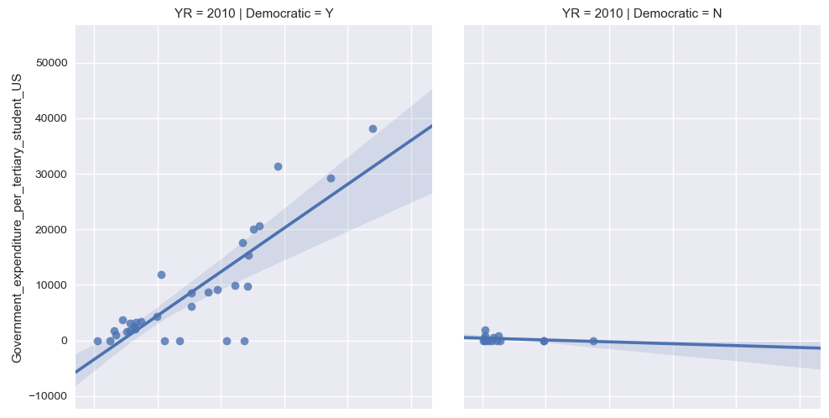
Scatter plot displays differences between Democratic and Non Democratic Country Tertiary Spending vs GDP per Capita - 2010
tertiaryedspendout1 & gdpcapitaout1 2010
Correlated test using
Spearmans R
0.03696836830717207
Weak correlation
Correlated test using Pearsons
0.03696836830717207
Weak correlation

Slide 22
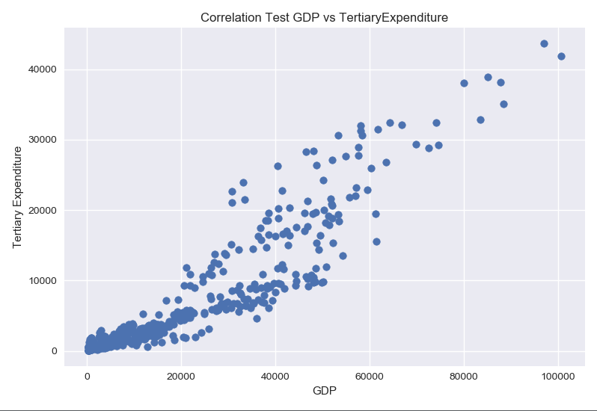
Scatter plot of the Correlation of GDP and TertiaryExpenditures

Slide 23
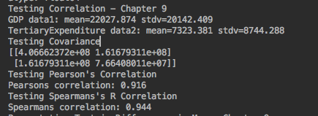
Hypothesis Testing: GDP and TertiaryExpenditures Using Correlation, Covariance, Pearson’s and Spearmans R Test.

Slide 24
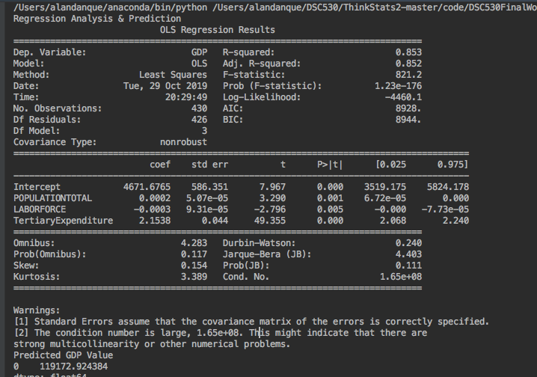
Regression analysis using ordinary least squares was able to predict GDP as a function of Population + Laborforce + TertiaryExpenditure. The example shows GDP does grow when TertiaryExpenditure is higher.

Slide 25
Conclusions:
My tests find that there is a significant correlation between a countries GDP and its spending on Tertiary Education.
It does not rule out the point that there may be other possibly better indicative variables that contribute to a country’s GDP.

Slide 26
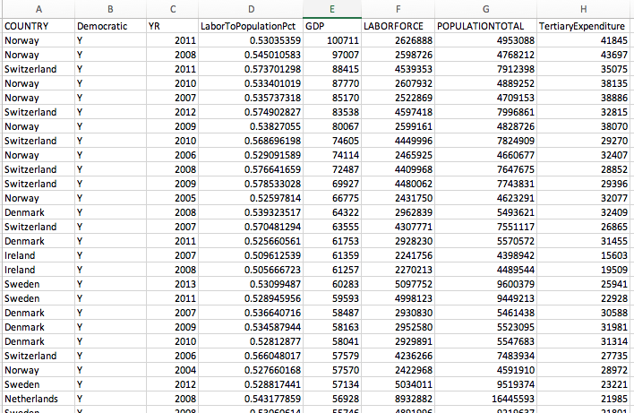
In review of the data available it appears to reflect that GDP is correlated to TertiaryExpenditure.

Slide 27
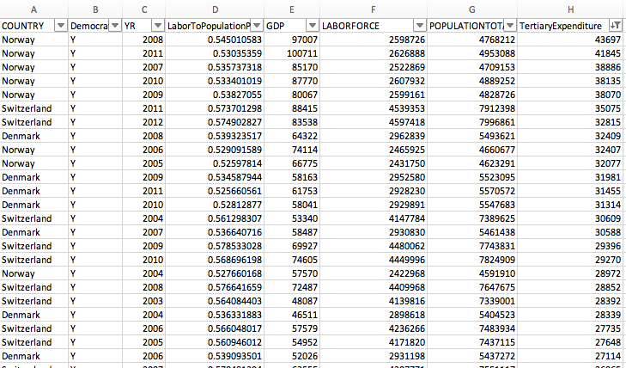
In review of the data available it appears to reflect that GDP is correlated to TertiaryExpenditure.

Slide 28
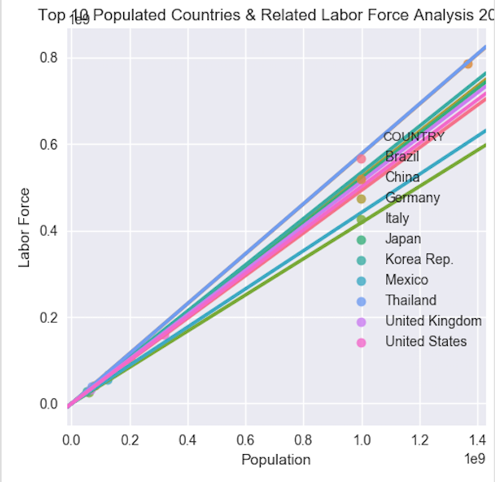
Top 10 Countries

Slide 29
References:
Jackallenyehuda, (December 2016). The Benefits of Higher Education. Retrieved from https://www.hastac.org/blogs/jackkunis/2016/12/08/benefits-higher-education

