Slide 1
Fair Returns
Country-Invariant Return-Risk Prediction for Cross-Border E-Commerce with a Variational Information Bottleneck and Gradient Reversal
Same order, six addresses
CDS521 Foundation of Artificial Intelligence · Lingnan University
Group 14 · YANG Liangxu · CHENG Zixi · CHEN Yuhuan · DING Jiajie · DENG Yujun · XIONG Jing
Open-Source Artifacts & Audit Logs: https://github.com/adantn/FairReturns-CDS521-Group14_Doubao
country-aware model
our model
Notes:
Thank you for joining us. We are Group 14, and our project is Fair Returns. We predict whether an online order will be returned under one constraint: the same order should receive the same risk regardless of the customer's country. I will begin with the motivation, and five teammates will present the remaining sections.

Slide 2
Roadmap: six parts
01
02
03
Introduction & motivation
Data & evidence of the problem
Related work & solution design
Speaker 1 · slides 1–4
Why should return risk change with the customer's country?
Speaker 2 · slides 5–7
Course Step 1 · identifying a real-world problem
Speaker 3 · slides 8–10
Course Step 2 · devising a feasible AI solution
04
05
06
Our model: VIB + GRL
Generative AI & prototype
Results, ethics & conclusion
Speaker 4 · slides 11–13
Course Step 2 · devising a feasible AI solution
Speaker 5 · slides 14–16
Course Step 3 · developing an initial demonstration
Speaker 6 · slides 17–24
Course Steps 3 & 4 · results, AI ethics and limitations
Part 1 · Introduction & motivation · Speaker 1
Notes:
The presentation has six parts, aligned with the four steps of the project brief. Part 2 identifies the problem in the data. Parts 3 and 4 present the design and model. Part 5 covers the prototype and GenAI components. Part 6 reports results, ethics and conclusions. The first five parts take about three minutes each; the results section is the longest.

Slide 3
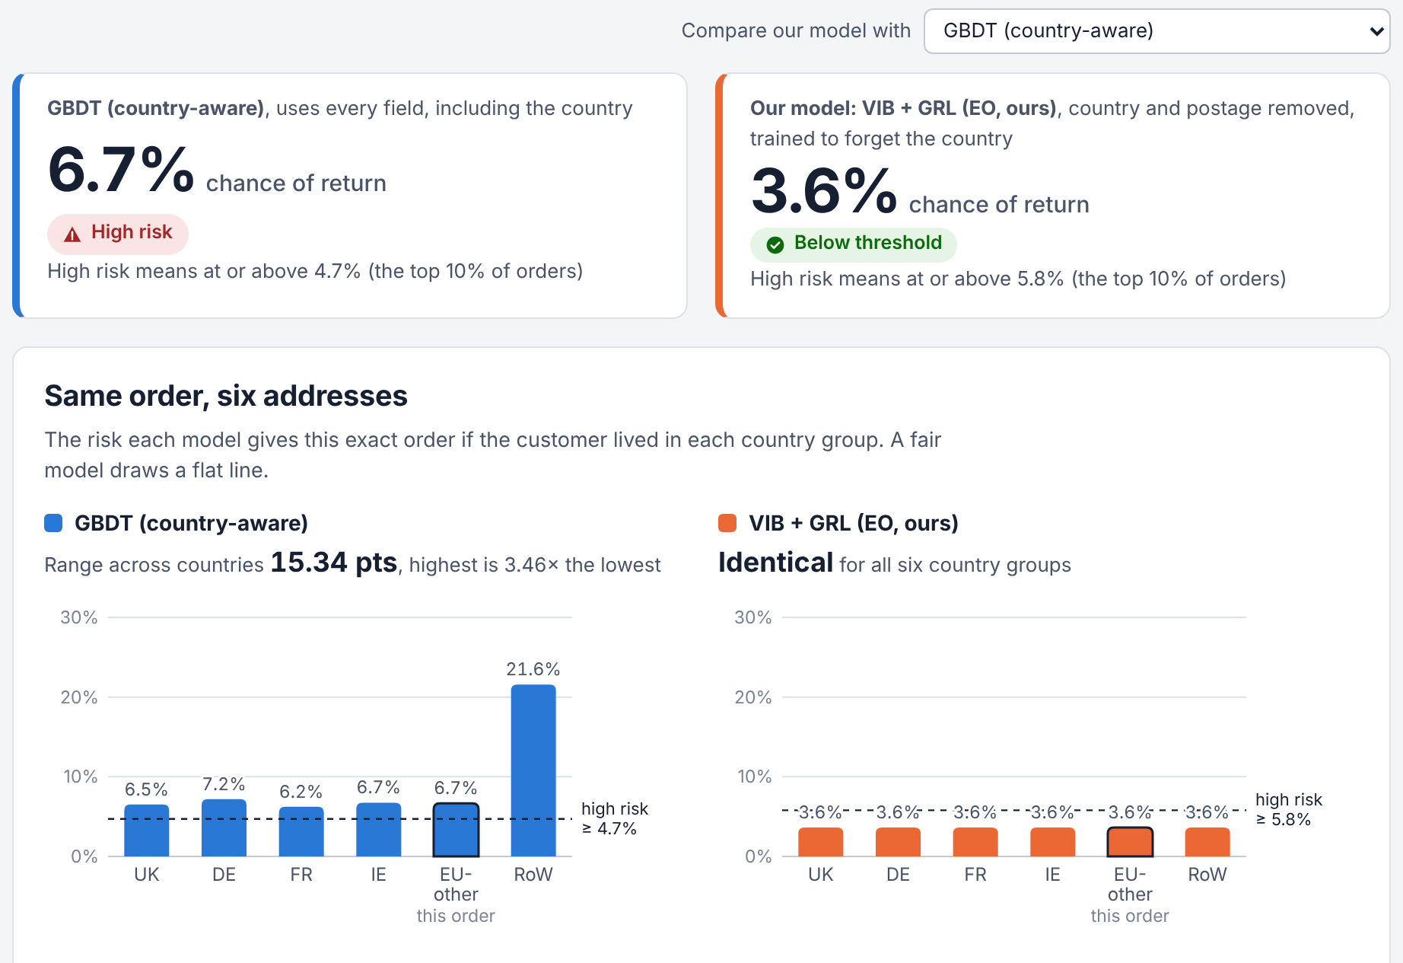
Returns are costly – and the country is a tempting shortcut
$685 bn
returned goods in US retail in 2024, equal to 13.2% of sales. Each flagged order may need a detail check, a packaging check or manual review.
2.6×
German order lines are returned 2.6× as often as UK lines in our data (4.42% vs 1.72%) – the country looks useful.
But using it treats otherwise identical orders differently only because of the buyer's location, contrary to the place-of-residence protections in EU Regulation 2018/302.
Same real order, six addresses: country-aware GBDT predicts 6.2% – 21.6%; our model predicts 3.6% in every case.
Part 1 · Introduction & motivation · Speaker 1
Notes:
Returns impose a substantial cost on online retailers. In 2024, returned goods in US retail were worth about 685 billion dollars, equal to 13.2 percent of sales. Retailers therefore score orders for return risk and use checks for details, packaging and manual review. In our data, German order lines are returned 2.6 times as often as UK lines. Using country as a predictor, however, treats otherwise identical orders differently based only on the buyer's location, contrary to the place-of-residence protections in EU Regulation 2018/302. For this real order, changing only the address moves the country-aware model's risk from 6.2 to 21.6 percent; our model remains at 3.6 percent.

Slide 4



Why AI – and what we contribute
Why AI?
How we use AI
Return risk depends on several signals acting together: customer history, product history, basket composition and timing.
Behavioural inputs only
No fields determined by the delivery address, including country and postage
0.718
AUC of six hand-written rules
0.761
AUC of gradient boosting
VIB + gradient reversal
A 16-dimensional representation from which a trained adversary cannot reliably infer country
…but a model optimized only for accuracy can use country as a shortcut. Removing the country column is insufficient when the postage line still encodes it.
LLMs where language helps
product attributes, audited assessor, model as a tool, guarded assistant
What we contribute
Evidence
country bias in a realistic return model, shown with a counterfactual “twin” test
Model
a 24 KB VIB + GRL model that more than halves both group gaps
Insight
a leftover proxy can mislead fairness training; counterfactual tests reveal it
System
four audited GenAI components in a working web prototype
Part 1 · Introduction & motivation · Speaker 1
Notes:
Return risk depends on several signals at once: customer history, product history, basket composition and timing. Six hand-written rules reach an AUC of 0.718, while gradient boosting reaches 0.761. AUC measures how well a model ranks risky orders; 1 is perfect and 0.5 is random guessing. A model optimized only for accuracy can use country as a shortcut, and removing the country column is insufficient when the postage line still encodes it. We therefore use behavioural inputs only, train the representation against an equalized-odds adversary, and use language models only where text processing helps. The four contributions are summarized at the bottom.

Slide 5




From 1.07 million raw rows to labelled order lines
UCI Online Retail II
Clean
Match returns
Label
1,067,371 rows · 5,942 customers · 41 countries · 4,620 products · Dec 2009 – Dec 2011
−34,335 duplicated rows; −22.8% rows without a customer number → 776,579 purchase and 17,586 cancellation lines
each cancellation → latest earlier purchase of the same product by the same customer (91.3% matched, median 10 days)
returned = 1 if a matched cancellation follows within 60 days → 1.82% of lines
Split | Period | Order lines | Returned | Use
Burn-in | Dec 2009 – Feb 2010 | 74,532 | 1.73% | history features only
Training | Mar 2010 – Feb 2011 | 376,992 | 1.82% | model fitting
Validation | Mar – May 2011 | 77,055 | 1.85% | decision threshold, epoch selection
Test | Jun – 9 Oct 2011 | 132,433 | 1.82% | all reported results
Time-based splits use only information available before the order day, so the model is not trained on future information.
115,567 lines in the last 60 days are censored (return window not closed).
Part 2 · Data & evidence of the problem · Speaker 2
Notes:
The dataset is UCI Online Retail II, which contains transactions from a UK online gift wholesaler between 2009 and 2011: about 1.07 million rows from 41 countries. We first removed duplicate rows and rows without a customer number. We then identified cancellations and matched each one to the customer's latest earlier purchase of the same product. A purchase line is labelled as returned when a matched cancellation follows within 60 days; about 1.8 percent of lines meet this definition. Finally, we split the data by time so that features never use future information.

Slide 6
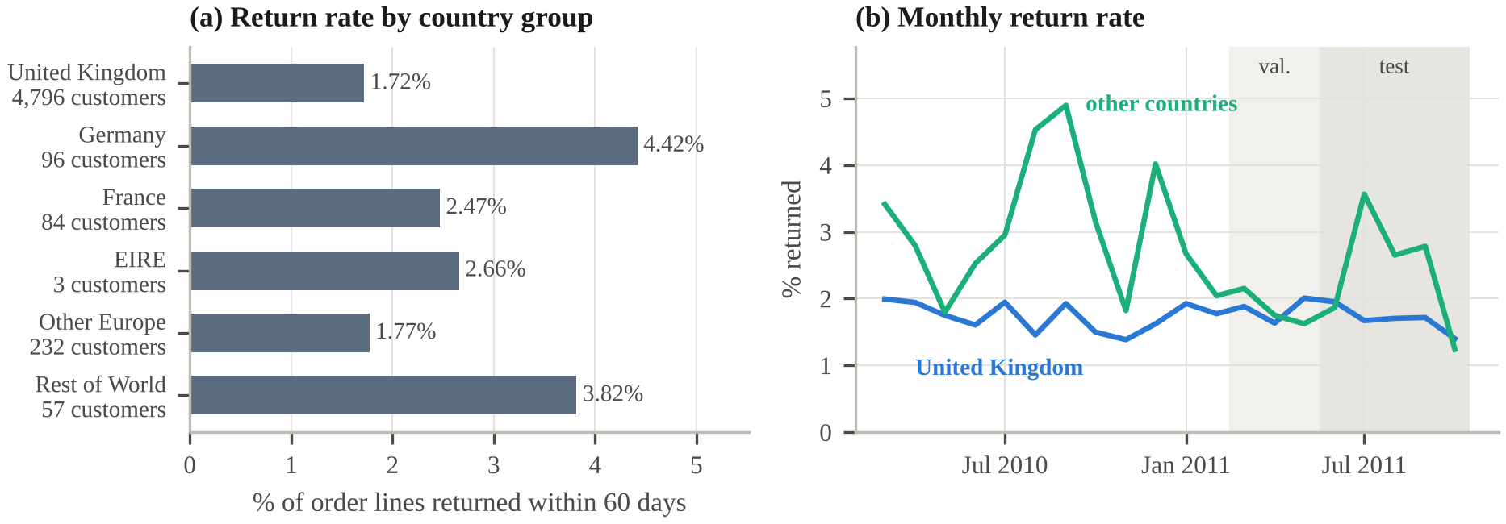
Return rates differ, and country information leaks through postage
1.72% vs 4.42%
UK vs German lines returned
5.0% → 3.2%
German rate, training → test
96 vs 4,796
German vs UK customers
The postage line is a country proxy
0.2%
UK invoices
80%
Germany invoices
75%
France invoices
→ GBDT without the country column still changes 1.4% of its decisions when an order moves country.
Part 2 · Data & evidence of the problem · Speaker 2
Notes:
Two patterns in the data matter. German order lines are returned at 4.42 percent, compared with 1.72 percent for UK lines. Germany has only 96 customers, while the UK has almost 4,800, and the German rate changes from 5 percent in training to 3.2 percent in the test period. Treating German orders as riskier is therefore unreliable and noisy. Removing the country column also does not remove country information: 80 percent of German invoices include a postage line, compared with 0.2 percent of UK invoices. Even without country and postage, a new classifier recovers the country with a balanced accuracy of 0.47, versus 0.17 for random guessing.

Slide 7
Problem formulation: five requirements
R1
Accuracy: rank returns well by AUC, with minimal loss relative to an unconstrained model.
The task
For each order line x the system outputs a risk score s(x) between 0 and 1.
The line is flagged high-risk if s(x) ≥ t, where t flags the riskiest 10% of validation lines – the share a service team can check.
R2
Group fairness: keep false-alarm and hit rates similar across country groups; report the largest gaps, ΔFPR and ΔTPR.
R3
Counterfactual invariance: the decision should remain unchanged when only the country or its associated fields change.
Constraints: one public dataset with inferred labels · CPU only · about 1,000 LLM calls · no personal data beyond pseudonymous customer numbers
R4
Efficiency: score thousands of lines per second on an ordinary CPU.
R5
Accountability: expose the main factors behind each score and suggest only non-penalising next steps.
Part 2 · Data & evidence of the problem · Speaker 2
Notes:
The system assigns each order line a risk score between 0 and 1 and flags the top 10 percent of validation lines as high-risk, approximately the volume a service team can review. Five requirements define the task: R1 ranks returns well; R2 keeps false-alarm and hit rates similar across country groups; R3 requires the decision to remain stable when only country-related fields change; R4 requires CPU efficiency; and R5 requires explanations and only non-penalising next steps. The study is limited to one public dataset, a CPU environment, about 1,000 LLM calls and pseudonymous customer numbers.

Slide 8



Related work and candidate solutions
Return prediction
Fairness criteria
Fair representations
Supervised classification; customer and product histories predict best
Gap: few studies examine differences across customer groups
Equalized odds; counterfactual fairness
Equal error rates and per-group calibration cannot both hold when base rates differ
Information bottleneck; gradient reversal
Adversarial training should be verified with an independent probe
Candidate | AI technique | R1 accuracy | R2 group gaps | R3 counterfactual | Main weakness
Six-rule expert system | logic, forward chaining | ~ 0.718 | ✓ | ✓ | misses signal interactions
GBDT (country-aware) | supervised learning | ✓ 0.761 | ✗ | ✗ | learns country as a shortcut
Reweighing | pre-processing | ✓ | ~ | ✓ | proxies still encode the group
Group thresholds | threshold search | ✓ | ✓ | ✗ | different rules per country
LLM as assessor | generative AI | ~ | ~ audit | ✗ | slow; needs its own audit
VIB + GRL (ours) | representation learning | ✓ | ✓ | ✓ | accuracy cost; residual info
✓ meets ~ partly ✗ fails. AUC on the test period (Part 6).
Part 3 · Related work & solution design · Speaker 3
Notes:
Earlier studies predict returns with customer and product history, but few examine fairness across customer groups. From fairness research, we use equalized odds, which targets similar hit and false-alarm rates, and counterfactual fairness, which requires the decision to remain unchanged when only the country changes. We also consider the information bottleneck and gradient reversal. We compare six candidate approaches: the six-rule system has smaller group gaps but lower accuracy, gradient boosting is more accurate but has larger country gaps, and country-specific thresholds violate counterfactual invariance. In our evaluation, the learned representation without country information was the only candidate that met all three requirements.

Slide 9

Design decision 1: use behavioural inputs only
51 behavioural inputs in five groups
Three feature sets
Customer history earlier orders, items, returns, smoothed return rate, spend, tenure, recency
aware
all inputs + country group
used by: naive baselines (LR, GBDT)
Product history earlier sales, smoothed return rate, price relative to usual price
unaware
country column removed, postage line kept
used by: “fairness through unawareness”
Order & basket quantity, price, line value, basket size and value, line share of basket
Timing month (sin/cos), hour, weekday
blind
country and postage removed
used by: GBDT-Blind, Reweighing, ablations, our model
Product attributes category, material, fragile, seasonal – from keyword rules or an LLM (G1)
Beta-smoothed return rate (r + α·p0) / (n + α)
p0 = 0.024; α = 10 for customers, 20 for products – so one return in two items does not imply a 50% rate
Excluded by design: everything determined by the delivery address, including country and postage.
Part 3 · Related work & solution design · Speaker 3
Notes:
Our first design decision is to use behavioural inputs only. The model receives 51 inputs in five groups: customer history, product history, the order and basket, timing, and product attributes. Return rates are beta-smoothed, so one return in two items does not produce a 50 percent rate. We remove all fields determined by the delivery address, including country and postage. To test this choice, we compare three feature sets. Aware includes country; unaware removes country but keeps postage; blind removes both and is the input set for our model.

Slide 10




How we evaluate the model
Accuracy
Group fairness
Counterfactual twins
Leakage probe
AUC and PR-AUC are measured on the time-based test period: June to October 2011, 132,433 lines.
At the top-10% threshold, report the largest country-group gaps in false-alarm rate (ΔFPR) and hit rate (ΔTPR). Groups with fewer than 10 customers are excluded.
Each test invoice is reassigned to a randomly drawn country group with postage redrawn. Flip rate is the share of decisions that change.
A fresh classifier attempts to recover the country group from z or from (score, true label). Chance is 1/6 = 0.167.
Uncertainty: neural models use 3 seeds (mean and standard deviation); 95% intervals use 100 customer-bootstrap resamples.
Part 3 · Related work & solution design · Speaker 3
Notes:
We evaluate the model with four measures. Accuracy is measured by AUC and PR-AUC on the test period, which contains 132,433 order lines. Group fairness is measured by the largest country-group gaps in false-alarm rate and hit rate at the top-10 percent threshold. Counterfactual twins copy each test invoice into another country group with postage redrawn and count the decisions that change. Finally, a leakage probe tests whether a fresh classifier can recover the country group from the learned representation or from the score and true label. Neural models use three seeds, and intervals use 100 customer-bootstrap resamples.

Slide 11
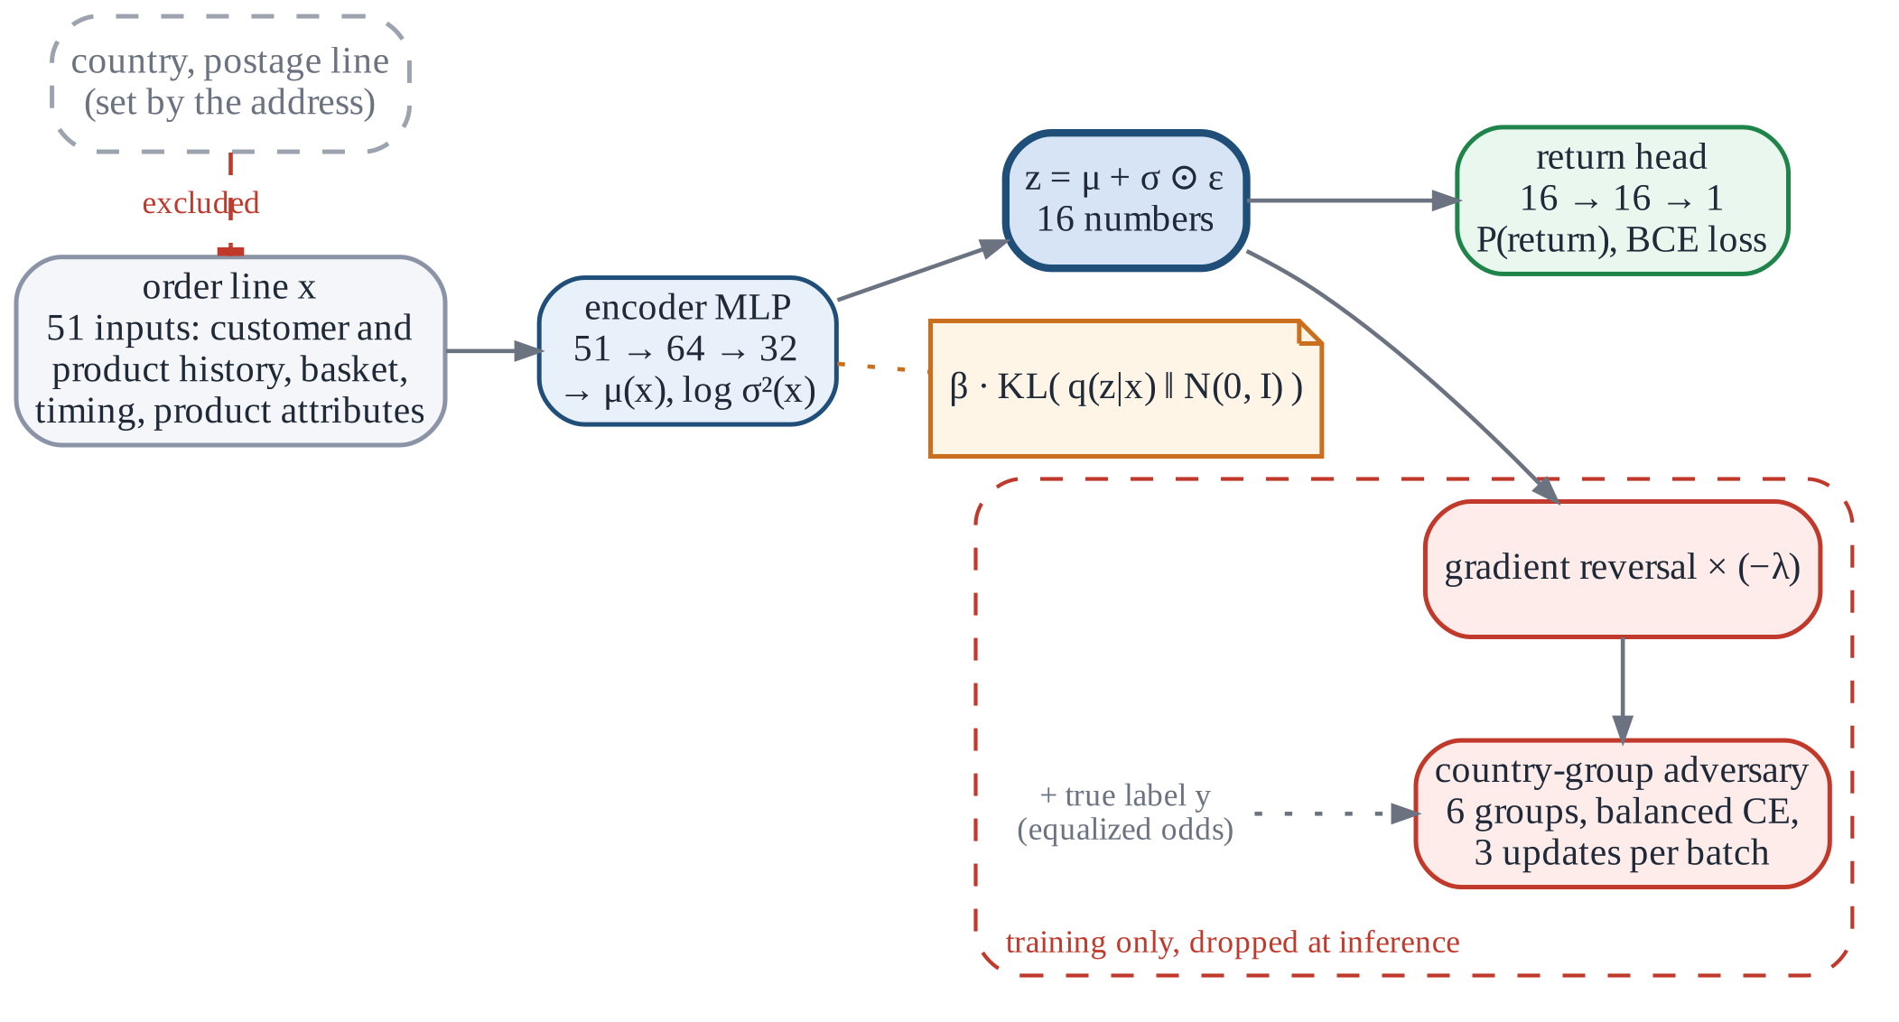
Model architecture
Training objective
The encoder and return head minimise
BCE(y, ŷ)
+ β · KL( q(z|x) || N(0, I) )
− λ · CE_{bal}(a, â(z, y))
The adversary minimises
CE_{bal}(a, â(z, y))
a = country group (6); y = true return label; z = 16-dimensional representation
Dashed grey: fields excluded by design. Red: training-only components, removed at prediction time.
Part 4 · Our model: VIB + GRL · Speaker 4
Notes:
The 51 inputs enter an encoder network, which compresses each order into a 16-dimensional representation z. A small return head uses z to estimate the probability of return. During training, the red components are also active: an adversary tries to recover the customer's country group from z and the true return label. The encoder therefore learns both to predict returns and to limit the country information available to the adversary. At prediction time, the red components are removed; only the encoder and return head are used.

Slide 12


Three components of the training procedure
Information bottleneck (VIB)
Gradient reversal layer (GRL)
Equalized-odds adversary
The encoder outputs μ(x) and log σ²(x) for a 16-dimensional Gaussian; z = μ + σ·ε.
The KL term pulls z towards N(0, I), so z retains mainly information that predicts return (β = 0.001).
The stochastic layer and KL term make the adversarial game more stable (Part 6).
Identity on the forward pass; multiplies the gradient by −λ on the backward pass.
The encoder receives reversed gradients and learns to reduce the adversary's accuracy.
Uses z and the true label y to target equal FPR and TPR rather than equal flag rates.
Class-balanced loss: small countries are weighted like the UK.
Three updates per batch keep the adversary aligned with the encoder.
λ = 0
first 10% of training
→
S-shaped ramp
λ rises to λmax = 1
→
Model selection
best validation AUC once λ ≥ 0.9
Part 4 · Our model: VIB + GRL · Speaker 4
Notes:
Three components define the training procedure. The information bottleneck encourages z to retain the information needed for return prediction while improving training stability. The gradient reversal layer is an identity transform in the forward pass and reverses the gradient in the backward pass, so the encoder learns to reduce the adversary's accuracy. The adversary receives z and the true return label and targets equal false-alarm and hit rates rather than equal flag rates. Class-balanced loss gives small countries comparable weight to the UK. The adversarial weight λ starts at zero and increases to one during training.

Slide 13
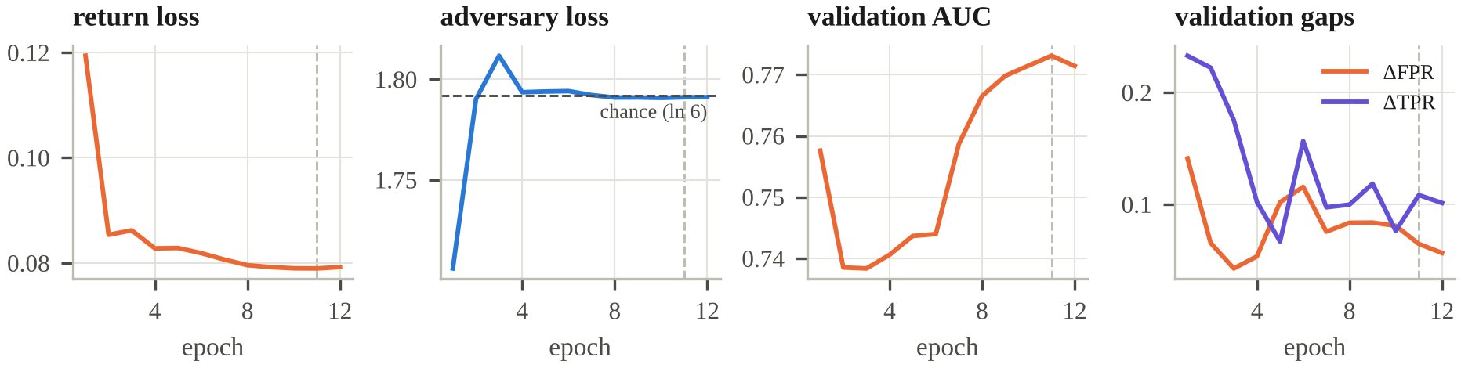
Training dynamics, size and speed
Return loss falls steadily
Adversary loss approaches ln 6 ≈ 1.79, the level of a random guess among six groups
Validation AUC initially dips as λ rises, then recovers to ≈ 0.77
Both fairness gaps shrink; the dashed line marks selected epoch 11
6,225
parameters at prediction
24 KB
45× smaller than the 1.1 MB GBDT
0.4 ms
per 1,000 lines (GBDT 9.7 ms)
NumPy
gradient-checked
Part 4 · Our model: VIB + GRL · Speaker 4
Notes:
The training curves show that return loss falls steadily. Adversary loss approaches about 1.79, the value expected for a random guess among six groups, indicating little remaining training signal for country prediction. Validation AUC initially declines while λ rises, then recovers to about 0.77, and both fairness gaps become smaller. We select epoch 11. The final model has about 6,200 parameters, or 24 kilobytes: 45 times smaller than the gradient boosting model. It scores 1,000 order lines in 0.4 milliseconds. It is implemented in NumPy, with gradient checks.

Slide 14
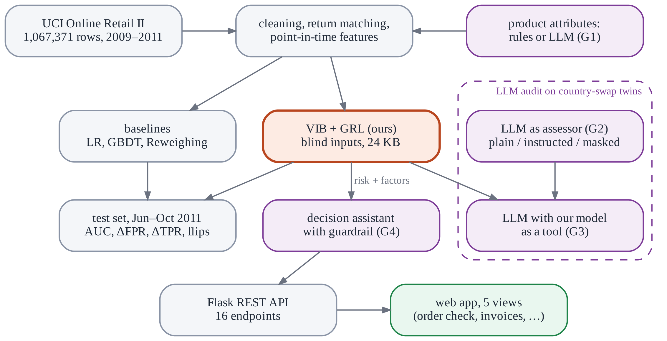



System overview and four GenAI roles
G1 Product attributes
LLM labels the top 1,000 products (category, material, fragile, seasonal). Validation: fixed controlled vocabulary
G2 LLM as risk assessor
Plain, instructed and country-masked prompts. Validation: twin audit, 100 pairs × 4 prompts
G3 LLM + our model as a tool
Order facts without country or postage, plus our risk score and factors. Validation: matches our model's invariance
Purple components use GenAI; orange is our model. `python run_pipeline.py` runs data preparation, labelling, model training, analysis, figures and the web bundle in about 25 minutes on a dual-core laptop. LLM calls use temperature 0 and are cached; only product descriptions and anonymised order facts are sent.
G4 Decision assistant
One of five permitted next steps with a note for staff. Validation: guardrail blocks country terms, other actions and surcharges
Part 5 · Generative AI & prototype · Speaker 5
Notes:
The data pipeline builds the features, our model is shown in orange, and the purple components use generative AI. In G1, a language model labels products within a fixed controlled vocabulary, so every output can be checked. In G2, the language model is evaluated directly as a risk assessor using country-swap twins. In G3, the language model uses our model as a tool. In G4, an assistant proposes one of five permitted next steps, and a guardrail blocks country references, other actions and surcharges. The complete pipeline runs with one command in about 25 minutes on a dual-core laptop.

Slide 15
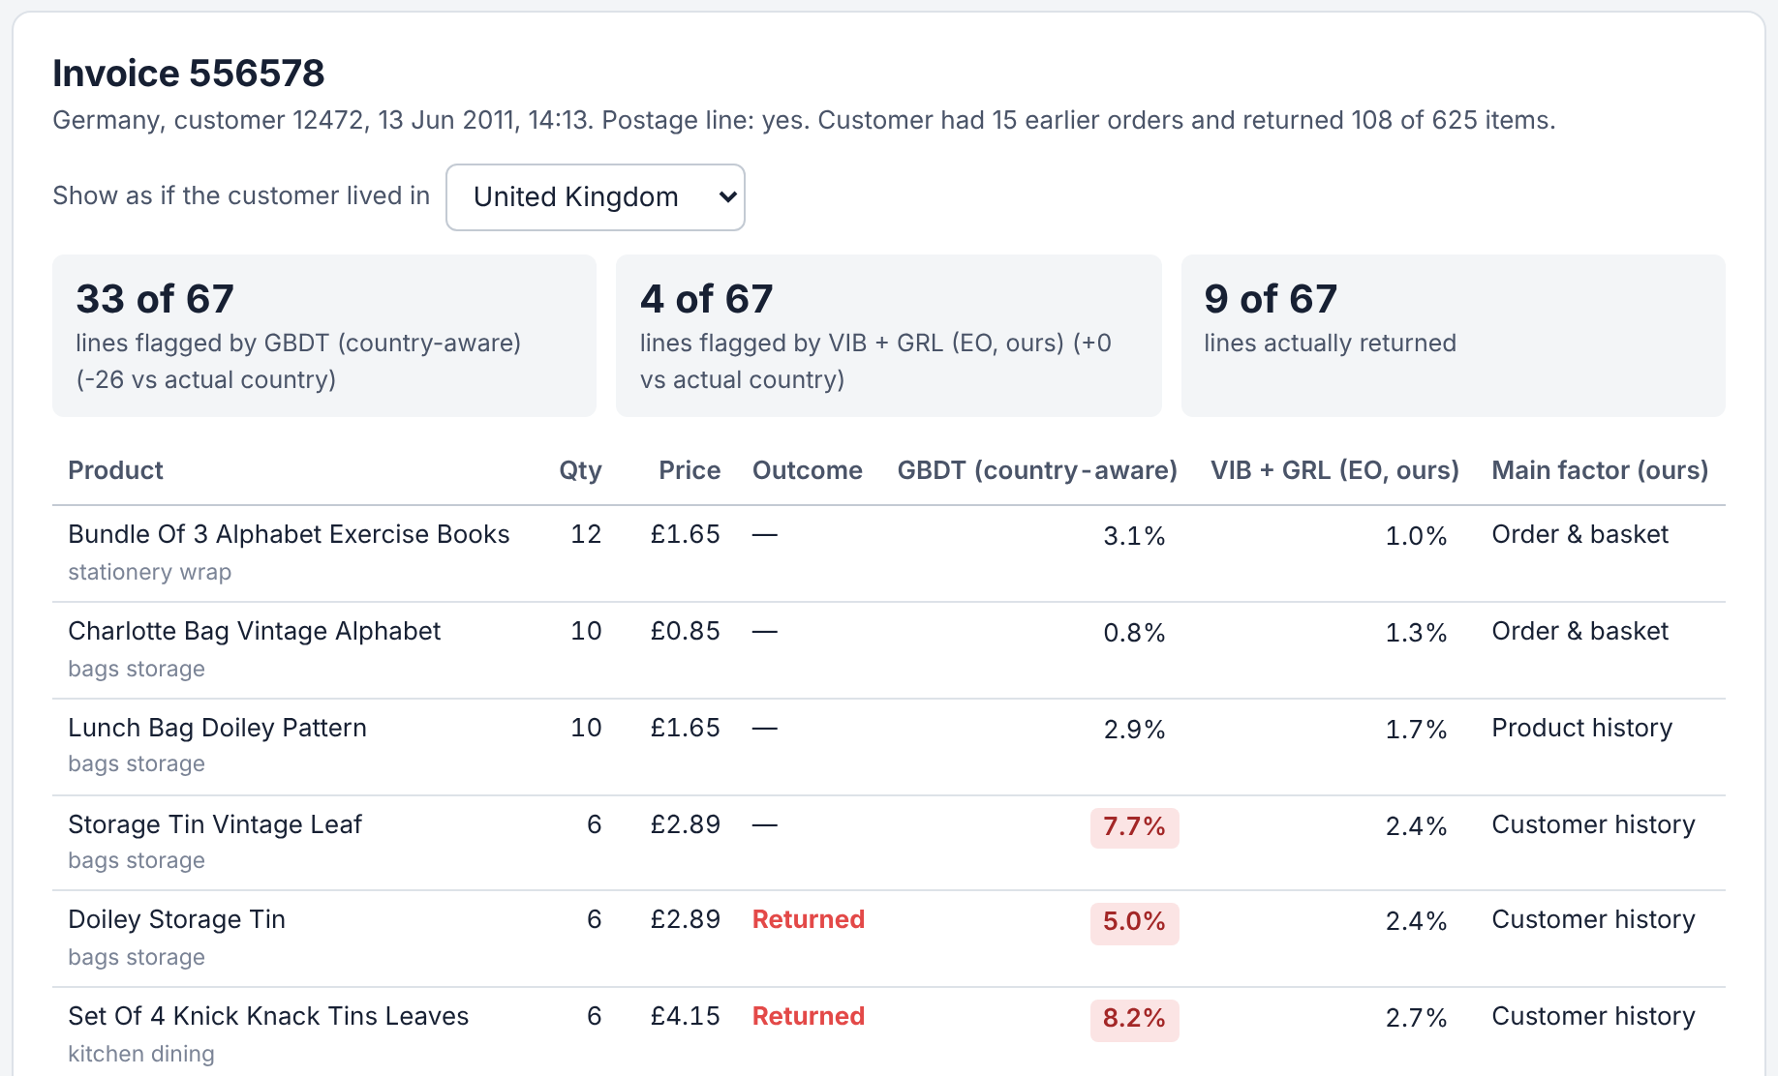
Prototype: replay a real invoice in another country
German invoice 556578 reassigned to a UK address
26
0
fewer flags from the country-aware GBDT (59 → 33)
change in our model's flag count (4 → 4)
Flask service, 16 REST endpoints
Five views: order check, real invoices, fairness results, GenAI audit, about
Batch scoring: upload a CSV in the Online Retail format, download the scores
Automated tests: gradients, data, metrics, guardrails and the API
Part 5 · Generative AI & prototype · Speaker 5
Notes:
The web prototype reopens a real German invoice with 67 order lines and reassigns it to a UK address. The country-aware model flags 26 fewer lines, from 59 to 33. Our model continues to flag the same four lines. The prototype includes a Flask service with 16 REST endpoints and five views, including the six-address order check shown earlier. Users can upload a CSV file of orders and download the scores. Automated tests cover gradients, data processing, metrics, guardrails and the API.

Slide 16
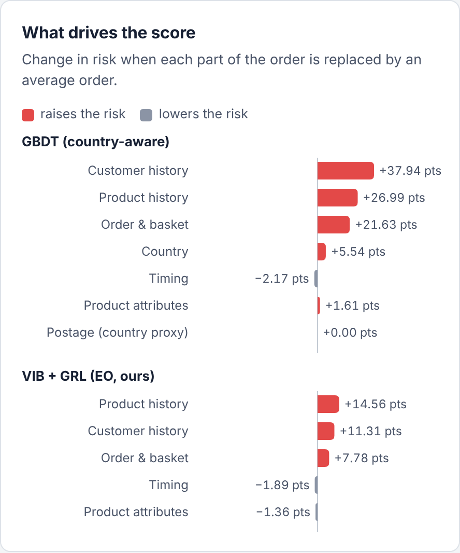
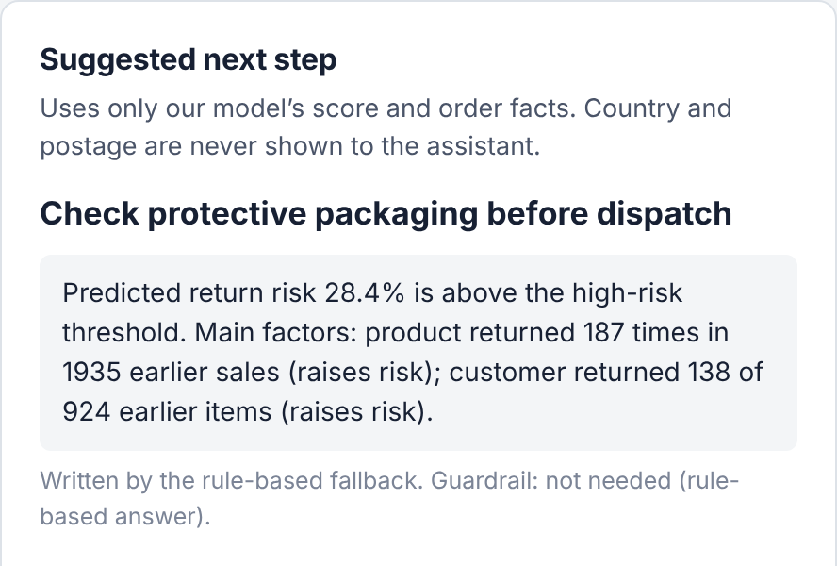
Decision support, not automatic decisions
28.4%
our risk score for this line, above the 5.8% threshold
The line was in fact returned.
A real German order line: 60 × Strawberry Ceramic Trinket Box
Explained: the product's history (187 returns in 1,935 sales) and the customer's (138 of 924 items) raise the risk.
No country factor: country alone adds 5.5 points in the country-aware GBDT; our model does not use it.
Non-penalising step: the assistant suggests a packaging check. The display uses the rule-based fallback; with an API key, an LLM drafts the note and the guardrail checks it.
Part 5 · Generative AI & prototype · Speaker 5
Notes:
The system supports human decisions rather than making automatic decisions. This real German order line contains 60 ceramic trinket boxes, and the customer later returned them. Our model assigns a risk score of 28.4 percent, above the high-risk threshold of 5.8 percent. The explanation shows that the product's return history and the customer's history raise the score. The country-aware model also adds 5.5 points from country alone, while our model has no country input. The assistant suggests a packaging check as a non-penalising next step. A person makes the final decision.

Slide 17
Main results on the test period
June – October 2011 · 132,433 order lines · neural models: mean and standard deviation over 3 seeds
Method | Inputs | AUC ↑ | ΔFPR ↓ | ΔTPR ↓ | Flips ↓ | z probe ↓ | Size
LR (country-aware) | aware | 0.753 | 0.317 | 0.511 | 6.35% | – | 1 KB
GBDT (country-aware) | aware | 0.761 | 0.164 | 0.352 | 2.41% | – | 1.1 MB
LR-Unaware | unaware | 0.753 | 0.205 | 0.427 | 4.08% | – | 1 KB
GBDT-Unaware | unaware | 0.758 | 0.116 | 0.275 | 1.40% | – | 1.1 MB
GBDT-Blind | blind | 0.756 | 0.111 | 0.237 | 0 | – | 1.1 MB
GBDT-Blind + Reweighing | blind | 0.759 | 0.072 | 0.258 | 0 | – | 1.1 MB
Six-rule expert system | blind | 0.718 | 0.064 | 0.223 | 0 | – | < 1 KB
MLP (no VIB, no adversary) | blind | 0.752 ± 0.005 | 0.118 ± 0.020 | 0.313 ± 0.026 | 0 | 0.405 | 24 KB
VIB only | blind | 0.755 ± 0.002 | 0.121 ± 0.007 | 0.335 ± 0.034 | 0 | 0.403 | 24 KB
GRL only | blind | 0.693 ± 0.025 | 0.050 ± 0.009 | 0.244 ± 0.042 | 0 | 0.402 | 24 KB
VIB + GRL (ours) | blind | 0.743 ± 0.004 | 0.057 ± 0.006 | 0.160 ± 0.032 | 0 | 0.321 | 24 KB
VIB + GRL, DP variant | blind | 0.738 ± 0.008 | 0.045 ± 0.004 | 0.227 ± 0.038 | 0 | 0.337 | 24 KB
VIB + GRL, postage kept | unaware | 0.749 ± 0.003 | 0.046 ± 0.016 | 0.128 ± 0.024 | 1.99% | 0.364 | 24 KB
ΔFPR and ΔTPR are the largest country-group gaps in false-alarm and hit rates at the top-10% threshold. Flips are decisions that change when only the country and postage change. The z probe reports balanced accuracy for recovering the country group from the representation; chance is 0.167.
Part 6 · Results, ethics & conclusion · Speaker 6
Notes:
All methods are compared on the test period from June to October 2011. The first rows use country directly or remove only the country column. From GBDT-Blind onward, all models use the blind inputs. The middle rows show separate MLP, VIB-only and GRL-only ablations; the final rows show our model in orange and two variants. The columns report accuracy, the two fairness gaps, the share of decisions that change with country, the country information left in the model, and model size. Neural results are averaged over three seeds.

Slide 18
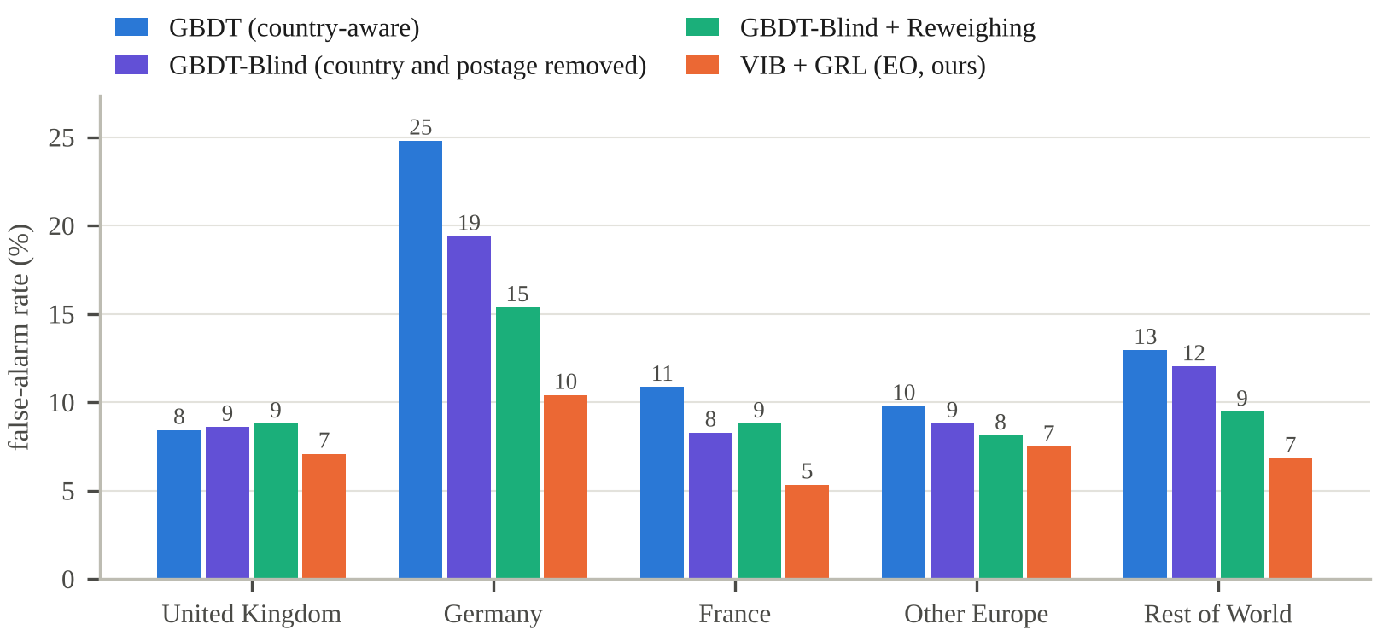
Smaller group gaps with a small accuracy cost
GBDT (country-aware) → VIB + GRL (ours)
False-alarm gap ΔFPR
0.164 → 0.057
−65%
Hit-rate gap ΔTPR
0.352 → 0.160
−55%
Decisions flipping with country
2.41% → 0
none
Ranking quality AUC
False-alarm rate: never-returned lines flagged high-risk (test, seed 0; EIRE with 3 customers not shown).
0.761 → 0.743
−0.018
24.8% vs 8.4%
Germany vs UK, country-aware GBDT (≈ 3×)
10.4% vs 7.1%
Germany vs UK, ours – lower in both groups shown
Model size
1.1 MB → 24 KB
45× smaller
Part 6 · Results, ethics & conclusion · Speaker 6
Notes:
We compare our model with the most accurate baseline, gradient boosting with country information. The false-alarm gap falls from 0.164 to 0.057, about 65 percent smaller, and the hit-rate gap falls by 55 percent. No decision changes in the country counterfactual test. The trade-off is a small AUC reduction, from 0.761 to 0.743, and the model is 45 times smaller. The bars compare false alarms by country group: the country-aware model wrongly flags 24.8 percent of German lines from customers who did not return, compared with 8.4 percent of UK lines. Our model lowers these rates to 10.4 and 7.1 percent.

Slide 19
Counterfactual test: deleting the column is not enough
Deleting the country column is insufficient: logistic regression still flips 6.35% → 4.08% of decisions, and GBDT flips 2.41% → 1.40%. The postage line continues to encode country. Removing every address-derived field reduces flips to 0.
Keeping postage and adding adversarial training yields smaller group gaps (ΔFPR 0.046), but 2.0% of decisions still change in the counterfactual test. The adversary learned to discount orders that appear foreign, lowering risk in 82% of lines. The test makes this failure visible; the final model excludes postage.
Part 6 · Results, ethics & conclusion · Speaker 6
Notes:
Deleting the country column is not enough. The share of decisions that change when only the country changes is 6.4 percent for logistic regression with country included. With country removed, it still changes 4.1 percent, and gradient boosting changes 1.4 percent; the postage line continues to encode country. We also trained a version of our model with postage retained. Its group gaps were smaller, but 2.0 percent of decisions still changed with country. The adversary had learned to lower risk for orders that appeared foreign. The counterfactual test exposed this behavior, and the final model therefore excludes postage.

Slide 20
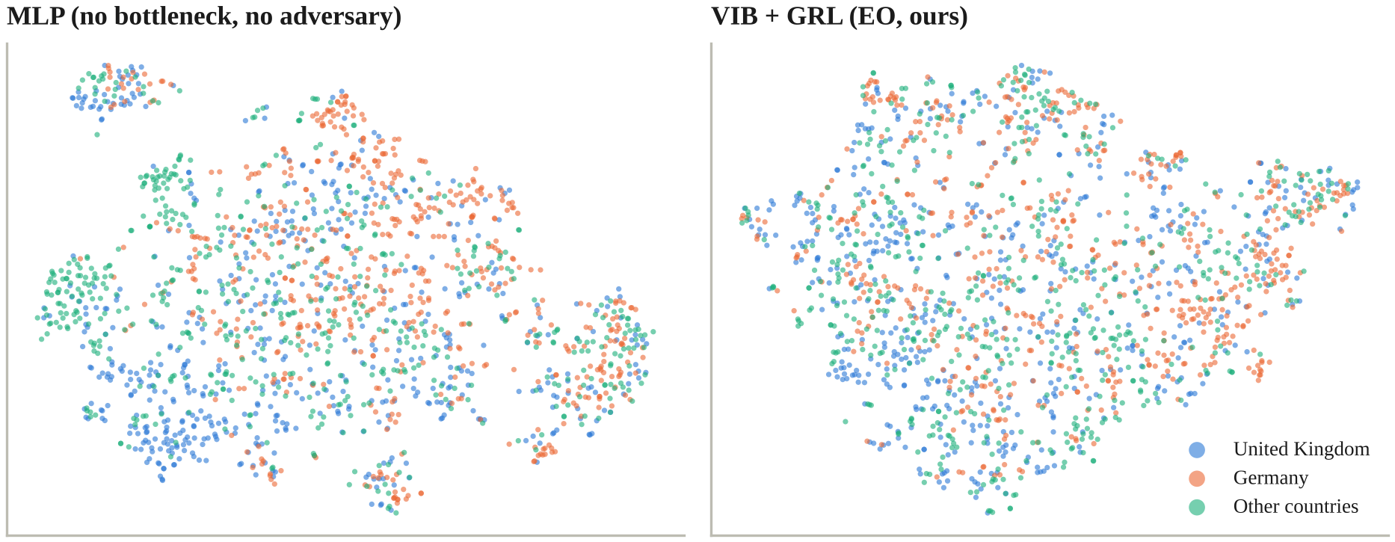
Ablation results: both components help
t-SNE projection of z (1,800 test lines): German lines (orange) form a cluster in a plain MLP (left) and overlap more with other groups under VIB + GRL (right).
Bottleneck alone: no fairness gain (ΔFPR ≈ 0.12)
Adversary alone: unstable (AUC 0.693 ± 0.025)
Together: AUC 0.743 ± 0.004, ΔFPR 0.057; z probe 0.321, while score + true label is near chance (0.17)
Part 6 · Results, ethics & conclusion · Speaker 6
Notes:
The ablation evaluates whether both components are needed. With the bottleneck alone, the false-alarm gap remains about 0.12. With the adversary alone, training is unstable and AUC falls to 0.693. With both components, AUC is 0.743 and ΔFPR is 0.057. The z representation still contains country information: a fresh probe reaches 0.321, above chance. The probe using the score and true label is close to chance at 0.17. The t-SNE plots show that German lines form a cluster in a plain MLP but overlap more with other groups under VIB + GRL.

Slide 21
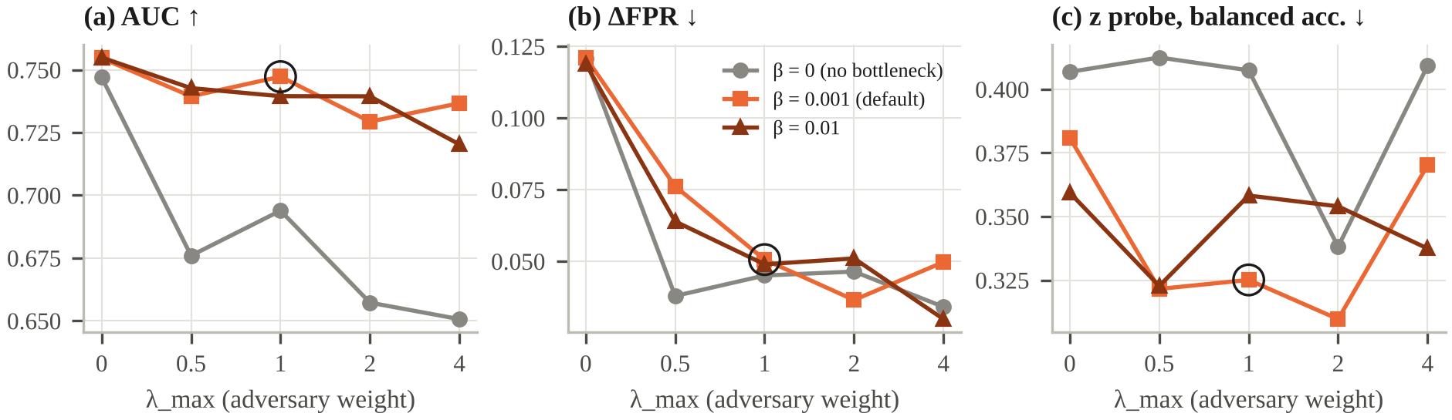
Robustness: parameter sensitivity and label noise
β–λmax grid
Without the bottleneck (β = 0, grey), AUC falls to 0.65–0.69 whenever the adversary is enabled. λmax > 1 reduces AUC without a consistent gain.
Each point and bar uses one seed. The grid was run after fixing the defaults as a sensitivity analysis, not for tuning.
Label-noise stress test
3% of German and French non-returned training lines are relabelled as returns; test labels remain clean. ΔFPR rises for GBDT-Blind (0.111 → 0.127) and Reweighing (0.072 → 0.079), but not for ours (0.057 → 0.053).
Part 6 · Results, ethics & conclusion · Speaker 6
Notes:
We test the results in two robustness checks. First, we vary the two main settings, beta and lambda. Without the bottleneck, shown in grey, AUC falls to between 0.65 and 0.69 when the adversary is enabled; with the bottleneck, training remains stable. Increasing λmax above one reduces accuracy without a consistent gain. Second, we simulate label noise by relabelling 3 percent of German and French non-returned training lines as returned, while keeping test labels clean. The false-alarm gap rises for GBDT-Blind and Reweighing, but not for our model, where it decreases from 0.057 to 0.053. The stress test uses one seed, so we treat it as an initial check.

Slide 22
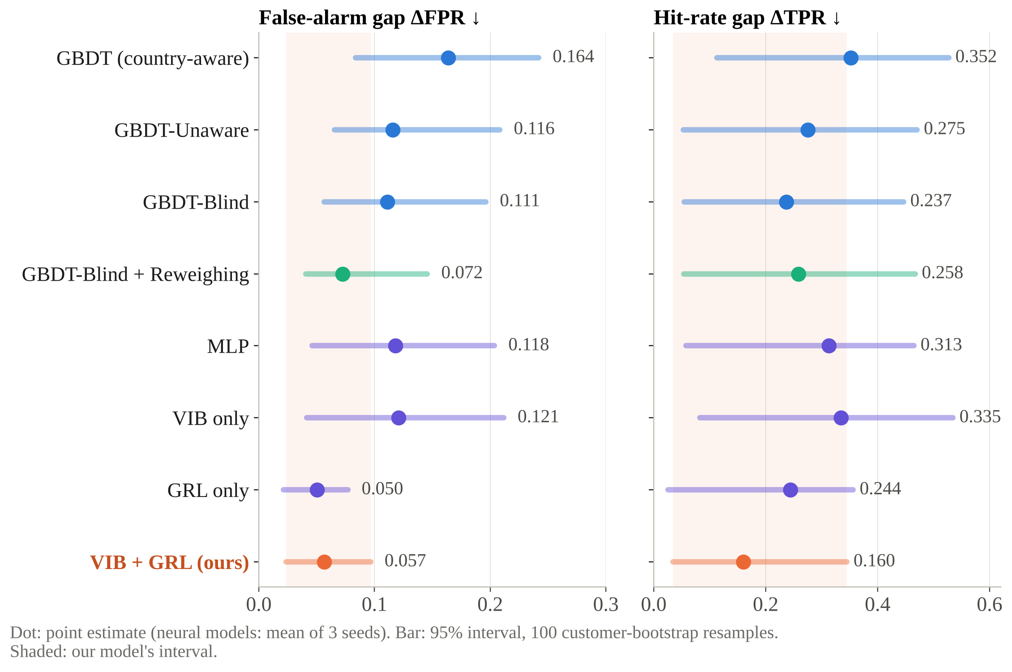
Uncertainty: small groups, wide intervals
ΔFPR: lower central estimate than country-aware GBDT
ours [0.024, 0.097] vs country-aware GBDT [0.084, 0.242]
ΔTPR: within noise
our interval [0.034, 0.345] overlaps most baselines
Calibration for frequent returners
Customers who had returned over 10% of items (4,856 lines) had a predicted return rate of 6.7% and an observed rate of 6.8% (GBDT-Blind 8.2%)
Part 6 · Results, ethics & conclusion · Speaker 6
Notes:
Uncertainty is reported with 95 percent intervals based on 100 customer-bootstrap resamples, because some country groups contain very few customers. For false alarms, our 95 percent interval is 0.024 to 0.097, compared with 0.084 to 0.242 for the country-aware model. For the hit-rate gap, our interval of 0.034 to 0.345 overlaps most baselines, so the difference may be due to noise. Calibration remains reasonable for frequent returners: among customers who had returned more than 10 percent of their items, the predicted rate is 6.7 percent and the observed rate is 6.8 percent.

Slide 23
Ethics and limitations
Our criterion combines equal false-alarm and hit rates with counterfactual invariance. Equal error rates and per-group calibration cannot both hold when group base rates differ.
Limitations & responsible use
Data: returns inferred from cancellations; registered country ≠ nationality; small groups; one UK wholesaler, 2009–2011
Model: z still carries country information (probe 0.32 vs chance 0.17), so it should not be reused; the fairness gain costs 0.018 AUC
GenAI: results depend on model, prompt and date; the audit is small; LLM-generated features require evaluation, and keyword tags performed poorly on new products
Oversight: the model only flags orders for staff review; actions are non-penalising; GDPR right not to be subject to solely automated decisions
Group fairness can cost individual customers: German invoice 556578
The customer had returned 108 of 625 earlier items; 9 of the invoice's 67 lines were returned.
GBDT-Blind
VIB + GRL (ours)
61
lines flagged
9 of 9
returns caught
4
lines flagged
1 of 9
returns caught
Likely explanation: to reduce the gap between countries, the adversary discounted behaviour common among German customers, including this customer's genuine history.
Future work: treat a customer's own history as a resolving variable.
Part 6 · Results, ethics & conclusion · Speaker 6
Notes:
We chose equal false-alarm and hit rates together with counterfactual invariance. When group base rates differ, equal error rates and equal calibration cannot both hold. We prioritize equal error rates because a false alarm affects a customer who did not return. Group fairness can also cost individual customers. In one German invoice, the customer had returned 108 of 625 earlier items, and 9 of its 67 lines were returned. GBDT-Blind flagged 61 lines and caught all nine; our model flagged four and caught one. A likely explanation is that the adversary discounted behaviour common among German customers, including this customer's genuine history. Future work could treat a customer's own history as a resolving variable. The remaining limitations are listed on the right.

Slide 24
Conclusion
3×
24 KB
2
Problem
Solution
Lessons
A country-aware return model trained on real data flagged German order lines from customers who did not return three times as often as UK lines, and changed decisions when only the address changed.
Address-free inputs and a variational information bottleneck trained against an equalized-odds adversary: decisions did not change in the country counterfactual test; false-alarm gap 0.164 → 0.057 at a cost of 0.018 AUC.
A fairness adversary can exploit a leftover proxy; group metrics should therefore be paired with counterfactual tests. Group fairness can also cost individuals.
GenAI contributed where outputs could be verified: fixed vocabularies, tool use and guardrails.
Thank you. Questions are welcome. Live demo: python -m fairreturn.backend → http://127.0.0.1:8000 | Code & Raw Trace: https://github.com/adantn/FairReturns-CDS521-Group14_Doubao
Part 6 · Results, ethics & conclusion · Speaker 6
Notes:
The project showed three things. Country bias was measurable: a country-aware model flagged German order lines from customers who did not return three times as often as UK lines. Our 24-kilobyte model reduced the false-alarm gap by about two thirds with a small accuracy cost, and its decisions did not change in the country counterfactual test. Group metrics should be paired with counterfactual tests, because a fairness adversary can exploit a remaining proxy, while group fairness can cost individual customers. GenAI contributed where its outputs could be verified. Thank you for your attention. We are happy to answer questions and can show the live demo.

