Slide 1
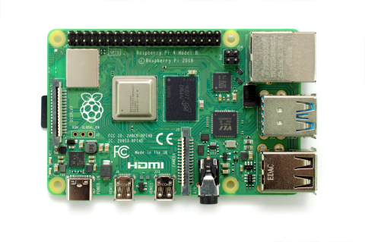
Raspberry Pi Repo Server
Turhan Kimbrough
Alexander Dao
Alexandra Chambers
Vince Lepatan

Slide 2
Overview
Project Summary
Schedule
How it works
Advantages/challenges
Team members and Responsibilities
Demo (completed)

Slide 3



Project Summary
The goal of this project is to create a private git repository hosted by the Raspberry Pi
Use key technological components such as Secure Shell (SSH), ngrok, and git

Slide 4
Gantt Chart
Task | Completed | Member(s) who completed
Brainstorm Ideas for Project | 2/6/2020 | All
Research book and sites | 2/10/2020 | All
Project Proposal Date | 2/13/2020 | All
Purchase all products (Rasberry Pi) | 2/20/2020 | Alexander
Project Redo (Due to Corona) | 2/20/202 | All
Raspberry Pi Private Git Server Proposal | 04/6/2020 | Vince
Connect to Private Git Server | 04/11/2020 | Turhan
Progress Report Due | 04/15/2020 | All
Integrate SSH with Git | 04/15/2020 | Vince
Test Git environment to push and pull | 04/17/2020 | Alexander
Record Demo Video | 04/17/2020 | Alexandra and Turhan
Debug, make last edits, before presentation | 05/2/2020 | All (Discord)
Presentation date | 05/15/2020 | All
Project final Project Package Due | 05/12/2020 | All

Slide 5
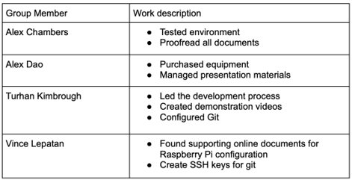
Team members & responsibilities

Slide 6
How it works
Raspberry Pi will have a bare git repository in one of its directories
Raspberry Pi will constantly listen on port 22
The client computer will initialize a git repository in one of its directories (use ‘git init’ or ‘git clone’ command)
The client computer can push/pull from the repository along with many other commands
When pulling always specify pi@<IP address>:/path/to/bare/git/repo

Slide 7
Advantages/challenges
Advantages
Challenges
Easy Setup
No code required
Can always be running
No need for a GitLab or GitHub
account
SSH configuration
Public IP address
Ngrok limitations
Trouble with multiple users logged in simultaneously

Slide 8
Demo Time! (View Video)

