Slide 1

Presented By
Group 6

Slide 2
Team Members
Adaobi Nwachukwu : 0808547
Asif Ahmed : 0823547
Ayushi​ Patel: 0804322
Jaykumar Prakashkumar Prajapati: 0802302
Pavni Bhatt: 0822290

Slide 3
TABLE OF CONTENT
Dataset description
Exploratory Data analysis
Data Visualization
Advance Analysis
Predictive Analysis
Advance EDA Techniques
Advance Modelling Techniques

Slide 4
DATASET DESCRIPTION
Dataset which is being used in the Analysis is an E-commerce churn data
Shape of the data : Rows – 541909, Features – 10
Numerical features: Quantity, Unit Price, Customer Id
Categorical features: Invoice No, Stock Code, Description, Invoice Date, Country

Slide 5
Exploratory Data Analysis
Features | Values
No. of Unique Products | 4070
Top 10 selling Product | 22197, 84077, 85099B, 85123ª, 84879, 21212, 23084, 22492, 22616, 21977
No. of Unique Customers | 4373
Country has the maximum customers | United Kingdom
Month having the highest Sales | November
Average Unit Price per Product | 38.96
Total Quantity Sold per Customer | 1184

Slide 6
DATA VISUALISATION

Slide 7
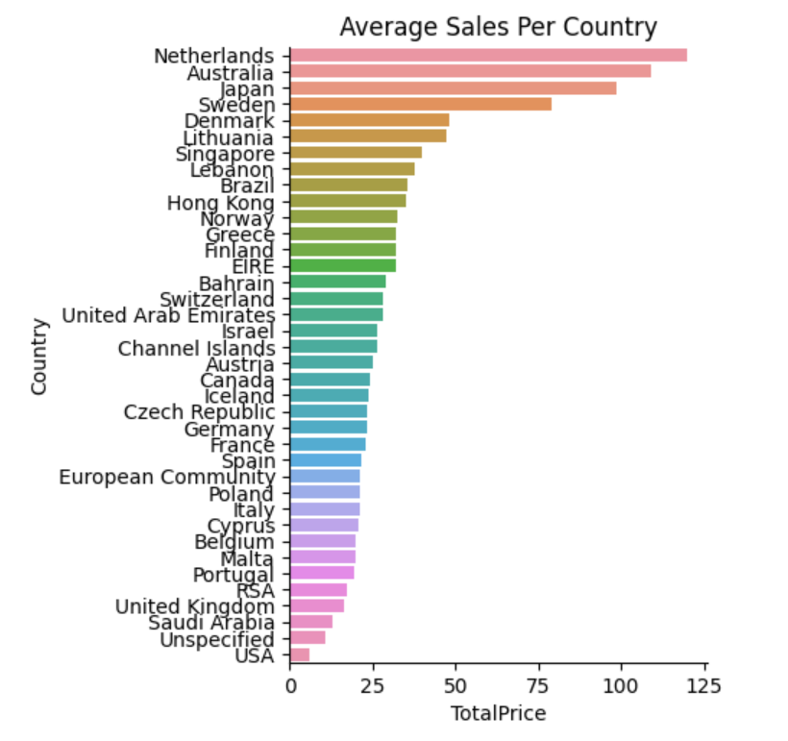
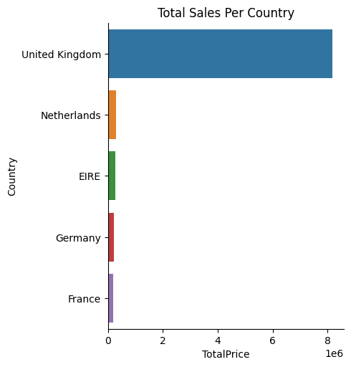
DISTRIBUTION OF SALES BY COUNTRY
Netherlands has the highest average sale among all the countries
Followed by Australia
Whereas USA has the lowest sale
Looking at the total sales UK has the highest though the Average is in the bottom

Slide 8
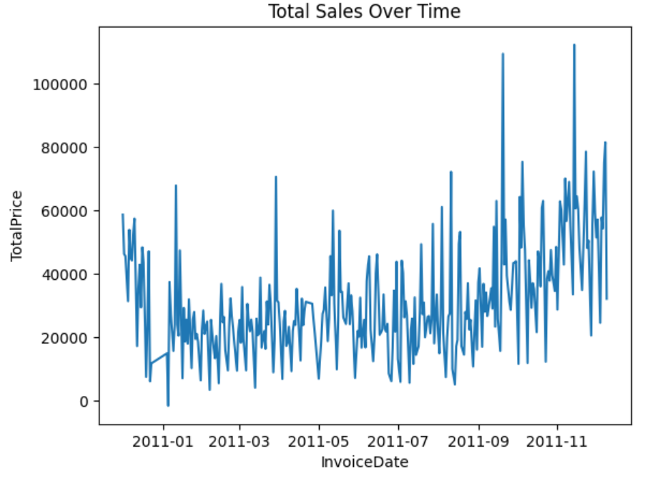
Total Sales Over Time
Data has seasonality present as it is evident from the graph
However, sales are increasing over time.

Slide 9
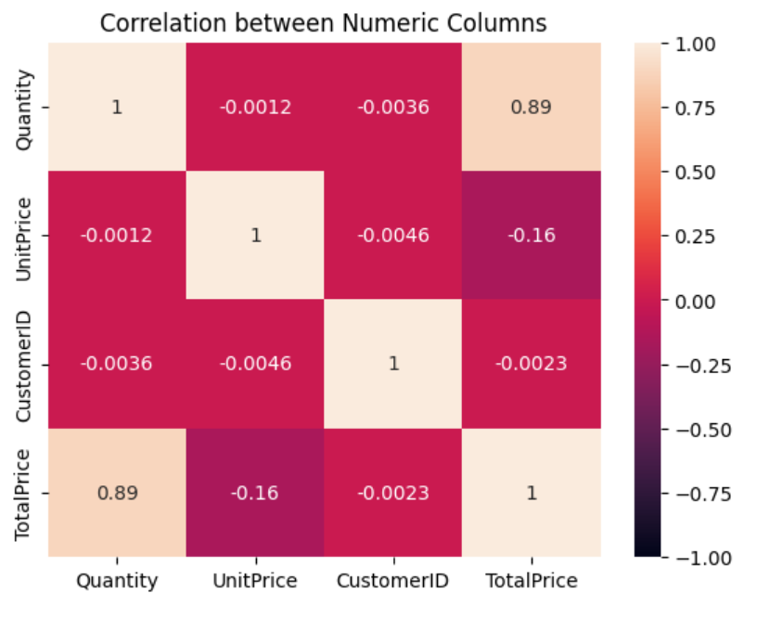
CORRELATION BETWEEN NUMERIC COLUMNS
There is positive correlation between Quantity and Total Price which is obvious
There is weak negative correlation between Total Price and Unit Price
Apart from the above, there is no quantifiable correlation among the variables

Slide 10
ADVANCE ANALYSIS

Slide 11
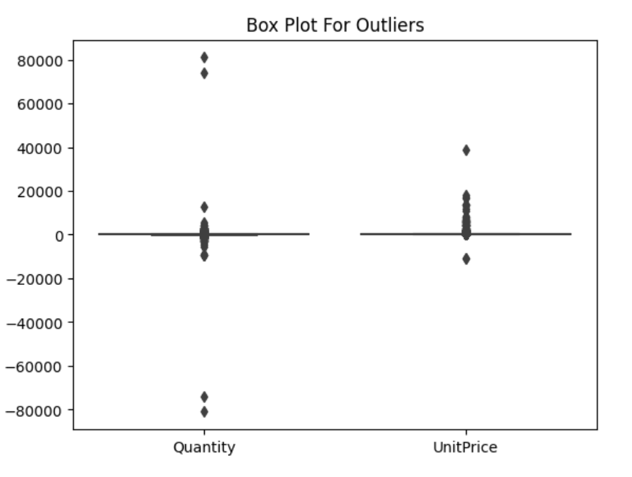
OUTLIER DETECTION
As the maximum Quantity in data has been flagged as a returned Outliers which is in positive side can be found be negative side.
Regarding Unit Price, most outliers are found at the positive side which can be translated that larger unit prices have not been returned.

Slide 12
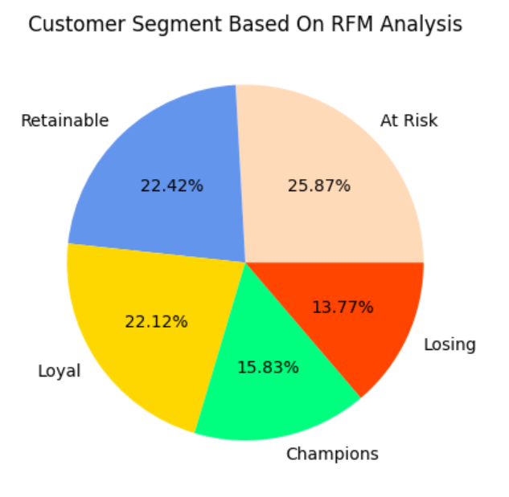
CUSTOMER SEGMENTATION
Based on RFM score, Customers have been divided into five segments
RFM Score | SEGMENT
0-1 | Losing
1-2 | At Risk
2-3 | Retainable
3-4 | Loyal
4-5 | Champions
‘At Risk’ Segment has highest proportions of customers
Whereas, ‘Losing’ Segment has the lowest proportion of customers

Slide 13
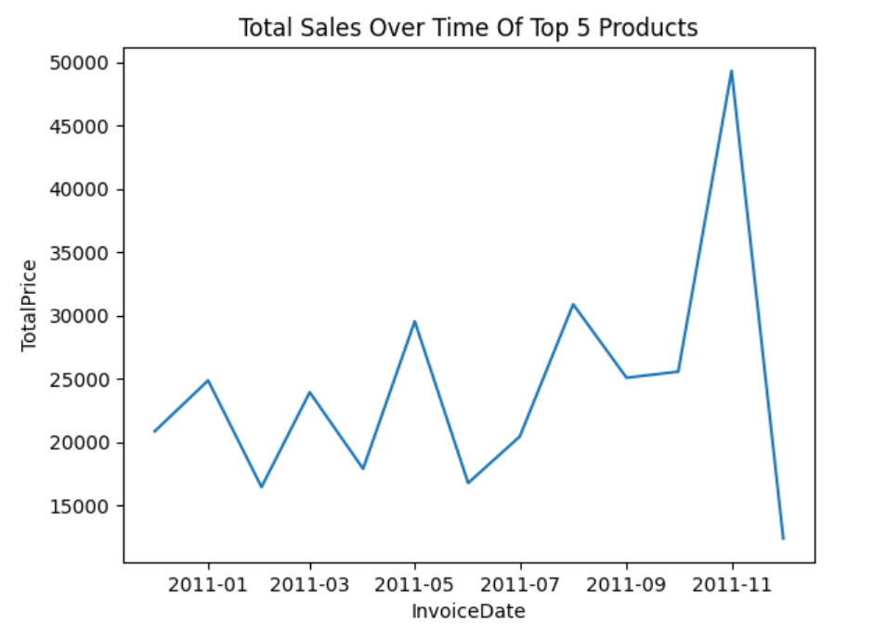
TOP FIVE PRODUCT SALES TREND
Sales trend is from Dec-2010 to Dec-2011
Sales has increased over time
It has increased exponentially from Sep-2011 to Nov-2011
Then it dropped to the lowest in Dec-2011

Slide 14
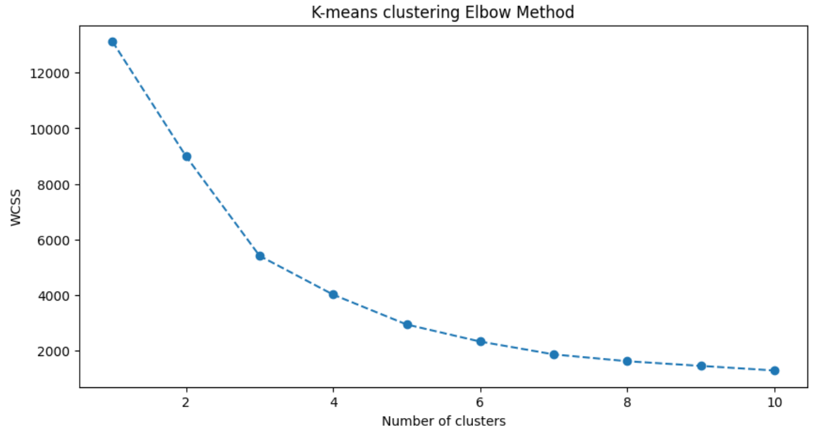
K-MEANS CLUSTERING
On the graph, the elbow is located at the third cluster. This is the only point on the graph where there is a sharp decline followed by a smoothing.
So Ideal number of clusters can be 3 based on the Within-Cluster Sum of Square methodology.

Slide 15
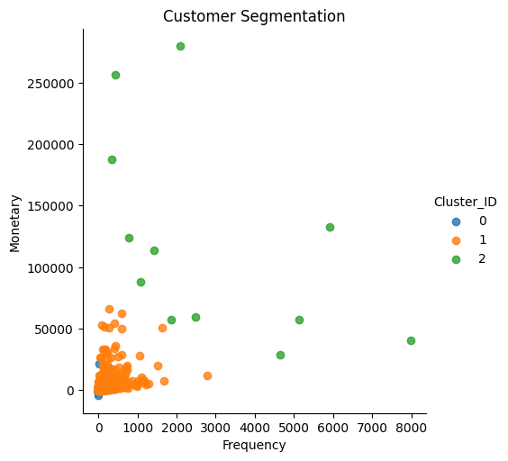
CUSTOMER SEGMENTATION BASED ON CLUSTERS
Cluster 0
Low Frequency and Less Monetary Purchase Value
Customers in this cluster are characterized by infrequent purchases and lower spending compared to the other clusters.
Cluster 1
Average Frequency and Monetary Purchase Value
This cluster represents the largest portion of your customer base.
These customers make purchases with a moderate frequency and spend an average amount.
Cluster 2
High Frequency and Monetary Purchase Value
This cluster represents the less portion of your customer base.
These customers make purchases with a high frequency and spend an average amount.

Slide 16
PREDICTIVE ANALYSIS

Slide 17
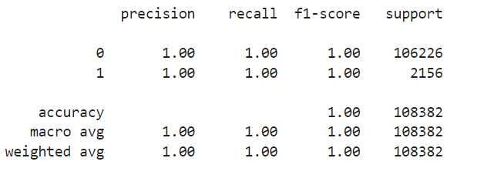
CLASSIFICATION MODEL
Model creation to predict whether Customer will return the product or Not
Using the 'ReturnFlag' as the target variable
Model evaluation has been done using accuracy, precision, recall and F1 score

Slide 18

REGRESSION MODEL
To predict ‘Total Price’ for an invoice
Using relevant features like Quantity, Unit Price and Return Flag
Evaluation of the Model has been done using R-squared and RMSE metrics
84% of the data has been explained by the model

Slide 19
ADVANCE EDA TECHNIQUES

Slide 20
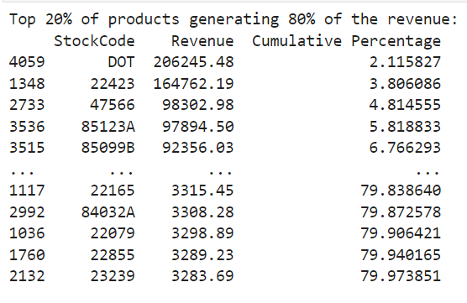
PARETO ANALYSIS
Identifying top 20% of the products generating 80% of the revenue
Stock Code - DOT has the highest contribution in generating 80% of the revenue
Whereas Stock Code – 23239 has the lowest contribution

Slide 21
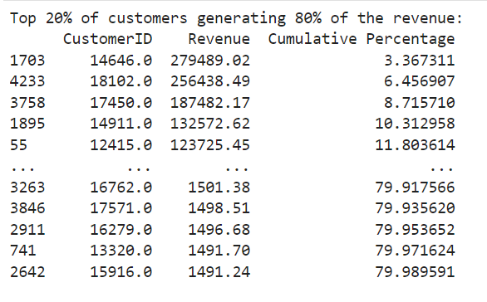
PARETO ANALYSIS
Identifying top 20% of the customers generating 80% of the revenue
Customer ID – 14646 has the highest contribution in generating 80% of the revenue
Whereas Customer ID – 15916 has the lowest contribution

Slide 22
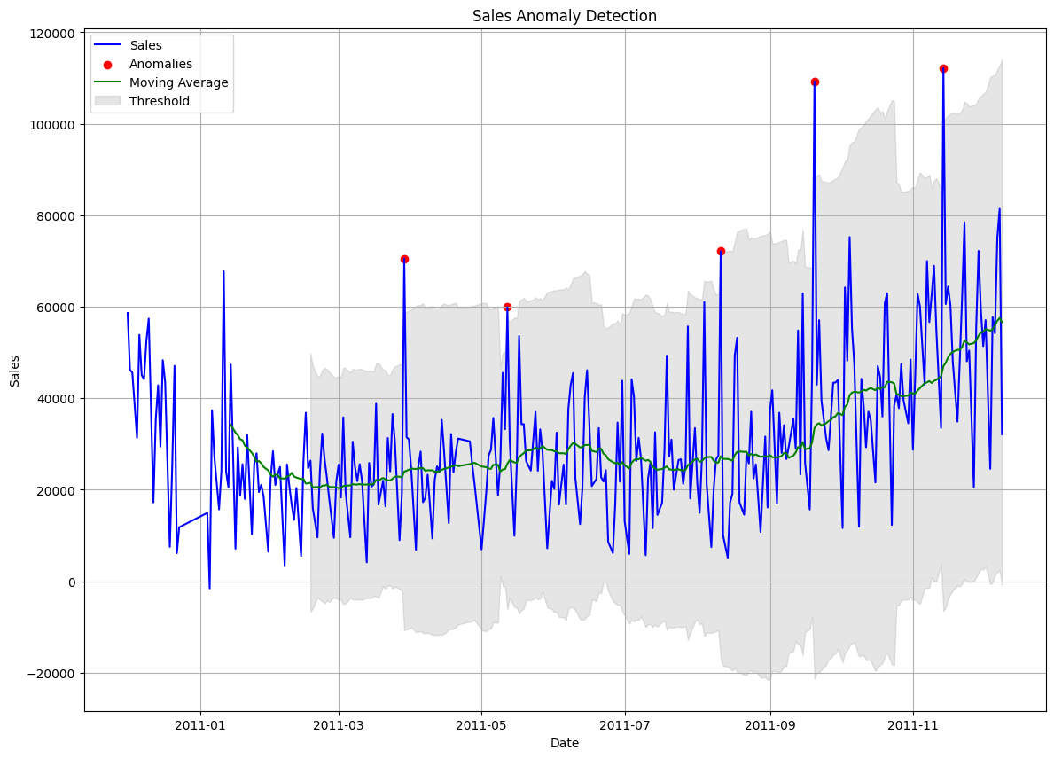
TIME SERIES ANOMALIES DETECTION
Anomalies detection using Moving Average

Slide 23
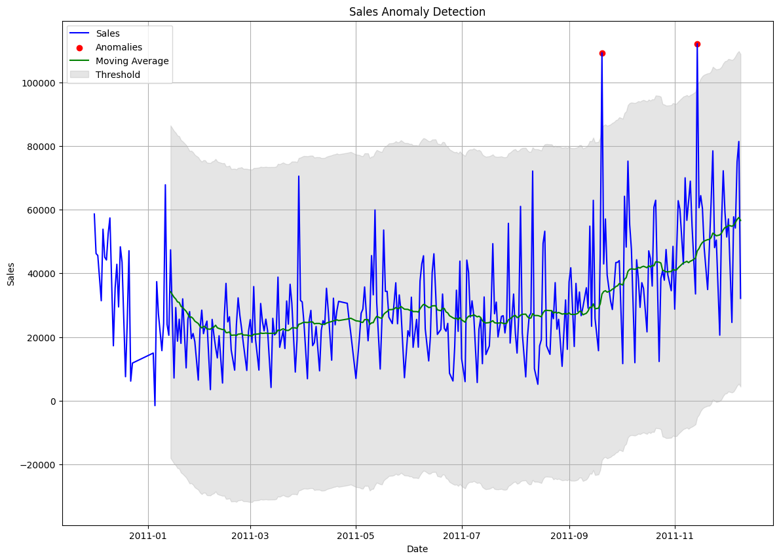
TIME SERIES ANOMALIES DETECTION
Anomalies detection using Z-score

Slide 24
ADVANCE MODELING TECHNIQUES

Slide 25
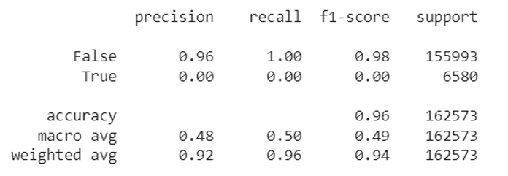
CLASSIFICATION MODEL FOR CHURN PREDICTION
Used Logistic Regression model for Churn prediction
Model is having Accuracy of 0.96

Slide 26
Hyperparameter Tuning & Model Optimization
Used Grid Search technique for hyperparameter tuning
There is no change in values of evaluation metrics as compared to previous model

Slide 27
THANK YOU

