Slide 1

CHURN ANALYSIS
Marketing Analytics Project
DAB 303 Section 03

Slide 2
GROUP 6
Group Members
Adaobi Nwachukwu : 0808547
Asif Ahmed : 0823547
Ayushi​ Patel: 0804322
Jaykumar Prakashkumar Prajapati: 0802302
Pavni Bhatt: 0822290

Slide 3
TABLE OF CONTENT
Dataset description
Exploratory Data analysis
Model creation and comparison
Overall Analysis
Identifying next possible churn customers
High-Level Marketing Strategy to entice customers

Slide 4
DATASET DESCRIPTION
Dataset which is being used in the Analysis is an E-commerce churn data
Shape of the data : Rows – 5630, Features – 20
Numerical features include : CustomerID , Churn , Tenure , CityTier, WarehouseToHome, HourSpendOnApp, NumberOfDeviceRegistered, SatisfactionScore, NumberOfAddress, Complain, OrderAmountHikeFromlastYear, CouponUsed, OrderCount, DaySinceLastOrder, CashbackAmount
Categorical features include : PreferredLoginDevice, PreferredPaymentMode, Gender, PreferedOrderCat, MaritalStatus

Slide 5
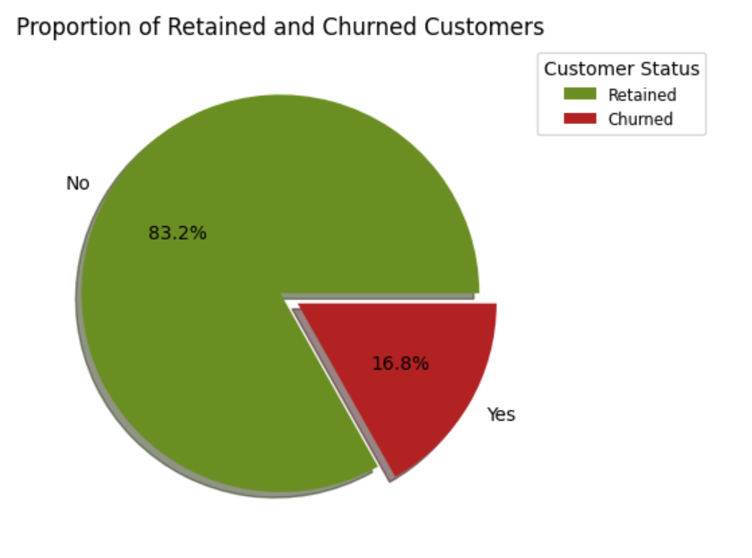
CHURN vs NON-CHURN
Pie-charts displays the churn vs non-churn customers
83.2% of the customers are Non-Churn whereas 16.8% are Churn customers

Slide 6
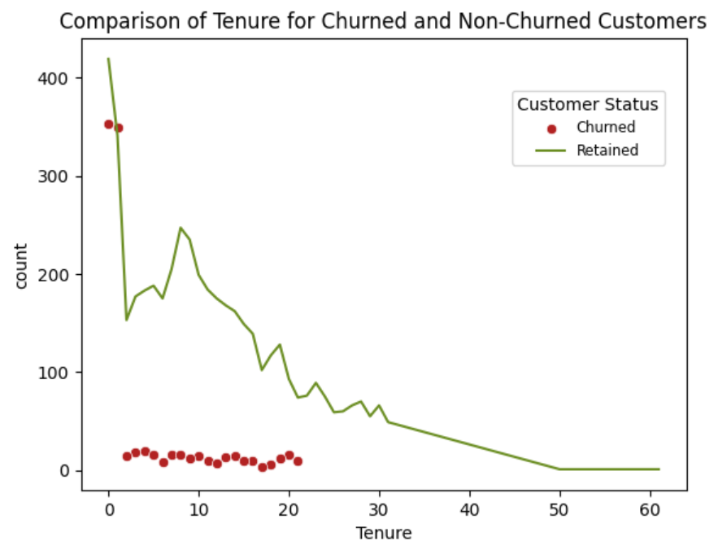
TENURE OF CHURN CUSTOMERS
We observed that customer churn is highest among those customers who have used the e-commerce site for a shorter duration.
The highest churn occurred with customers with tenure less than 22 months

Slide 7
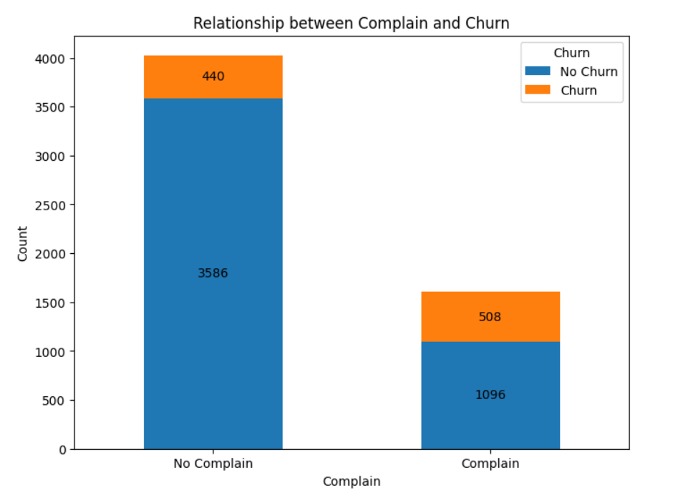
HOW HAS THE COMPLAIN AFFECTS CUSTOMER CHRUN
The stacked bar chart shows that about 25% of the customers who complained churned(approx.)
This means that the E-commerce company should ensure to handle customer complaints immediately in order to retain them

Slide 8
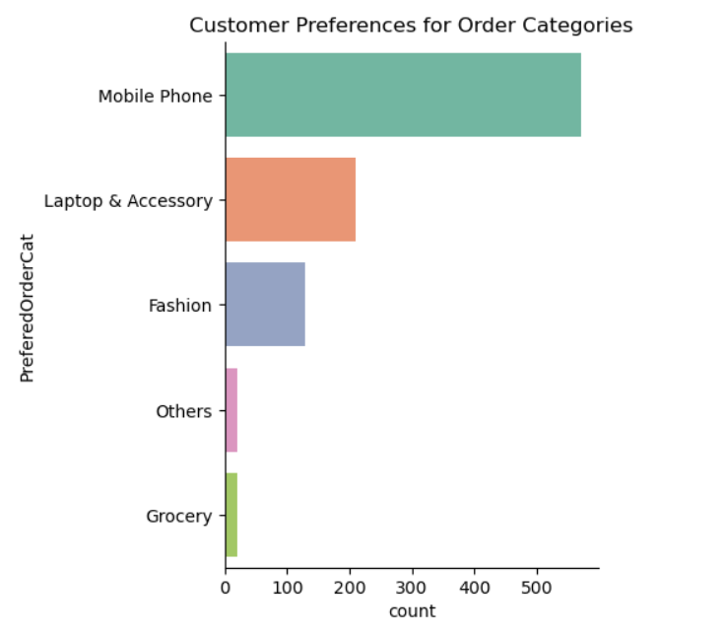
CHURN DISTRIBUTION BY ORDER CATEGORY
The graph clearly shows that customers with ‘Mobile Phone’ as Preferred Order Category churn the most.
Followed by Laptop and Accessory

Slide 9
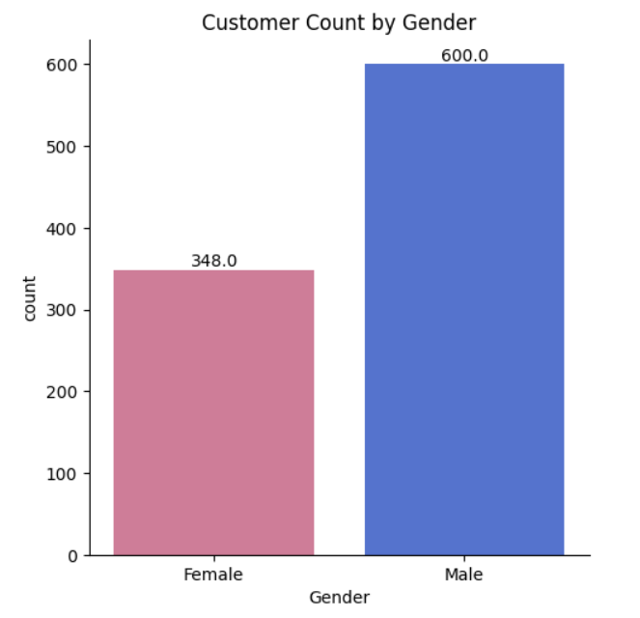
CHURN DISTRIBUTION BY GENDER
The male gender had almost twice as much churn as the female gender
Gender is also an important factor that affects the churn

Slide 10
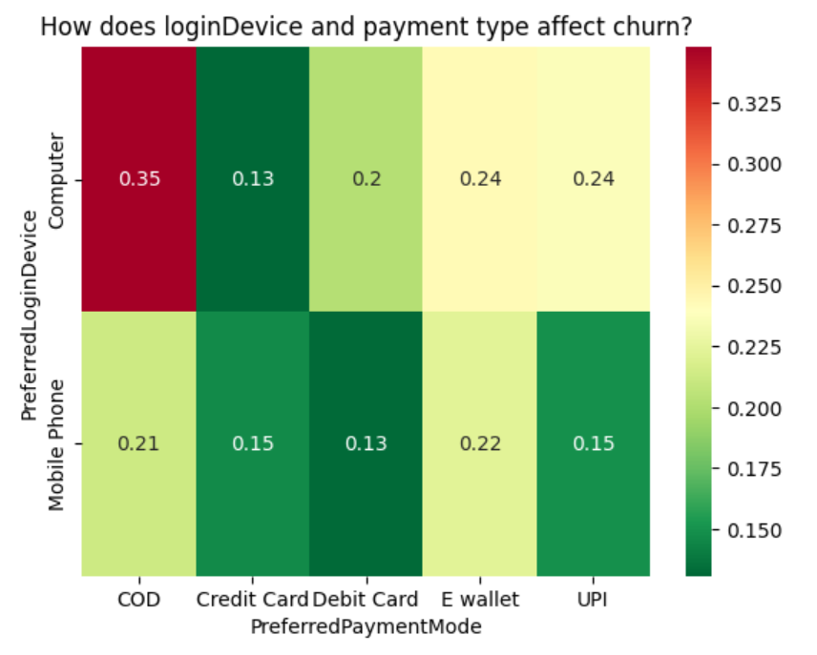
CHURN DISTRIBUTION BY LOGIN DEVICES AND PAYMENT TYPE
Customers with ‘Computer’ as Login Device and ‘Cash on Delivery’ as a mode of payment has the highest churn rate of 0.35
On the other hand, customers using Digital mode of payments has the lower churn rate with respect to ‘Mobile’ and ‘Computer’ as their login devices

Slide 11
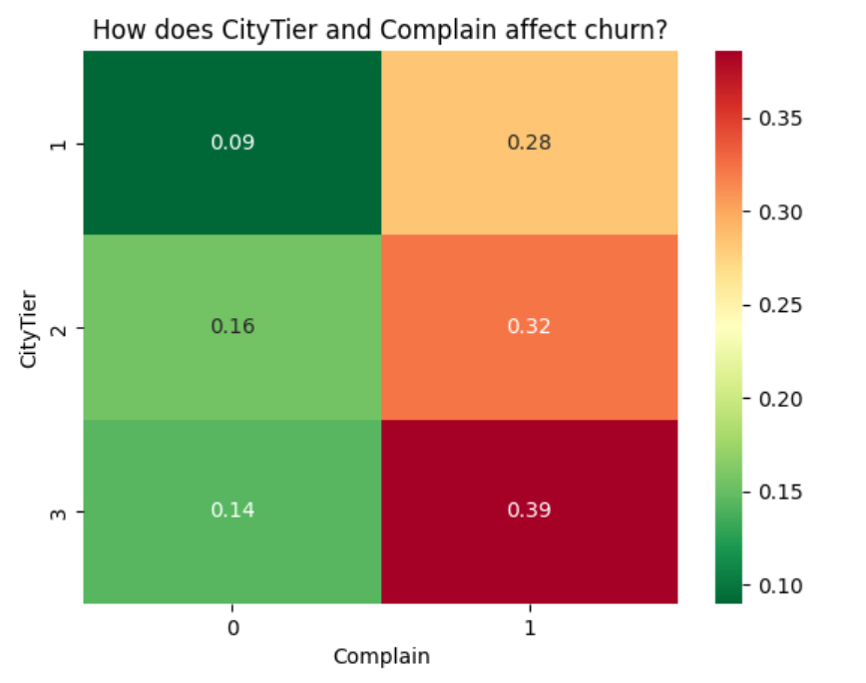
CHURN DISTRIBUTION BY CITY TIER AND COMPLAIN
After considering the churn based on City Tier and Complain, we found that among the churn customers, the City tier categorized as 3 has the highest complain rate in comparison to other City tiers.
Followed by City Tier 2

Slide 12
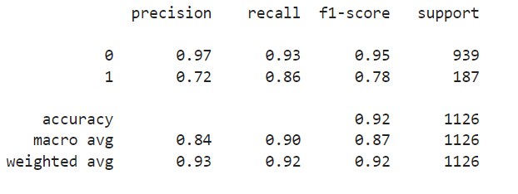
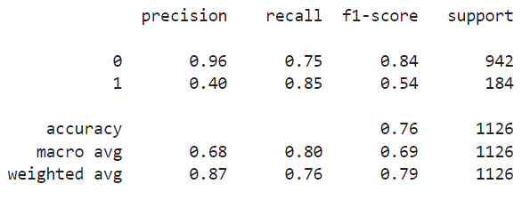
MACHINE LEARNING MODELS
SUMMARY AND COMPARISON
DECISION TREE
LOGISTIC REGRESSION
Based on Evaluation Metrics of the model, Decision Tree performs the better than Logistic Regression

Slide 13
OVERALL ANALYSIS
Customers churn at early stages
25% of customers who complained churned
Customers who were categorized under the ‘mobile phone’ order category churned the most
Customers who had a combination of ‘computer’ as preferred login device and ‘cash on delivery’ as payment mode had the highest churn rate
Male customers churned about 50% more than female customers
Correlation between city tier and complain

Slide 14
IDENTIFYING CUSTOMER SEGEMENT MOST LIKELY TO CHURN NEXT
Customers whose tenure is less than 24 months
Those who complain has the highest possibility of churning next
‘Mobile Phone’ category customers have the highest possibility of churning next
Customers who are using ‘Cash on Delivery’ as a payment mode and having ‘Computer’ as Login Device
City Tier 3 customers who are complaining
Male customers who are meeting all the above criteria

Slide 15
HIGH LEVEL MARKETING STRATERGY
For Customers churn at early stages
Improving the way we introduce our product, by providing great customer support, and by offering rewards and loyalty programs.
This helps us build strong, long-lasting relationships with our customers and keeps them from leaving
For Addressing Complaints
Analyze and address specific complaints, offering personalized solutions and swift responses
Launch re-engagement campaigns with exclusive offers and continuous feedback loops.

Slide 16
HIGH LEVEL MARKETING STRATERGY
For Male Customer Retention
Tailor messaging, product improvements, and retention efforts to meet male customer preferences
Customer Segmentation - by segmenting your customer base by gender to understand the unique needs and preferences of male customers.
For Churned customers under ‘Mobile Phone’ order category
Make sure the 'mobile phones' you sell meet their needs and are priced right
Study their behavior, listening to their feedback and adjusting strategies

Slide 17
HIGH LEVEL MARKETING STRATERGY
For Customer using ‘COD’ payment mode
Understand why customers who use 'computers' and prefer 'cash on delivery' are leaving through surveys and data analysis
Encourage alternative payment methods and provide incentives or discounts for doing so
For Churned customers in ‘Tier 3’ cities
Research and understand the unique needs of Tier 3 city residents.
Tailor marketing messages, affordability, and value offerings to these markets.
Build a strong online presence, local partnerships, and accessible customer support.

Slide 18
REFERENCES
https://medium.com/@uqba2199/customer-churn-prediction-using-machine-learning-e36036f6aafa
https://365datascience.com/tutorials/python-tutorials/how-to-build-a-customer-churn-prediction-model-in-python/
https://medium.com/@lucapetriconi/churn-modeling-a-detailed-step-by-step-guide-in-python-1e96d51c7523 https://matplotlib.org/stable/gallery/color/named_colors.html

Slide 19
THANK YOU

