Slide 1
TOKEN2049 ORIGINS
StratosNotes
Structured notes anyone can issue in minutes. The note runs on Solana, Chainlink CRE observes and pays it, and investors buy on Solana or Ethereum.
Solana
Chainlink CRE
Chainlink CCIP
sp.stratoslab.app · Solana devnet + Ethereum Sepolia
Notes:
A structured note is a promise about dates and prices. Today a bank's calculation agent watches the dates and a paying agent moves the money, and you can only buy the note where the bank is. StratosNotes is a self-service issuance engine and marketplace: the note runs on Solana, Chainlink CRE is the calculation and paying agent, and investors can be on Solana or Ethereum.

Slide 2
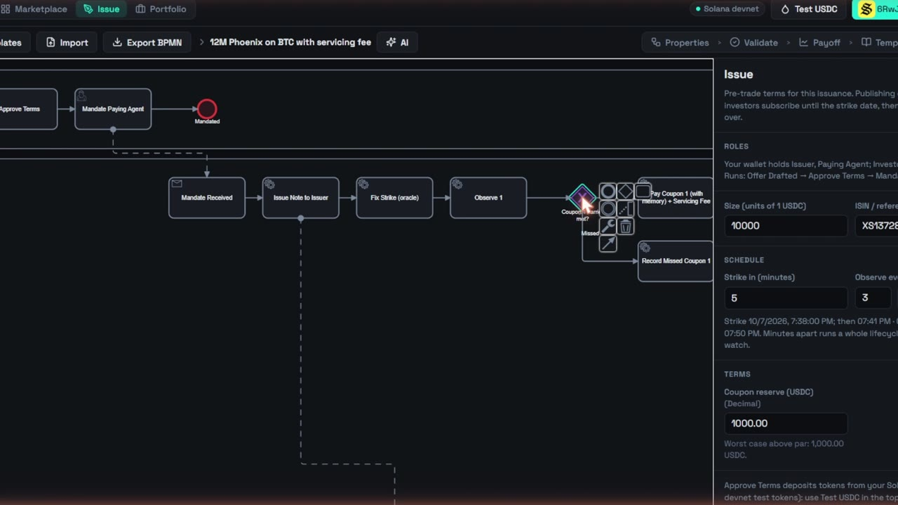
DEMO
Two minutes, template to live note
Also at sp.stratoslab.app/#demo
StratosNotes · sp.stratoslab.app
2
Notes:
Play the two-minute demo: the BPMN workflow behind a note, issuing it with this issuance's terms, an investor subscribing, and Chainlink CRE fixing the strike and observing on Solana devnet. Also online at sp.stratoslab.app/#demo.

Slide 3
THE PROBLEM
A note is a promise about dates and prices
A calculation agent
watches the dates and prices
“
Every quarter, if the worst of ETH and BTC is at or above 70% of its starting level you get a 2.5% coupon; if both are at or above 100% you get your money back early.
A paying agent
moves the money, and investors trust both
Weeks and a legal team
to create one note
One venue
investors buy only where the issuer's platform lives
StratosNotes · sp.stratoslab.app
3
Notes:
Read the example coupon aloud. Someone has to watch those dates, read those prices and move the money. Today that is a bank's calculation agent and paying agent; creating a note takes weeks and a legal team; and investors can only buy it where the issuer's platform lives.

Slide 4
WHAT IT DOES
From idea to paid coupons, in five steps
1
2
3
4
5
Design
Template
Issue
Sell
Observe & pay
Template, term sheet, AI or BPMN canvas. Validated as you edit.
Save to the library: published on Solana by its hash, signed by the author.
Size, strike and observation dates, coupon reserve. The book opens.
Solana: USDC for units in one transaction. Ethereum: tUSD over CCIP.
CRE reads Chainlink feeds and settles on-chain. Paid on either chain.
Five products: fixed coupon note, reverse convertible, phoenix with memory, snowball, principal-protected. One underlying or a worst-of basket of up to three. Cash or physical settlement.
StratosNotes · sp.stratoslab.app
4
Notes:
One workspace, in the design of Flow. Start from a published template, a term sheet, a sentence to the AI or a blank canvas. Save any design to the library. Issue: set size, strike and observation dates, deposit the coupon reserve, publish. Sell on either chain: Solana investors swap USDC for units in one transaction; Ethereum investors send tUSD and a subscribe call over CCIP. On every date CRE reads the Chainlink feeds and writes a signed report; coupons, autocall, knock-in and redemption settle on-chain.

Slide 5
HOW IT WORKS
One program, one CRE workflow, one CCIP lane
Author
template · term sheet · AI · canvas
Chainlink feeds
ETH · BTC · SOL
CRE keeper
observe · decide
Ethereum
investors (Sepolia)
signed reports
flow_engine
One Anchor program on Solana.
Runs every issuance: state machine,
holdings, vault, outbox
Outbox
locked by CRE
Relay
anyone can run
Chainlink CCIP
tUSD · tETH
tBTC · tSOL
BPMN workflow
validated, compiled
payouts out: ccip_send
Definition
Solana account, by hash
subscriptions in: ccip_receive
Prices always come from Chainlink feeds; the lifecycle always runs on Solana; money and delivered tokens cross chains.
StratosNotes · sp.stratoslab.app
5
Notes:
Left to right. Any authoring route becomes a BPMN workflow, compiled to a definition stored on Solana once, by its hash. One Anchor program, flow_engine, runs every issuance. Above it, the CRE notes-keeper reads Chainlink feeds for ETH, BTC and SOL and writes signed reports into the engine through the forwarder. To the right, CCIP: Ethereum investors subscribe in through ccip_receive; payouts CRE locked in the outbox go out through a permissionless relay and ccip_send. The relay decides nothing.

Slide 6
BEST USE OF SOLANA
Every note is a BPMN workflow on one Solana program
State machine
Time and roles
Holdings and DvP
Token multiset; gateways on price predicates (min / max for worst-of); fork / join
Timers on per-issuance dates, open roles, repeatable subscription windows
Internal holdings ledger, atomic USDC-for-note swap, transfers in whole or in part
Distribution
CCIP native
Fits the runtime
Pays every holder in cash or the underlying's token, from a token vault per issuance
A CCIP receiver and sender: subscribe in with ccip_receive, pay out with ccip_send
Own heap allocator so large definitions fit Solana's 32 KiB heap
flow_engine · Anchor 0.31.1 · devnet 9a5xpgRgK7NQMVtYvLuVq1XooK3Ca4CrKVkFEnVRGaHx
StratosNotes · sp.stratoslab.app
6
Notes:
Best Use of Solana. One Anchor program runs BPMN workflows on-chain. A compiled workflow is stored once, addressed by its hash, and every issuance is a process of it. Five product engines, worst-of baskets, physical delivery, the template library and any workflow edited on the canvas all run on the same program. It has its own heap allocator so large definitions fit Solana's 32 KiB heap on the report path.

Slide 7
BEST WORKFLOW WITH CRE
Chainlink CRE is the calculation and paying agent
Reads Solana
Every DON node reads finalized engine state; the DON agrees on what is due
Reads prices
Chainlink feed of every underlying at the finalized Ethereum block, staleness-checked
Settles
One DON-signed report through the forwarder runs an observation and everything after it
Pays Ethereum
Payout reports lock each Sepolia holder's coupon, redemption or token for CCIP
Phoenix on ETH · Worst-of ETH, BTC, SOL
StratosNotes · sp.stratoslab.app
7
Notes:
Best Workflow with CRE. One CRE workflow serves every note. Each cron run reads the engine's notes from Solana at finalized state, reads the Chainlink feed of every underlying at the finalized Ethereum block with a staleness check, and writes DON-signed reports through the keystone forwarder. One report runs an observation and everything after it. CRE is also the paying agent on Ethereum: a payout report has the engine lock exactly what a Sepolia holder is owed. The chart shows the devnet reports from the evidence, against the 300k compute cap at the top of the axis.

Slide 8
CHAINLINK CCIP
Subscribe and get paid on Solana or Ethereum
306 tUSD
110 tUSD
0.0382 tETH
Subscribe in
Automatic payouts
Physical delivery
300 units bought from Sepolia; CRE autocalled; paid back over CCIP
Three coupons and the redemption, locked by CRE, sent by the relay
0.03824647 tETH (100 ÷ 2,614.62 strike) plus 5 tUSD of coupons
FCN on ETH · DFaUHwaG…
Phoenix · 8DtC17Ar…
Reverse convertible · CviXTYq7…
~1 min
35–40 min
0
Solana → Ethereum
Ethereum → Solana
manual steps for payouts
StratosNotes · sp.stratoslab.app
8
Notes:
Investors on Ethereum, over CCIP: one Ethereum address across three notes. On the FCN it subscribed 300 units from Sepolia; CRE autocalled and 306 tUSD went back. On the phoenix, CRE locked three coupons and the redemption in four payout reports, and 110 tUSD, the reference payoff, arrived with nobody acting. On the physically settled reverse convertible, the note knocked in and delivered 0.03824647 tETH, 100 units divided by the 2,614.62 strike, plus 5 tUSD of coupons. Outbound takes about a minute; inbound takes 35 to 40 minutes because of Ethereum finality.

Slide 9
EVIDENCE
Two full lifecycles, exactly the reference payoff
Phoenix on ETH
Worst-of ETH, BTC, SOL
8SvcVvQ8… · paid 525, 420, 105 USDC
3o6EuEWk… · paid 636, 424 USDC
Event | Transaction | Compute units
CRE fixes the strike | 2VxTRWLp… | 51,394
Investor sells 100 of 600 units | 3umFWgcG… | 34,775
Observation 1: coupon | Ju2Wo4k5… | 68,976
Observation 2: autocall, redemption | 4hySSWXN… | 87,593
Event | Transaction | Compute units
CRE fixes three strikes | 2JoaJh49… | 63,723
Observation 1: worst 100%, coupon | 3GL2E2Q7… | 84,063
Observation 2: autocall, redemption | 42Q2F5oR… | 99,231
Worst-of: each CRE report carried three Chainlink prices; the engine computed perfK = min(obsK_i / initialLevel_i) on-chain and tested every barrier against it. Full transaction ids: docs/SUBMISSION.md and docs/crosschain.md.
StratosNotes · sp.stratoslab.app
9
Notes:
Two whole lives on Solana devnet, run by CRE with nobody acting except one investor selling part of a position. The ETH phoenix paid 525, 420 and 105 USDC for 500, 400 and 100 units. The worst-of phoenix on ETH, BTC and SOL computed the worst performance on-chain from three Chainlink prices per report and paid 636 and 424 USDC for 600 and 400 units. Both match the reference payoff exactly.

Slide 10
AI AND TEMPLATES
Design by sentence, issue from a signed library
PROMPT
“12 month phoenix on the worst of ETH and BTC, 10% p.a. paid quarterly, 70% coupon barrier with memory…”
Template library: six on devnet
Worst-of phoenix (ETH, BTC, SOL)
Worst-of FCN (ETH, BTC)
~7 s
10% p.a. → 2.5%
BTC snowball
term sheet to parameters
per quarterly period
90%-protected SOL note
Step-down phoenix (custom workflow)
2 underlyings
Asks
BTC phoenix with a servicing fee (custom)
become a worst-of basket
when terms are missing, never invents
Each entry is signed by its author and recompiled against its definition address; forgeries are rejected.
StratosNotes · sp.stratoslab.app
10
Notes:
Design with AI: a full phoenix term sheet becomes the right parameters in about seven seconds. Ten percent a year paid quarterly becomes 2.5 percent a period; the worst of ETH and BTC becomes a two-asset basket. A request missing terms gets a question back instead of a guess, and asking for a paying-agent fee comes back as a validated workflow change. The template library has six templates on devnet, each signed by its author and recompiled against its definition address; forged or mismatched entries are rejected.

Slide 11
TESTS
Every payout checked against a reference payoff
12
product lifecycles
3
cross-chain scenarios
All five products, worst-of, physical delivery, two custom templates; every payout equals the reference payoff
Subscribe via ccip_receive; late subscription refunded; autocall paid through payout report → outbox → flush_outbox
< 300k
compute per CRE report
6
signed templates
Every report in the e2e suite fits CRE's cap (max 98k there)
Library rejects forged signatures and mismatched workflows, checked against production
Also: unit tests for every product's BPMN round-trip, min / max, worst-of payoff and the AI pipeline; Foundry tests for the Sepolia faucet; the CRE workflow compiles with cre-compile.
StratosNotes · sp.stratoslab.app
11
Notes:
The products end-to-end suite runs twelve lifecycles on a local validator: all five products, worst-of baskets, physical delivery and the two custom templates, with a partial transfer mid-life. Every payout equals the expected payoff. The cross-chain suite uses a mock CCIP router and offramp with the real PDAs: a Sepolia subscription, a late one refunded, and the autocall paid through the CRE path: payout report, outbox, flush_outbox, ccip_send.

Slide 12
LIMITS AND NEXT
What is not done yet, and what comes next
Limits
Next
Inbound CCIP is slow
Ethereum → Solana takes 35–40 min; Ethereum-open books stay open at least 40 min
cre workflow deploy to the DON; log triggers on engine events
DON executor and our receiver
The offramp runs out of heap after our receiver succeeds; our relayer re-executes
Note units as SPL tokens (Token-2022), transferable over CCIP
CRE decides, a relay sends
CRE writes can't use lookup tables; the relay cannot change amount or destination
More CCIP chains (Base, Arbitrum); a smaller receiver footprint
Issuer reserves from Ethereum in the app
Test tokens
Our own CCIP tokens: we control the lane and the faucet. Notes point at mint addresses, so USDC needs no engine change
Investor allowlists, template ratings, issuer profiles
CRE simulator
Runs with --broadcast until DON deploy access; the engine accepts the staging forwarder
Flow's Canton target for private institutional issuance
StratosNotes · sp.stratoslab.app
12
Notes:
Be direct about the limits. Inbound CCIP is slow, so a book that takes Ethereum subscriptions stays open at least 40 minutes. The DON executor runs out of heap after our receiver succeeds, so a relayer re-executes those messages manually. CRE locks payouts but cannot submit the CCIP send itself because the router needs address lookup tables, so a permissionless relay delivers them. The tokens are our own CCIP burn-mint test tokens: we control the lane and the faucet, and a note points at mint addresses, so real USDC needs no engine change. Next: deploy to the DON, note units as SPL tokens, more chains.

Slide 13
One Solana program runs every note.
One CRE workflow observes and pays them all.
CCIP moves the money.
SITE
sp.stratoslab.app
APP
sp.stratoslab.app/app
CODE
github.com/adappterxyz/StratosNotes
DOCS
docs/SUBMISSION.md · docs/DEMO.md · docs/crosschain.md
StratosNotes · TOKEN2049 Origins
Notes:
One Solana program runs every note as a BPMN workflow; one CRE workflow observes them all and pays holders on Solana and Ethereum; CCIP moves the money; anyone can issue from the library. The links are in the submission.

