Slide 1
SCN093 Applied Data Science
Week 1: What is Data Science?

Slide 2
Agenda: Tuesday Session
1. Introductions and Ice Breaker
2. Administrative Details
3. Goal Setting
4. Start of Course Survey

Slide 3
Introductions
Name
Grade Fall 2021
Where you live
Most difficult thing about learning during pandemic
Favorite summer activity

Slide 4
Admin Details
Overview/intro to the course
Course time: Tues Thurs 4:30 - 6pm
'Office' hours: Thurs 6:30 - 7:30pm
Course Description
Introduction to data science. You will be exposed to different technical capabilities and speakers to understand the width and breadth of data science and data analytics in the workforce.
Three weeks of technical work that will include install R, R Studio, Python, and a number of other programs. After technical sessions, we will move on to a number of speaker series from industry professionals who will introduce you to the scope of careers you can perform with a background in data.

Slide 5
Admin Details
Logistics of the course
Week One: What is Data Science
Week Two: Intros to Python and R
Week Three: Databases, APIs, and Integrations
Week Four: Data Analytics in Government and Data Uses in Network Engineering
Week Five: Marketing Analytics and Machine Learning in Use
Week Six: Finance Analytics and Data Consulting

Slide 6
Admin Details
Slack overview
Download desktop version
Create a username and log in
Workspace: SCN 093
Adding channels
Creating channels
Direct messages

Slide 7
Admin Details
Expectations

Slide 8
Goal Setting
The purpose of this course is to introduce you to coding basics and expose you to individuals within different areas of expertise throughout data science.
Activity:
In the general Slack channel, please write one goal you are interested in accomplishing during this course.

Slide 9
Questions

Slide 10
SCN093 Applied Data Science
Week 1: What is Data Science?

Slide 11
Agenda: Thursday Session
1. Warm Up
2. Why Data?
3. Different Areas of Data
4. Data Types
5. Data Literacy and Data Communication

Slide 12
Warm Up
In the Discussion Questions thread in Slack, name either one thing you are most looking forward to in the syllabus or one thing you wish was on the syllabus but isn’t.

Slide 13
Why Data?
Qualitative vs Quantitative
Inherent biases and how data combats that
Using the Null Hypothesis method
Discussion:
What use cases do you see for data in the world?
In what instances could data use prove problematic?
In one sentence how would you communicate the need for data in the world?

Slide 14
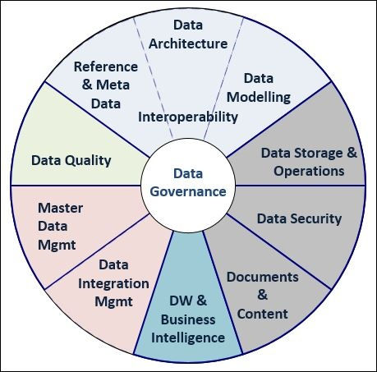
Areas of Data
Data Governance
Holistic structure and implementation of data strategy within an organization
Combination of technology, hardware, and people
Key in creating a comprehensive data solution

Slide 15
Areas of Data
Architecture: Design of the physical and virtual infrastructure by which data is supported.
Modelling: Manipulation of data using algorithms to solve problems.
Storage/Operations: Management of the physical and virtual infrastructure by which data is supported.
Security: Processes, policies, and technology that keeps data safe.
Doco/Content: Documentation saves lives.
DW/BI: Restructuring and analysis of data for decision making.
Integration Mgmt: Design of connection between data sources, esp through data factories.
Quality: Data cleaning. One of the most integral and time consuming steps of data analysis.
Refs/MetaData: Descriptive data associated with each column within a dataset as well as the overall dataset itself

Slide 16
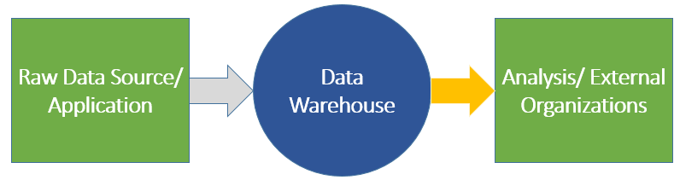
Architecture (Top Layer)
Design, Components, Strategy, and Theory

Slide 17
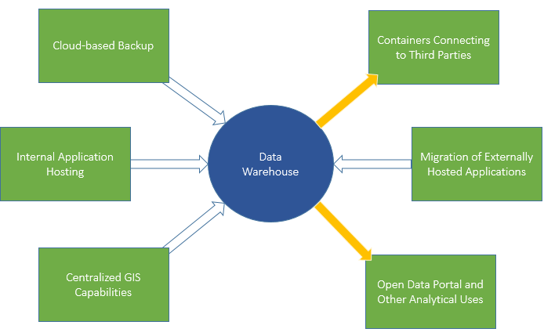
Architecture (Middle Layer)
Design, Components, Strategy, and Theory

Slide 18
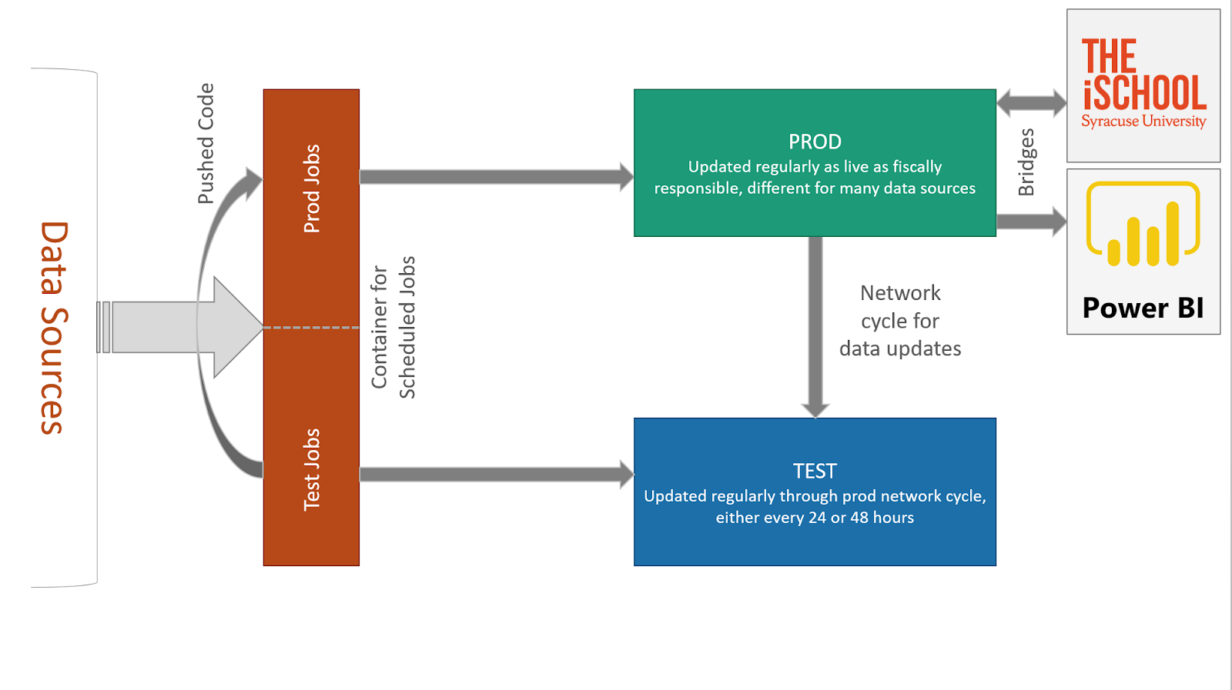
Architecture (Bottom Layer)
Design, Components, Strategy, and Theory

Slide 19
Modeling
Data Infrastructure Mapping: Visual representations of a database or larger server that show the connections between different elements of that data resource. Allows for scalability of data use as more individuals are able to digest the high level layout of the data infrastructure.
Schema Development: Technical and physical layout of tables within a data resource. This is the system by which the actual data will be accessed through querying, and is a key part of the operational functionality of any data resource. Improper schema development or setup has the potential to be detrimental to a data system.

Slide 20
Storage/Operations
Administration: This aspect of data systems tends to be more technical in nature and supports the overall usage of any data resource. Responsibilities include user management, setup of any additional data software and integrations, maintain licenses, identify best practices in implementation, and build out ETL/ELT or Data Factory solutions.
Technical Theory/Layout: Storage and operations involves developing the larger environment that a data resource lives in. Similar to the data architecture, this larger architecture has to be designed and can include firewall, data resources, application containers, bridges to external organizations, ETL/ELT, data factory, code containers, and automation resources in a basic system.
Resource Management: Administration of these environments includes a large amount of resource management. This walks a thin line of spending the least amount possible on hosting costs while ensuring the system is able to run without crashing. There is a significant amount of analytics within this system style itself that support this effort.

Slide 21
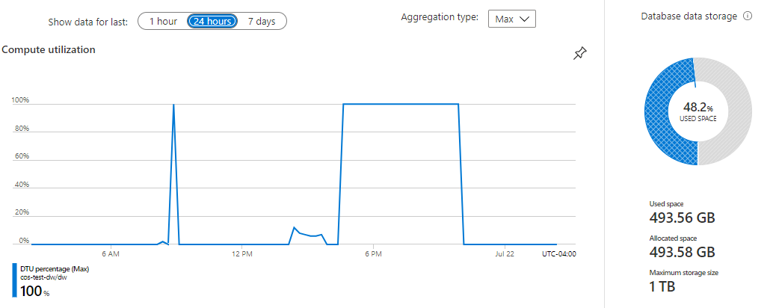
Resource Management Analytics

Slide 22
Security
PII: Personally identifiable information, metrics or combinations of metrics that have the potential to identify a specific person either outright or through descriptive data points within a population. This can be identified in a number of levels:
Low Risk:
Medium Risk:
High Risk:
Transparency v Security: Historically institutions have gone to great lengths to ensure their data remains extremely private. Within the last five years or so this method has changed and more organizations are offering open data, hackathons, and third party data partnerships. This shift towards transparency has made security even more important as the security has to be fine tuned to continue protecting information required by law or organizational need.
Data Sharing Agreements, NDAs, MOUs: These documents allow different organizations to come together in partnerships or collectives to contribute to the other’s data growth.

Slide 23
Doco/Content
Data Dictionary: A consolidation of all metrics across a data resource with definitions, data type, table location, any notes on the metric, and other information an organization might want to collect on those metrics. The key goals of a data dictionary is to create standardization across a data resource and to provide a single source of definition for users of the system.
Trainings: User training is necessary for any type of data use. Organizations are beginning to hold trainings not only for technical users but for the end users of those reports, dashboards, and other analysis. As a data professional you will need to be able to translate complex data topics to a number of data literacy levels.
Workshops: Unlike trainings, workshops are much more hands on and meant to engage those within the session. These are used to help develop use cases, identify gaps in knowledge, break down silos, build data strategy, and answer other larger data related questions.

Slide 24
Data Warehouse/Business Intelligence
Consolidation of Data: DW is meant to bring data from different resources into a single database for cross-departmental and higher level analytics.
Scalability: DW requires an organization to critically look at their data governance, stewardship, and processes during development ensuring an environment that can be scalable.
Types of Data Warehouse Schema:
Star:
Snowflake:
Galaxy:
Algorithms/Operations/Predictive: This type of BI relies on back end development to support processes and are often not intrinsically seen by the end user.
Dashboarding & Reporting: Visualizations and reports are the most referenced form of BI. These allow for self serve analytics further down the data literacy chain.

Slide 25
Integration Management
ETL: Extract Transform Load. A method of migrating data into a data warehouse with an intermediary step of transforming the data using individual coding methods.
ELT: Extract Load Transform. A method of migrating data into a data warehouse with transformation done directly within the new location. Allows for greater flexibility within the DW itself but increases hosting costs.
Data Factory: Proprietary integration engines that differ based on the technology. Streamlines data integration with prebuilt connections to common applications.
API: Application programming interface, a connection between computers or between computer programs. It is a type of software interface, offering a service to other pieces of software.
Test v Dev v Production: Integrations and code development begin in dev environments, move to test, and finally get pushed to production.

Slide 26
Data Quality
Importance of data cleaning: Insights from dirty or inconsistent data can be more dangerous than no data support at all. Incorrect conclusions can cause drastic operational results.
Processes for data cleaning:
Proprietary scripting, custom solutions
Out of the box extensions
Basic manual cleaning
Machine learning, esp around more consistent data
Automated vs manual data:
Automated Data Collection: Information often collected by sensors or other software systems such as point of sale. Data collected this way is considered high quality and extremely accurate with internal validation systems, bias checks, and bug fixes.
Manual Data Collection: Information collected and/or input with manual intervention. This data is considered less reliable and often requires significant cross validation with other systems, extensive data cleaning, and human resource management to ensure continued training on the processes of collection/input.

Slide 27
References/Meta Data
Occasionally not included in data resources but important in understanding context and bias for these systems.
References include any external resources that were used in the support of any of the previous areas of data science we just walked through.
‘Data about data’
Some types of meta data:
Descriptive
Statistical
System
Operational
Administrative
Structural

Slide 28
Discussion
On first introduction, which of these areas of data science do you find most appealing?
Can you think of any aspects of data science that may not fit into these categories?

Slide 29
Data Types
Boolean: a binary variable, having two possible values TRUE or FALSE
Numeric: a variable expressed explicitly as a number -infinity through infinity. This can be expressed as an INT (a whole number) or a FLOAT (a decimal)
Categorical: a variable represented through a number representing a category. This number cannot be used in numeric analysis.
String: a variable stored as simple text. Often these are narrative variables or variables joined to categoricals describing those categories.
Primary Key: Column within a data source that cannot contain any NULL values

Slide 30
Discussion
How do different data types impact the types of analysis being done?
What data type do you personally find most insightful?
What are examples of questions that could be used to collect data and which data types would you associate with those questions?

Slide 31
Data Literacy & Communication
Story telling through data
Understanding the correct medium (report, dashboard, presentation, etc.)
Starting with the goal, not the data

Slide 32
Discussion
Why do you think it’s important to effectively communicate data?
What is an aspect of data literacy you find challenging?
How do you think you would communicate heavily technical data solutions to a non-technical audience?

Slide 33
Questions

