Slide 1
SCN093 Applied Data Science
Week 6 Data ethics and wrap up

Slide 2
Agenda: Tuesday Session
1. Warm Up
2. Activity
3. Python
4. Activity
5. Different Envs in Python

Slide 3
Warm Up
There is one week of class left. What is one thing you wanted to learn that you haven’t yet?

Slide 4
Building Different Environments
Some packages in python don’t play well together, or you may have specific different needs for different projects. When this is the case, we can install different instances of python environments that don’t interact with one another
Open Anaconda
conda create -n exe -c conda-forge geopandas
C:\Users\[YOUR USER]\Anaconda3\envs

Slide 5
Activity
Design a Survey!
Pick a business
What is an issue that might impact that business?
What questions would you ask your customers to fix that issue?
How would you analyze?

Slide 6
Questions

Slide 7
Agenda: Thursday Session
1. Setting the stage
2. Where we are
3. Discussion
4. Bias
5. Surveillance
6. Governance
7. Questions

Slide 8
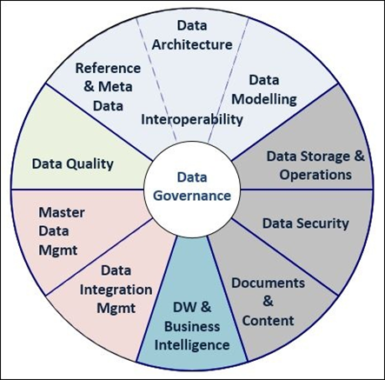
Data Universe: Setting the Stage
Governance: Umbrella term for management of the entire data universe within and outside of an organization

Slide 9
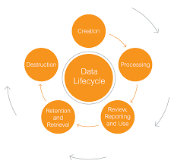
Data Universe: Setting the Stage
The data lifecycle continues and grows, especially as the organization matures in its ability to use that data. Throughout each of the cycles the process should be reassessed to better address the needs of the organization, the end users, and the residents of Syracuse. Reassessment needs to include evaluation of equity in all steps.

Slide 10
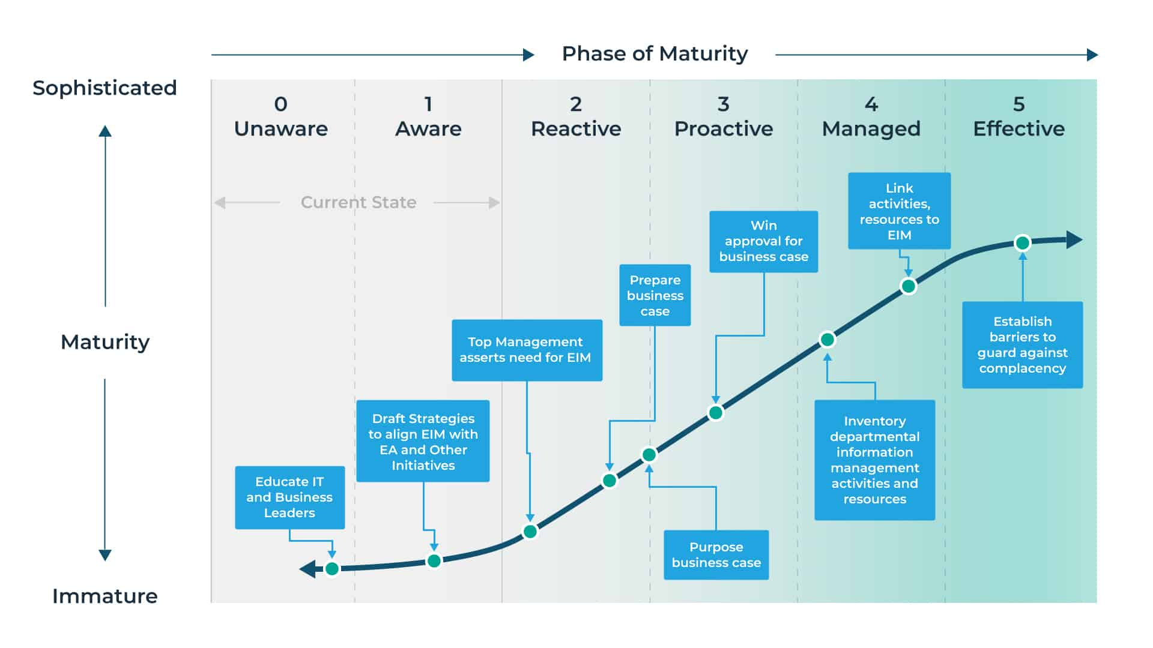
Where Are We?
Syracuse

Slide 11
Discussion
How does data usage impact you as a consumer?
Notes:
Notes
Notes:
Some prompting questions:
Has this term come up in your professional setting, XXXX?
Has there been conflicts in your organization around

Slide 12
Discussion
How does data usage impact you as a data professional?
Notes:
Notes
Notes:
Some prompting questions:
Has this term come up in your professional setting, XXXX?
Has there been conflicts in your organization around

Slide 13
Discussion
How does data usage impact the economy?
Notes:
Notes
Notes:
Some prompting questions:
Has this term come up in your professional setting, XXXX?
Has there been conflicts in your organization around

Slide 14
Biases
Inherent v Intentional Bias: Intentional bias is a product of the data collection methods and process with human intervention. This requires significant change management to culture and can be easy to identify but difficult to remedy. Inherent bias speaks more to best intentions with ill conceived notions or lack of coverage in a population. While these can be difficult to root out, once discovered there is generally a concrete solution.
Guiding questions:
These definitions speak to data collection, but how else can bias impact the data lifecycle?
What steps can we take to identify and decrease bias?
How could inaccurate definition of this term impact end users?

Slide 15
Surveillance
Technologies that observe or analyze the movements, behavior, or actions of identifiable individuals in a manner that is reasonably likely to raise concerns about civil liberties, freedom of speech or association, racial equity or social justice.
Guiding questions:
In what instances is surveillance acceptable? In what instances is it absolutely not?
How do we communicate surveillance to promote productive conversations around the data type?
How can we understand potential surveillance technologies most accurately to ensure the systems are not used in nefarious ways?

Slide 16
Governance
The holistic structure and implementation of data strategy within an organization that is a combination of technology, hardware, and people. This is key in creating a comprehensive data solution.
Guiding questions:
What are some of the first questions we should be tackling around governance?
Who needs to be involved in building governance policy?
How much should security, infrastructure, and technical details be driven by governance policy and how much by industry best practices?

Slide 17
Questions

