Slide 1
Definitions
Masking is the process by which the detection threshold of a signal is increased by the presence of a stronger signal (masker).
A ‘not-masked’ threshold is the quietest level of the signal which can be perceived when isolated (in quiet).
A masked threshold is the quietest level of a signal that can be perceived when accompanied by noise.
The ‘amount of masking’ is the difference between the two, and is defined as the increase (in dB) in the detection threshold of a signal due to the presence of a masker

Slide 2
3 Types of Masking
Simultaneous Masking
Forward (post-stimulatory) Masking
Backward (pre-stimulatory) Masking
time
time
time

Slide 3
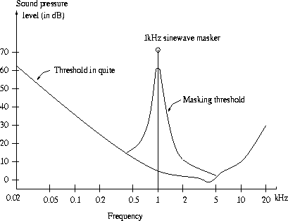
3 Types of Masking: Simultaneous Masking
Moore, 1995
Frequency domain phenomenon
Occurs when a signal is made inaudible by a simultaneously occurring stronger signal
Masking thresholds depend on SPL and the characteristics of both signals
Higher frequencies are more easily masked

Slide 4
3 Types of Masking: Simultaneous Masking
Fletcher suggested that the auditory system behaves like a bank of overlapping band pass filters called “auditory filters”
Moore, 1995
Frequency
ERB
Frequency

Slide 5
3 Types of Masking: Post-Masking
Time domain phenomenon where ear becomes saturated and requires time to recover
4 neurophysiological properties of forward masking are:
Central Inhibition
Basilar Membrane Persistence
Neural Persistence
Nerve Adaptation
Moore, 1995
time
time

Slide 6
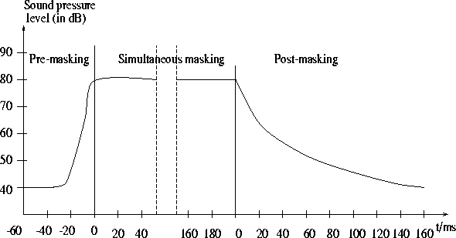
3 Types of Masking: Pre Masking
Is another time domain phenomenon for which not much is known
The duration when pre-masking applies is less than one tenth that of the post-masking, which is in the order of 20 to 200 msec.
Both pre and post-masking are exploited in the ISO/MPEG audio coding algorithm.
Hydrogen Audio

Slide 7
Masking as a tool: MPEG Audio Compression
Lossy audio data compression methods like MPEG and audio encoding remove sounds which are masked anyway
MPEG audio compression uses psychoacoustic models to construct a multi-dimensional reference array to map transmitted masked frequency components using fewer bits
Defines 3 layers that gradually tradeoff quality for bit-rate and involve increasing complex codecs
Layer 1: Uses simultaneous masking only with DCT type filter and equal frequency spread per band
Layer 2: Uses temporal masking and 3 frames in the filter
Layer 3: Uses temporal masking with a non-equal frequency critical band filter and a Huffman coder
Davis et al., 1997

