Slide 1
Play With Yourself ™
An accompaniment tool for the modern musician
By Adar Guy, Colin Malloy and Hector Perez

Slide 2
What is ‘Play With Yourself ™?
Why?
Play With Yourself ™ is a system that produces a MIDI accompaniment (melodic, harmonic, and/or percussive) based on features extracted from an audio input.
Harmonic and rhythmic features of the input audio are used to generate this accompaniment. Features include tempo, onsets, beats, and chords.
Automatic accompaniment generation would be useful for musicians who want to quickly create demos of their music or do not have access to additional musicians for recording.
… Run Demo

Slide 3
Current Progress:

Slide 4
Phases for System Development
Phase 1: Detect Beats/Onsets
The system detects and tracks all onsets of the input signal and determines the beats that surpass a user defined threshold. The tempo is then calculated for the entire signal (BPM).
Notes:
First the beat detection and harmonic detection were tested separately. After ensuring adequate results, they were combined into a single source code file.
From this, we were able to have a list of chords predicted for all audio frames, and also the times in seconds for the beats in the audio input.
The next step was to get the system to predict the chords for the frames that had beats in them (this would be useful, because we would know what note to place, and at what time).
After successfully obtaining lists of chords predicted at the beats, we were off to search for a library that could write MIDIFiles. MIDI util proved useful for this.

Slide 5
Phases for System Development
Phase 2: Predict Chords
Using the beat times determined in phase 1, the system computes the predicted chord for a given beat. The tonic of each chord is used with beat times to determine the melodic accompaniment pitches and durations. To determine the harmonic accompaniment the system refines the predicted chord list into a set of chords with the referenced start/end times. The percussive accompaniment is built by taking a ‘perfect’ tempo and adjusting transient placements based on the distance from the closest onset determined by a user defined window size.
Notes:
MIDIutil allowed us, after organizing our data into a specific format, to write multi-track MIDI Files. This library requires information about the audio events to write such as their respective MIDI note numbers, durations, volumes, and track to be written to.
Finally some refinements have been made, by improving the detection of beats through use of the tempo. Using the tempo, the prediction for where the next beat will be is obtained. However, instead of just using it, it is checked whether there is an onset at that time. If there isn’t, but there is one nearby, then the prediction of where the next will be is updated.

Slide 6
Phases for System Development
Phase 3: Convert Predicted Notes to MIDI
The system then converts the note/chord names into their corresponding MIDI values (from a preset list) for the melodic and harmonic accompaniments. For the percussive accompaniment, MIDI values (from a preset list of patterns) are sequentially placed in an array.

Slide 7
Phases for System Development
Phase 4: Create MIDI File
Finally, lists corresponding to a melodic MIDI value sequence, a harmonic MIDI value sequence, and a rhythmic MIDI value sequence are used along with the start/end times for each accompaniment, to create MIDI tracks with each accompaniment. The volumes for each track are determined by a user defined ratio of the onset peak sizes. Program numbers (instruments) are also user defined.

Slide 8
What resources are we using?
Python programming language
A powerful language for signal processing and information retrieval
LibROSA : Beat and tempo extraction
A python package for music and audio analysis.
PyMIR : Chord extraction
A Python library for common tasks in Music Information Retrieval (MIR)
MIDIUtil : Writing midi files from data.
A Python library for creating multi-track MIDI files from within Python programs.

Slide 9
How do the libraries work?

Slide 10
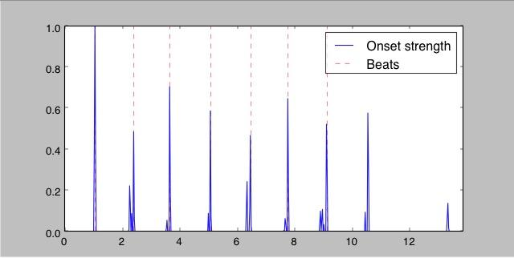
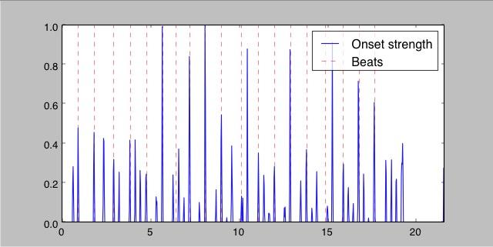
Library Functionality:
libROSA (used for beat detection)
librosa.beat.beat_track(y=None, sr=22050, onset_envelope=None, hop_length=512, start_bpm=120.0, tightness=100, trim=True, bpm=None, units='frames')
This method returns the tempo and the beats for an audio signal. It operates on three stages:
Measure onset strength
Estimate tempo from onset correlation
Pick peaks in onset strength that are coherent with tempo detected
After determining the onset envelope it is possible to determine the times in seconds at which onsets occur by using the frames_to_time method.
LibROSA’s handles simple inputs with ease. Every beat corresponds to a peak onset. However, some peak onsets are not detected.
In cases of more complex inputs, LibROSA shows even more inconsistencies with determining the beats from onsets.

Slide 11
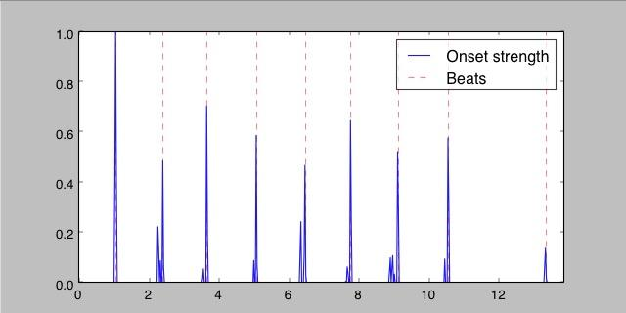
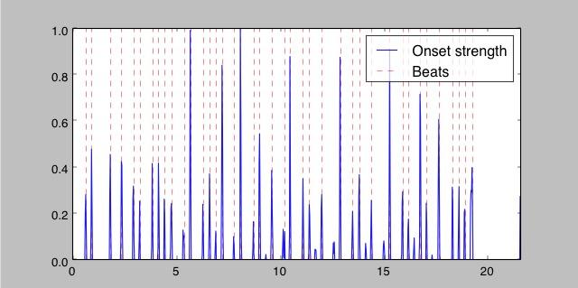
Rhythmic Analysis
def track_beats(y, sr, UI_onset, UI_dynamic, UI_window):
print "...Tracking onsets"
onset_env = librosa.onset.onset_strength(y=y, sr=sr, aggregate=np.median);
onsets = librosa.util.normalize(onset_env)
times = librosa.frames_to_time(np.arange(len(onsets)));
tempo = librosa.beat.beat_track(y=y, sr=sr);
msec_tempo = 60/tempo[0]
beats = []
for i in range(1, len(onsets)-1): #PEAK PICKING
if ((onsets[i] > onsets[i-1] and onsets[i] > onsets[i+1]) and onsets[i] > UI_onset):
beats.append(i)
i = 1; j = 0;
while (i < len(times[beats])):
beat_length = times[beats][i]-times[beats][j]
if(beat_length < UI_window):
if(times[beats][j] < times[beats][i]):
del beats[j]
else:
del beats[i]
i += 1; j += 1
i += 1; j += 1
volume = onsets[beats]*UI_dynamic*127
return onsets, beats, volume, times, tempo, msec_tempo
Our implementation uses libROSA’s onset detection and a user defined onset threshold to determine beats corresponding to all onsets
Our implementation handles more complex inputs correctly so that every onset beat is detected

Slide 12
Library Functionality:
frame : 0 | chord : G | startTime : 0.00000 | endTime : 0.37152
frame : 1 | chord : G | startTime : 0.37152 | endTime : 0.74304
frame : 2 | chord : G | startTime : 0.74304 | endTime : 1.11456
frame : 3 | chord : G | startTime : 1.11456 | endTime : 1.48608
frame : 4 | chord : G | startTime : 1.48608 | endTime : 1.85760
frame : 5 | chord : G | startTime : 1.85760 | endTime : 2.22912
frame : 6 | chord : C | startTime : 2.22912 | endTime : 2.60063
frame : 7 | chord : C | startTime : 2.60063 | endTime : 2.97215
frame : 8 | chord : G | startTime : 2.97215 | endTime : 3.34367
frame : 9 | chord : G | startTime : 3.34367 | endTime : 3.71519
...
PyMIR (used for chord detection)
chroma(spectrum) and getChord(chroma)
The Pitch.py module contains a method that computes the chroma from the spectrum.
chroma(spectrum) computes a chroma vector from the spectrum of a frame of samples.
The frequencies found in the spectrum are converted into MIDI values. The magnitudes for each frequency bin are added to one of 12 pitch classes. The vectors are normalized and divided by the highest value, so that the vector contains numbers between 0 and 1.
The Pitch.py module contains a dictionary of 24 chord profiles, each with a representative chroma vector. These vectors are binary. For example, the key of C minor has the following vector in its profile: [1,0,0,1,0,0,0,1,0,0,0,0].
getChord(chroma) predicts a chord from the list by comparing its chroma vector with the estimated vector.
Cosine similarity is used to determine which vector among the 24 chord profiles is most similar. Cosine similarity is expressed as the division of the dot product of the vectors, by the multiplication of their magnitudes.

Slide 13
Harmonic Analysis
def get_chords(input_file, beat_times, times):
print "...Predicting chords"
audiofile = pymir.AudioFile.open(input_file);
t = len(audiofile)/times[-1]
bt = [int(round(x*t, 3)) for x in beat_times]
frames = audiofile.framesFromOnsets(bt)
chords = []; startTimes = []; endTimes = [];
numFrames = 0; frameIndex = 0; startIndex = 0;
for frame in frames:
spectrum = frame.spectrum();
chroma = spectrum.chroma();
chord, score = pymir.Pitch.getChord(chroma);
chords = np.append(chords, chord);
endIndex = startIndex + len(frame);
startTimes = np.append(startTimes, beat_times[frameIndex]);
if ((frameIndex+1)==len(beat_times)):
endTimes = np.append(endTimes, times[-1]);
else:
endTimes = np.append(endTimes, beat_times[frameIndex+1]);
frameIndex = frameIndex + 1
startIndex = startIndex + len(frame)
return chords, startTimes, endTimes, frameIndex
def determine_durations(chords, startTimes, endTimes, frameIndex, volume):
i = 1; j = 0;
while (i < len(chords)):
if (chords[i] == chords[j]):
if (volume[i] > volume[j]):
volume = np.delete(volume, j)
else:
volume = np.delete(volume, i)
chords = np.delete(chords, i)
startTimes = np.delete(startTimes, i)
endTimes = np.delete(endTimes, j)
frameIndex -= 1
i -= 1; j -= 1
i += 1; j += 1
return chords, startTimes, endTimes, frameIndex, volume
frame : 1 | chord : G | startTime : 0.92880 | endTime : 2.36844
frame : 2 | chord : C | startTime : 2.36844 | endTime : 2.94893
frame : 3 | chord : G | startTime : 2.94893 | endTime : 6.91955
frame : 4 | chord : Gm | startTime : 6.91955 | endTime : 7.22141
frame : 5 | chord : D | startTime : 7.22141 | endTime : 9.61306
frame : 6 | chord : G | startTime : 9.61306 | endTime : 12.02794
frame : 7 | chord : C | startTime : 12.02794 | endTime : 12.91029
frame : 8 | chord : G | startTime : 12.91029 | endTime : 16.76481
frame : 9 | chord : D | startTime : 16.76481 | endTime : 18.92426
frame : 10 | chord : G | startTime : 18.92426 | endTime : 21.59456

Slide 14
Library Functionality:
MIDIUtil (used for MIDI file creation)
midiutil.MIDIFile(numberOfTracks) - creates a MIDI file object with a specified number of tracks.
MIDIFile.addNote(track, channel, noteNumber, time, duration, volume) - adds a MIDI note, to a specific channel/track, at a specified time. (Can also supply the volume and duration of the note).
MIDIFile.writeFile(filename) - writes all the information to a MIDI file with a specified name
MIDIUtil is able to take information in a certain format and from it create a midi file with events in time.
MIDIUtil requires that the information to be written follows a certain format. To write the file the data generated (the notes in the accompaniment) must be organized into arrays of durations, volumes and notes.
In order to specify chords to be written in the midi file, a chord list of 24 root position chords were created. Each chord consists of a list of three MIDI numbers. This simplifies the process, instead of supplying one note at a time.

Slide 15
MIDI File Generation
degrees = [60, 62, 64, 65, 67, 69, 71, 72] # MIDI note number
track = 0
channel = 0
time = 0 # In beats
duration = 1 # In beats
tempo = 60 # In BPM
volume = 100 # 0-127, as per the MIDI standard
MyMIDI = MIDIFile(1) # One track
MyMIDI.addTempo(track, time, tempo)
for i, pitch in enumerate(degrees):
MyMIDI.addNote(track, channel, pitch, time + i, duration, volume)
with open("major-scale.mid", "wb") as output_file:
MyMIDI.writeFile(output_file)
def write_midi_file(filename, midi_tracks, program, duration, tempo, volume):
print "...Writing MIDI file"
MyMIDI = midiutil.MIDIFile(len(midi_tracks))
time = 0;
channel = 1
for i in range(len(midi_tracks)):
MyMIDI.addTempo(track=i+1, time=time, tempo=tempo)
MyMIDI.addProgramChange(track=i+1, channel=channel-1, time=time, program=program[i])
d = duration[i]; v = volume[i]
for j, midi_note in enumerate(midi_tracks[i]):
for k in range(len(midi_note)):
MyMIDI.addNote(i, channel-1, midi_note[k], time, d[j], v[j])
time = sum(d[:j+1])
time = 0
with open(filename[:-4]+"_accompaniment.mid", "wb") as output_file:
MyMIDI.writeFile(output_file)

Slide 16
Plans for the future

Slide 17
Worst Case (now)
Let's start with the negative, so we can go to the positive later…
Our program successfully detects beats and chords, and can produce MIDI file accompaniments to match the input but all inputs must be in 4/4 time and cannot be very complex rhythmically.
Program runs from the command line, accepting user input controls to specify the onset threshold, dynamic threshold, beat window size, beat pattern, and accompaniment instruments. The accompaniments lack complexity and if they are not desired, these user input controls must be adjusted manually.
Harmonic accompaniment consists only of root position chords that are determined from the chords/single pitches detected in the signal. The resulting harmonies add a simple texture but do not follow common standards for harmonic accompaniment
Percussive accompaniment has very few patterns to choose from (more will be added) and these patterns conform to 4/4 time.

Slide 18
Base Case
Getting better…
The program still runs from the command line (no GUI), but now (along with outputting a MIDI file) the program plays an excerpt of the accompaniment with the input audio so that the user can sample the accompaniment before proceeding to creating the file. If it is not a desired accompaniment, the user can alter parameters until the correct sound is achieved
Generated MIDI accompaniments are consistent with all (common) time signatures of a given input signal
User input controls are slowly becoming more refined, giving more options for beat patterns and instrument choice, as well as being able to be adjusted concurrently
The progressions that are chosen for the melodic and harmonic accompaniments are now selected as they relate to the detected input chord/pitch. This would likely involve a similarity matrix or a clustering algorithm

Slide 19
Best Case
This would be great …
A GUI has been created that is intuitive for the user (facilitates interaction).
The system has a plugin that can be used from within a DAW.
The MIDI tracks generated are complex and dynamic but provide meaningful accompaniments for the input signal.
Users can fine-tune the controls to effect rhythmic and harmonic detection as well as for the generation of MIDI accompaniments based on the information extracted. This could be accomplished using a combination of Hidden Markov Models and cosine similarity of chroma vectors. The outputs would be compared and the best output will be chosen (would involve the creation of a set of rules that lets us decide which of the two to output in each case).
The plugin is sold to a huge company that gives us millions of dollars.

Slide 20
How would the system look in a DAW?

Slide 21
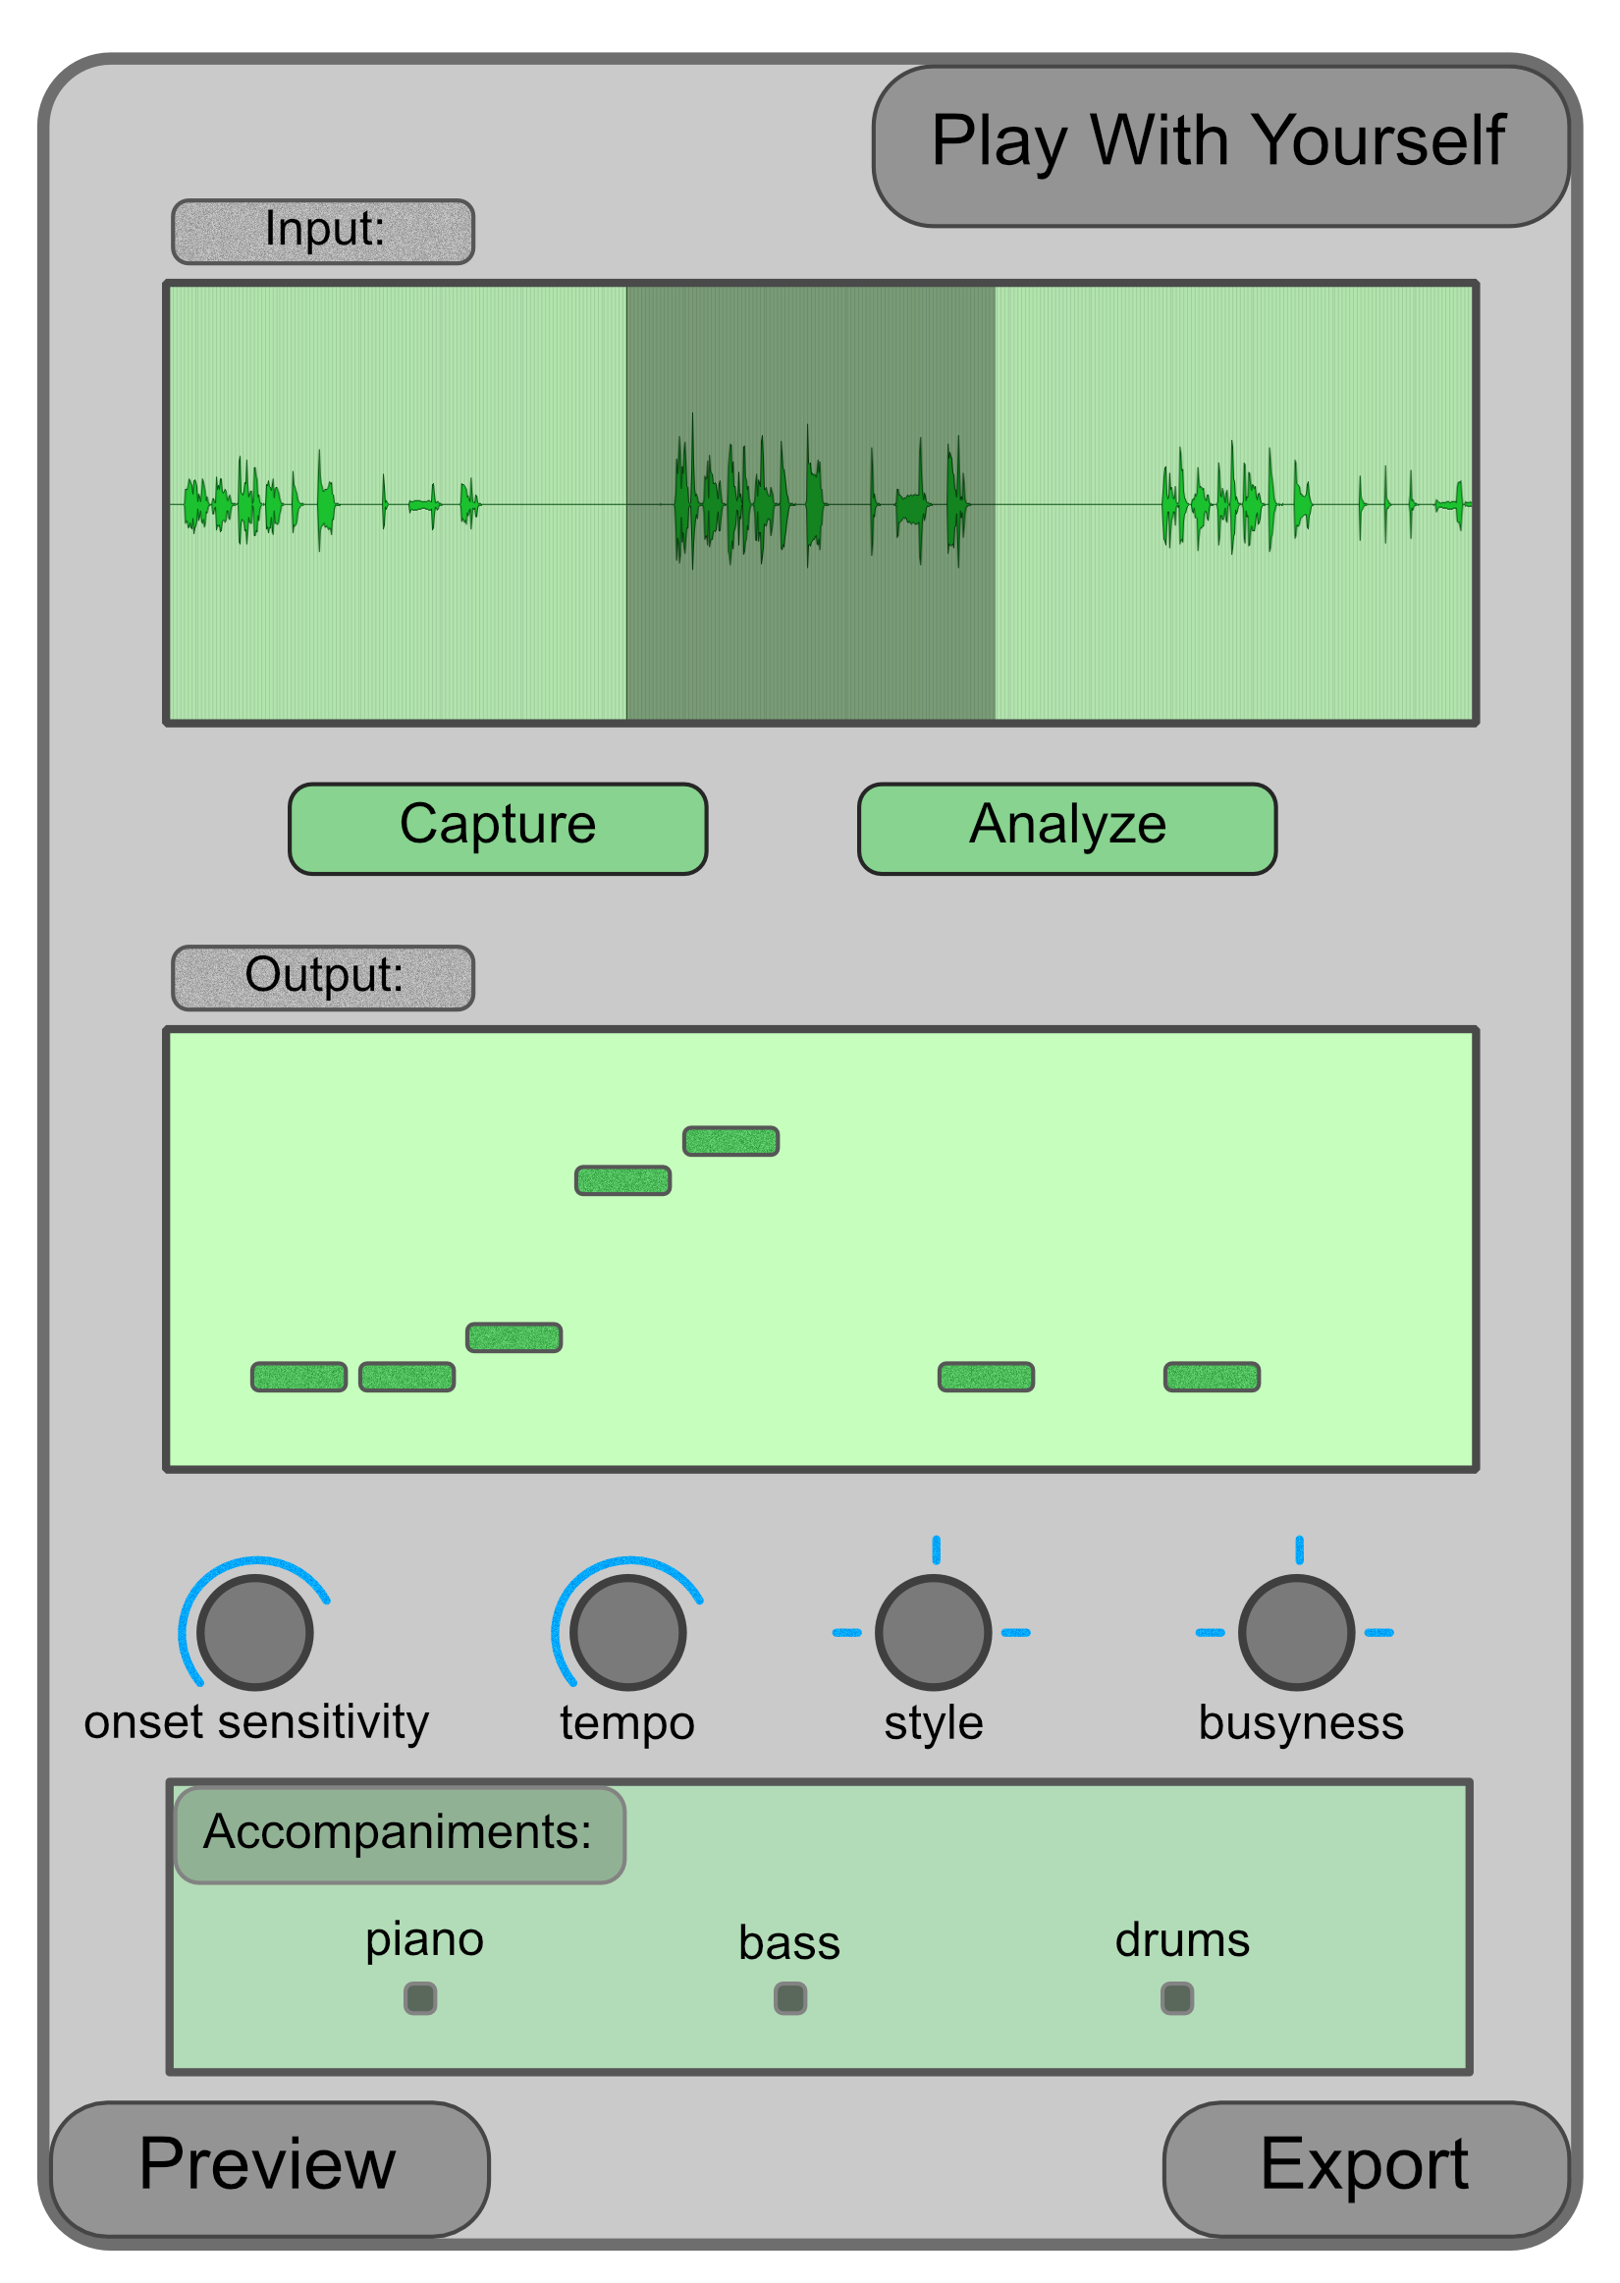
Play With Yourself ™
as a Plugin
As a plugin in any standard DAW, the user would be able to :
Select portions of the audio track to analyze and accompany
Set sensitivity levels for analysis
Set output parameters such as style, busyness, and select accompaniment instruments

Slide 22
Conclusion
This problem was different from real-time automatic accompaniment generation.
Approaching the problem of non-real time automatic accompaniment, we managed to create a simple accompaniment for a musical audio signal.
We focused on a baseline for the project which dealt with musical excerpts in 4/4 meter with easily identifiable rhythmic patterns.
The current implementation permits a number of parameters that will allow users to tailor the accompaniment generated to their liking.
Play With Yourself will be a useful, time-saving tool for musicians. And after all, if you can’t play with others, Play With Yourself ™*.
*Patent pending.

