Slide 1
Secure Data Hiding In Images Using Steganography
CAPSTONE PROJECT
Presented By:
Student Name : ADARI GUNA KAUSHIK
College Name & Department : ADITYA DEGREE COLLEGE && BSC AI

Slide 2
OUTLINE
Problem Statement
Technology used
Wow factor
End users
Result
Conclusion
Git-hub Link
Future scope

Slide 3
Problem Statement
With increasing cyber threats, protecting sensitive data is crucial. Encryption alone makes hidden messages obvious, raising suspicion. Steganography provides a way to conceal secret information within images, making it undetectable to unauthorized users. This project focuses on using Least Significant Bit (LSB) substitution, Discrete Cosine Transform (DCT), and Discrete Wavelet Transform (DWT) methods to ensure secure and robust data hiding while maintaining image quality.

Slide 4
Technology used
Programming Language– Python
Image Processing – OpenCV, PIL
Steganographic Methods– LSB, DCT, DWT
Cryptography – AES, RSA for encryption
GUI Development – Tkinter
Storage – SQLite, File system
Security & Testing – StegExpose for steganalysis

Slide 5
Wow factors
Undetectable Data Hiding – Concealed messages remain invisible to the human eye.
Hybrid Security Approach – Uses both encryption and steganography for double protection.
Resilient to Modifications– Data remains intact even after compression or resizing.
Multiple Steganographic Techniques – Users can select between LSB, DCT, and DWT methods.
AI-Assisted Security– Implements deep learning techniques to detect and prevent steganalysis attacks.

Slide 6
End users
Government & Defense– Secure transmission of classified information.
Journalists & Activists– Protect sensitive data from surveillance.
Businesses & Corporations– Safeguard confidential corporate data.
Individuals– Enables private messaging and digital watermarking for copyrights.

Slide 7
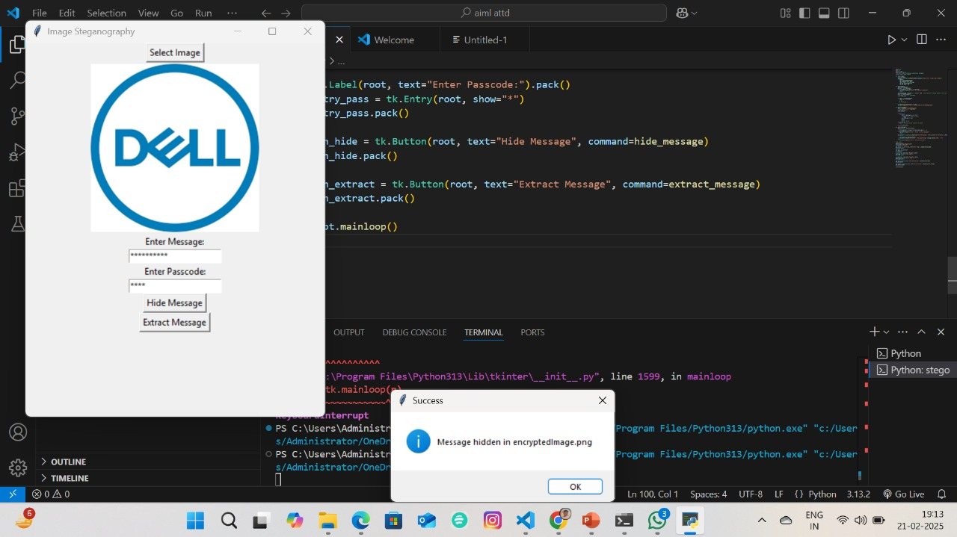
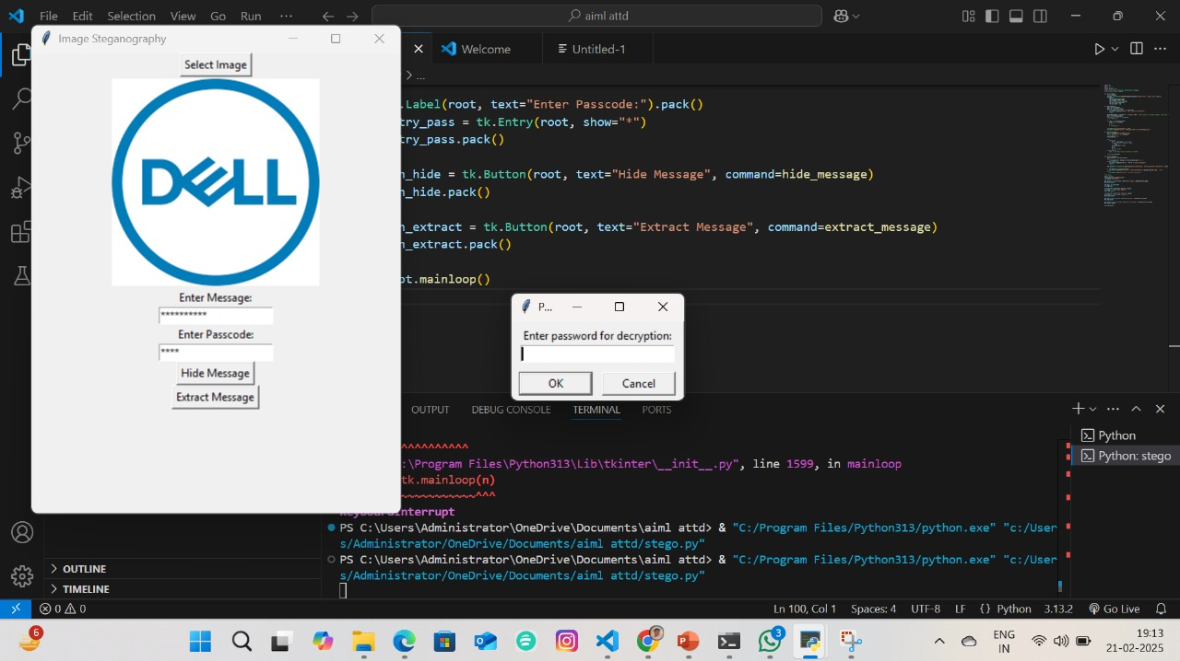
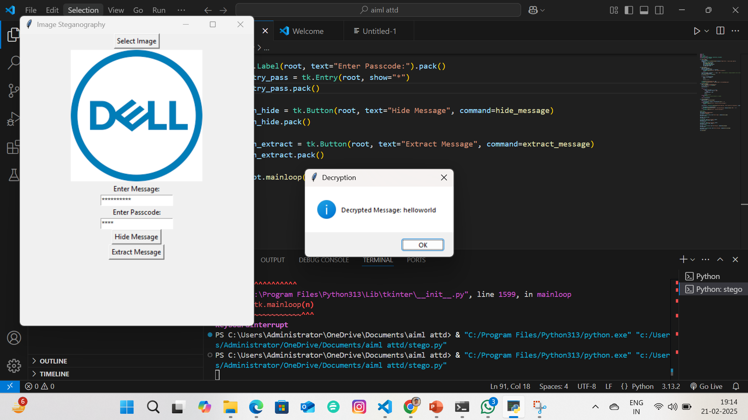
Results
.

Slide 8
Conclusion
Steganography is an effective method for covert communication by embedding secret messages within images. This project successfully implements LSB, DCT, and DWT methods to enhance data security. Future advancements may include AI-powered steganalysis resistance, real-time encryption, and cloud-based implementations.

Slide 9
GitHub Link
https://github.com/adarigunakaushik2905/Secure-Data-Hiding-in-Images-Using-Steganography.git

Slide 10
Future scope(optional)
AI-Powered Steganalysis Resistance– Improve security by detecting and countering advanced threats.
Web & Mobile Implementation– Expand usability for secure communication across devices.
Blockchain Integration– Ensure data authenticity and traceability for sensitive communications.
Performance Optimization – Reduce computational load for real-time steganographic applications.

Slide 11
THANK YOU

