Slide 1
Data-Driven Diversity: Exploring Inclusivity in UK Job Ads
A Story of Inclusive Hiring

Slide 2
Executive Summary
Using Develop Diverse software we analysed each job posting for inclusivity scores in various groups, including gender, age, ethnicity etc.
Our analysis of 5000 UK job ads provides significant insights into the degree of inclusivity in recruitment practices.
Specifically, we found that certain groups such as women, neurodivergent and people with disabilities were overlooked in job ads.
In conclusion, our findings underscore the importance of inclusive recruitment policies and offer valuable insights for companies looking to improve their hiring strategies.

Slide 3
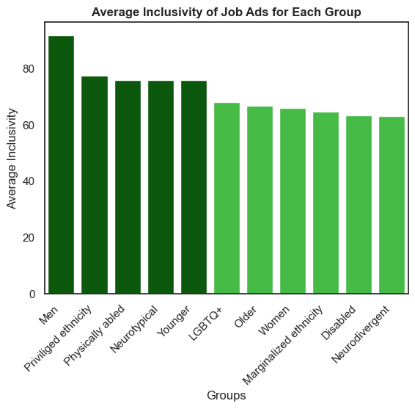
How Analyzing Job Posting Inclusivity Revealed Vital Lessons for Companies: Insights from Data and My Personal Journey. (1/3)
Data Does Not Lie: Men are Overwhelmingly Privileged Group.
Women Lag Behind LGBTQ+ and Older Workers in Inclusivity of Job Postings.
Chart Reveals Harsh Reality: Disabled and Neurodivergent Groups Facing Highest Exclusivity from Ads.

Slide 4
How Analyzing Job Posting Inclusivity Revealed Vital Lessons for Companies: Insights from Data and My Personal Journey. (2/3)
How Inclusive Are You? Adding Marks to the Groups You Belong to.
What is Your Place in a World of Privilege and Marginalization?
What This Chart Taught Me About My Personal Journey: Insights and Reflections.

Slide 5
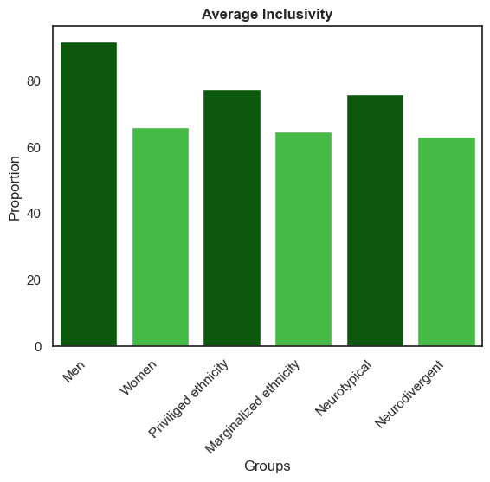
How Analyzing Job Posting Inclusivity Revealed Vital Lessons for Companies: Insights from Data and My Personal Journey. (3/3)
Zooming in On Three Disadvantaged Groups: A Thought-Provoking Perspective for Companies.
What Sets These Groups Apart in Today’s Reality Backed by Evidence?
Challenging Companies with Unconventional Questions That Hold the Key to Inclusion.

Slide 6
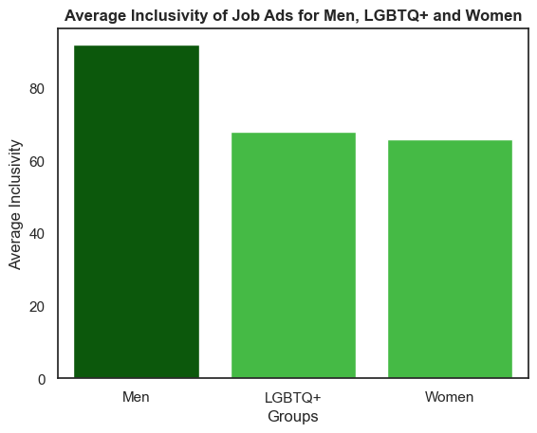
Cracking the Inclusivity Code: Discovering the Most and Least Inclusive Job Categories for Women and Reasons Why. (1/3)
The Inclusivity Score for the LGBTQ+ Community is Higher than that of Women. Why?
More Straightforward Linguistic Patterns.
Increased Awareness and Focus on LGBTQ+ Rights and Inclusivity in the Workplace.

Slide 7
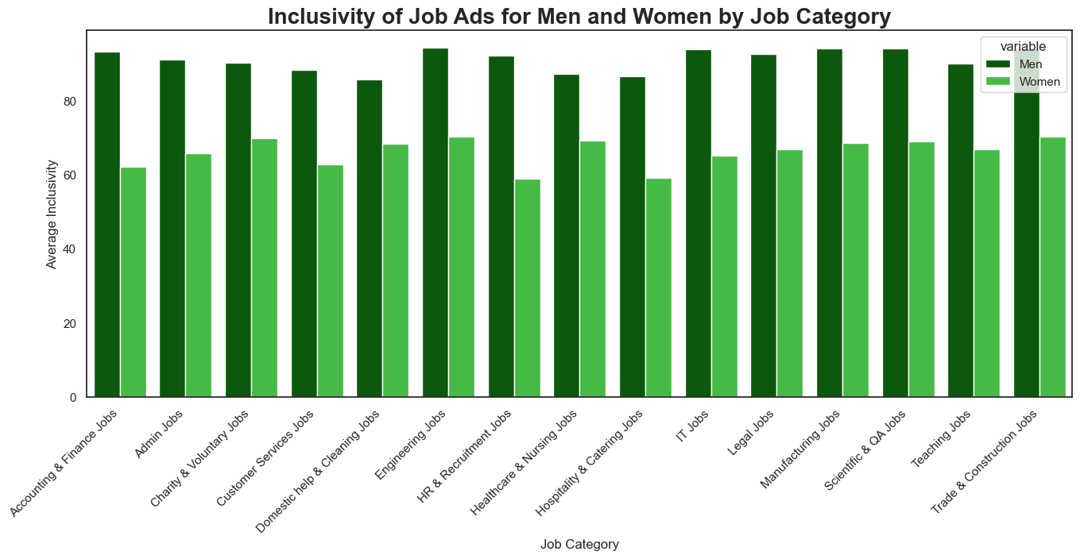
Cracking the Inclusivity Code: Discovering the Most and Least Inclusive Job Categories for Women and the Reasons Why. (2/3)
Gender Stereotypes in Job Sectors vs. Inclusive Language in Job Ads: Insights from Female-Dominated Fields.
Gender Bias: A Common Factor in Inclusive Language Across Job Sectors?
Job Distribution Impact on Gender Bias in Ads?

Slide 8
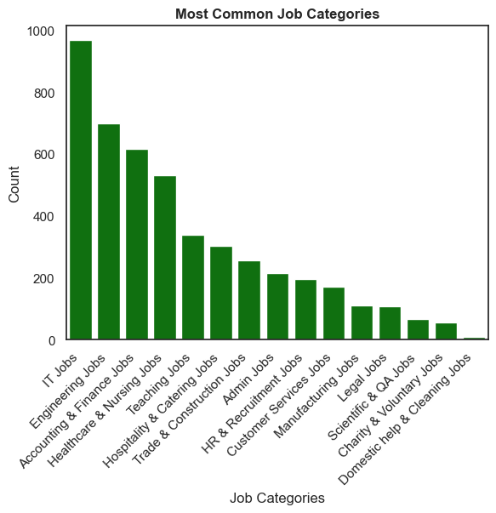
Cracking the Inclusivity Code: Discovering the Most and Least Inclusive Job Categories for Women and Reasons Why. (3/3)
Explaining the Inclusivity Disparity: Is it Simply Due to More Job Ads in Male-Dominated Fields?
IT and Engineering: The Job Sectors that Rule Them All?

Slide 9
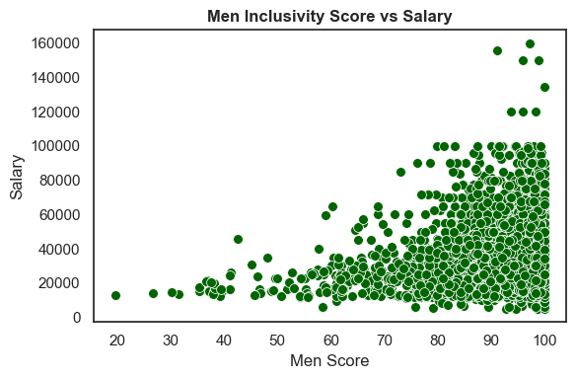
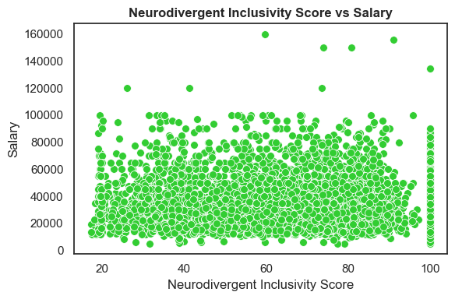
Breaking the Glass Ceiling: Revealing How Salary Impact Inclusivity Scores for Different Groups in Job Ads.
Men on Top: High Paying Jobs Remain Inclusive to Them.
Beyond Salary: Neurodivergent Individuals Excluded from Job Opportunities.

Slide 10

Thank You.

