Slide 1
ROAD ACCIDENT
ANALYSIS
Where, when and under what conditions people are being hurt on the road
Dashboard findings | Current Year 2022 vs Previous Year 2021
Source: MAINDATA.xlsx and CALENDER.xlsx
Notes:
Introduce the dashboard and the analysis report behind it. Everything here compares CY 2022 with PY 2021.

Slide 2
Casualties fell, but the picture is more nuanced than the headline
-11.9%
vs -5.7%
1.47%
to 1.07%
65%
3.83%
Casualties: dashboard vs like-for-like
Fatal-accident rate, 2021 to 2022
of fatal accidents happen on rural roads (35% of all accidents)
fatal rate on unlit dark roads, 4.3x daylight
Urban and commuter-hour roads generate the volume; rural, high-speed, dark and weekend roads generate the deaths. Targeted action there will do more than a blanket campaign.
Road Accident Analysis | CY 2022 vs PY 2021
2
Notes:
Four numbers to remember. The headline fall is overstated by missing Scottish records, severity did improve, and the danger is concentrated in specific conditions.

Slide 3
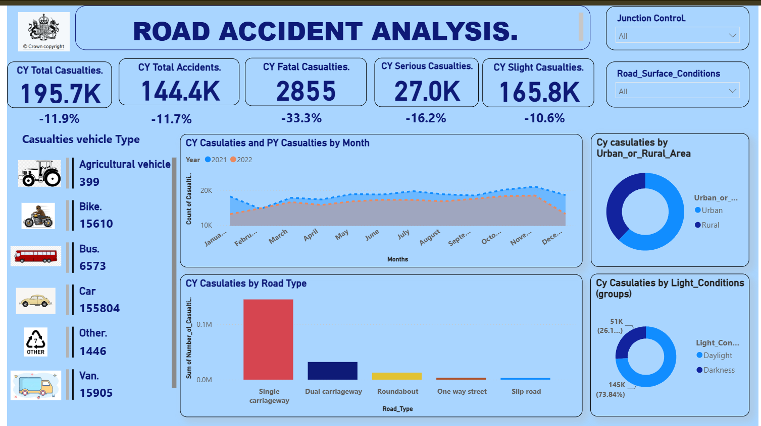
The dashboard and the data behind it
MAINDATA: 307,973 accidents x 24 columns, 1 Jan 2021 to 31 Dec 2022
CALENDER: 730 daily rows; defines CY (2022) and PY (2021)
Star model: one date table to one fact table
Dynamic CY/PY measures, no hard-coded years
Five KPI cards, vehicle cards, area, column and donut charts, two slicers
Every card and chart was recomputed from the raw data and matches.
Road Accident Analysis | CY 2022 vs PY 2021
3
Notes:
Star model: CALENDER[Date] one-to-many to MAINDATA[Accident Date]. CY is the latest year in the calendar and PY the year before, so the measures roll forward on refresh.

Slide 4
About half of the headline drop is a data-coverage effect
55%
of the 26,409 fewer casualties come from missing Scottish records
11,537 to 292
accidents from eight Scottish forces, 2021 to 2022
1.45% to 1.07%
like-for-like fatal-accident rate: the safety gain is real
* Casualties in fatal-severity accidents, not only deaths
Road Accident Analysis | CY 2022 vs PY 2021
4
Notes:
Eight Scottish police-force areas have 11,537 accidents in 2021 but only 292 in 2022. They account for 14,599 of the 26,409 fewer casualties. The fatal-accident rate still improved, so the safety gain is real.

Slide 5
Bus and coach is the only vehicle group getting worse
+26.1%
Bus and coach casualties, like-for-like (5,210 to 6,570)
79.6%
of casualties are in cars; 82.8% of the fall
Indicative only: each accident credits casualties to one vehicle type, and "Bike" is almost all motorcycles (26 pedal-cycle records).
Road Accident Analysis | CY 2022 vs PY 2021
5
Notes:
Cars are 79.6% of casualties and drove 82.8% of the fall. Bus and coach casualties rose 5.6% as shown and 26.1% like-for-like (5,210 to 6,570). Caution: each accident carries one Vehicle_Type, and Bike is almost all motorcycles.

Slide 6
Volume peaks in Oct-Nov; Jan and Dec fell furthest
-28% / -29%
January and December 2022
Still -23% and -24% like-for-like, so Scotland does not explain it
December 2022: about 310 accidents a day vs 454 in November
Worth confirming with the data owner
Road Accident Analysis | CY 2022 vs PY 2021
6
Notes:
January (-28%) and December (-29%) 2022 are not explained by Scotland (still -23% and -24% like-for-like). December 2022 averages about 310 accidents a day against 454 in November. Confirm with the data owner.

Slide 7
Urban is a volume problem; rural is a severity problem
2.00%
fatal-accident rate on rural roads
0.57%
fatal-accident rate on urban roads
3.5x
rural is 3.5 times as deadly per accident; urban still has 61.9% of casualties
Road Accident Analysis | CY 2022 vs PY 2021
7
Notes:
Urban carries 61.9% of casualties, rural 38.1%. But rural roads hold 34.9% of accidents and 65.2% of fatal accidents: a 2.00% fatal rate against 0.57% urban, 3.5 times higher.

Slide 8
Fast roads and dual carriageways are most severe
14.4% to 35.4%
20.3% to 49.6%
60 mph roads: share of accidents vs share of fatal accidents
Rural 60/70 mph roads: accidents vs fatal accidents
Road Accident Analysis | CY 2022 vs PY 2021
8
Notes:
60 mph roads are 14.4% of accidents but 35.4% of fatal accidents (2.65% fatal rate, 5x the 30 mph rate). Rural roads with a 60 or 70 mph limit are 20.3% of accidents but 49.6% of fatal accidents. No traffic-volume data exists to compute risk per mile.

Slide 9
Dark roads, late nights and weekends are deadlier
3.83%
fatal rate on unlit dark roads (4.3x daylight)
3.52% vs 0.57%
fatal rate at 02:00 vs 08:00
Sunday
quietest day but most severe: 1.76% fatal rate. Friday is busiest (23,863)
Road Accident Analysis | CY 2022 vs PY 2021
9
Notes:
Unlit darkness has a 3.83% fatal rate, 4.3 times daylight. Lit night driving (1.06%) is barely riskier than daylight. Fatal rate is lowest at 08:00 (0.57%) and highest at 02:00 (3.52%). Friday is busiest (23,863 accidents); Sunday is quietest but most severe (1.76% fatal rate).

Slide 10
Wintry conditions rose; wet and foggy fell
+89%
+42%
Snow surface
Frost or ice
-15%
-6%
Wet or damp
Dry
Severity did not rise: 0.68% fatal rate on snow vs 1.08% on dry roads, consistent with drivers slowing down.
Road Accident Analysis | CY 2022 vs PY 2021
10
Notes:
Most casualties happen in benign conditions (67.4% dry, 80.0% fine weather). Frost/ice casualties rose 29% (42% like-for-like) and snow 65% (89%), while wet-surface casualties fell 22%. Adverse conditions did not raise severity (fatal rate 0.68% on snow vs 1.08% dry), consistent with drivers slowing down.

Slide 11
Accidents away from junctions are the most severe
40.0%
48.3%
of casualties are away from junctions
at give-way or uncontrolled junctions
Geography
Metropolitan Police: 14.6% of casualties (28,557) but only a 0.52% fatal rate
Highest fatal rates are rural or semi-rural: South Oxfordshire 3.80%, North Kesteven 3.71%, Cherwell 3.37%
Counts are small (10 to 15 fatal accidents each)
Road Accident Analysis | CY 2022 vs PY 2021
11
Notes:
Two in five casualties (40.0%) happen away from junctions. Give way or uncontrolled junctions hold 48.3% of casualties. The Metropolitan Police area records 14.6% of casualties (28,557) but only a 0.52% fatal rate. Highest-rate authorities have small counts (10 to 15 fatal accidents).

Slide 12
Dashboard review: fix these before publishing
Issue | What we found | Suggested fix
Scottish coverage break | 11,537 accidents in 2021 vs 292 in 2022 from eight forces | Get the missing 2022 data, or add a Police_Force slicer and a coverage note
"Fatal Casualties" label | Counts all casualties in fatal accidents (2,855), not deaths | Rename it; add a fatal-accident-rate KPI (1.07%)
One vehicle per accident | Casualties credited to a single Vehicle_Type | Treat vehicle comparisons as indicative; add a vehicle-level table
"Others." junction bucket | 32% of casualties; 99.6% are "Not at junction" | Merge with "Not at junction or within 20 metres"
Chart design | Raw field names, axis starts near 10K, CY/PY vs 2021/2022 labels, unlabelled donut | Plain titles, zero-based axis, consistent CY/PY labels, data labels
Missing views | No time of day, day of week, speed limit, severity split or map | Add hour x weekday heatmap, speed-limit fatal rate and a map
Also: no traffic-volume (exposure) data, so rates are per accident, not per mile; only two years of history.
Road Accident Analysis | CY 2022 vs PY 2021
12
Notes:
The most important fix is the Scottish coverage gap: resolve it before publishing any year-on-year claims.

Slide 13
Recommendations: target where the deaths are
1
Rural 60/70 mph roads first
About half of fatal accidents in one-fifth of accidents: speed management, average-speed cameras, junction and bend treatments.
2
Manage unlit rural roads at night
Lighting, reflective studs and signage, or lower limits where lighting is not feasible.
3
Focus on 22:00-05:59 and weekends
Sat + Sun are 24% of accidents but 35% of fatal ones. Check causes against other sources first.
4
Prepare for winter; review bus and coach
Gritting and alerts; bus and coach is the only group with a rising trend (+26.1%).
5
Fix the analytics
Resolve the Scotland gap before YoY claims; add contributory factors and traffic exposure; extend beyond two years.
Road Accident Analysis | CY 2022 vs PY 2021
13
Notes:
The data has no contributory-factor field, so check causes against other sources before finalising night and weekend messaging.

Slide 14
Key takeaway
Urban and commuter-hour roads generate the volume; rural, high-speed, dark and weekend roads generate the deaths.
-5.7%
3.5x
4.3x
+26.1%
like-for-like casualty fall (not -11.9%)
rural fatal rate vs urban
unlit night fatal rate vs daylight
bus and coach casualties
Thank you | Questions?
Notes:
Close on the targeted-action message and the four numbers.

