Slide 1
ORIGIN'26
Team SixSeven | Project: Campus ERP
Problem Statement: PS-6: ERP-based Integrated Student Management System
Name | Registration Number
Parth Pancholi | 25BCE10443
Adarsh Pratap Singh | 25BCE10285
Disha Dashore | 25BAI10444
Deployment Link: https://team-sixseven-erp.vercel.app/

Slide 2
The Problem Statement (PS-6)
Disconnected Systems: Institutes run admissions, timetables, attendance, fees, exams and scores across disconnected spreadsheets, registers and paper trails.
No Single Source of Truth: The admin office, a faculty member and a student each see a different, often stale, picture of the same record.
Manual Overheads: Re-staffing a timetable when a teacher goes on leave is done by hand, class by class.
Data Drift: Marks are entered on paper before being typed into a spreadsheet, so grades and marks can silently disagree.
Financial Disconnect: Fee and fine balances are tracked separately from the ledger that produced them, so a due amount can drift from reality.
The Goal: One ERP where every number is always the live truth, not a cached guess.

Slide 3
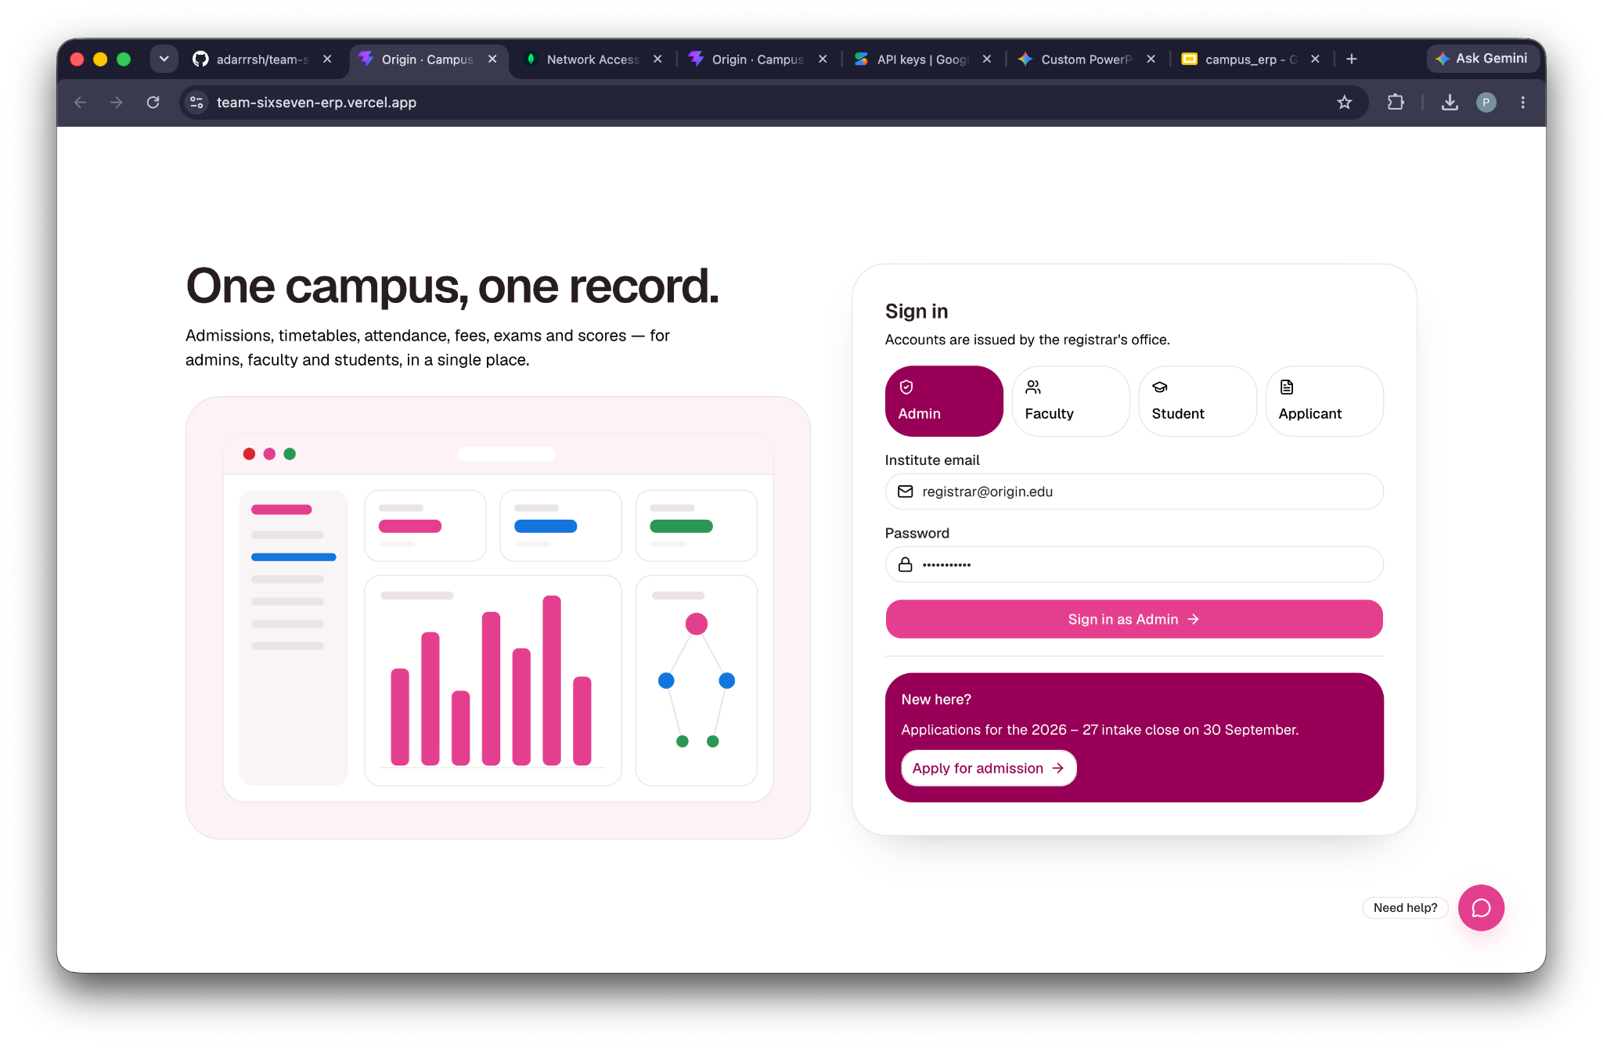
Proposed Solution
A single web application with four role-based interfaces — Admin, Faculty, Student, Applicant — all reading and writing the same MongoDB-backed API.
Nothing is hardcoded and nothing is pre-seeded: every figure (attendance %, fees due, grade, timetable slot) is computed live from the records that produced it.
A background consistency checker continuously verifies that every derived number still agrees with its source records.
A Gemini-powered chatbot on the login page guides new applicants through admission and sign-in.
Force-directed knowledge graphs visualise how courses, faculty and students actually connect.

Slide 4
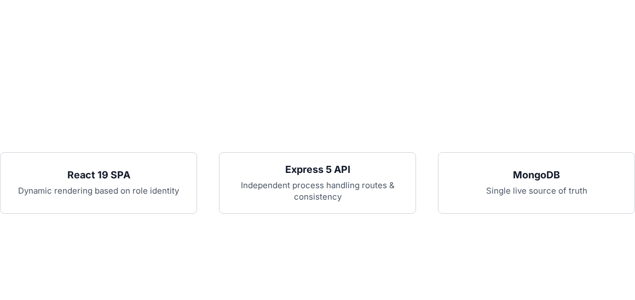
System Architecture
One Express 5 REST API under /api, backed by a single MongoDB database via Mongoose 9.
One React 19 single-page app, routed with React Router, that renders a different portal depending on which role signed in.
Session identity is resolved from the signed-in user, not a hardcoded constant — the same component renders correctly for whichever student or faculty member is logged in.
Backend and frontend are two independent processes joined only by the API base URL, so either can be redeployed without touching the other.
A checkConsistency() audit function in the backend scans every collection and flags any figure that no longer matches its source.

Slide 5



Tech Stack
Frontend
Backend
Data Strategy
React 19, React Router, Vite, Tailwind CSS v4, shadcn/ui, Framer Motion, React Flow (org chart), react-force-graph-2d (knowledge graphs).
Node.js, Express 5, MongoDB, Mongoose 9, Google Gemini API (chatbot), and Node's built-in test runner (node --test) for automated testing.
No seed script. The database starts empty and every record is created through the app itself, keeping the demo data identical to what a real deployment would look like.
Includes xlsx for spreadsheet export

Slide 6
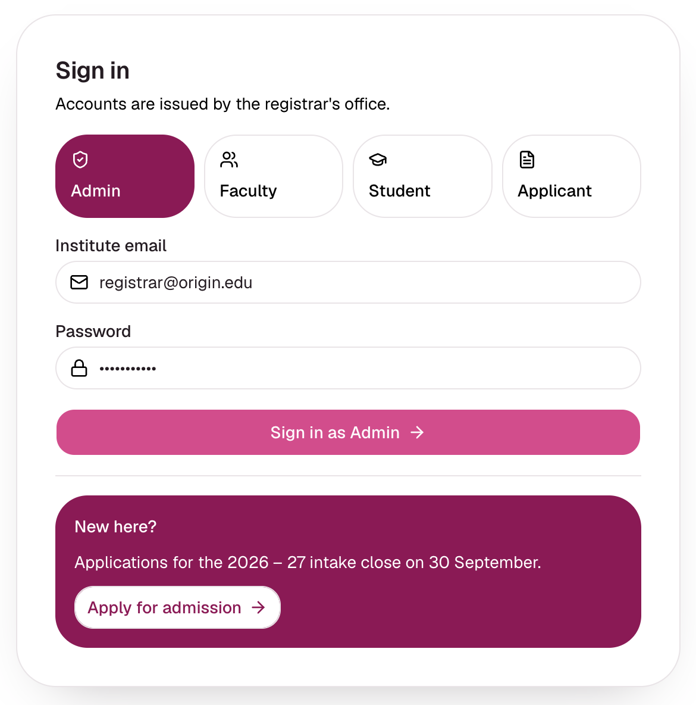
Login & Role-Based Access
One login page serving four portals — Admin, Faculty, Student, Applicant — selected with a single toggle.
The backend, not the frontend, decides which portal an account belongs to, so a faculty login can never land on the admin console.
Session state persists in the browser so a refresh keeps the same signed-in identity.
The same page carries the AI admissions chatbot for anyone who isn't sure how to apply or sign in.
"Apply for admission" links straight into the applicant flow for new users.

Slide 7
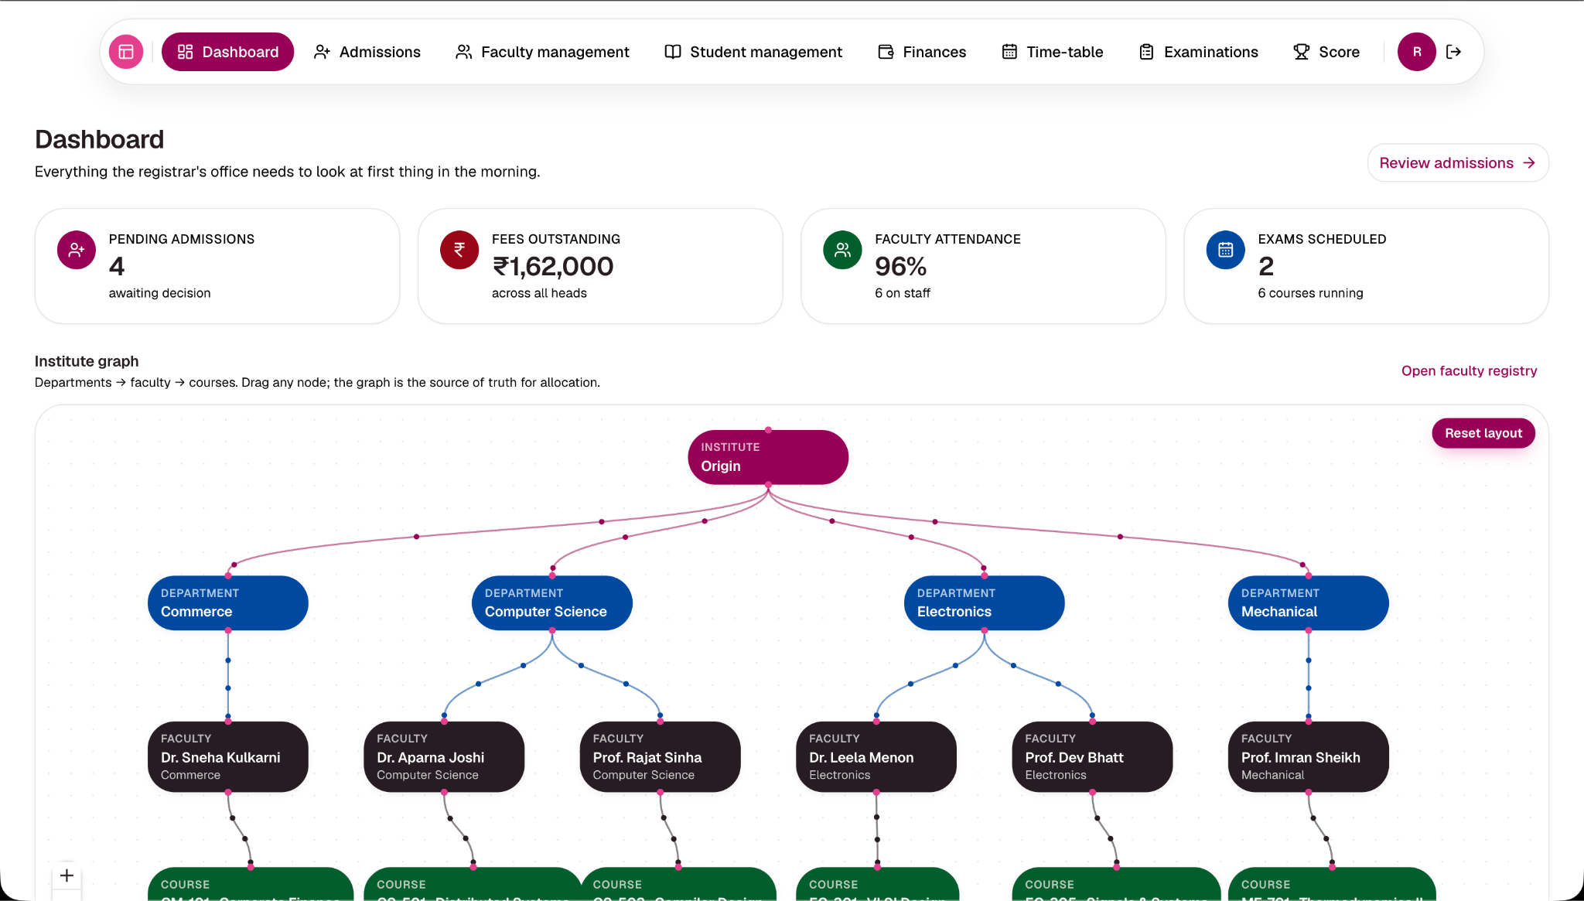
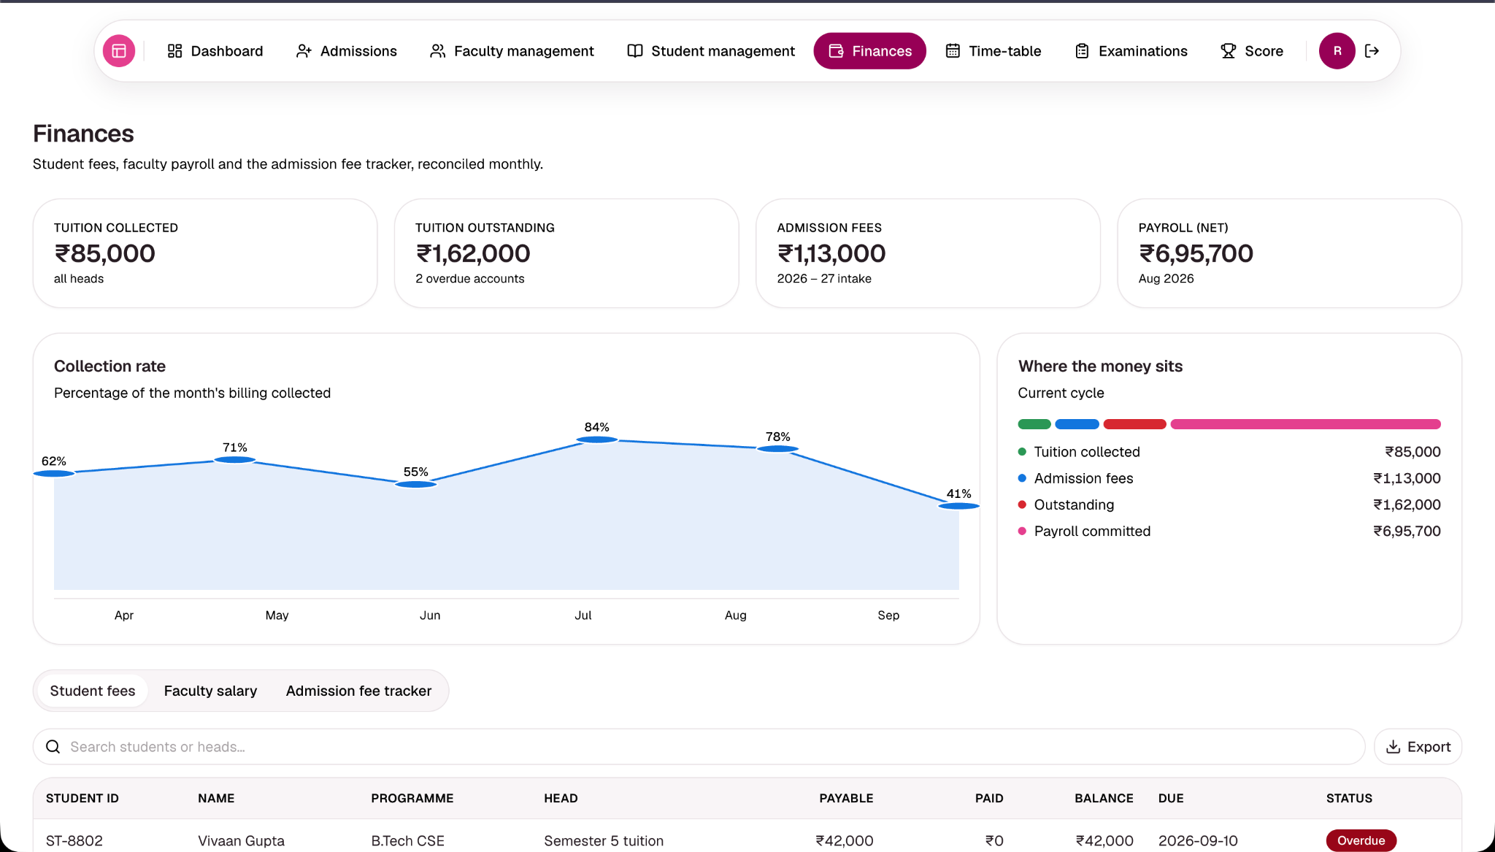
Admin Portal: Dashboard & Organisation
Export to .csv / .xlsx Every data table on every admin page can be exported directly to a spreadsheet with a single click.
Institute-wide dashboard: live counts of students, faculty and departments straight from the database (currently 9 students, 6 faculty, across 4 departments).
A React Flow organisation chart lays out the institute's actual department and reporting structure.
Departmental breakdowns and enrolment charts replace what used to be a static summary page.

Slide 8
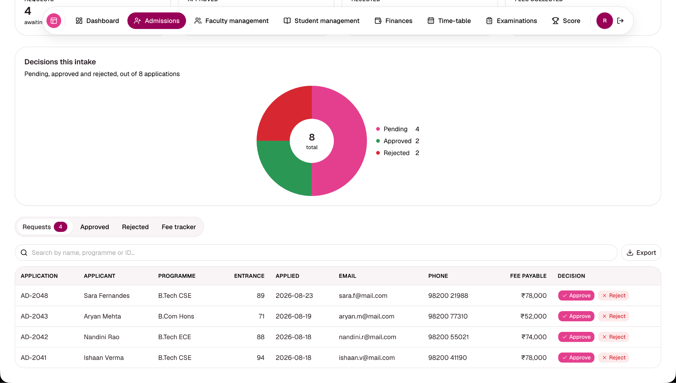
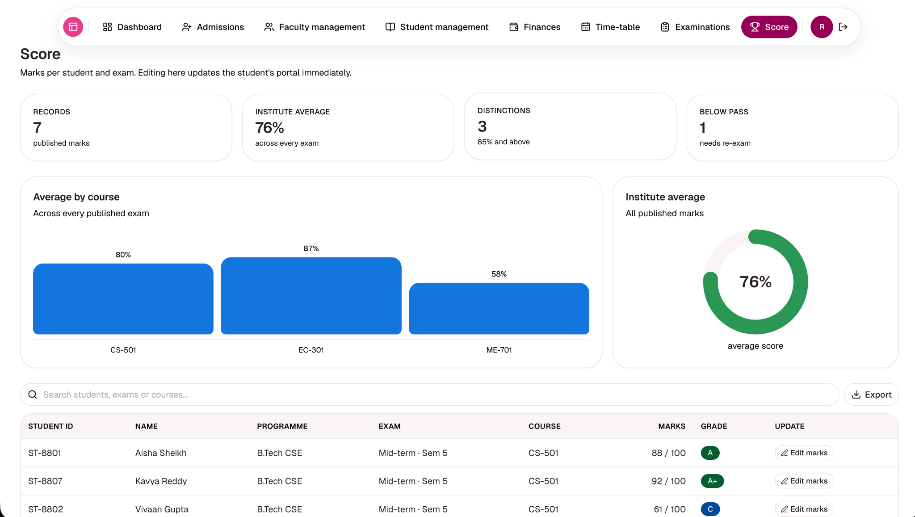
Admin Portal: Admissions, Finance & Scores
Admissions pipeline: Review an application, approve/reject it, and collect the seat fee — approval and payment together issue the student a login.
Finance dashboards: Cover tuition collection, admission fees and payroll, each broken down by chart rather than a single number.
Score overview: Aggregates every published exam result across departments and courses.
A background job flags any paid admission that never resulted in an enrolled student, preventing lost payments.

Slide 9
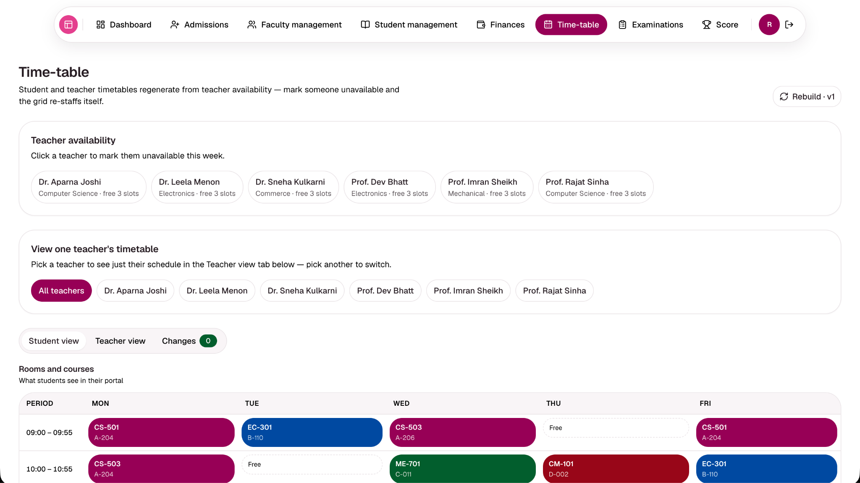
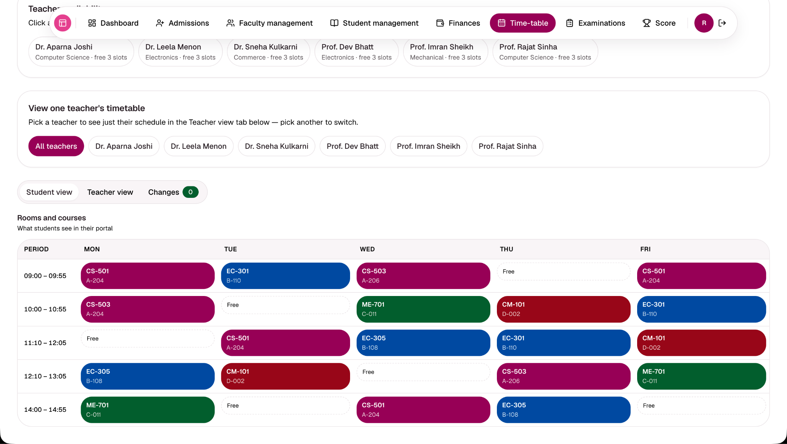
Admin Portal: Timetable Management
Shared Grid: A single shared timetable grid — the exact same data students and faculty see, not a separate copy per role.
Single-Teacher View: Admins can pick one teacher at a time to see just their schedule, highlighted against the full grid.
Automatic Re-staffing: Marking a teacher unavailable (or leave approved) automatically re-staffs their slots to a free colleague at read time.
Audit Trail: A "Changes" tab lists every reassignment made, flagging any slot that could not be covered as "Needs cover".
Versioning: The rebuild versions the timetable (v1, v2) so admins can see when it last regenerated.
Seamless Recovery: A returning teacher automatically gets their own slots back — nothing is permanently overwritten.

Slide 10
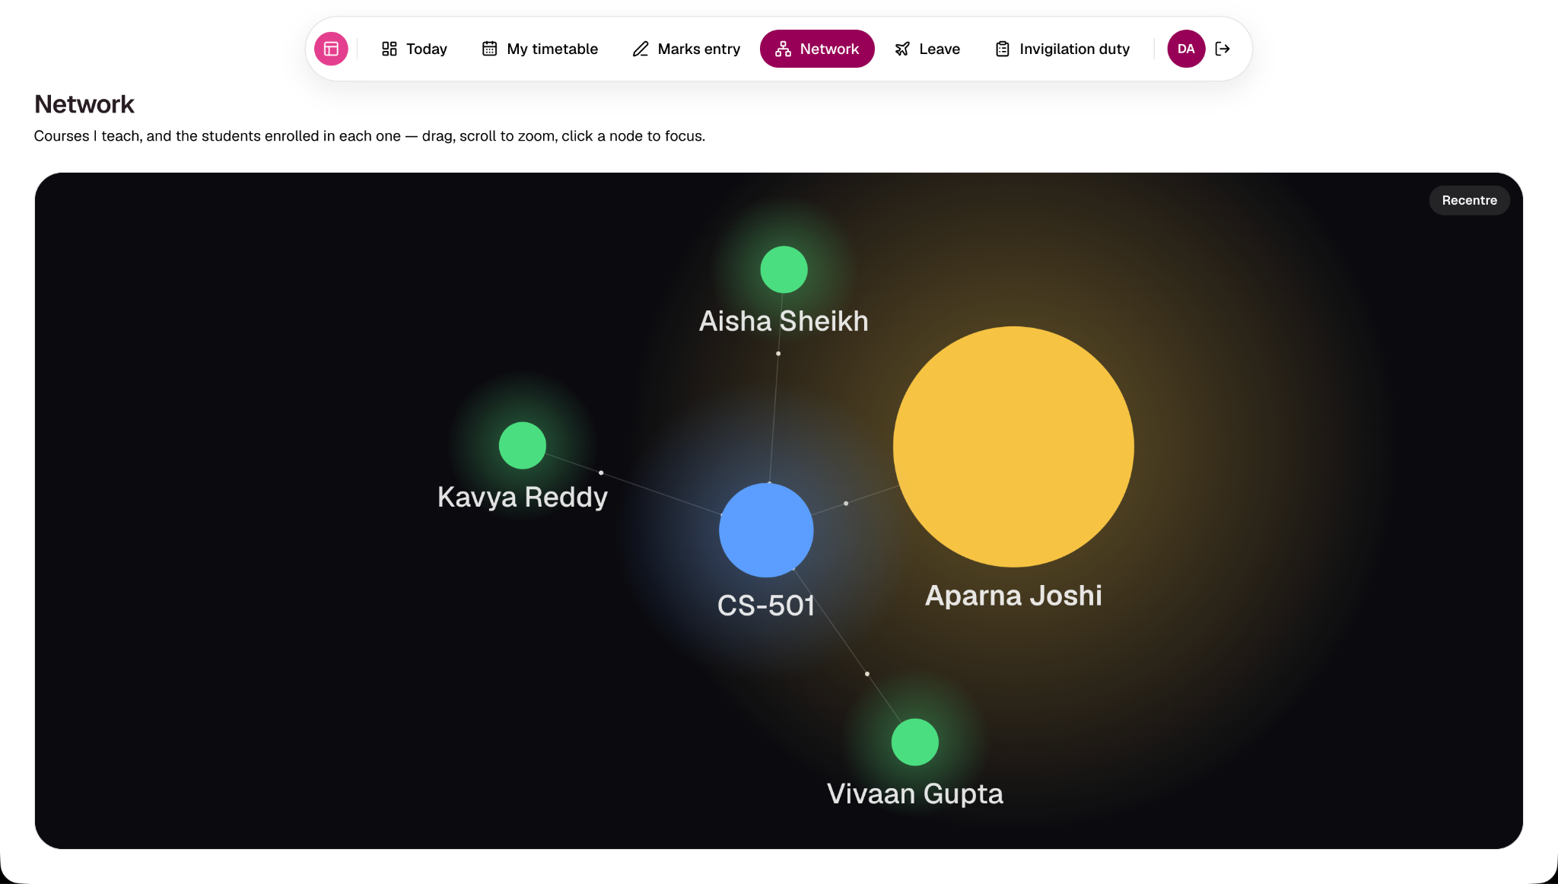
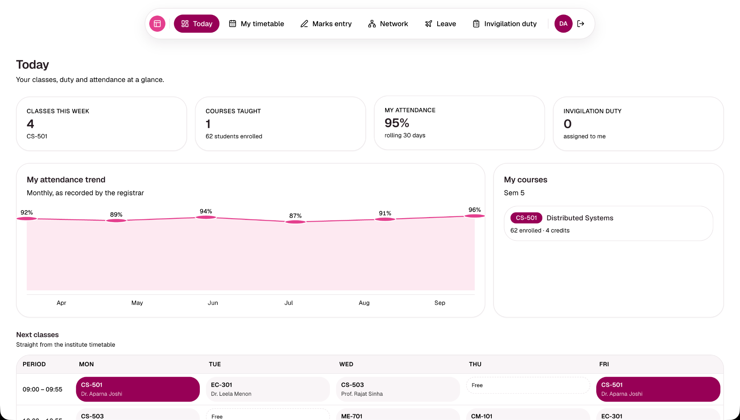
Faculty Portal
Personal dashboard: Scoped to the signed-in faculty member's own courses, students and weekly schedule. Includes attendance marking.
Leave application flow: The admin timetable reacts automatically the moment a leave is approved.
Marks entry per exam: Grades are computed automatically from marks — a faculty member never has to work out grade boundaries.
Knowledge graph: Force-directed graph showing the faculty member at the centre, branching out to courses taught and students enrolled.

Slide 11
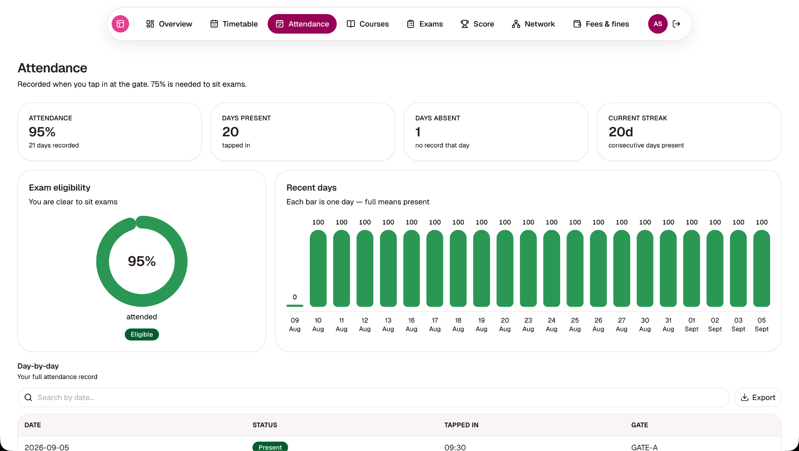
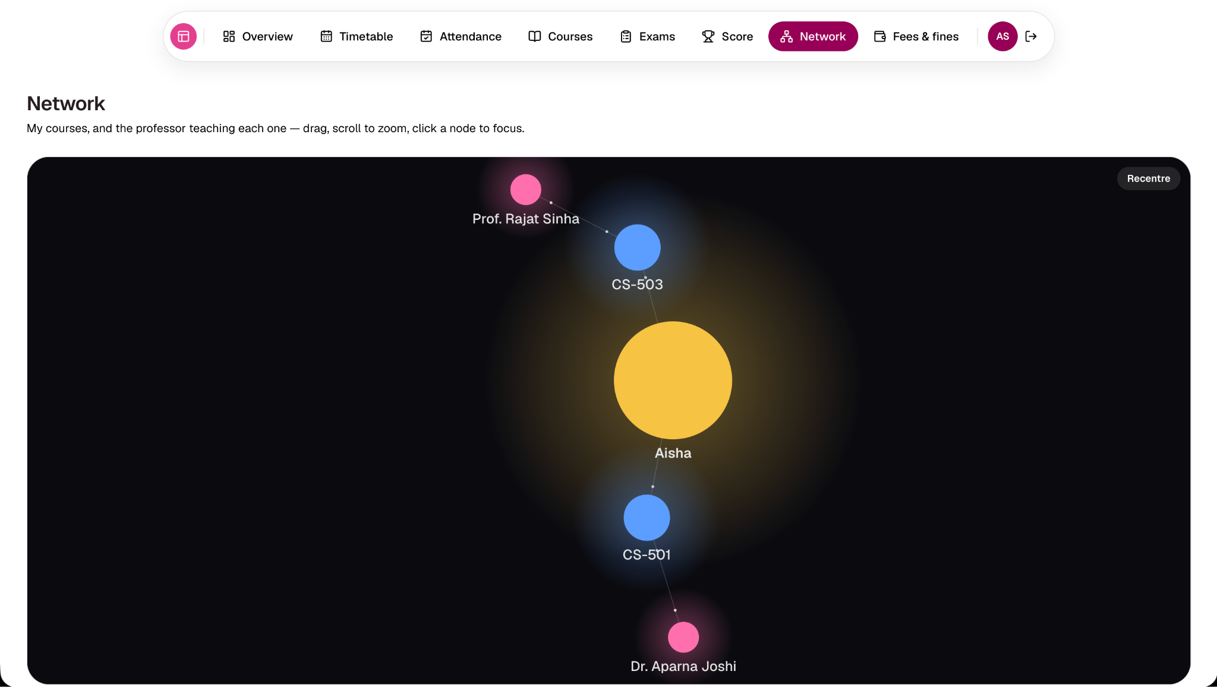
Student Portal
Personal dashboard: Scoped to the student's own attendance, fees, fines, courses and scores.
Progress visuals: CGPA and attendance-trend charts replace a static percentage, making progress visible over time.
Financial tracking: Fee payments and outstanding fines with real backend errors surfaced instead of fake confirmations.
Knowledge graph: Force-directed graph putting the student at the centre, branching to enrolled courses and professors.

Slide 12

Applicant Portal
Public Application Flow
Live Status Tracking
A public application form for prospective students, entirely separate from the main sign-in flow to ease onboarding.
Application status (Pending / Approved / Rejected) is visible to the applicant, driven directly by the same record the admin reviews.
Seat-Fee Gate
Continuous Support
Seat-fee payment is only unlocked once approved. Paying this fee is the trigger that issues the applicant's actual student login.
The login-page chatbot remains available throughout to answer "how do I apply" and "what happens next" questions instantly.

Slide 13
AI Admissions Chatbot
Gemini-Powered
Structured Responses
Google Gemini-powered assistant embedded in the login page, scoped specifically to guiding visitors through the admission and sign-in process.
Answers are capped at five lines and returned in a structured JSON format that the frontend renders directly for a clean UI.
Jailbreak Resistant
Graceful Fallback
Highly resistant to jailbreak-style prompts ("ignore all previous instructions"). The bot stays on topic regardless of commands.
Any question it can't answer, or any API failure, falls back to a fixed support contact (support@origin.edu) rather than hallucinating.

Slide 14
Data Integrity & Live Wiring
Zero Seed Data: No hardcoded data anywhere in the app and no seed script — the database starts empty and every screen reads real records.
Strict Cross-Validation: A background checkConsistency routine cross-validates:
▪
Attendance percentages vs register
Test Automation: Backed by an automated test suite (Node's built-in test runner) asserting the database has zero consistency issues.
▪
Fee balances vs fee heads
▪
Fine totals vs unpaid fines
▪
Grades vs raw marks
Synchronous UI: Every dialog waits for the real backend response before closing, showing real failures instead of optimistic fake successes.
▪
Faculty leave status vs actual approved leave
▪
Every foreign reference against its target record

Slide 15
Conclusion & Future Scope
Origin replaces four disconnected spreadsheets with one live, role-aware ERP where every screen reads the same source of truth.
Delivered: Admissions, timetabling with automatic re-staffing, attendance, fees, exams and scores, an AI admissions assistant, and knowledge-graph visualisations.
Future: Real authentication and session tokens for enterprise security.
Future: Integration of a production payment gateway.
Future: Dedicated mobile app and richer historical analytics.
Deployment: https://team-sixseven-erp.vercel.app/

