Slide 1
Google capstone project: Cyclist bike share analysis
July 31, 2024
Adarsha Pratap Adhikari

Slide 2
Background
Problem statement
Key stakeholders
Methodology
Data
Quality control
Data analysis
Findings
Conclusion
Recommendation

Slide 3

Background
Cyclist is a growing bike sharing company
Cyclist launched in 2016
Grown to a fleet of 5,824 bicycles
692 stations across Chicago
3 pricing plans
Single ride passes, full ride passes and annual membership
2 types of customers
Casual riders: who purchase single and full ride passes
Cyclist members: who purchase annual membership

Slide 4
Problem statement
How do annual members and casual riders use Cyclist differently?
Cyclist found annual members profitable than casual riders
Maximizing annual members will be key to future growth
Opportunity to convert casual riders to members
Company set a goal to design marketing strategies to convert casual riders to members
The team needs to understand how annual members and casual riders differ

Slide 5
Key stakeholders
3 key stakeholders involved in this project
Lily Moreno: Director of Marketing
Develop campaigns and initiatives to promote ride share program
Marketing analytics team: Team of data analyst (I am a part of this team)
Collect, analyze, and report data to guide marketing strategy
Executive team
Decide over a recommended marketing plan

Slide 6
Data
Trip data was acquired from the cyclist’s data repository
4 month trip data from January to April was acquired for the year 2021
Dataset for each month was combined into a single csv dataset
Contains 712,183 rows and 13 columns
The csv dataset was used for processing and analysis

Slide 7
Quality control
Dataset was cleaned and processed for data analysis
New columns created
Created 3 new columns
ride_length: to calculate the length of each ride
day_of_week: to calculate day of week that the ride started
Month: to calculate month in which the ride started
Erroneous data
Removed erroneous data from the dataset
Changed data types of 6 columns

Slide 8



Data analysis
Python was used for data analysis
Python
Data processing, analysis and visualization
Packages used: pandas, plotly

Slide 9
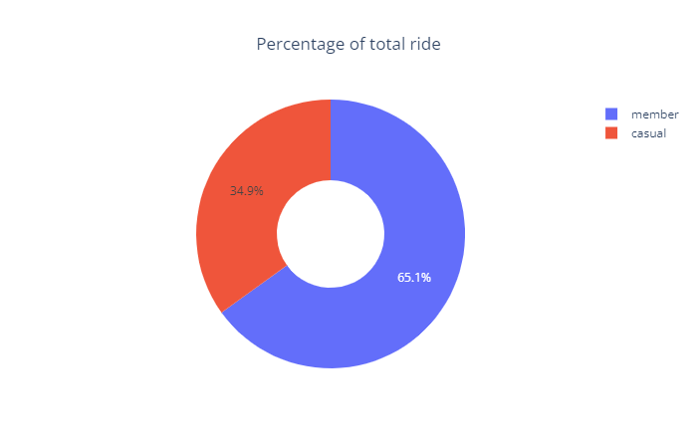
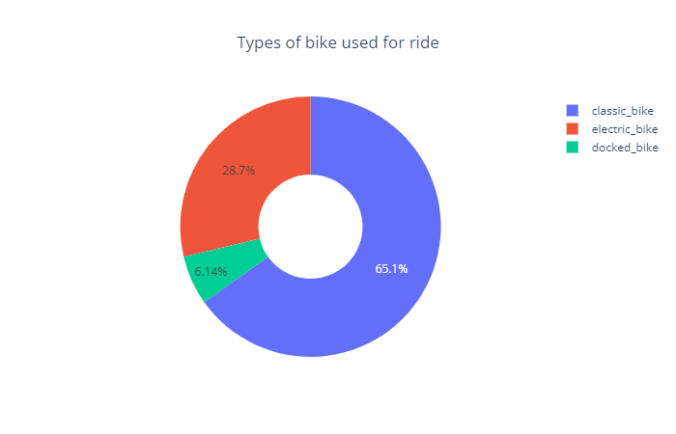
Findings
Majority of rides are done by members and frequently used bike is classic bike
463,292 (65.1%) rides are done by annual members
463,871 (65.1%) rides are done using classic bike followed by electric bike and docked bike

Slide 10
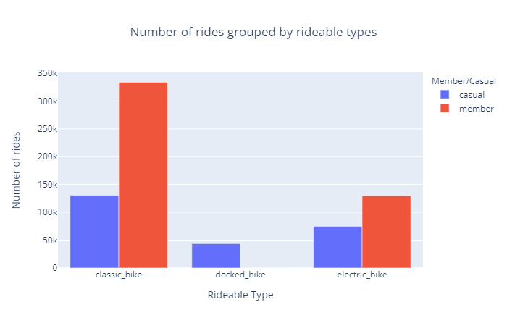
Findings
The preference of bike are similar among members and casual riders
333,614 rides are done using classic bike by annual members followed by electric bike and docked bike
130,257 rides are done using classic bike by casual riders followed by electric bike and docked bike

Slide 11
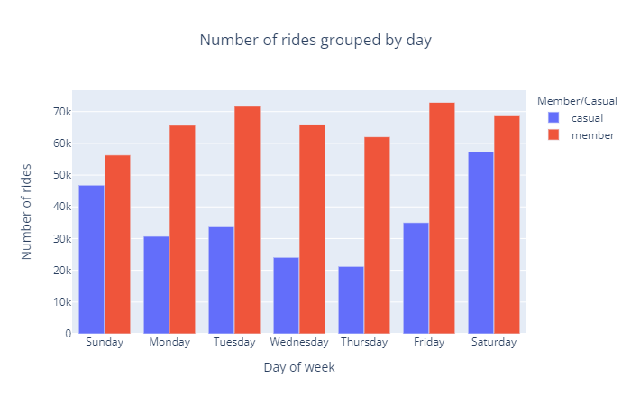
Findings
Members use bike share most in weekdays but casual riders use it during weekends
Highest number of rides by members are on Friday and Tuesday
Highest number of rides by causal riders are on Saturday and Sunday

Slide 12
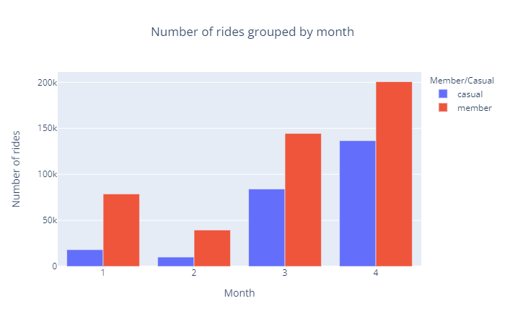
Findings
The number of rides by casual riders is growing faster than the rides by members
The number of rides are growing every month for both casual riders and members except in February
The compound monthly growth rate for casual riders is 65.71% compared to 26.35% for members

Slide 13
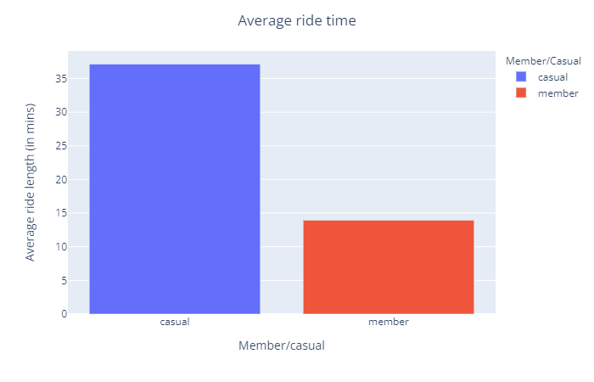
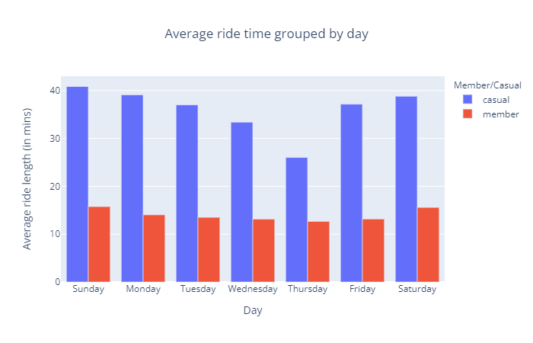
Findings
The average ride time of casual riders is twice that of members
The average ride time of casual riders is 37.14 mins whereas the ride time of members is 13.95 mins
The average ride time of casual riders and members also shows similar trend on day to day basis

Slide 14
Conclusion
Classic bike is the most preferred bike among both the customer segment.
Members tend to use the ride on weekdays whereas casual riders tend to use it on weekends.
The rides by casual riders is growing faster than the annual members.
The average ride time of casual riders is twice than of annual members.

Slide 15
Recommendations
Remove docked bike and increase the number of classic bikes
Introduce a new flexible membership plan for weekdays and weekends only riders
Provide special incentives to members to encourage growing casual riders to become members
Offer trial membership option at a reduced rate for a month for frequent casual riders

Slide 16
Thank You

