Slide 1

SVIT Student Placement Prediction Using Machine Learning

Slide 2

Abstract
Predicting the number of potential candidates is one of biggest challenges for the placement officer, since sometime a student with very good academic score doesn’t get place and the one with the low academic score but good communication skills get place.
Clearly, there are more than one factor influencing the placements. Finding the relation between factors can be even challenging for a trained statistician. Even companies visiting the college uses the criteria of aggregate to sort out students and sometime due to error of method they end up empty handed with no potential student.
We are proposing a machine learning evaluation system which will consider many different factors like communication skills, technical skills, aggregate to determine the potential of the student. We are using Decision Tree Algorithm which gives excellent performance in classification problem with less data constraint.

Slide 3
Contents
Introduction
Existing System
Disadvantages of Existing System
Proposed System
Advantages of Proposed System
Architecture
Algorithm
Module 1 Description
Module 1 Output
Conclusion
References

Slide 4

Introduction
Nowadays educational institutes are growing in high numbers. Aim of every higher educational institute is to get their students a well-paid job through their placement cell. One of the largest challenges that higher learning establishments face nowadays is to boost the placement performance of scholars.
The placement prediction is additional complicated once the quality of instructional entities increases. with the machine learning techniques, the information is often extracted from operational and historical knowledge that resides at intervals the academic organization’s databases exploitation. The information set for system implementation contains data regarding past data of scholars.
We use Decision machine learning module to provide efficient and accurate results and we also provide a nice Graphical User Interface for easy interaction with the model.

Slide 5

Existing System
Currently the existing system utilizes algorithms like K Neighbours, Logistic regression.
And with no proper interface to actually utilize those applications.

Slide 6
Disadvantages of Existing System
K Neighbor's algorithms is very computationally heavy since it has undergo through the whole dataset each time we do prediction.
Logistic regression is based on a linear model and in real world almost no problem is in linear due to which logistic regression is not a very good option either.
Without the interface User cannot completely utilize the application.

Slide 7

Proposed System
Proposed system utilizes Decision Tree Algorithms and provides a simple and a very interactive user interface so that anyone with basic computer operation skills can utilize the full potential of the application.

Slide 8

Advantages of Proposed System
Tree Based Algorithms like Random Forest works really well when the given data is very less (or) very huge and is also good while scaling up and feature extraction of the Data.
Proposed system also provides a nice user interface for easy usage of the application.

Slide 9
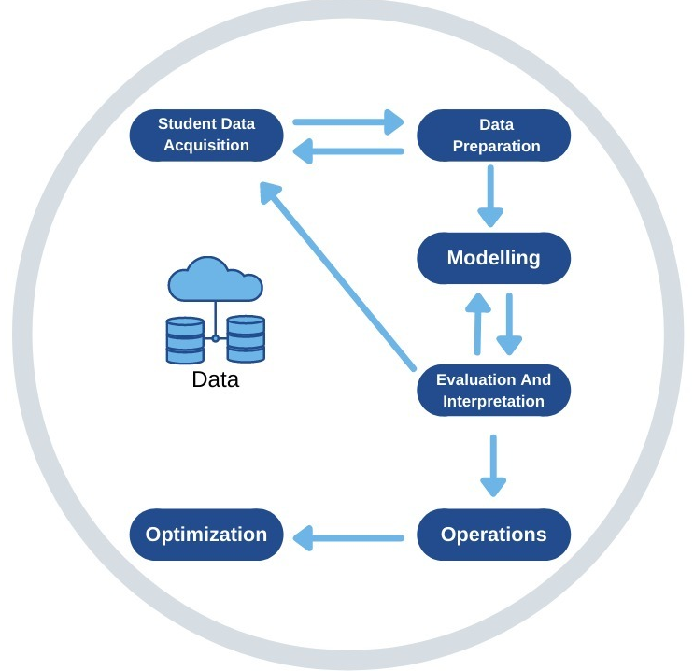
Architecture

Slide 10

Algorithm
Random Forest Regressor
Steps involved in random forest algorithm:
Step 1: In Random forest n number of random records are taken from the data set having k number of records.
Step 2: Individual decision trees are constructed for each sample.
Step 3: Each decision tree will generate an output.
Step 4: Final output is considered based on Majority Voting or Averaging for Classification and regression respectively

Slide 11
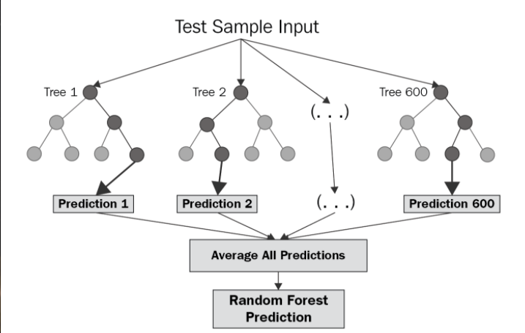
Random Forest Regressor

Slide 12
Module 1 Description
Data collection: This dataset includes categorical values with attributes. All this attributes are main attributes which are related to different Technologies .
And also some attributes has high importance and some are general attributes.

Slide 13
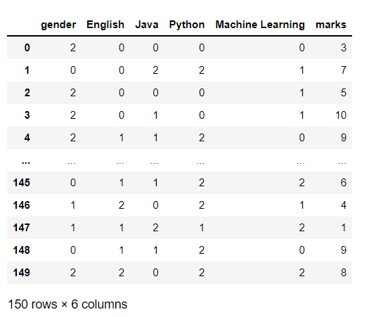
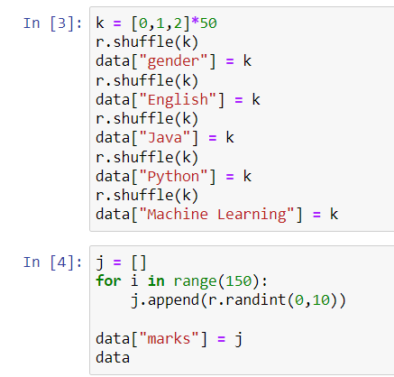
Module 1 Output

Slide 14

Conclusion
The Project Implementation is being done properly. The proposed system will utilize Decision Tree Algorithms and provide a simple and very interactive user interface so that anyone with basic computer operation skills can utilize the full potential of the application.
All these predictions help the institute to improvise the student performance and can come up with 100% results. . We can also enhance the project by predicting some solutions or suggestions for the output generated by system.

Slide 15

References
● Shreyas Harinath, Aksha Prasad, Suma H and Suraksha A. Student Placement Prediction using Machine Learning, International Research Journal of Engineering and Technology (IRJIET) Volume: 06 Issue: 04 April 2019
● Senthil Kumar Thangavel, Divya Bharathi P, and Abhijith Shankar. Student Placement Analyzer: A recommendation System Using Machine Learning, International Conference on advanced computing and Communication systems (ICACCS-2017), Jan 06- 07,2017, Coimbatore, INDIA.
● K. Sreenivasa Rao, N. Swapna, P. Praveen Kumar Educational data mining for student placement prediction using machine Learning algorithms Research Paper, International Research Journal of Engineering and Technology (IRJIET) 2018

