Slide 1

DESIGN OF AI BASED CHATBOT FOR FAQS
Presented by:
Adarsh Choudhary (18030480002)
Hanzala Sohrab (18030480014)
Under the guidance
of
Mr. Dinesh Kumar Prabhakar
Department of Information Technology
B.I.T SINDRI, DHANBAD

Slide 2
Contents
Introduction
Problem statement
Objective
Literature Review
Methodology
Experimental Layout
Conclusion
References

Slide 3
Introduction
Businesses publish FAQ sections to answer frequent user questions, however users may have a hard time getting their questions answered because of reasons such as:
They do not use the exact same words as in the frequently asked question. This can stop them from finding the right answers if the website uses simple search functions.
Their question may involve a combination of questions which can result in a lengthy answer
The FAQ section may not be mobile friendly
They may just not like using FAQs and prefer a chat-like interface

Slide 4
cont.
FAQ chat-bots aim to resolve these problems by using NLP capabilities and providing answers in an intuitive chat interface. To build FAQ chat-bots, chat-bot vendors:
crawl company’s website for information
use the crawl data to build an initial bot
enable users to make changes to automatically built bot via a user interface

Slide 5
Problem statement
There have always been queries of people regarding various topics to which answers are provided manually by people
Finding information in a website can sometimes be time-taking and one may even get frustrated
In order to make this process fast the FAQs can be answer using the latest AI technologies where answers can be automatically generated according to the questions
This process can reduce lot of work pressure for both the user and the organization

Slide 6
Objective
For this project, we will perform NLU on incoming WhatsApp messages and send a response based on the question asked.
The primary aim is to provide a method for analyzing the user’s questions and providing answers to frequently asked questions (FAQs).

Slide 7
Modules
01
Convert raw text from user messages into structured data.
Parse the user’s intent and extract important key details.
Train the model with collected data
Setting us the Rasa server
02
Create websockets to connect to WhatsApp servers
Listen for incoming messages
Implementing the WhatsApp APIs using Baileys
03
Send messages received in Baileys server to the Rasa server
Rasa server performs text analysis
Rasa server sends appropriate response back to Baileys which sends it to the user
Connecting the two modules using REST APIs

Slide 8
Literature Review
Bocklisch et. al introduced the rasa NLU and core for the first time with an open source license [8]. The aim of this study was to provide a dialogue system based on machine learning and understanding the language to the enthusiast who are no such expert in technology. The package[2] they developed was of minimal size and advancement is done in the package. With the efforts of 344 contributors , 244 releases of rasa have been released with a total of 18023 commits.
Lacerda used the core of rasa and presented a new software stack called as Rasa-ptbr-boilerplate for the non specialist who doesn't much about the internals of the chatbot , considering the chatbot as blackbox. [9]
Jiao designed a functional framework which implements the principle of RASA NLU [10]. furthermore he integrated the RASA NLU with the neural network methods resulting in an entity extraction system and later on recognizes the intents and related entities. This study showed that the Neural network outperforms RASA NLU.

Slide 9
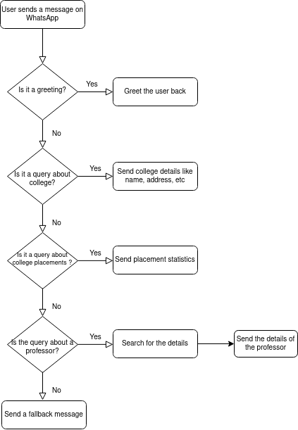
Methodology

Slide 10
Experimental Layout
User sends a WhatsApp message on a particular number
1
4
Baileys server listens for any incoming message and sends it to the Rasa server
2
3
Rasa server analyses the query and based on the trained model, sends an appropriate response back to Baileys

Slide 11
cont.
We will create two separate servers. One for implementing the WhatsApp Web API, and the other for analyzing the user queries.
We will use the Baileys library to create our own customized lightweight full-featured WhatsApp Web + Multi-Device API.
The first time we run the bot on WhatsApp, we will have to scan the QR code to enable WhatsApp Web. Once we run this code, the responder will then connect to WhatsApp and it will print out a QR code for us to scan with WhatsApp on our phone. Once we scan it with our phone, the bot will start recieving and responding to messages.
After scanning the QR, our authorization credentials will be stored in a JSON file that can be used for authenticating whenever a connection is made to WhatsApp.
Whenever the Baileys server will receive any message, it will send it to the second server where the message will be analyzed and appropriate response will be sent back to the first server which, in turn, will send it back to the user as a WhatsApp message.

Slide 12
cont.
In the second server, we will use Rasa.
Rasa Open Source is an open source framework for building chat and voice-based virtual assistants.
To handle FAQs and chitchat we will need to used a rule-based dialogue management policy (the RulePolicy) and an easy way to return the appropriate response for a question (the ResponseSelector).

Slide 13
Time frame
1 day
2 days
1 day
1 day
Implementing WhatsApp APIs
Setting up the Rasa server
Connecting the two servers
Collecting data and training the model
Customizing Baileys for our use case
Creating stories, chat-flow, etc
Creating APIs to connect the servers
Collecting data from the college website and other available sources and then training the model used in Rasa server

Slide 14
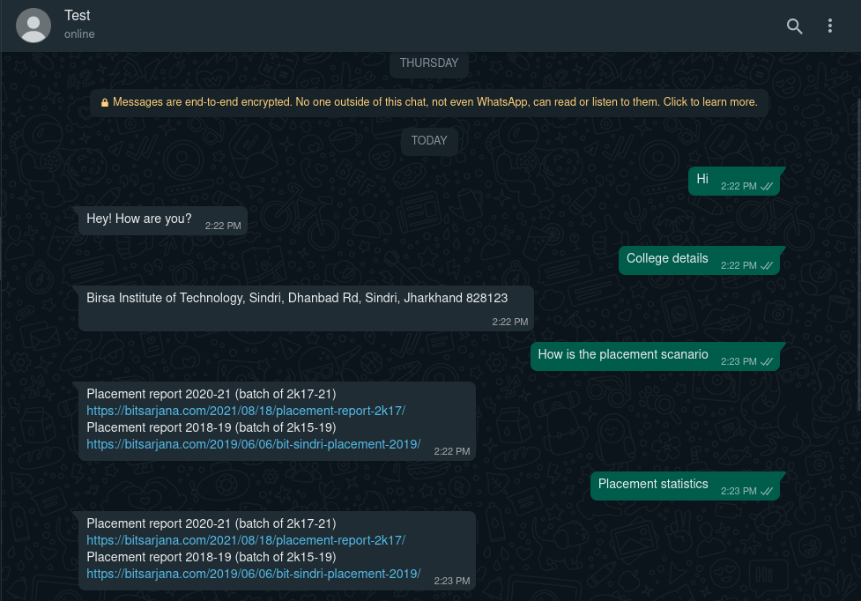
Results

Slide 15
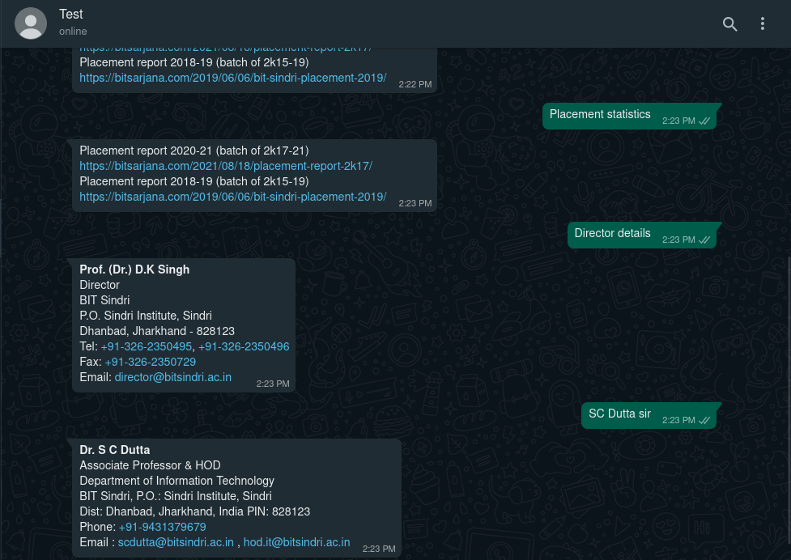
cont.

Slide 16
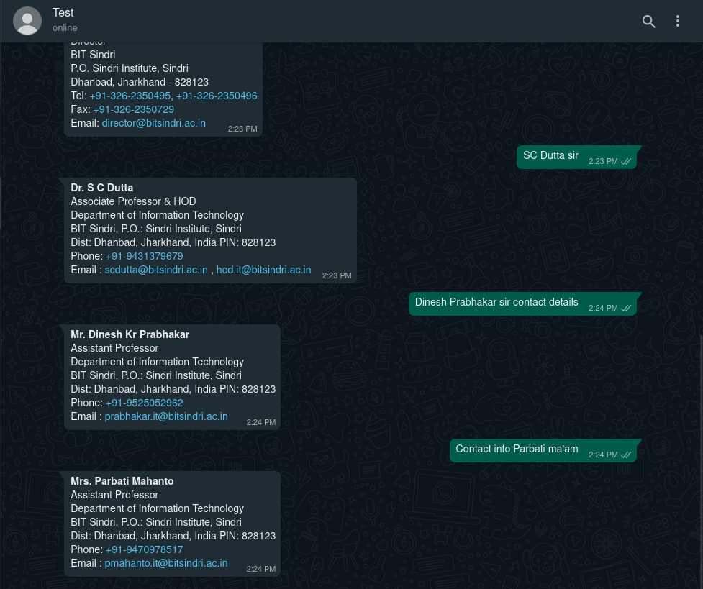
cont.

Slide 17
Conclusion
Businesses publish FAQ sections to answer frequent user questions, however users may have a hard time getting their questions answered because of reasons such as:
They do not use the exact same words as in the frequently asked question. This can stop them from finding the right answers if the website uses simple search functions.
Their question may involve a combination of questions which can result in a lengthy answer
The FAQ section may not be mobile friendly
They may just not like using FAQs and prefer a chat-like interface
FAQ chat-bots aim to resolve these problems by using NLP capabilities and providing answers in an intuitive chat interface. To build FAQ chat-bots, chat-bot vendors:
crawl company’s website for information
use the crawl data to build an initial bot
enable users to make changes to automatically built bot via a user interface

Slide 18
Reference
[1]. Baileys, https://github.com/adiwajshing/Baileys
[2]. Rasa, https://rasa.com/
[3]. Rasa server implementation, https://github.com/hanzala-sohrab/rasa-server
[4]. Baileys implementation, https://github.com/hanzala-sohrab/baileys-whatsapp-server
[5]. Rasa architecture overview, https://rasa.com/docs/rasa/arch-overview/
[6]. BIT Sindri, https://bitsindri.ac.in/ accessed on 30/05/2022
[7]. Sarjana, https://bitsarjana.com/2019/06/06/bit-sindri-placement-2019/, https://bitsarjana.com/2021/08/18/placement-report-2k17/ accessed on 30/05/2022
[8]. Bocklisch, T., Faulkner, J., Pawlowski, N., & Nichol, A. (2017). Rasa: Open source language understanding and dialogue management. arXiv preprint arXiv:1712.05181
[9]. Lacerda, A. R. T. D. (2019). Rasa-ptbr-boilerplate: FLOSS project that enables brazilian portuguese chatbot development by non-experts
[10]. Jiao, A. (2020). An Intelligent Chatbot System Based on Entity Extraction Using RASA NLU and Neural Network. JPhCS, 1487(1), 012014
[11]. Rakesh Kumar Sharma, Manoj Joshi (June-2020), An Analytical Study and Review of open source chatbot framework, RASA, International Journal of Engineering Research & Technology (IJERT), ISSN: 2278-0181
[12]. Frommert, C., Häfner, A., Friedrich, J., & Zinke, C. (2018, September). Using chatbots to assist communication in collaborative networks. In the Working Conference on Virtual Enterprises (pp. 257-265). Springer, Cham.
-

Slide 19
Thank you

