Slide 1

Student Performance Factors
Analytical Report
HACKATHON 1
(Data Analysis With Python)
Presented To: Mr. Siva Rama Krishna Sir
Name: Adarsh Kumar
Batch: FSDS@10:30 A.M.
Mobile: +918340658445

Slide 2
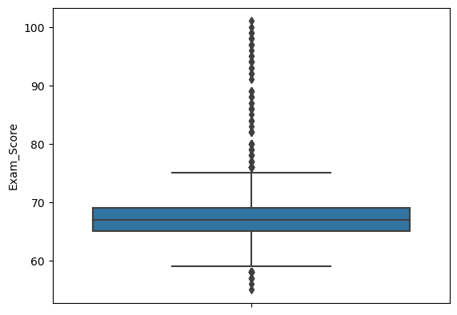
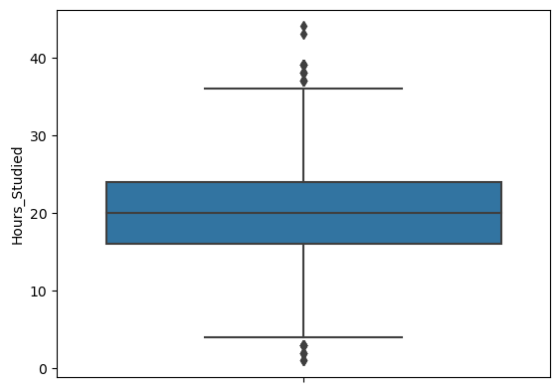
Observation:
- BoxPlot for Exam Score to detect outliers. During statistical analysis, one student had 101 marks, which is also clearly visible in this box plot.
Observation:
- BoxPlot for Study Hours to detect outliers. During statistical analysis, some students have good study hours more than 35 hrs and some have study hours less than 5 hrs a week, which is also clearly visible in this box plot.

Slide 3
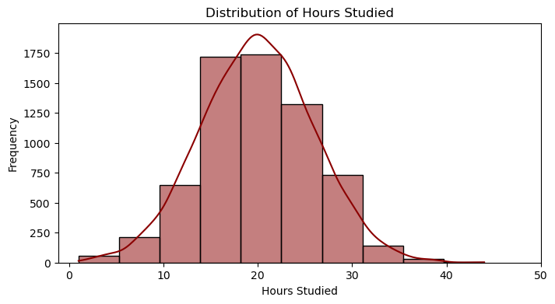
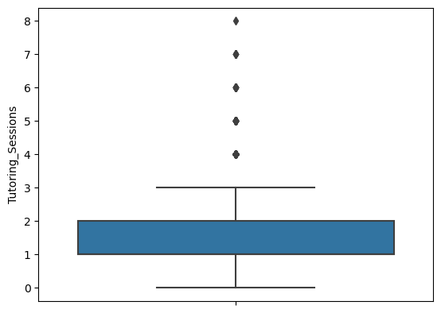
Observation:
Study Hours is normally distributed.
most of the students have study hours between 10 to 30 hrs
very few students study for less than 10 hrs or more than 30 hrs in a week
Observation:
- BoxPlot for Tutoring Session to detect outliers. As few students have more than 3 tutoring sessions which is also good for students as we will see further.

Slide 4
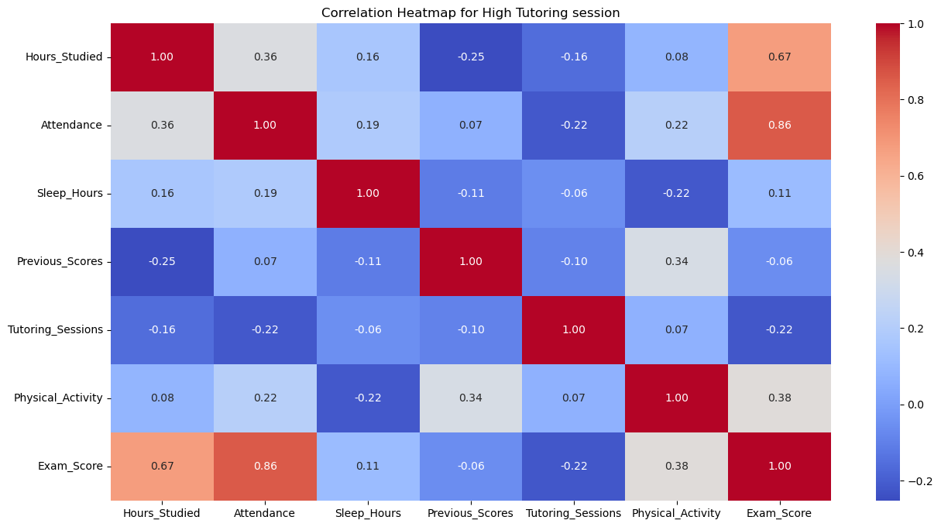
Observations:
For those students who have more tutoring sessions those exam marks are highly correlated
To the attendance in the class as well as moderate correlation with the study hours. Therefore, We can say that for Tuition Sessions is required for better performance as well as attending classes and study hours is also important.

Slide 5
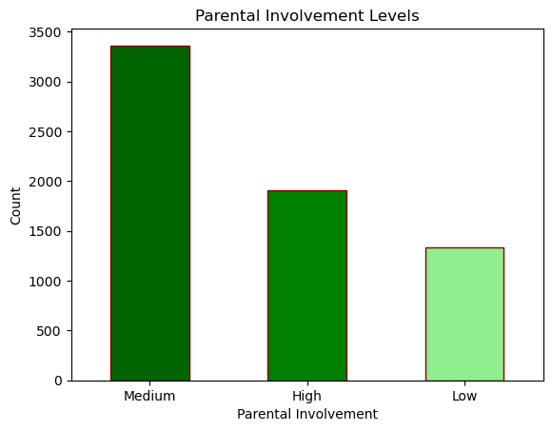
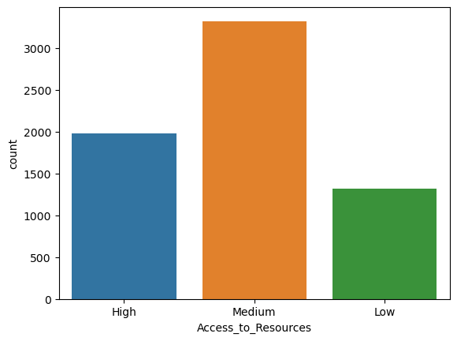
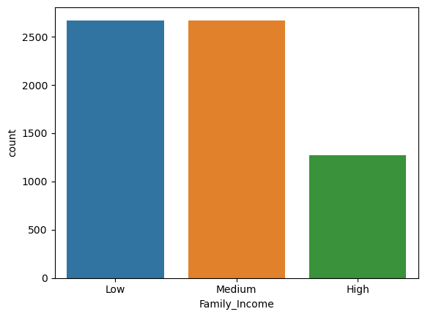
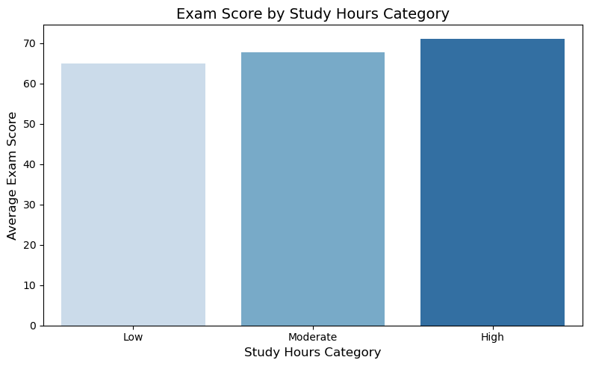
Observations:
From these plots, we can observe that around 1200 students out of 6607 are rich because they have high family income.
And around 1200 students have low parental involvement.
And similarly around 1200 students have low resources.
High Study Hours gives higher the Average Exam Scores.

Slide 6
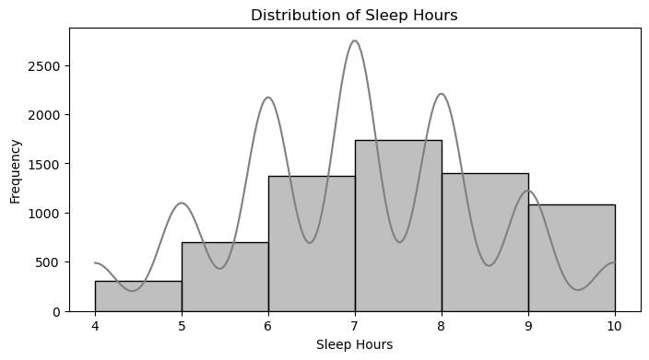
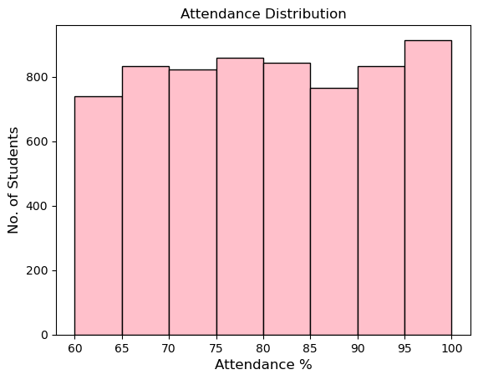
Observations:
More number of students sleep for 6 to 9 hrs daily.
most of the students take sleep of 7 to 8 hrs.
least number of students take sleep of 4 to 5 hrs daily.
Observations:
Here is the data of students who have more than 60% attendance.
Most of the students have more than 75% attendance.

Slide 7
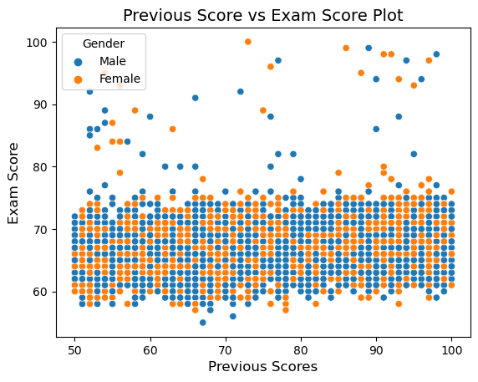
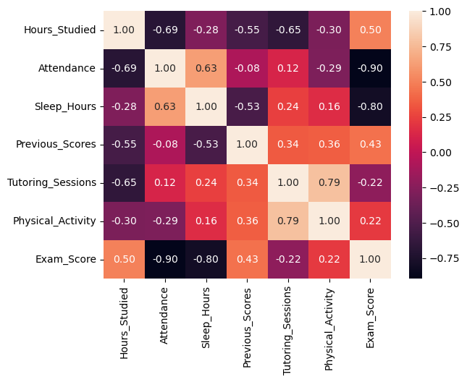
Observation:
There is no clear linear correlation between previous scores and exam scores
Some students with low previous score also perform well in exam score
Some students with high previous score between 90 to 100 also perform well in exam score above 90.
A few students show stark contrast in performance such as achieving low exam scores despite high previous scores.
Now what is the reason behind this inconsistency?
Observation
From this analysis we have observed that those students who have more than 90 marks in previous score but less than 60 marks in exam score
They have low motivation level
Their study hours is low
Very low Tutoring session
family income is low
not much positive peer influence

Slide 8
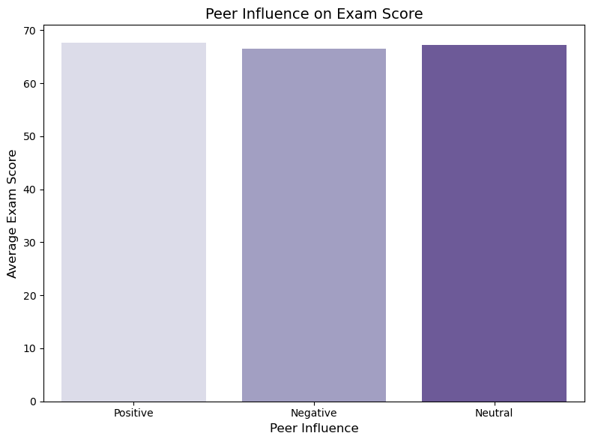
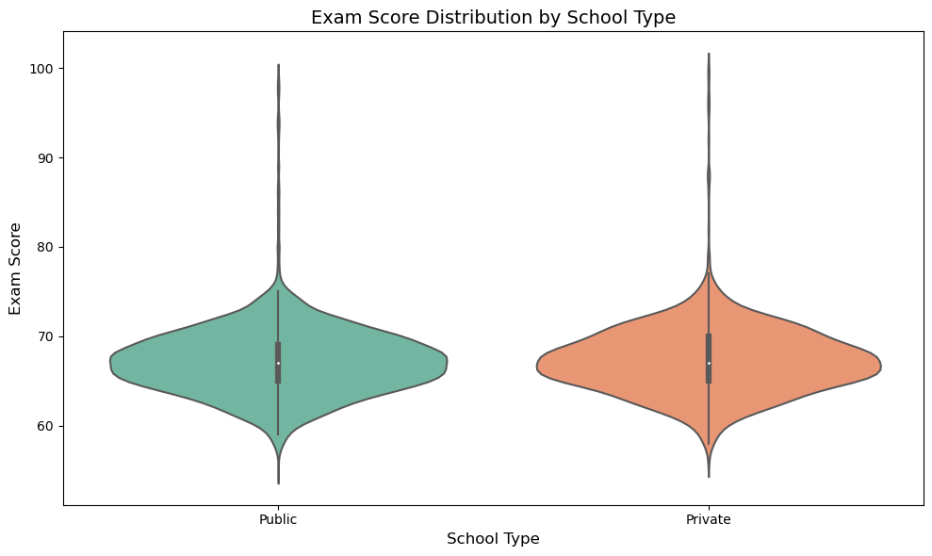
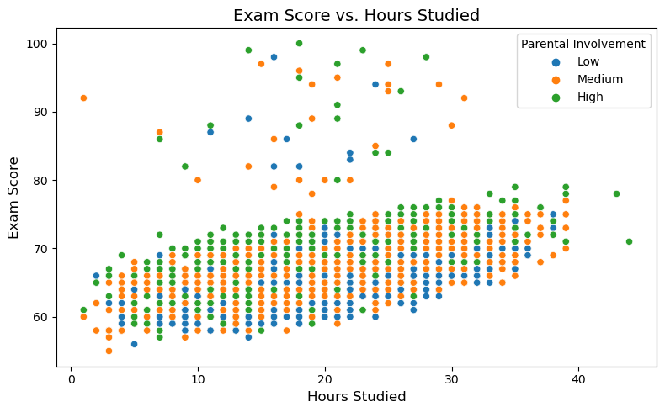
Observations:
No much effect due to Peer Influence on Exam Score.
Almost same number of students studied in public as well as private school.
Plot 3 shows Average study hours student performing well and those students whom parental involvement is there getting top marks.

Slide 9
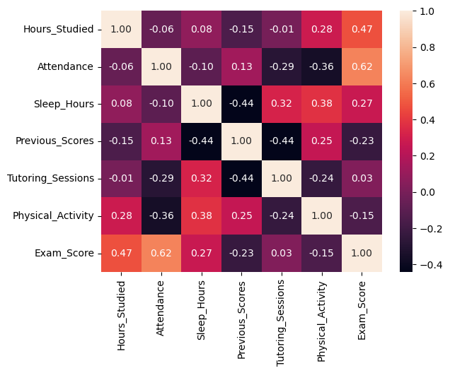
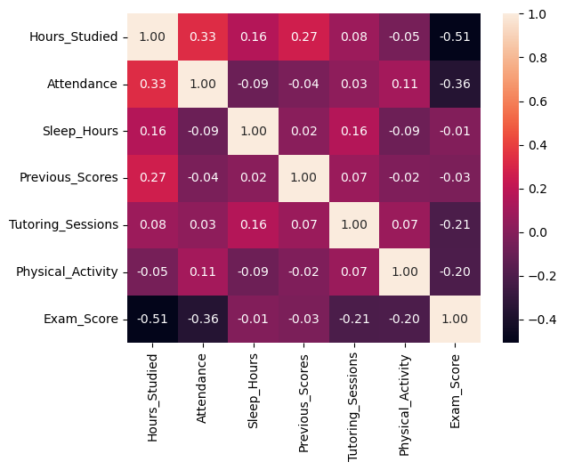
Under Performance Heatmap
Here study hours and attendance are highly correlated.
Good Performance Heatmap
Not much correlation in continuous columns here.

Slide 10
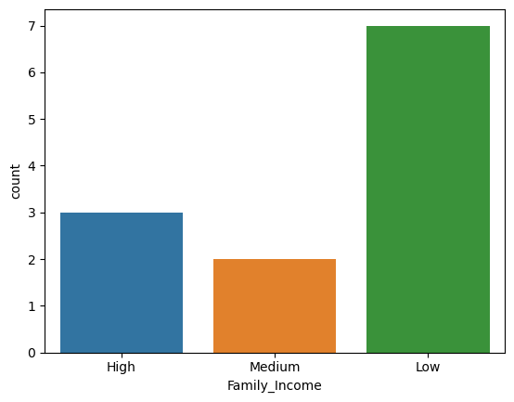
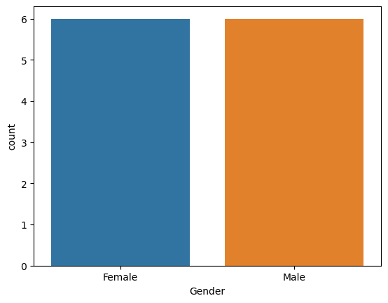

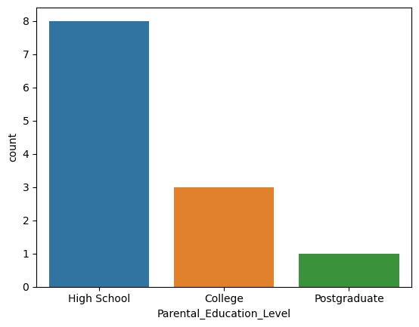
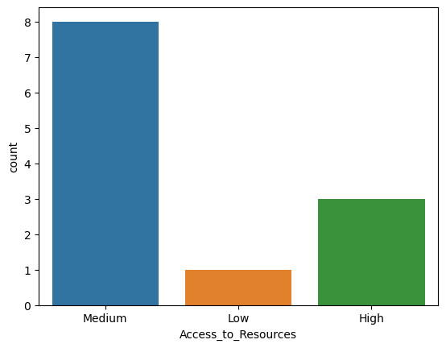
Under Performance Analysis
Observations:
For the underperformance students, gender and school type don’t impact.
We can observe from the plot at the left bottom that the Parental Education level is an issue and can say a slightly big issue for underperforming.
Resources aren’t an issue for them.
The family income of most of the underperformed guys is low.

Slide 11
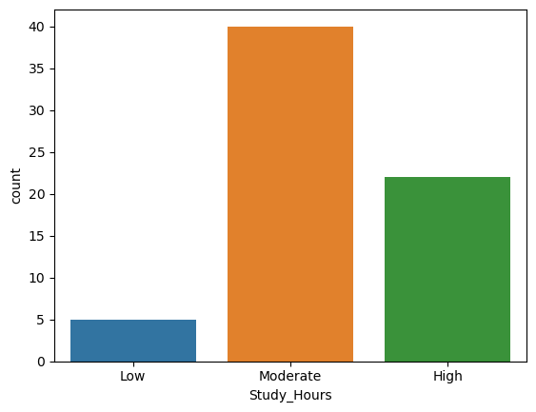
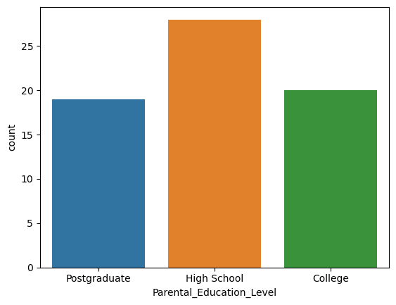
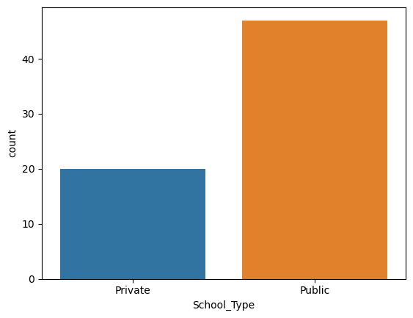
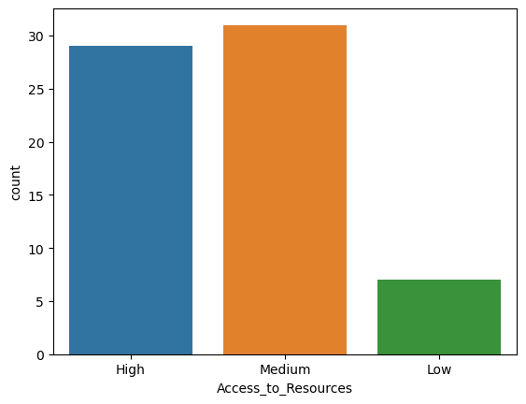
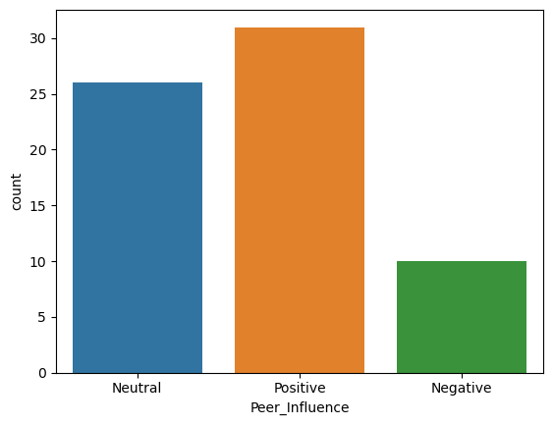
Good Performance Analysis
Observations:
Parental Education is better for good performing guys.
Most of good performing students belongs to public school.
Study hours is totally responsible for good performance.
Availability of resources is very high.
Most of the students have positive peer influence.

Slide 12
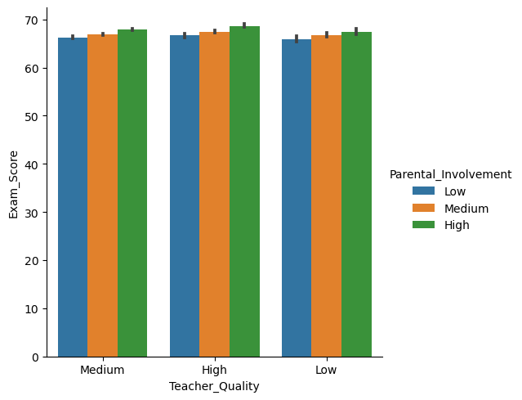
Observations:
This plot shows the relationship between teacher quality and exam scores with additional variables of parental involvement.
Exam Scores are highest when teacher quality is high.
Higher parental involvement (green bars) slightly improves exam scores across all levels of teacher quality.
When teacher quality is low and parental involvement is low the Exam scores are lowest.
Teacher Quality plays a slightly more significant role as compared to parental involvement.

Slide 13
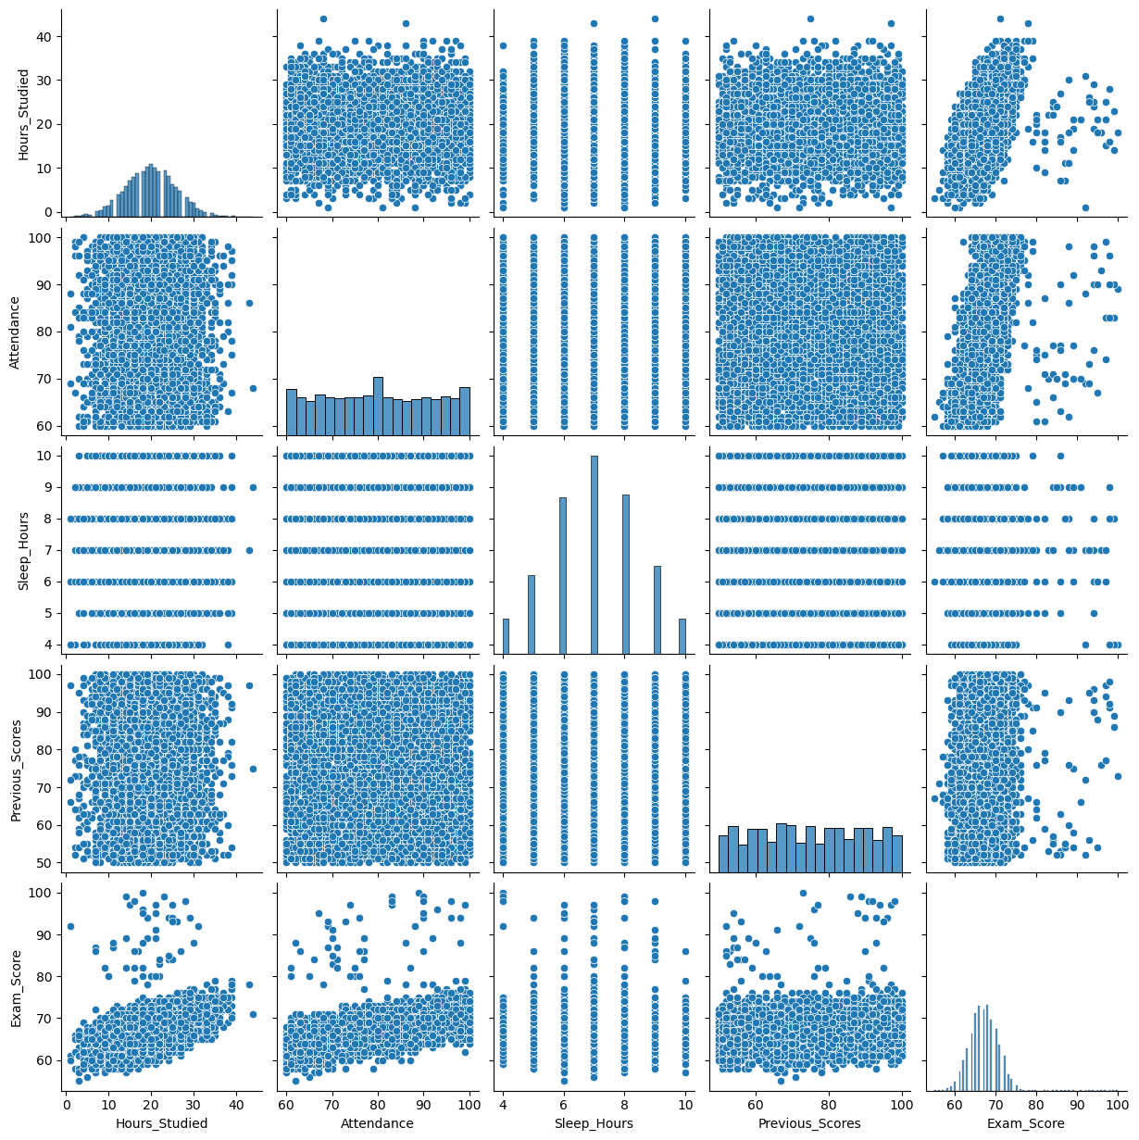
Observations
Increment in Resources, Study Hours, Attendance and Tutoring Session is Required for Better Performance

