Slide 1


Slide 2

CineSuggest is a leading platform for discovering and exploring movies. CineSuggest offers a comprehensive and user-friendly platform to browse, search, and get personalized movie recommendations.
A Web application that integrates machine learning for movie recommendations.

Slide 3

Scope of CineSuggest
Provide users with a rich database of movies including detailed information, ratings, genres, trailers, and much more.
Advanced search and filtering options for movies based on genres, release dates, ratings, etc.
Personalized movie recommendation engine based on user preferences.
User registration and social features such as watchlists, and user interactions (following, sharing lists).

Slide 4

Probable Applications
For any movie enthusiasts and movie maniacs
For journalists and bloggers
For film studies and researches

Slide 5

Tools & Technologies
HTML
CSS
JavaScript
Python
Jupyter Notebook
MongoDBYouTube
Data API

Slide 6

Functionalities
Personalized user profiles with preferences and watchlists.
Display detailed movie information
Advanced searching and filtering options
Movie recommendation engine
Social
features such as sharing watchlists
Watch
trailers

Slide 7

Modules
User Management Module
Movie Database Module
Search and Discovery Module
Movie Recommendation Module

Slide 8

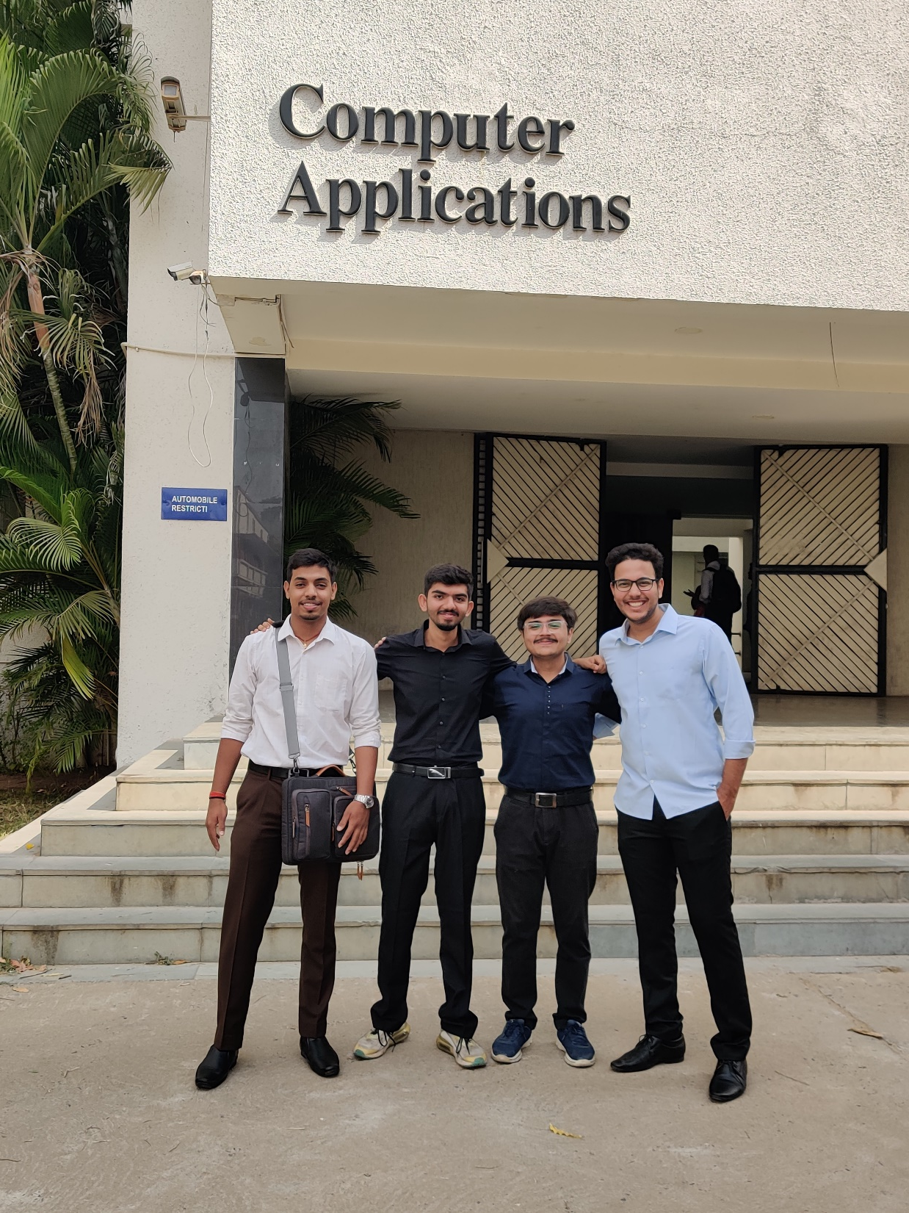
Thank You and do engage with CineSuggest
Team Leader:
Adarsh Singh
Team Member:
Abhishek Mishra
Kalp Shah
Pranav Rajyaguru
8021081556
8022024016
8022023860
8022000472

