Slide 1
ICTW(A)
Name : Suthar Adarsh Sujalkumar
Roll No : CE124
ID No : 20CEUBS017
Experiment : 2
Lab : 2
Aim: Familiarizing with HTML Links, HTML Images , HTML Tables, HTML Lists

Slide 2

HTML links
<!DOCTYPE html>
<html>
<body>
<h2>Target</h2>
<a href="https://www.google.co.in target="_blank">go to google!!</a><br>
<a href ="https://www.google.co.in target="_self">go to google!!</a><br>
<a href ="https://www.google.co.in target="_parent">go to google!!</a><br>
<a href ="https://www.google.co.in target="_top">go to google!!</a><br>
</body>
</html>
Output:

Slide 3
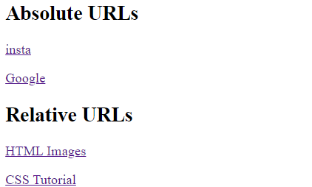
Absolute URLs vs. Relative URLs
<!DOCTYPE html>
<html>
<body>
<h2>Absolute URLs</h2>
<p><a href="https://www.instagram.org/">insta</a></p>
<p><a href="https://www.google.com/">Google</a></p>
<h2>Relative URLs</h2>
<p><a href="html_images.asp">HTML Images</a></p>
<p><a href="/css/default.asp">CSS Tutorial</a></p>
</body>
</html>
Output:
NOTE:: Both examples above are using an absolute
URL (a full web address) in the href attribute.
A local link (a link to a page within the same website) is specified with a relative URL (without the "https://www" part):

Slide 4
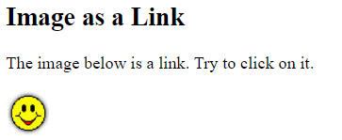
Image as a Link
<!DOCTYPE html>
<html>
<body>
<h2>Image as a Link</h2>
<p>The image below is a link. Try to click on it.</p>
<a href="default.asp"><img src="smiley.gif" alt="HTML tutorial" style="width:42px;height:42px;"></a>
</body>
</html>
Output:

Slide 5
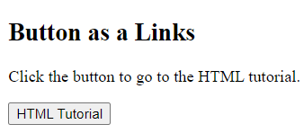
Button as a Links
<!DOCTYPE html>
<html>
<body>
<h2>Button as a Links</h2>
<p>Click the button to go to the HTML tutorial.</p>
<button onclick="document.location='default.asp'">HTML Tutorial</button>
</body>
</html>
Output:

Slide 6
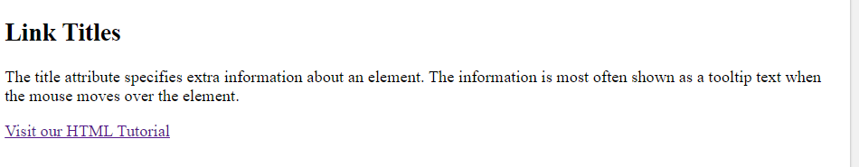
Link Titles
<!DOCTYPE html>
<html lang="en-US">
<body>
<h2>Link Titles</h2>
<p>The title attribute specifies extra information about an element. The information is most often shown as a tooltip text when the mouse moves over the element.</p>
<a href="https://www.w3schools.com/html/" title="Go to W3Schools HTML section">Visit our HTML Tutorial</a>
</body>
</html>
Output:

Slide 7
Link Button
<!DOCTYPE html>
<html>
<head>
<style>
a:link, a:visited {
background-color: #A52A2A;
color: white;
padding: 15px 25px;
text-align: center;
text-decoration: none;
display: inline-block;
}

Slide 8
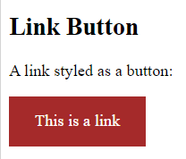
a:hover, a:active {
background-color: red;
}
</style>
</head>
<body>
<h2>Link Button</h2>
<p>A link styled as a button:</p>
<a href="default.asp" target="_blank">This is a link</a>
</body>
</html>
Output:

Slide 9
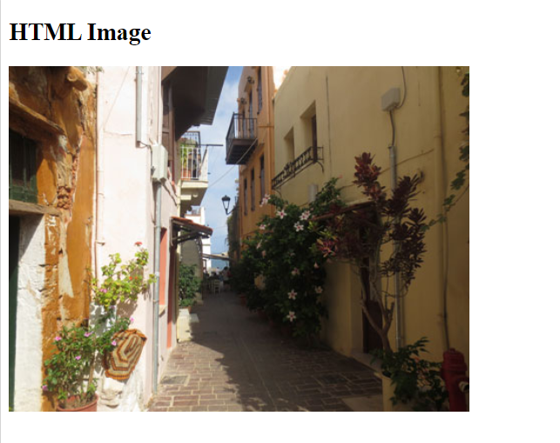
HTML Image
<!DOCTYPE html>
<html>
<body>
<h2>HTML Image</h2>
<img src="img_chania.jpg" alt="Flowers in Chania" width="460" height="345">
</body>
</html>
Output:

Slide 10
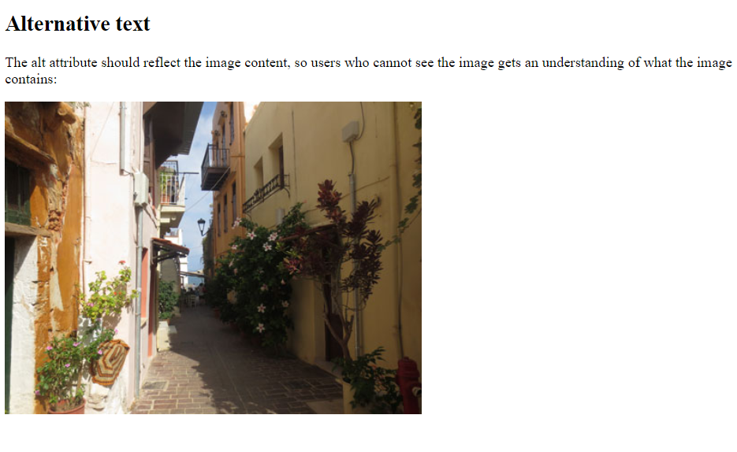
The src attribute
<!DOCTYPE html>
<html>
<body>
<h2>Alternative text</h2>
<p>The alt attribute should reflect the image content, so users who cannot see the image gets an understanding of what the image contains:</p>
<img src="img_chania.jpg" alt="Flowers in Chania" width="460" height="345">
</body>
</html>
Output:

Slide 11
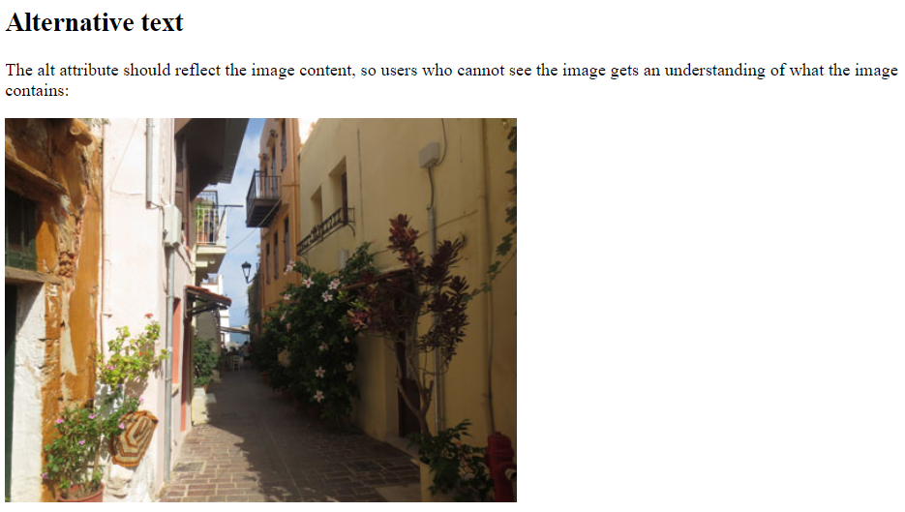
The alt attribute
<!DOCTYPE html>
<html>
<body>
<h2>Alternative text</h2>
<p>The alt attribute should reflect the image content, so users who cannot see the image gets an understanding of what the image contains:</p>
<img src="img_chania.jpg" alt="Flowers in Chania" width="460" height="345">
</body>
</html>
Output:

Slide 12
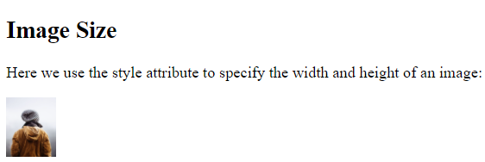
Image Size - Width and Height
<!DOCTYPE html>
<html>
<body>
<h2>Image Size</h2>
<p>Here we use the style attribute to specify the width and height of an image:</p>
<img src="img_girl.jpg" alt="Girl in a jacket" style="width:50px;height:60px;">
</body>
</html>
Output:

Slide 13
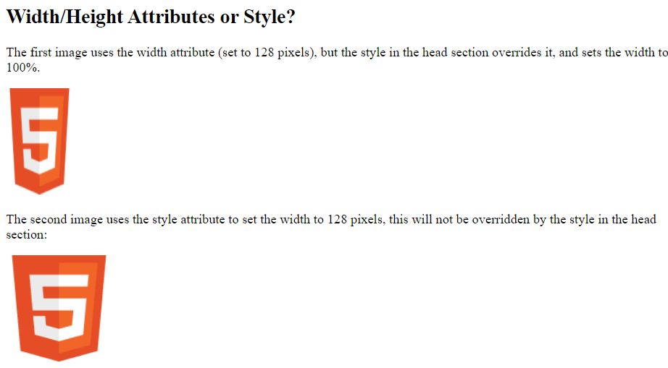
Width and Height, or Style?
<!DOCTYPE html>
<html>
<head>
<style>
/* This style sets the width of all images to 100%: */
img {
width: 10%;
}
</style>
</head> Output:
<body>

Slide 14
<h2>Width/Height Attributes or Style?</h2>
<p>The first image uses the width attribute (set to 128 pixels), but the style in the head section overrides it, and sets the width to 100%.</p>
<img src="html5.gif" alt="HTML5 Icon" width="12" height="128">
<p>The second image uses the style attribute to set the width to 128 pixels, this will not be overridden by the style in the head section:</p>
<img src="html5.gif" alt="HTML5 Icon" style="width:128px;height:128px;">
</body>
</html>

Slide 15
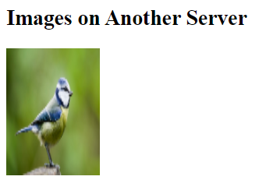
Images on Another Server
<!DOCTYPE html>
<html>
<body>
<h2>Images on Another Server</h2>
<img src="https://www.thespruce.com/thmb/rk3DGZLrlgEOprRfSwKqKopUzk4=/2121x1193/smart/filters:no_upscale()/Bird-GettyImages-582446599-58ec5c4d5f9b58ef7e24e7f4.jpg" alt="https://www.thespruce.com/" style="width:104px;height:142px;"
</body>
</html>
Output:

Slide 16
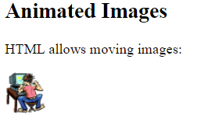
Animated Images
<!DOCTYPE html>
<html>
<body>
<h2>Animated Images</h2>
<p>HTML allows moving images:</p>
<img src="programming.gif" alt="Computer man" style="width:48px;height:48px;">
</body>
</html>
Output:

Slide 17
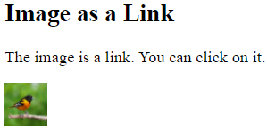
Image as a Link
<!DOCTYPE html>
<html>
<body>
<h2>Image as a Link</h2>
<p>The image is a link. You can click on it.</p>
<a href="default.asp">
<img src="https://static.scientificamerican.com/sciam/cache/file/7A715AD8-449D-4B5A-ABA2C5D92D9B5A21_source.png" alt="https://www.scientificamerican.com/" style="width:42px;height:42px;">
</a>
</body>
</html>
Output:

Slide 18
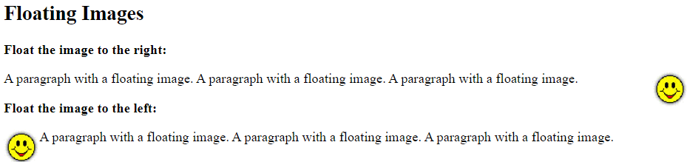
Floating Images
<!DOCTYPE html>
<html>
<body>
<h2>Floating Images</h2>
<p><strong>Float the image to the right:</strong></p>
<p>
<img src="smiley.gif" alt="Smiley face" style="float:right;width:42px;height:42px;">
A paragraph with a floating image. A paragraph with a floating image. A paragraph with a floating image.
</p>
<p><strong>Float the image to the left:</strong></p>
<p>
<img src="smiley.gif" alt="Smiley face" style="float:left;width:42px;height:42px;">
A paragraph with a floating image. A paragraph with a floating image. A paragraph with a floating image.
</p>
</body>
</html>
Output:

Slide 19
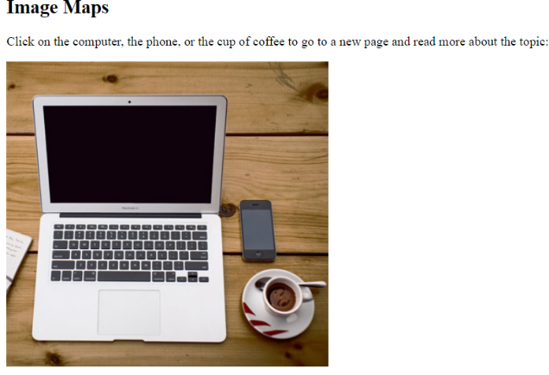
Image Maps
<!DOCTYPE html>
<html>
<body>
<h2>Image Maps</h2>
<p>Click on the computer, the phone, or the cup of coffee to go to a new page and read more about the topic:</p>
<img src="workplace.jpg" alt="Workplace" usemap="#workmap" width="400" height="379">
<map name="workmap">
<area shape="rect" coords="34,44,270,350" alt="Computer" href="computer.htm">
<area shape="rect" coords="290,172,333,250" alt="Phone" href="phone.htm">
<area shape="circle" coords="337,300,44" alt="Cup of coffee" href="coffee.htm">
</map>
</body> Output:
</html>

Slide 20

Background Image
<!DOCTYPE html>
<html>
<head>
<style>
body {background-image: url('img_girl.jpg’);}
</style>
</head>
<body>
<h2>Background Image</h2>
<p>By default, the background image will repeat itself if it is smaller than the element .</p>
</body>
</html>
Output:

Slide 21
HTML Table
<!DOCTYPE html>
<html>
<head>
<style>
table {
font-family: arial, sans-serif;
border-collapse: collapse;
width: 100%;}
td, th {border: 1px solid #33FF5A;
text-align: left;
padding: 8px;}
tr:nth-child(even) { background-color: #33FF5A;}
</style>
</head>
<body>
<h2>HTML Table</h2>
<table>
<tr>
<th>Name</th>
<th>Age</th>
<th>Marks</th>
</tr>

Slide 22
<tr>
<td>Mihir</td>
<td>19</td>
<td>98</td>
</tr>
<tr>
<td>Arjun</td>
<td>19</td>
<td>97</td>
</tr>
<tr>
<td>Vedant</td>
<td>20</td>
<td>96</td>
</tr>
<tr>
<td>Yash</td>
<td>19</td>
<td>93</td>
</tr>
<tr>

Slide 23
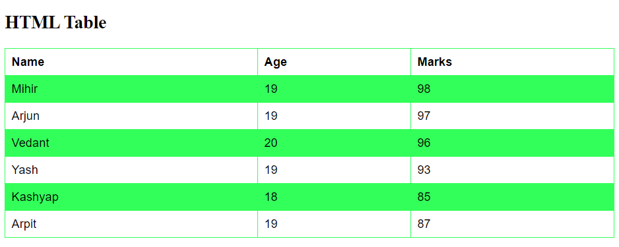
<td>Kashyap</td>
<td>18</td>
<td>85</td>
</tr>
<tr>
<td>Arpit</td>
<td>19</td>
<td>87</td>
</tr>
</table>
</body>
</html>
Output:

Slide 24
Table With Border
<!DOCTYPE html>
<html>
<head>
<style>
table, th, td {
border: 1px solid black;
}
</style>
</head>
<body>
<h2>Table With Border</h2>
<p>Use the CSS border property to add a border to the table.</p>
<table style="width:100%">
<tr>
<th>Firstname</th>
<th>Lastname</th>
<th>Age</th>
</tr>
<tr>
<td>Jill</td>
<td>Smith</td>
<td>50</td>
</tr>

Slide 25
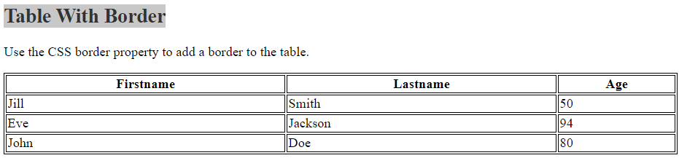
<tr>
<td>Eve</td>
<td>Jackson</td>
<td>94</td>
</tr>
<tr>
<td>John</td>
<td>Doe</td>
<td>80</td>
</tr>
</table>
</body>
</html>
Output:

Slide 26
Cellpadding with left align , border space
<!DOCTYPE html>
<html>
<head>
<style>
table, th, td {
border: 1px solid black;
border-collapse: collapse;
}
th, td {
padding: 15px;
}
th {
text-align: left;
}
table {
border-spacing: 15px;
}
</style>
</head>
<body>

Slide 27
<h2>Cellpadding</h2>
<p>Cell padding specifies the space between the cell content and its borders.</p>
<table style="width:100%">
<tr>
<th>Firstname</th>
<th>Lastname</th>
<th>Age</th>
</tr>
<tr>
<td>Mihir</td>
<td>Chauhan</td>
<td>60</td>
</tr>
<tr>
<td>Arjun</td>

Slide 28
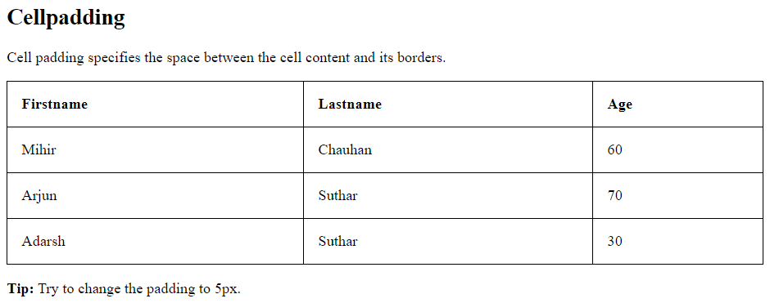
<td>Suthar</td>
<td>70</td>
</tr>
<tr>
<td>Adarsh</td>
<td>Suthar</td>
<td>30</td>
</tr>
</table>
<p><strong>Tip:</strong> Try to change the padding to 5px.</p>
</body>
</html>
Output:

Slide 29
Cell that spans two columns
<!DOCTYPE html>
<html>
<head>
<style>
table, th, td {
border: 1px solid black;
border-collapse: collapse;
}
th, td {
padding: 5px;
text-align: left;
}
</style>
</head>
<body>
<h2>Cell that spans two columns</h2>
<p>To make a cell span more than one column, use the colspan attribute.</p>
<table style="width:100%">

Slide 30
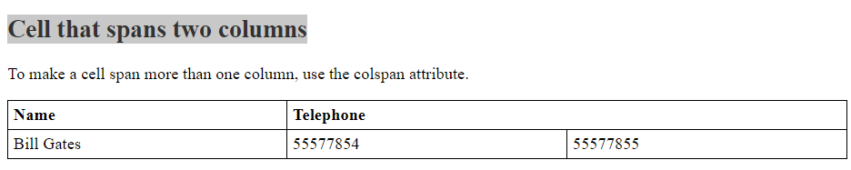
<tr>
<th>Name</th>
<th colspan="2">Telephone</th>
</tr>
<tr>
<td>Bill Gates</td>
<td>55577854</td>
<td>55577855</td>
</tr>
</table>
</body>
</html>
Output:

Slide 31
Cell that spans two rows
<!DOCTYPE html>
<html>
<head>
<style>
table, th, td {
border: 1px solid black;
border-collapse: collapse;
}
th, td {
padding: 5px;
text-align: left;
}
#t01 {
width: 100%;
background-color: #33FFDF;
}
</style>
</head>
<body>
<h2>Cell that spans two rows</h2>
<p>To make a cell span more than one row, use the rowspan attribute.</p>
<table style="width:100%">
<table id="t01">
<tr>

Slide 32
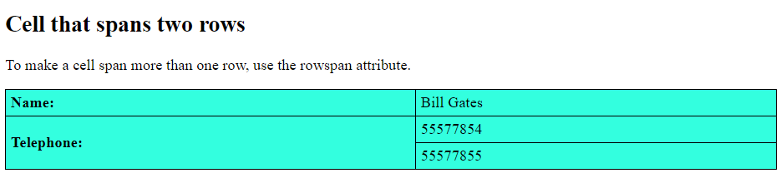
<th>Name:</th>
<td>Bill Gates</td>
</tr>
<tr>
<th rowspan="2">Telephone:</th>
<td>55577854</td>
</tr>
<tr>
<td>55577855</td>
</tr>
</table>
</body>
</html>
Output:

Slide 33
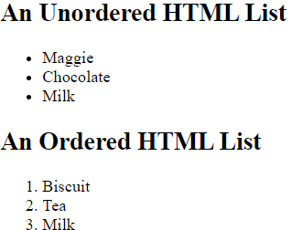
An Unordered and ordered HTML List
<!DOCTYPE html>
<html>
<body>
<h2>An Unordered HTML List</h2>
<ul>
<li>Maggie</li>
<li>Chocolate</li>
<li>Milk</li>
</ul>
<h2>An Ordered HTML List</h2>
<ol>
<li>Biscuit</li>
<li>Tea</li>
<li>Milk</li>
</ol>
</body>
</html>
Output:

Slide 34
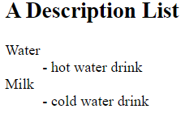
A Description List
<!DOCTYPE html>
<html>
<body>
<h2>A Description List</h2>
<dl>
<dt>Water</dt>
<dd>- hot water drink</dd>
<dt>Milk</dt>
<dd>- cold water drink</dd>
</dl>
</body>
</html>
Output:

Slide 35
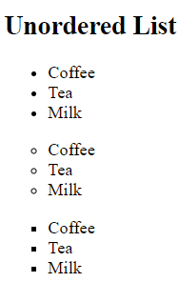
Unordered List
<!DOCTYPE html>
<html>
<body>
<h2>Unordered List </h2>
<ul style="list-style-type:disc;">
<li>Coffee</li>
<li>Tea</li>
<li>Milk</li>
</ul>
<ul style="list-style-type:circle">
<li>Coffee</li>
<li>Tea</li>
<li>Milk</li>
</ul>
<ul style="list-style-type:square;">
<li>Coffee</li>
<li>Tea</li>
<li>Milk</li>
</ul>
</body>
</html>
Output:

Slide 36
Ordered List
<!DOCTYPE html>
<html>
<body>
<h2>Ordered List </h2>
<ol type="1">
<li>Coffee</li>
<li>Tea</li>
<li>Milk</li>
</ol>
<ol type="A">
<li>Coffee</li>
<li>Tea</li>
<li>Milk</li>
</ol>
<ol type="a">
<li>Coffee</li>
<li>Tea</li>
<li>Milk</li>
</ol>

Slide 37
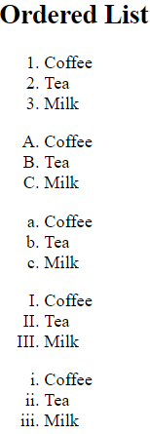
<ol type="I">
<li>Coffee</li>
<li>Tea</li>
<li>Milk</li>
</ol>
<ol type="i">
<li>Coffee</li>
<li>Tea</li>
<li>Milk</li>
</ol>
</body>
</html>
Output:

Slide 38
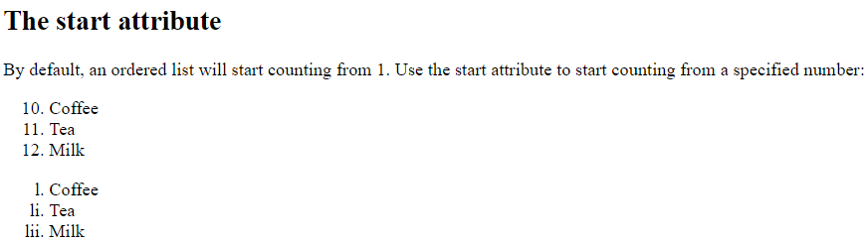
Control List Counting
<!DOCTYPE html>
<html>
<body>
<h2>The start attribute</h2>
<p>By default, an ordered list will start counting from 1. Use the start attribute to start counting from a specified number:</p>
<ol start="10">
<li>Coffee</li>
<li>Tea</li>
<li>Milk</li>
</ol>
<ol type="i" start="50">
<li>Coffee</li>
<li>Tea</li>
<li>Milk</li>
</ol>
</body>
</html>
Output:

Slide 39
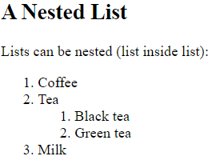
Nested HTML Lists
<!DOCTYPE html>
<html>
<body>
<h2>A Nested List</h2>
<p>Lists can be nested (list inside list):</p>
<ol>
<li>Coffee</li>
<li>Tea
<ol>
<li>Black tea</li>
<li>Green tea</li>
</ol>
</li>
<li>Milk</li>
</ol>
</body>
</html>
Output:

Slide 40
Thank You

