Slide 1
ICTW(A)-HTML
Name : Adarsh Suthar
Roll no : CE124
Assignment : 3
Lab no : 3
Aim :Learning to create HTML form and form validation on front end using appropriate HTML tags.

Slide 2
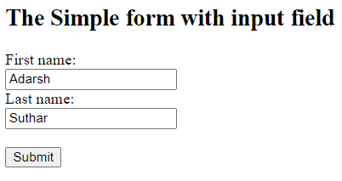
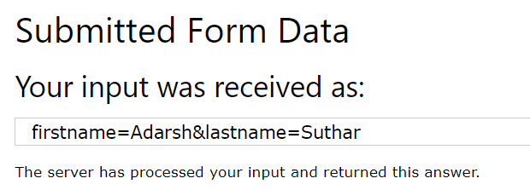
The Simple form with input field
<!DOCTYPE html>
<html>
<body>
<h2>The Simple form with input field</h2>
<form action="/action_page.php">
<label for="fname">First name:</label><br>
<input type="text" id="fname" value="Adarsh"><br>
<label for="fname1">Last name:</label><br>
<input type="text" id="fname1" value="Suthar"><br><br>
<input type="submit" value="Submit">
</form>
</body>
</html>
Output:

Slide 3
HTML Forms
<!DOCTYPE html>
<html>
<body>
<h2>HTML Forms</h2>
<form action="/action_page.php">
<label for="fname">First name:</label><br>
<input type="text" id="fname" name="fname" value="John"><br>
<label for="lname">Last name:</label><br>
<input type="text" id="lname" name="lname" value="Doe"><br><br>
Gender:
<input type="radio" id="Rb" name="Rb" value="Rb">
<label for="Rb">Male</label>
<input type="radio" id="Rb1" name="Rb1" value="Rb1">
<label for="Rb1">Female</label><br><br>
Hobby:

Slide 4
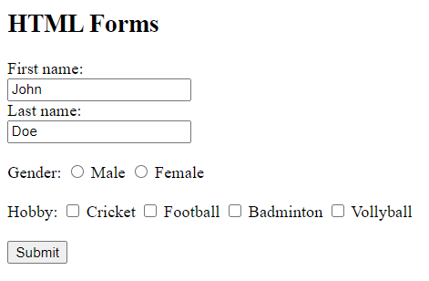
<input type="checkbox" id="ch" name="ch" value="ch">
<label for="ch">Cricket</label>
<input type="checkbox" id="ch1" name="ch1" value="ch1">
<label for="ch1">Football</label>
<input type="checkbox" id="ch2" name="ch2" value="ch2">
<label for="ch2">Badminton</label>
<input type="checkbox" id="ch3" name="ch3" value="ch3">
<label for="ch3">Vollyball</label><br><br>
<input type="submit" value="Submit">
</form>
</body>
</html>
Output:

Slide 5
The method,autocomplete,target,action Attribute
<!DOCTYPE html>
<html>
<body>
<h2>The method,autocomplete,target,action Attribute</h2>
<p>The action attribute defines the action to be performed when the form is submitted.</p>
<p>The target attribute specifies where to display the response that is received after submitting the form.</p>
<p>The method attribute specifies the HTTP method to be used when submitting the form data.</p>
<p>The autocomplete attribute specifies whether a form should have autocomplete on or off.
</p>
<p>The novalidate attribute is a boolean attribute.</p>

Slide 6
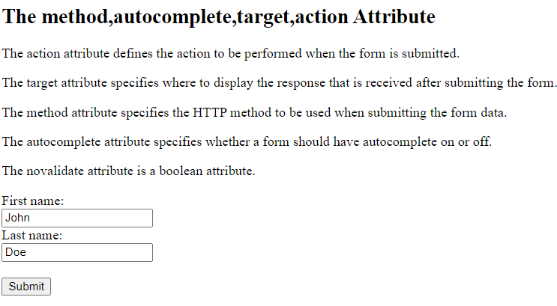
<form action="/action_page.php" target="_blank" method="post" autocomplete="on" novalidate>
<label for="fname">First name:</label><br>
<input type="text" id="fname" name="fname" value="John"><br>
<label for="lname">Last name:</label><br>
<input type="text" id="lname" name="lname" value="Doe"><br><br>
<input type="submit" value="Submit">
</form>
</body>
</html>
Output:

Slide 7
Html form Elements
<!DOCTYPE html>
<html>
<body>
<h2>The select Element</h2>
<p>The select element defines a drop-down list:</p>
<button type="button" onclick="alert('Hello User!')">Click Me!</button><br><br>
<form action="/action_page.php">
<label for="language">Choose a Language:</label>
<select id="l1" name="language" >
<option value="c">C</option>
<option value="c">C++</option>
<option value="html">HTML</option>
<option value="php">PHP</option>
</select><br><br>
<form action="/action_page.php">
<label for="language">Choose a Language:</label>
<select id="l1" name="language" size="3" >
<option value="c">C</option>
<option value="c">C++</option>
<option value="html">HTML</option>
<option value="php">PHP</option>
</select><br> <br>

Slide 8
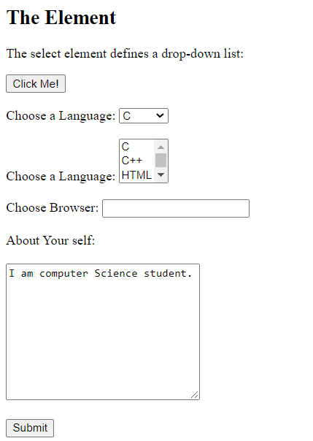
Choose Browser:
<input list="browsers" name="browser">
<datalist id="browsers">
<option value="Internet Explorer">
<option value="Firefox">
<option value="Chrome">
<option value="Opera">
<option value="Safari">
</datalist>
<br><br>
About Your self:
<br><br><textarea name="message" rows="1
0" cols="30">I am computer Science student.</textarea>
<br><br>
<input type="submit" value="Submit">
</form>
</body>
</html>
Output:

Slide 9
Validate Input
<!DOCTYPE html>
<html>
<body>
<h2>JavaScript Can Validate Input</h2>
<p>Please input a number between 1 and 10:</p>
<input id="numb">
<button type="button" onclick="myFunction()">Submit</button>
<p id="demo"></p>
<script>
function myFunction() {
var x, text;
// Get the value of the input field with id="numb"
x = document.getElementById("numb").value;

Slide 10
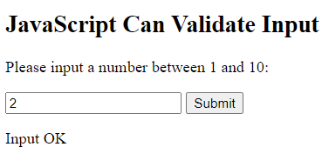
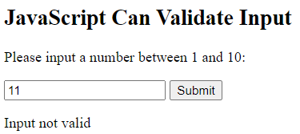
// If x is Not a Number or less than one or greater than 10
if (isNaN(x) || x < 1 || x > 10) {
text = "Input not valid";
} else {
text = "Input OK";
}
document.getElementById("demo").innerHTML = text;
}
</script>
</body>
</html>
Output:

Slide 11
Password Validation
<!DOCTYPE html>
<html>
<head>
<meta name="viewport" content="width=device-width, initial-scale=1">
<style>
/* Style all input fields */
input {
width: 100%;
padding: 12px;
border: 1px solid #

Slide 12
border-radius: 4px;
box-sizing: border-box;
margin-top: 6px;
margin-bottom: 16px;}
/* Style the submit button */
input[type=submit] {
background-color: #4CAF50;
color: white;}
/* Style the container for inputs */
.container {
background-color: #f1f1f1;
padding: 20px;
}

Slide 13
/* The message box is shown when the user clicks on the password field */
#message { display:none;
background: #f1f1f1;
color: #000;
position: relative;
padding: 20px;
margin-top: 10px;}
#message p { padding: 10px 35px;
font-size: 18px;}
/* Add a green text color and a checkmark when the requirements are right */
.valid {
color: green;
}

Slide 14
.valid:before {
position: relative;
left: -35px;
content: "✔";}
/* Add a red text color and an "x" when the requirements are wrong */
.invalid { color: red;}
.invalid:before { position: relative;
left: -35px;
content: "✖";}
</style>
</head>
<body>

Slide 15
<h3>Password Validation</h3>
<p>Try to submit the form.</p>
<div class="container">
<form action="/action_page.php">
<label for="usrname">Username</label>
<input type="text" id="usrname" name="usrname" required>
<label for="psw">Password</label>
<input type="password" id="psw" name="psw" pattern="(?=.*\d)(?=.*[a-z])(?=.*[A-Z]).{8,}" title="Must contain at least one number and one uppercase and lowercase letter, and at least 8 or more characters" required>
<input type="submit" value="Submit">
</form>
</div>
<div id="message">

Slide 16
<h3>Password must contain the following:</h3>
<p id="letter" class="invalid">A <b>lowercase</b> letter</p>
<p id="capital" class="invalid">A <b>capital (uppercase)</b> letter</p>
<p id="number" class="invalid">A <b>number</b></p>
<p id="length" class="invalid">Minimum <b>8 characters</b></p>
</div>
<script>
var myInput = document.getElementById("psw");
var letter = document.getElementById("letter");
var capital = document.getElementById("capital");
var number = document.getElementById("number");
var length = document.getElementById("length");

Slide 17
// When the user clicks on the password field, show the message box
myInput.onfocus = function() {document.getElementById("message").style.display = "block";}
// When the user clicks outside of the password field, hide the message box
myInput.onblur = function() {document.getElementById("message").style.display = "none";}
// When the user starts to type something inside the password field
myInput.onkeyup = function() {
// Validate lowercase letters
var lowerCaseLetters = /[a-z]/g;
if(myInput.value.match(lowerCaseLetters)) {
letter.classList.remove("invalid");
letter.classList.add("valid");
}

Slide 18
else {
letter.classList.remove("valid");
letter.classList.add("invalid");}
// Validate capital letters
var upperCaseLetters = /[A-Z]/g;
if(myInput.value.match(upperCaseLetters)) {
capital.classList.remove("invalid");
capital.classList.add("valid");}
else {
capital.classList.remove("valid");
capital.classList.add("invalid");
}
// Validate numbers

Slide 19
var numbers = /[0-9]/g;
if(myInput.value.match(numbers)) {
number.classList.remove("invalid");
number.classList.add("valid");
} else {
number.classList.remove("valid");
number.classList.add("invalid"); }
// Validate length
if(myInput.value.length >= 8) {
length.classList.remove("invalid");
length.classList.add("valid");
} else {
length.classList.remove("valid");
length.classList.add("invalid");}

Slide 20
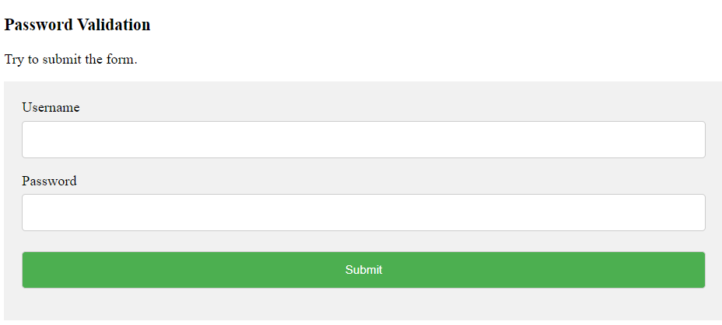
}
</script>
</body>
</html>
Output:

Slide 21
