Slide 1
ICTW(b)-PHP
Name : Adarsh Suthar
Roll no : CE124
Assignment : 1

Slide 2
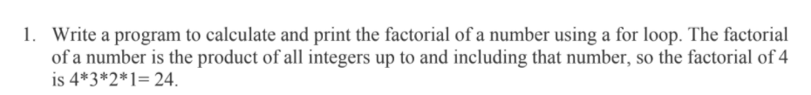

Code 1 :
<?php
$i=4; Output :
$fact=1;
for(;$i!=0;$i--)
{
$fact*=$i;
}
echo "the factorial of 4 is $fact";
?>

Slide 3
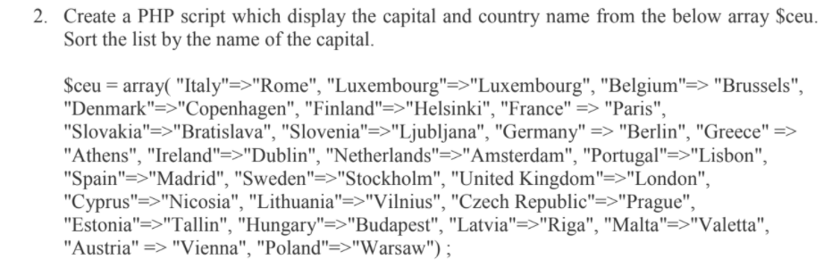
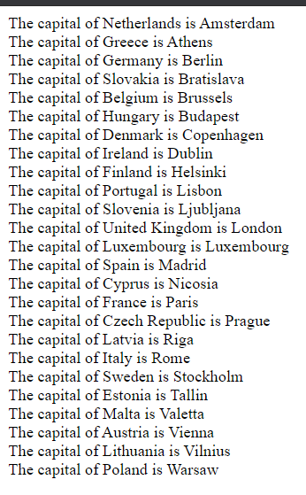
Code 2 :
<?php
$ceu = array( "Italy"=>"Rome", "Luxembourg"=>"Luxembourg", "Belgium"=> "Brussels", Output :
"Denmark"=>"Copenhagen", "Finland"=>"Helsinki", "France" => "Paris",
"Slovakia"=>"Bratislava", "Slovenia"=>"Ljubljana", "Germany" => "Berlin", "Greece" =>
"Athens", "Ireland"=>"Dublin", "Netherlands"=>"Amsterdam", "Portugal"=>"Lisbon",
"Spain"=>"Madrid", "Sweden"=>"Stockholm", "United Kingdom"=>"London",
"Cyprus"=>"Nicosia", "Lithuania"=>"Vilnius", "Czech Republic"=>"Prague",
"Estonia"=>"Tallin", "Hungary"=>"Budapest", "Latvia"=>"Riga", "Malta"=>"Valetta",
"Austria" => "Vienna", "Poland"=>"Warsaw") ;
asort($ceu);
foreach($ceu as $i=>$y)
{
echo "The capital of " . $i . " is " . $y;
echo "<br>";
}
?>

Slide 4
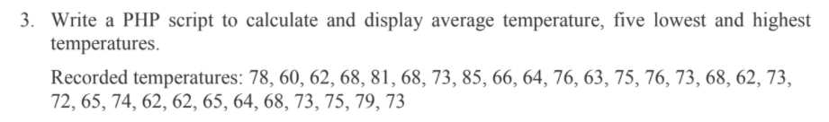

Code 3 :
<?php
$j=0;
$sum=0;
$a = array(78, 60, 62, 68, 81, 68, 73, 85, 66, 64, 76, 63, 75, 76, 73, 68, 62, 73,72, 65, 74,62, 62, 65, 64, 68, 73, 75, 79, 73);
echo "<br>";
foreach($a as $i){$sum+=$i;
$j++;}
echo "<br>";
$sum/=$j;
echo "average temperature is $sum";
$count=0;
sort($a);
echo "<br> List of five lowest temperatures : $a[0]"; Output :
$i=1;
$x=1;
while($i!=5){if($a[$x]>$a[($x)-1]){
echo ",$a[$x]";
$i++;
}
$x++;
}
rsort($a);
echo "<br> List of five highest temperatures : ";
for ($x=5;$x>=0;$x--)
{
echo "$a[$x]";
if($x!=0)
echo ",";}
?>

Slide 5

Code 4 :
<?php Output :
$date1=date_create(date("2002-12-16"));
$date2=date_create("2021-07-06");
$diff=date_diff($date1,$date2);
echo $diff->format("%R%a days");
?>

Slide 6
Code 5 :
<?php
$arr1=array('he','is','playing','cricket','well','at','ground');
$arr2=array('she','is','playing','tennis','well','at','ground’); Output :
$union = array_unique(array_merge($arr1, $arr2));
echo "the unique words in both string are : ";
print_r($union);
$intersection= array_intersect($arr1, $arr2);
echo "<br>";
echo "the intersection words in both string are : ";
print_r($intersection);
echo "<br>";
echo "the different words in first string are : ";
$diffrence=array_diff($arr1,$arr2);
print_r($diffrence);
echo "<br>";
echo "the different words in second string are : ";
$diffrence=array_diff($arr2,$arr1);
print_r($diffrence);
?>

Slide 7


Code 6 :
<?php
function ch_palindrome($string) Output :
{
if($string==strrev($string))
return 1;
else
return 0;
}
$string= "madam";
if(ch_palindrome($string))
echo "The given string : " . "$string" . " is palindrome";
else
echo "The given string : " . "$string" . " is not palindrome";
?>

