Slide 1
Physics
Name : Suthar Adarsh Sujalkumar
Roll No : CE124
ID No : 20CEUBS017
Experiment : 3
Lab : 3
Aim:STUDY ABOUT THE HALF WAVE RECTIFIER AND FULL WAVE RECTIFIER. TO STUDY THE USE OF CAPACITOR FILTER. STUDY OF OTHER RECTIFYING CIRCUITS LIKE CLIPPERS.

Slide 2
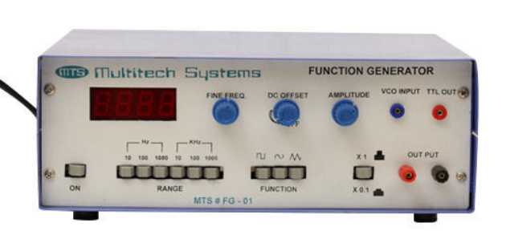
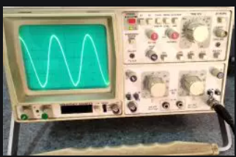
Task 1: Use of function generator and oscilloscope.
→ Function generator :
A function generator is a specific form of signal generator that is able to generate waveforms with common shapes. Unlike RF generators and some others that only create sine waves, the function generator is able to create repetitive waveforms with a number of common shapes.
→ Oscilloscope:
an oscilloscope is a sophisticated diagnostic instrument that draws a graph of an electrical signal. This graph can tell you many things about a signal, such as: The time and voltage values of a signal.

Slide 3
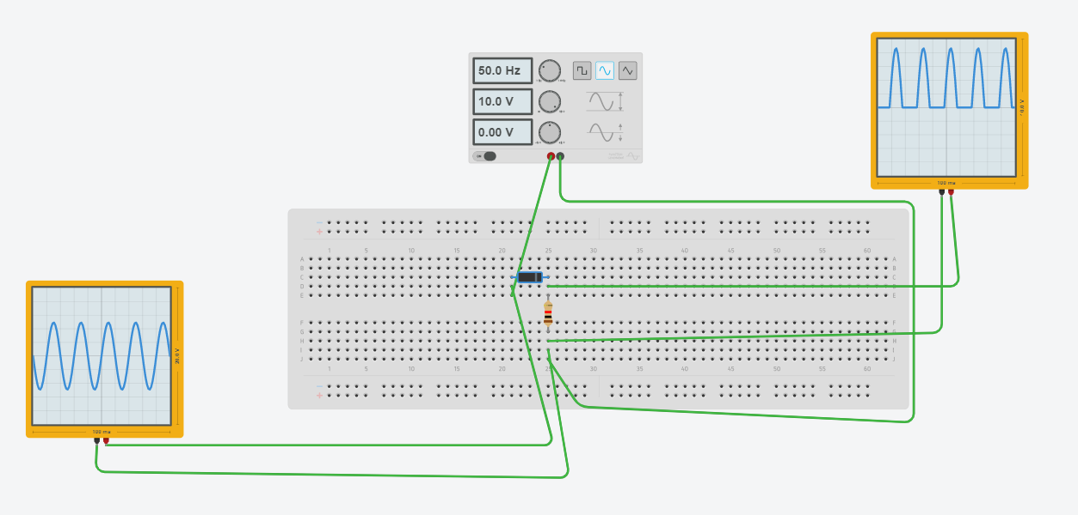
Task 2: Rectify the input sinusoidal voltage by removing the negative cycles. Consider RL=100ohm

Slide 4
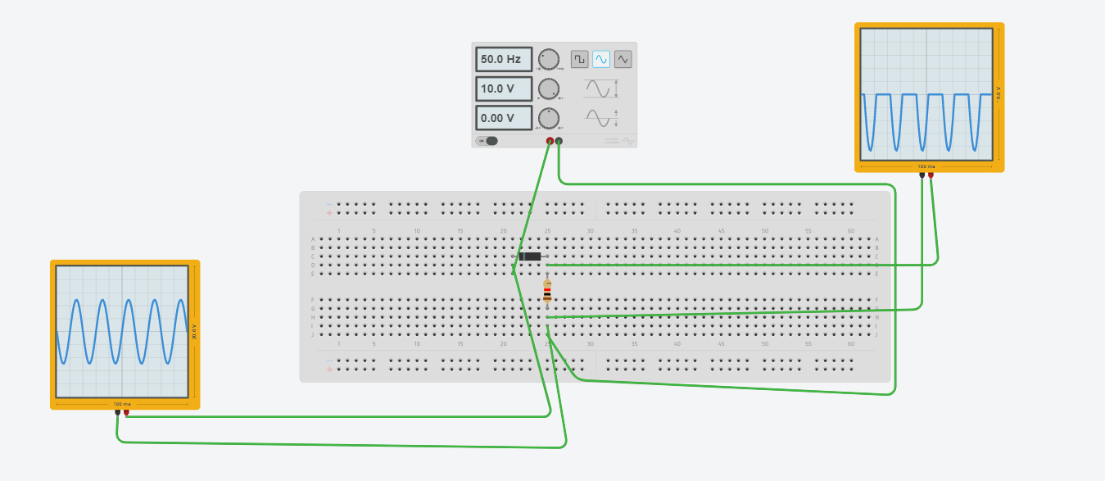
Task 3: Rectify the input sinusoidal voltage by removing the positive cycles.

Slide 5
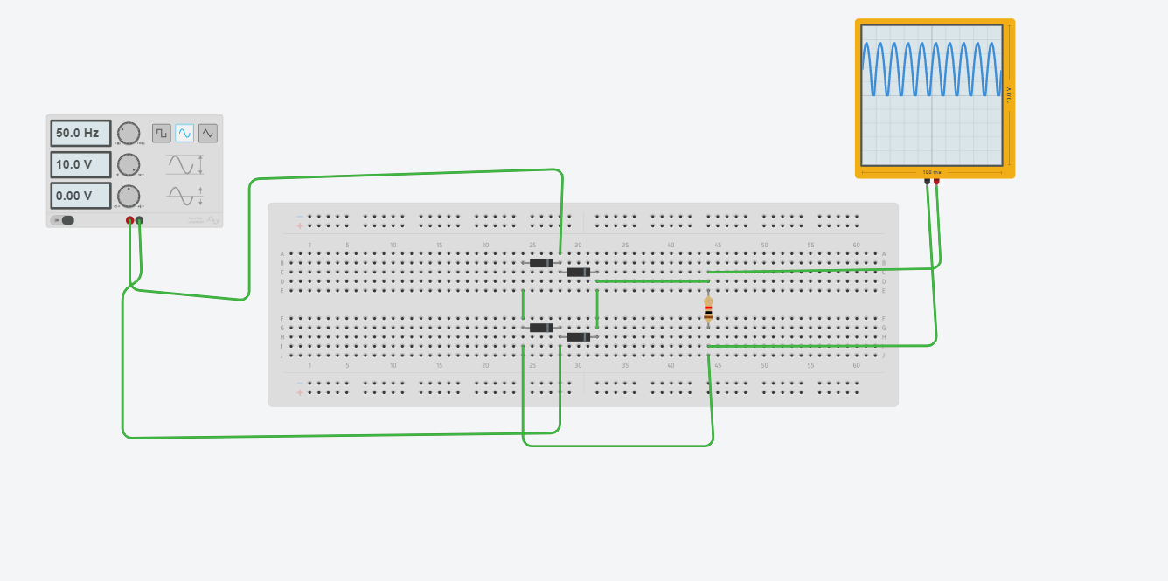
TASK 4: Implementation of full wave rectification. Consider the supply voltage amplitude 10 ; frequency 50Hz. Consider RL=1Kohm

Slide 6
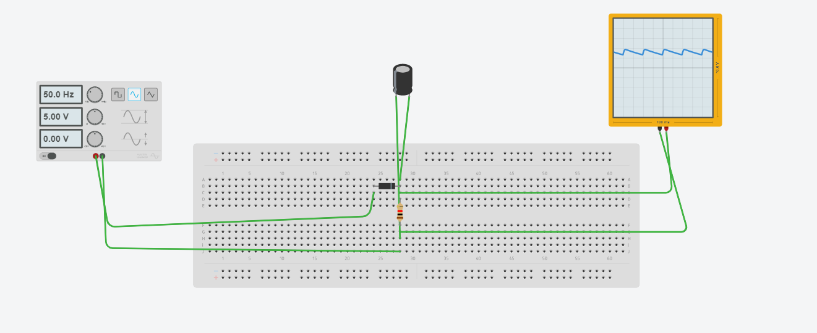
Task 5: Half wave rectification with capacitor filter. Apply the capacitor filter to designs in task 2 and task 3. Also study the impact of the capacitance (50 microfarad to 5 milifarad) on the waveforms. . Consider RL=1Kohm

Slide 7
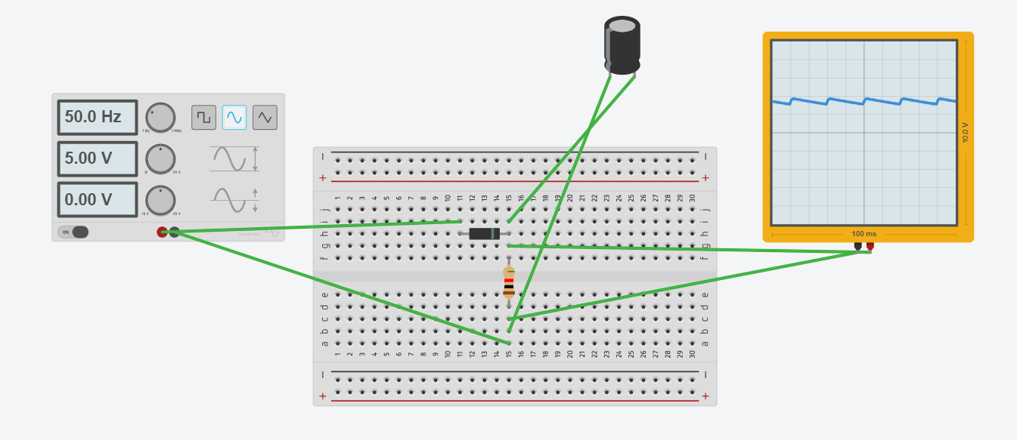
Task 5: Half wave rectification with capacitor filter. Apply the capacitor filter to designs in task 2 and task 3. Also study the impact of the capacitance (50 microfarad to 5 milifarad) on the waveforms. . Consider RL=1Kohm
100 uf:

Slide 8
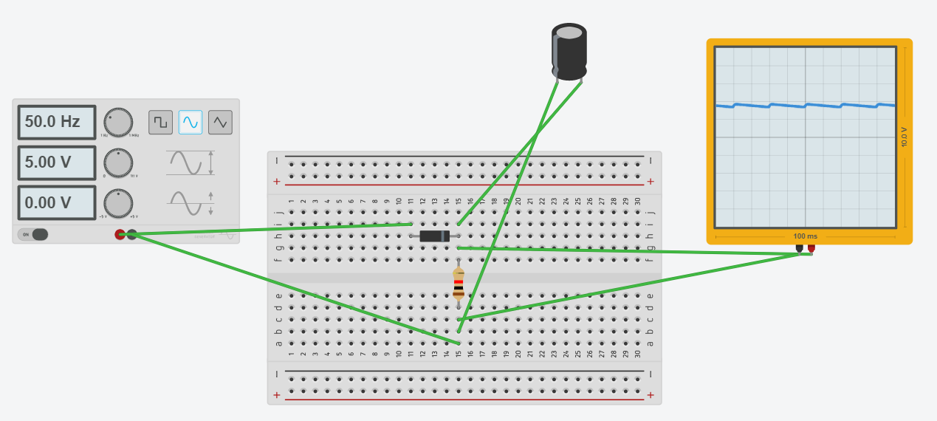
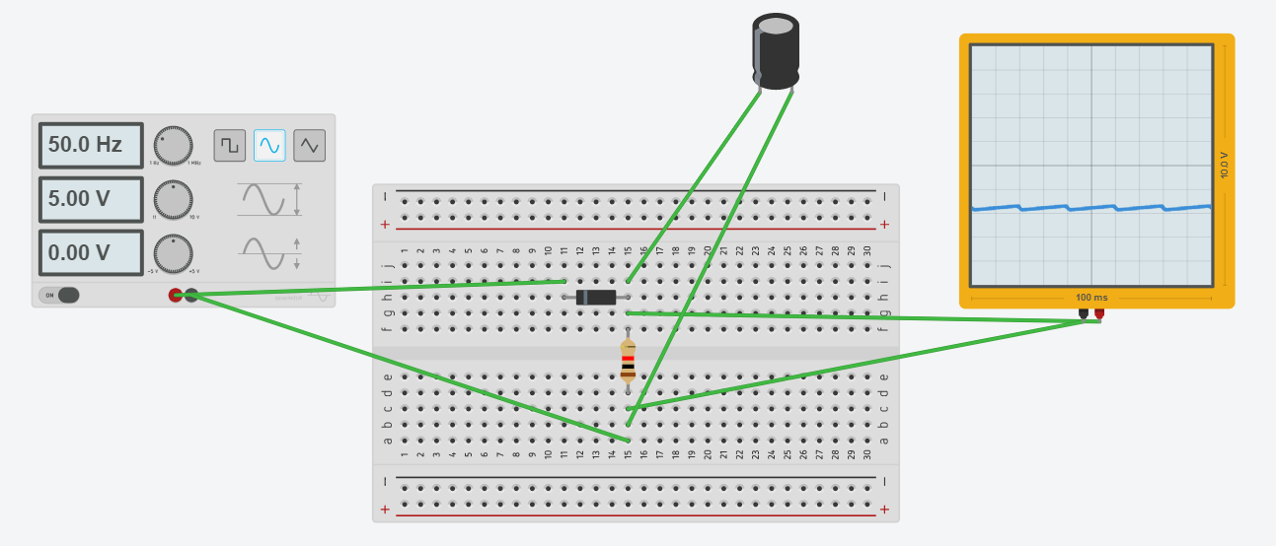
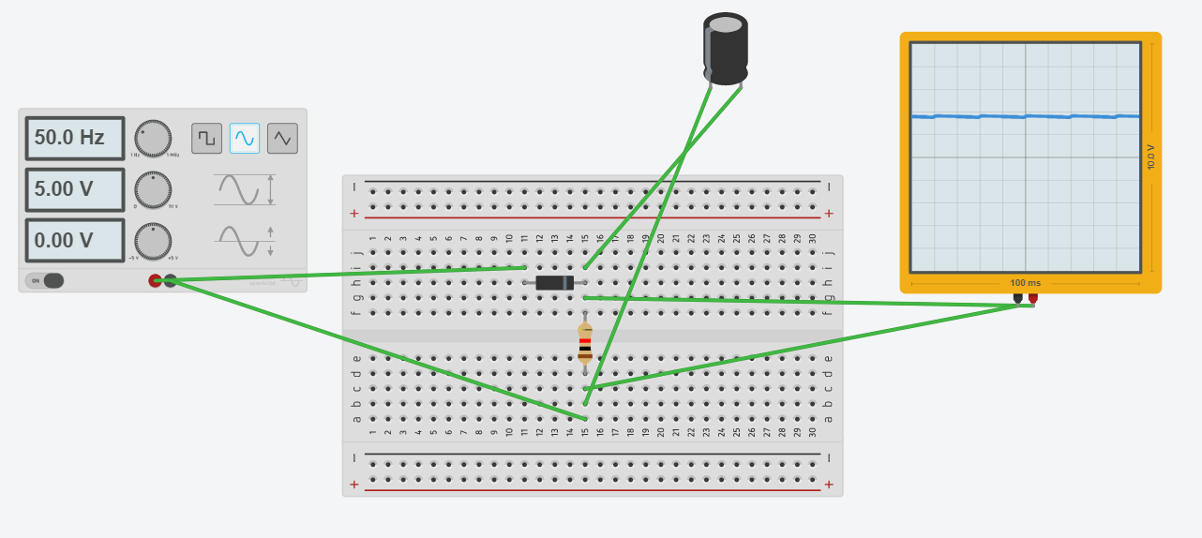
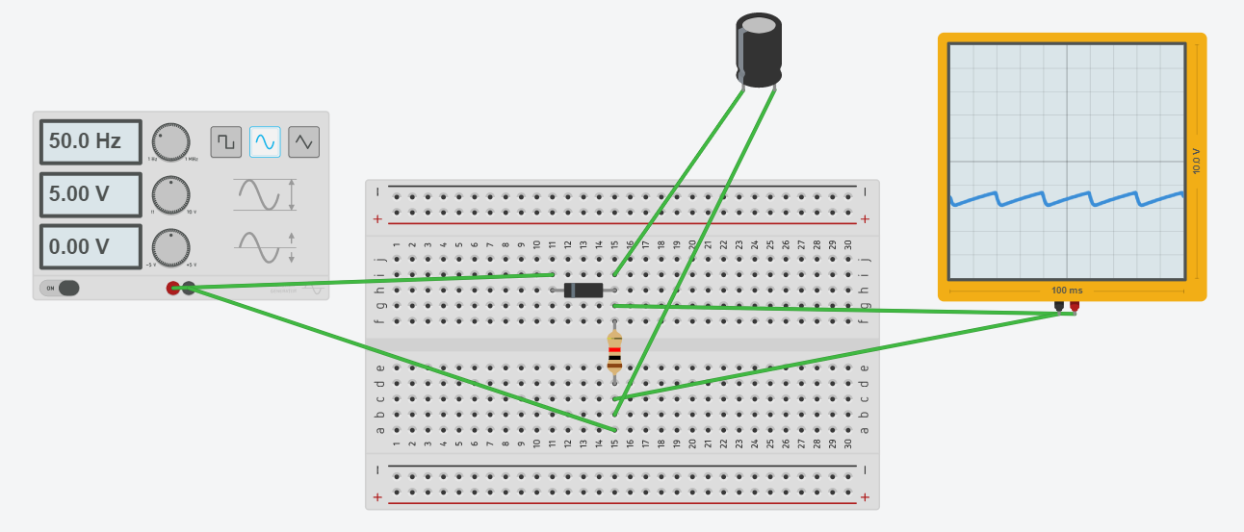
200 uf: 200 ufreverse bias :
500 uf: 50 ufreverse bias :

Slide 9
Task: 6 Understand the concept of clippers.
Clippers can be broadly classified into two basic types of circuits. They are: series clippers and shunt or parallel clippers. Series clipper circuit contains a power diode in series with the load connected at the end of the circuit. The shunt clipper contains a diode in parallel with the resistive load.
The half –wave rectifier circuit is similar to a series clipper circuit. If the diode in series clipper circuit is in forward bias condition, the output waveform at the load follows the input waveform. When the diode is in reverse bias and it is unable to conduct current, the output of the circuit is nearly zero volts.

Slide 10
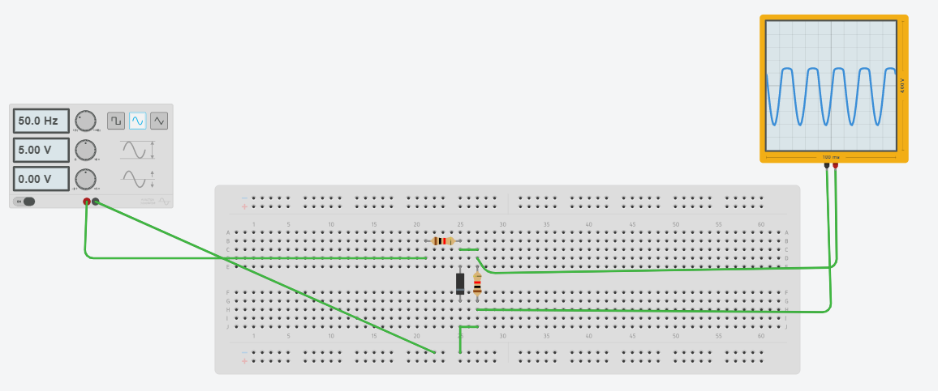
Task: 7 What is the expected output of this circuit? Simulate the same. Consider series resistance value 10 ohms, load resistance value 100 ohm. Consider the following Supply specifications: 10 V, 50Hz, 0 DC bias.

Slide 11
Task 8: Reverse the polarity of the diode. What is the expected output? Simulate the same .Consider series resistance value 10 ohms, load resistance value 100 ohm. Consider the following Supply specifications: 10 V, 50Hz, 0 DC bias.

Slide 12
Task 9: What is the expected output of the following circuit-Shunt Positive Clipper with Positive Shunt Bias Voltage?
Simulate the same . Consider series resistance value 10 ohms, load resistance value 100 ohm. Consider the following Supply specifications: 10 V, 50Hz, 0 DC bias. DC Reference voltage value is 3V DC.

Slide 13
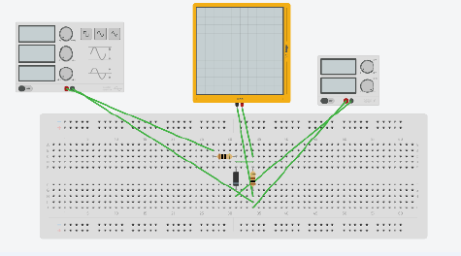
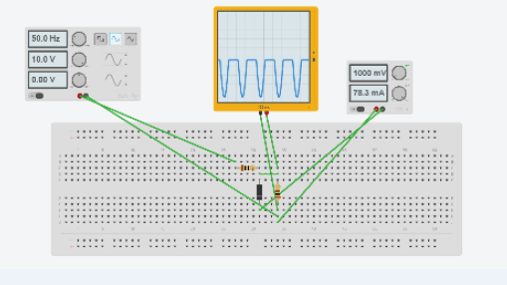
Task 10: What is the expected output of the following circuit-Shunt Positive Clipper with negative Shunt Bias Voltage? Simulate the same. Consider series resistance value 10 ohms,load resistance value 100 ohm. Consider the following Supply specifications: 10 V, 50Hz, 0 DC bias. DC Reference voltage value is 3V DC.

Slide 14
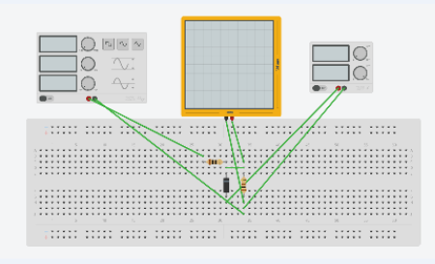
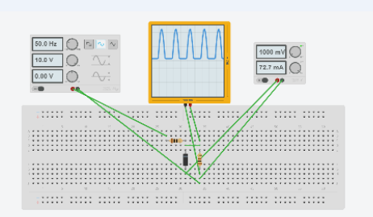
Task 11: What is the expected output of the following circuit-Shunt negative Clipper with Positive Shunt Bias Voltage? Simulate the same. Consider series resistance value 10 ohms, load resistance value 100 ohm. Consider the following Supply specifications: 10 V, 50Hz, 0 DC bias. DC Reference voltage value is 3V DC.

Slide 15
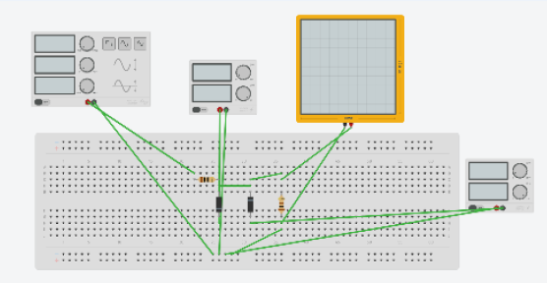
Task 12: What is the expected output of the following circuit? Simulate the same. Consider series resistance value 10 ohms, load resistance value 100 ohm. Consider the following Supply specifications: 10 V, 50Hz, 0 DC bias. DC Reference voltage value VDC1=1V DC,VDC2=2V DC

