Slide 1

A Machine Learning Approach for Multilevel Stress Classification Using Physiological Signals from Wearable Devices
Department of Computer Science & Engineering
Team Members | SRN
Adarsh Kapse | 02FE23BCI014
Sakshi Galatage | 02FE23BCI020
Neil Rego | 02FE23BCI036
Ramakrishna Huddar | 02FE23BCI007
Under the Guidance of Dr.Prema.T.Akkasaligar

Slide 2
Introduction
As we know wearable devices such as smartwatches, fitness trackers, and wristbands have become increasingly popular for continuous health monitoring and lifestyle management. This study focuses on stress detection using two wearable devices — Empatica E4 and Polar H10. With wearable technology playing a key role in health monitoring, the research aims to compare how accurately these devices measure physiological signals related to stress. Using supervised machine learning techniques such as resampling, feature extraction, and clustering, the study analyzes and compares the signals recorded by both devices. The goal is to identify which device provides more reliable data for stress detection and to offer insights that can help improve the use of wearable technologies in healthcare research.

Slide 3
Literature survey
Author (Year) | Approach | Methodology | Dataset | Disadvantages
Terasawa et al. (2023) | Smartwatch fitness tracking comparison | Evaluated Garmin, Mi, Huawei vs real-world activity | Free-living activity dataset | Accuracy drops with irregular movement
Wouters et al. (2025) | Validation of consumer devices for AF detection | Compared Apple Watch, KardiaMobile, PPG apps vs 12-lead ECG | Clinical AF patients | PPG accuracy inconsistent, highly user dependent
Theurl et al. (2023) | Smartwatch vs ECG in patients | Compared Garmin vivoactive 4 PPG signals against ECG | Cardiovascular patients | PPG unreliable during high motion
Coste et al. (2025) | HRV validation across body positions | Compared Polar H10 vs Polar OH1 under multiple postures | HRV dataset under varied positions | PPG limited under motion
Sartor et al. (2023) | Wrist vs chest HR comparison | Compared optical wrist sensors with Polar H10 chest strap | Healthy and cardiac subjects | Wrist sensors inaccurate during vigorous activity

Slide 4
Literature survey
Author (Year) | Approach | Methodology | Dataset | Disadvantages
Edubirdie et al. (2022) | Comparative wearable HR study | Compared Fitbit, Mio, Scosche, Garmin, and Polar H7 with ECG | Exercise dataset | Tested on older-generation devices
Sibomana et al. (2025) | Systematic AF detection review | Compared ECG patches with PPG-based smartwatches | Multiple AF studies | Heterogeneous designs reduce comparability
Luo et al. (2025) | Systematic AF smartwatch review | Compared ECG-based vs PPG-based devices | Aggregated AF datasets | ECG-based watches less accessible
Martín-Escudero et al. (2023) | Exercise-based HR validation | Compared Polar M600 vs ECG during intense workouts | High-intensity activity dataset | Accuracy drops with intensity
Schaffarczyk et al. (2022) | HRV chest strap validation | Compared Polar H10 vs ECG during rest and exercise | Recreational men and women | Chest straps less comfortable long-term

Slide 5
Literature survey
Author (Year) | Approach | Methodology | Dataset | Disadvantages
Flett et al. (2024) | PPG smartwatch accuracy study | Compared smartwatch PPG vs ECG chest strap | Controlled exercise dataset | Motion artifacts reduce accuracy
Umair et al. (2021) | HRV and stress monitoring | Compared chest-strap and wrist sensors for HRV | Controlled stress task dataset | Limited free-living validation
Lee et al. (2024) | Multicenter wearable validation | Evaluated 11 consumer devices | Multicenter dataset | Performance inconsistent across centers
Schyvens et al. (2025) | Sleep scoring validation | Compared six wrist devices vs PSG | PSG-based sleep dataset | Poor REM and deep sleep detection
Dial et al. (2025) | Nocturnal HRV validation | Compared Garmin, Oura, Fitbit, Apple, Whoop vs ECG | Nighttime HRV dataset | HRV algorithms inconsistent

Slide 6
Background of the problem
With the growing popularity of wearable health devices such as the Empatica E4 and Polar H10, continuous monitoring of physiological signals has become a practical way to study human stress levels in real time. These devices can record important biosignals like heart rate, blood volume pulse, and skin temperature, which are closely linked to stress detection. However, while each device has been individually validated for accuracy, there is limited research comparing their performance under the same conditions. Differences in sensor design, data quality, and signal processing make it challenging to determine which device provides more reliable results for stress prediction. Therefore, a comparative study using machine learning techniques is necessary to analyze how both devices perform in detecting stress and to provide a clearer understanding of their effectiveness in health monitoring applications.

Slide 7
Different solutions
1. Comparison of Consumer Smart Devices
Devices Used: Garmin, Mi, Huawei, Apple Watch, Polar H10, Empatica, Fitbit. Solution: Real-world validation of physiological signals (heart rate, HRV, PPG) to estimate stress levels. Technique: Comparison of wearable readings against gold-standard ECG to detect physiological variations linked to stress.
2. Heart Rate Variability (HRV) Analysis
Devices Used: Polar H10, Fitbit, Oura Ring, Whoop, Garmin. Solution: HRV features such as LF/HF ratio are used as key indicators of stress response. Technique: HRV time-domain and frequency-domain features computed from ECG or PPG data for stress classification.
3. Photoplethysmography (PPG) Signal Processing
Devices Used: Smartwatches and wristbands with optical sensors (Apple, Garmin, Huawei). Solution: Detection of stress using pulse wave amplitude, heart rate, and variability in PPG signals. Technique: Noise removal and signal smoothing followed by machine learning classification of stress vs. non-stress states.

Slide 8
4. Multimodal Physiological Data Fusion
Devices Used: Empatica E4 (BVP, EDA, temperature, accelerometer), Polar H10 (ECG, HR). Solution: Integration of multiple physiological parameters (EDA, HRV, skin temperature) to enhance stress detection accuracy. Technique: Feature extraction and fusion of biosignals analyzed using supervised ML algorithms like SVM and Random Forest.
5. Supervised Machine Learning Models
Approach: Stress classification using labeled physiological datasets. Techniques Used: Support Vector Machine (SVM), Random Forest (RF), Logistic Regression (LR), k-Nearest Neighbors (kNN). Input Features: Heart rate, HRV metrics, EDA peaks, temperature variation, and motion activity for stress prediction.
6. Sleep and Activity-Based Stress Prediction
Devices Used: Oura Ring, Fitbit, Polar M600. Solution: Identifying stress indirectly through changes in sleep quality and daily activity levels. Technique: Actigraphy-based monitoring and sleep–wake cycle analysis to detect deviations linked with stress.
7. Comparative Device Validation
Devices Compared: Chest straps (Polar H10, H7), armbands (Polar OH1), and wrist sensors. Solution: Evaluating the reliability of stress-related physiological parameters across sensor placements. Technique: Signal synchronization and correlation with ECG under rest, activity, and induced stress conditions.

Slide 9
Objectives
To design a framework to compare physiological signals collected from Empatica E4 and Polar H10 for effective stress detection.
To develop a preprocessing pipeline that includes resampling, merging, handling missing data, and feature extraction to prepare high-quality input data for analysis.
To implement supervised machine learning models including Random Forest, Logistic Regression, Decision Tree, XGBoost, CatBoost Classifiers , LightGBM Classifier ,MLP Classifier and Deep MLP Classifier for accurate stress level classification and comparison between devices.
To evaluate supervised models using metrics like Accuracy, Weighted F1-Score for effective stress detection between Empatica E4 and Polar H10.

Slide 10
Base Paper for Research
Dataset: 32 participants, each wearing six heart rate sensors (ECG[Electrocardiogram],PPG[Photoplethysmography], EDA[Electrodermal Activity]) during 70-minute stress and activity sessions.
Models used: K-Means, Hierarchial Clustering.
Key predictors: HRV features (time-domain, frequency-domain, nonlinear measures).
Methodology: Quantitative Analysis (Pearson and Spearman Correlation).
Limitations: Only a few classifiers were tested; multimodal models could provide better accuracy.

Slide 11
Tool learning
Jupyter Notebook → for experimentation, prototyping, and visualization.
Python → the go-to programming language for ML.
scikit-learn → classic ML algorithms (regression, classification, clustering, etc.).
NumPy & Pandas → data manipulation, preprocessing, and matrix operations.
Matplotlib & Seaborn → data visualization and exploratory data analysis.
TensorFlow → popular frameworks for neural networks.
PyTorch → flexible and widely used in research and production.

Slide 12
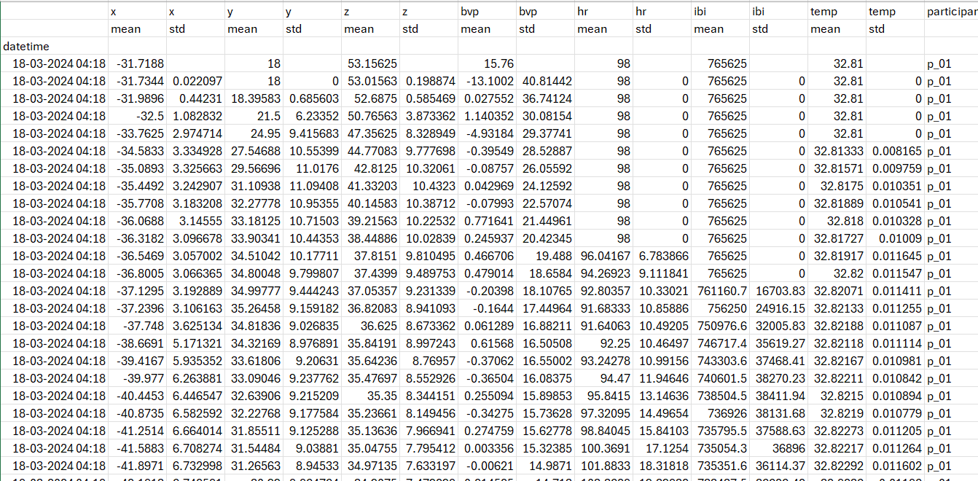
Dataset Description
Multimodal dataset collected from 24 participants using 2 wearable devices.
Devices include a chest-belts, wristbands.
Activities performed: resting, cycling, running – each for 10 minutes at two intensity levels.
Covers light, moderate, and vigorous movement intensities.
Sensors capture HR, BVP, ACC, ECG, TEMP, IBI
Dataset Link : https://zenodo.org/records/14635823

Slide 13
Requirement Analysis
1) Data Collection Needs
Collect signals from Polar H10 (HR (Heart Rate),IBI (Inter-Beat Interval),ECG (Electrocardiogram),
ACC (Accelerometer)) and Empatica E4 (HR,IBI,BVP(Blood Volume Pulse),ACC).
Record data during rest, light activity, and stress tasks.
2) System / Processing Requirements
Clean data using resampling and noise removal.
Extract features such as HR, HRV changes.
3)Evaluation Requirements
Measure model performance using Accuracy, Weighted F1-Score.
Compare results between Empatica E4 and Polar H10.
Test reliability across different people, activities, and stress levels.
4) Stress Level Analysis
The proposed work assigns stress levels using simple thresholds based on well-known physiological signals linked to stress. Studies indicate that lower heart rate variability (both the mean and variation) correlates significantly with increased stress levels, and that a reduced inter-beat interval signifies an increased heart rate, another prevalent indicator of stress. The Empatica E4 does not measure HRV, so the study uses skin temperature instead. Skin temperature tends to drop when a person is stressed because blood flow to the skin decreases. Based on these patterns, values below -0.5 were labeled as High stress, values above +0.5 were labeled as Low stress, and anything in between is marked as Medium stress.

Slide 14
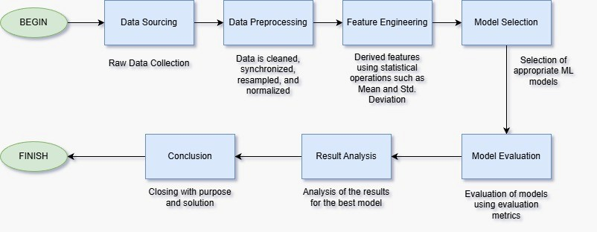
Block diagram of proposed methodology

Slide 15
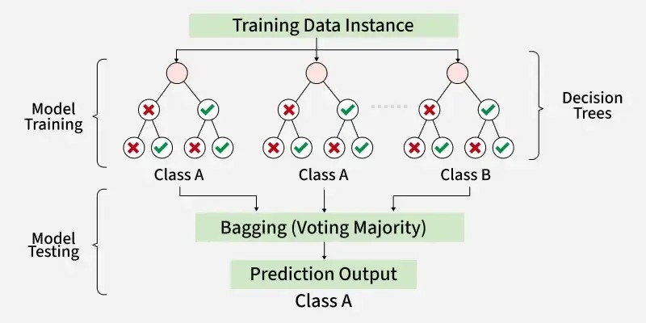
Model Architecture 1 (Decision Tree Classifier)

Slide 16
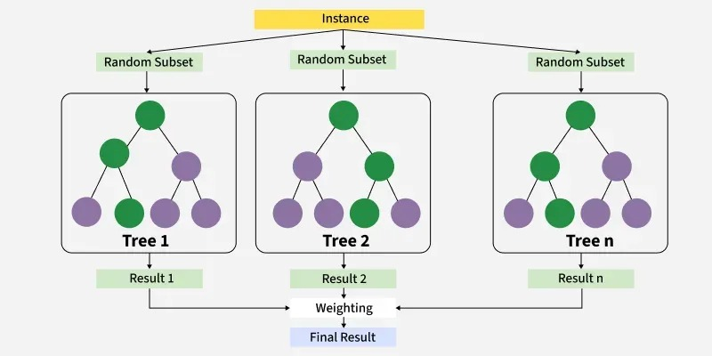
Model Architecture 2 (Random Forest Classifier)

Slide 17
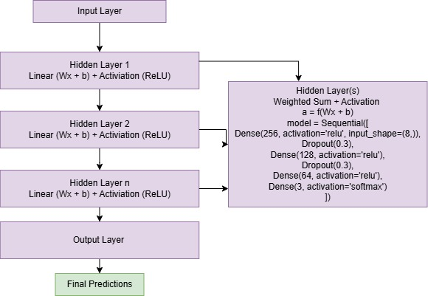
Model Architecture 3 (Deep MLP)

Slide 18
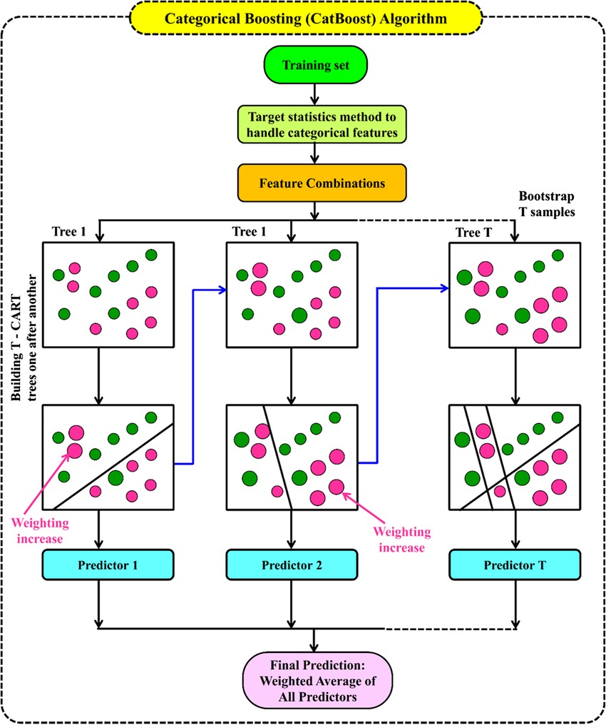
Model Architecture 4 (CatBoost Classifier)

Slide 19
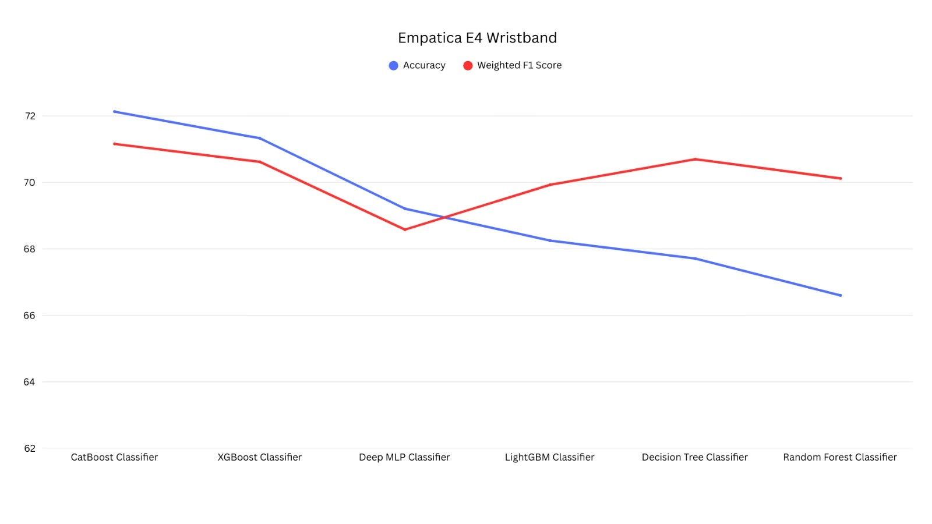
Graph of Empatica E4

Slide 20
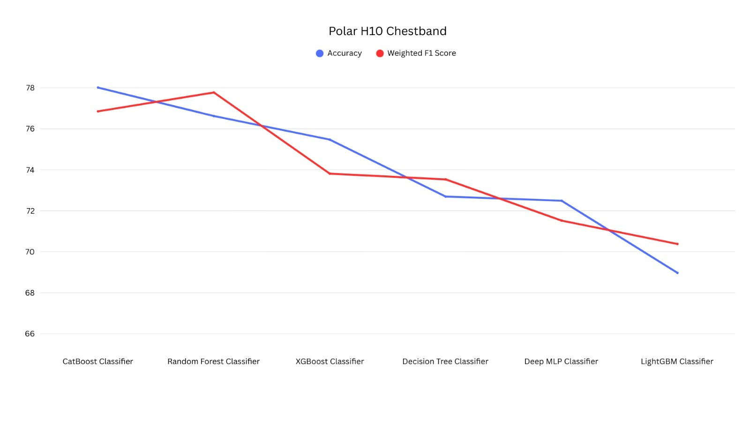
Graph of Polar H10

Slide 21
Empatica E4 Evaluation matrices table
ML Models | Accuracy (%) | Weighted F1 Score (%)
Random Forest Classifier | 66.60 | 70.12
Logistic Regression | 66.49 | 69.00
Decision Tree Classifier | 67.71 | 70.70
XGBoost Classifier | 71.33 | 70.62
CatBoost Classifier | 72.13 | 71.16
LightGBM Classifier | 68.25 | 69.93
MLP Classifier | 64.60 | 63.94
Deep MLP Classifier | 69.21 | 68.58

Slide 22
Polar H10 Evaluation matrices table
ML Models | Accuracy (%) | Weighted F1 Score (%)
Random Forest Classifier | 76.62 | 77.77
Logistic Regression | 68.68 | 70.03
Decision Tree Classifier | 72.69 | 73.53
XGBoost Classifier | 75.47 | 73.81
CatBoost Classifier | 78.01 | 76.85
LightGBM Classifier | 68.97 | 70.38
MLP Classifier | 66.48 | 66.19
Deep MLP Classifier | 72.49 | 71.52

Slide 23
References
[1] Eriko Terasawa, Yoshihiro Asano, Makiko Aoki, Hisayo Okayama, “Comparison of Fitness Tracking Using Three Different Smartwatches during Free Activities in Daily Life”, Open Journal of Nursing, 2023 Oct;13(10). doi: https://doi.org/10.4236/ojn.2023.1310041
[2] F. Wouters, H. Gruwez, C. Smeets, A. Pijalovic, W. Wilms, J. Vranken, Z. Pieters, H. Van Herendael, D. Nuyens, M. Rivero-Ayerza, P. Vandervoort, P. Haemers, L. Pison, “Comparative Evaluation of Consumer Wearable Devices for Atrial Fibrillation Detection: Validation Study”, JMIR Formative Research, 2025;9:e65139. doi: https://doi.org/10.2196/65139
[3] Florian Theurl, Markus Schreinlechner, Nikolaus Sappler, Michael Toifl, Thomas Dolejsi, Florian Hofer, Christian Massmann, Christoph Steinbring, Stefan Komarek, Klaus Mölgg, Bernhard Dejakum, Christoph Böhme, Rainer Kirchmair, Sebastian Reinstadler, Axel Bauer, “Smartwatch-derived heart rate variability: A head-to-head comparison with the gold standard in cardiovascular disease”,European Heart Journal Digital Health, 2023;4(3):155–164. doi: https://doi.org/10.1093/ehjdh/ztad022
[4] A. Coste, G. Millour, C. Hausswirth, “A Comparative Study Between ECG- and PPG-Based Heart Rate Sensors for Heart Rate Variability Measurements: Influence of Body Position, Duration, Sex, and Age”, Sensors, 2025;25(18):5745. doi: https://doi.org/10.3390/s25185745
[5] Federico Sartor, Jeroen Gelissen, Rob van Dinther, “Wrist-worn optical and chest strap heart rate comparison in a heterogeneous sample of healthy individuals and in coronary artery disease patients”, BMC Sports Science, Medicine and Rehabilitation, 2018;10:10. doi: https://doi.org/10.1186/s13102-018-0098-0

Slide 24
References
[6] Edubirdie, “Comparative Study of Wearable Heart Rate Monitors”, 2022. Available at: https://hub.edubirdie.com/examples/comparative-study-of-wearable-heart-rate-monitors/
[7] O. Sibomana, C. M. Hakayuwa, A. Obianke, et al., “Diagnostic Accuracy of ECG Smart Chest Patches versus PPG Smartwatches for Atrial Fibrillation Detection: A Systematic Review and Meta-Analysis”, BMC Cardiovascular Disorders, 2025;25:132. doi: https://doi.org/10.1186/s12872-025-04582-2
[8] D. Y. Luo, Z. W. Zhang, O. Sibomana, S. Izere, “Comparison of Diagnostic Accuracy of Electrocardiogram-Based versus Photoplethysmography-Based Smartwatches for Atrial Fibrillation Detection: A Systematic Review and Meta-Analysis”, Annals of Medicine and Surgery, 2025;87(4):2307–2323. doi: https://doi.org/10.1097/MS9.0000000000003155
[9] Pablo Martín-Escudero, Ana M. Cabanas, María L. Dotor-Castilla, et al., “Are Activity Wrist-Worn Devices Accurate for Determining Heart Rate during Intense Exercise?”, Bioengineering, 2023;10(2):254. doi: https://doi.org/10.3390/bioengineering10020254
[10] Martin Schaffarczyk, Ben Rogers, Robin Reer, Thomas Gronwald, “Validity of the Polar H10 Sensor for Heart Rate Variability Analysis during Resting State and Incremental Exercise in Recreational Men and Women”, Sensors, 2022;22(17):6536. doi: https://doi.org/10.3390/s22176536

Slide 25
References
[11] Ian L. Flett, Yu Su, Craig Cameron, Cheng Zhou, Laura H. Pearson, James G. Chase, “Assessing Accuracy of a Wrist-Worn Wearable Device Over Changing Levels of Activity”, IFAC-PapersOnLine, 2024;58(24):409–414. doi: https://doi.org/10.1016/j.ifacol.2024.11.072
[12] Muhammad Umair, Navid Chalabianloo, Corina Sas, Cagatay Ersoy, “HRV and Stress: A Mixed-Methods Approach for Comparison of Wearable Heart Rate Sensors for Biofeedback”, IEEE Access, 2021;9:14005–14024. doi: https://doi.org/10.1109/ACCESS.2021.3052131
[13] Taeyoung Lee, Youngho Cho, Kyung S. Cha, et al., “Accuracy of 11 Wearable, Nearable, and Airable Consumer Sleep Trackers: Prospective Multicenter Validation Study”, JMIR mHealth and uHealth, 2023;11:e50983. doi: https://doi.org/10.2196/50983
[14] A. M. Schyvens, B. Peters, N. C. Van Oost, et al., “A Performance Validation of Six Commercial Wrist-Worn Wearable Sleep-Tracking Devices for Sleep Stage Scoring Compared to Polysomnography”, Sleep Advances, 2025;6(2):zpaf021. doi: https://doi.org/10.1093/sleepadvances/zpaf021
[15] Michael B. Dial, Margaret E. Hollander, Emaly A. Vatne, Angela M. Emerson, Nathan A. Edwards, Joshua A. Hagen, “Validation of Nocturnal Resting Heart Rate and Heart Rate Variability in Consumer Wearables”, Physiological Reports, 2025;13(16):e70527. doi: https://doi.org/10.14814/phy2.70527

Slide 26
References
[16] Sanghyun Park, Dong Zheng, Uichin Lee, “GalaxyPPG: A PPG Signal Dataset Collected in Semi-Naturalistic Settings Using Galaxy Watch”, Zenodo Dataset, Version 1.0.0, 2025. doi: https://doi.org/10.5281/zenodo.14635823
[17] Liudmila Prokhorenkova, Gleb Gusev, Aleksandr Vorobev, Anna V. Dorogush, Andrey Gulin, “CatBoost: Unbiased Boosting with Categorical Features”, Advances in Neural Information Processing Systems, 2018;31:6638–6648. Available at: https://arxiv.org/abs/1810.11363
[18] Sylvain Laborde, Emma Mosley, Julian F. Thayer, “Heart Rate Variability and Cardiac Vagal Tone in Psychophysiological Research: Recommendations for Experiment Planning, Data Analysis, and Data Reporting”, Frontiers in Psychology, 2017;8:213. doi: https://doi.org/10.3389/fpsyg.2017.00213
[19] Hyun G. Kim, Eun J. Cheon, Dong S. Bai, Young H. Lee, Bong H. Koo, “Stress and Heart Rate Variability: A Meta-Analysis”, Psychiatry Investigation, 2018;15(3):235–245. doi: https://doi.org/10.30773/pi.2017.08.17
[20] Sylvia D. Kreibig, “Autonomic Nervous System Activity in Emotion: A Review”, Biological Psychology, 2010;84(3):394–421. doi: https://doi.org/10.1016/j.biopsycho.2010.03.010

Slide 27
Thank you !

