Slide 1










MINOR PROJECT-1
HOSPITAL MANAGEMENT SYSTEM
SUBMITTED BY : ADARSH KUMAR MISHRA
UNIVERSITY ROLLNO:- (22020107038)
COURSE:- BVOC SOFTWARE DEVELOPMENT
SUBMITTED TO : VIPIN RATHI SIR ,
DEPARTMENT HEAD,
COMPUTER SCIENCE DEPARTMENT ,RAMANUJAN COLLEGE,
UNIVERSITY OF DELHI

Slide 2

Table Of Content
Project Purpose
Project Benefits
﻿Technology Stack in the project
Project Features and Work Flow
Sample Outputs
Future enhancements

Slide 3





The system will be used as the application that serves hospitals, clinic, dispensaries or
other health institutions.
01.
PURPOSE
OF THIS PROJECT
The intention of the system is to increase the number of
patients that can be treated and managed properly.
02.
The purpose of this project is to
computerize all details regarding patient details and hospital details.
03.

Slide 4
PROJECT BENEFITS
This project will automate hospital front-office operations, making processes simpler, faster, and more cost-effective. It manages tasks such as patient registration, diagnosis recording, staff management, and appointment scheduling. The system is secured with role-based access, ensuring only administrators or receptionists can interact with sensitive data. This improves security and speeds up data processing.
WHY THIS PROJECT ?
Traditional methods takes more time.
Keeping records manually makes data more bulk.
Risk of losing information in traditional methods.
Role based access provided in this project.

Slide 5




TECHNOLOGY STACK
TKINTER
PYTHON
SQLITE3
FRONTEND
BACKEND
DATABASE

Slide 6
FEATURES OF THE PROJECT
1.User Authentication: Secure login with role-based access.
2.Patient Management: Easily register, update, and retrieve patient information.
3.Staff Management: Record and organize staff details.
4.Room Allocation
5.Appointment Booking: Schedule, search, and update appointments seamlessly.
6.Billing System: Generate and update patient bills.

Slide 7
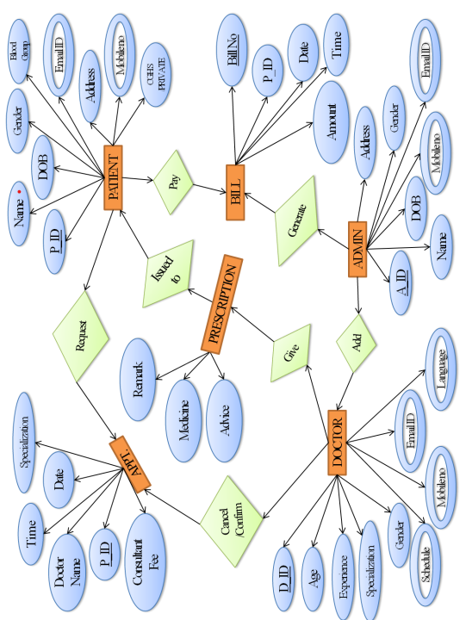


ER DIAGRAM

Slide 8
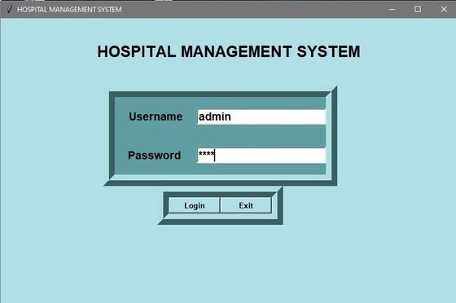
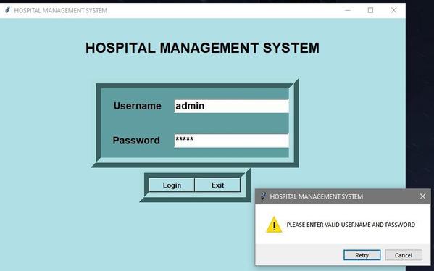
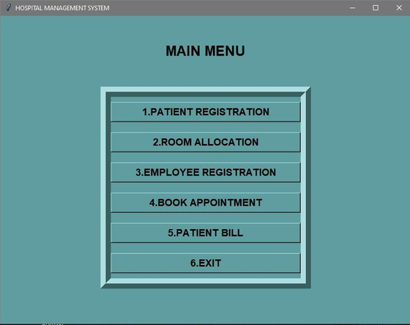
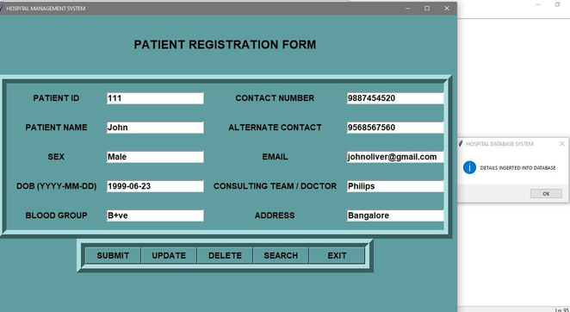
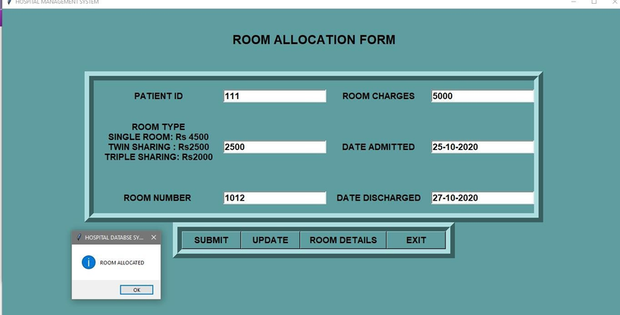
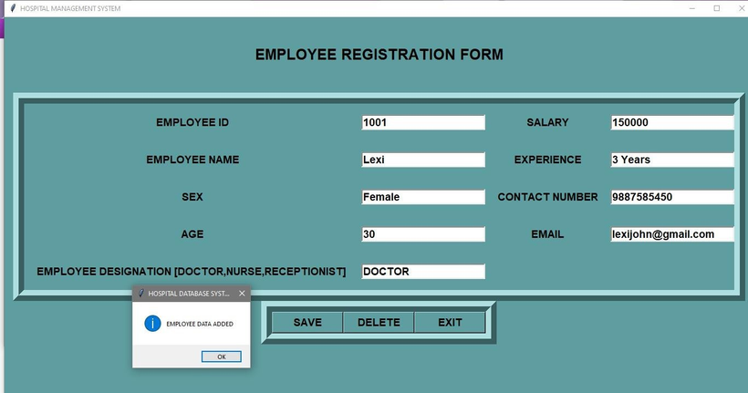
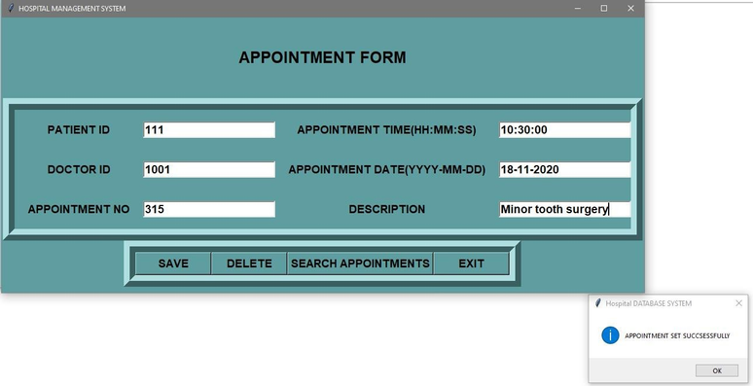
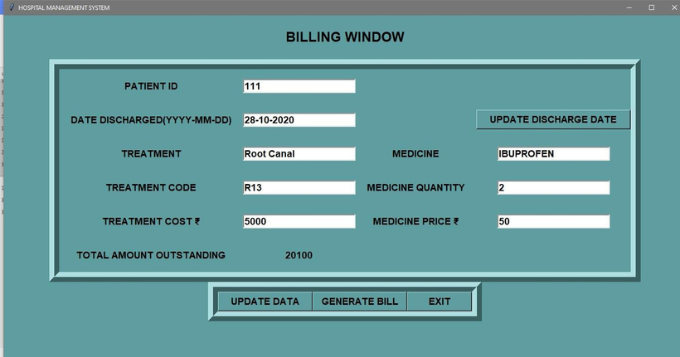
OUTPUTS
ADMIN LOGIN
PASSWORD AUTHENTICATION
MAIN MENU
PATIENT REGISTRATION
PATIENT ROOM ALLOCATION
EMPLOYEE REGISTRATION
PATIENT APPOINTMENT
BILLING

Slide 9
CHALLENGES FACED
Understanding and integrating SQLite3 with Python for seamless communication.
Implementing a secure and efficient login system for Admin and Receptionist.
Designing a user-friendly interface for Admin and Receptionist tasks using Tkinter.
FUTURE ENHANCEMENTS
CREATING A WEB APPLICATION BASED ON THE PROJECT
ADDING PATIENT DIAGNOSIS HISTORY
ADDING FEEDBACK AND SUPPORT FACILITIES
ADDING FUNCTIONALITIES FOR MULTI-USER SCENARIOS BY UPDATING DATABASE (MYSQL AND MONGODB)

Slide 10


Thank you!

