Slide 1










MINOR PROJECT-1
HOSPITAL MANAGEMENT SYSTEM
SUBMITTED BY : ADARSH KUMAR MISHRA
UNIVERSITY ROLLNO:- (22020107038)
COURSE:- BVOC SOFTWARE DEVELOPMENT
SUBMITTED TO : VIPIN RATHI SIR ,
DEPARTMENT HEAD,
COMPUTER SCIENCE DEPARTMENT ,RAMANUJAN COLLEGE,
UNIVERSITY OF DELHI

Slide 2
PROJECT OBJECTIVE
The goal of this project is to automate hospital front-office operations, making processes simpler, faster, and more cost-effective. It manages tasks such as patient registration, diagnosis recording, staff management, and appointment scheduling. The system is secured with role-based access, ensuring only administrators or receptionists can interact with sensitive data. This improves security and speeds up data processing.
WHY THIS PROJECT ?
Traditional methods takes more time.
Keeping records manually makes data more bulk.
Risk of losing information in traditional methods.
Role based access provided in this project.

Slide 3




TECHNOLOGY STACK
TKINTER
PYTHON
SQLITE3
FRONTEND
BACKEND
DATABASE

Slide 4
FEATURES OF THE PROJECT
1.User Authentication: Secure login with role-based access.
2.Patient Management: Easily register, update, and retrieve patient information.
3.Staff Management: Record and organize staff details.
4.Room Allocation
5.Appointment Booking: Schedule, search, and update appointments seamlessly.
6.Billing System: Generate and update patient bills.

Slide 5
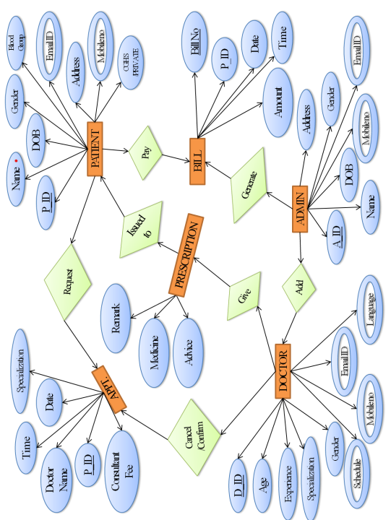


ER DIAGRAM

Slide 6
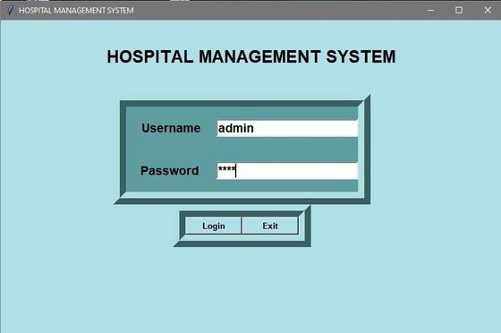
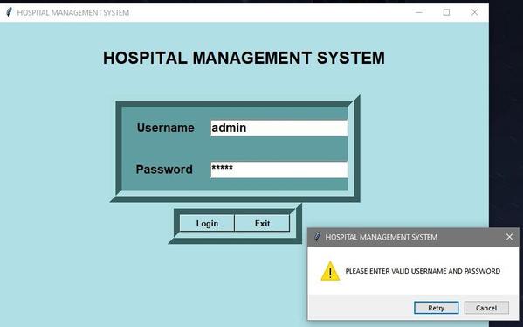
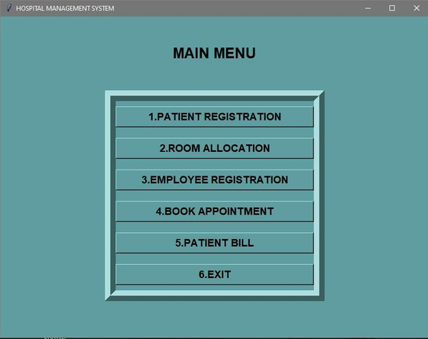
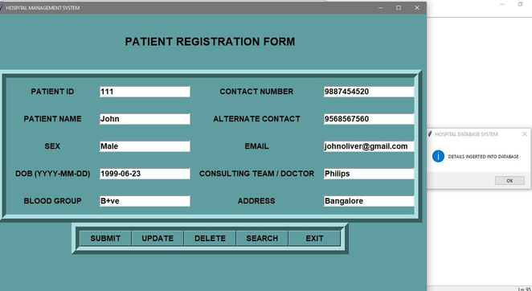
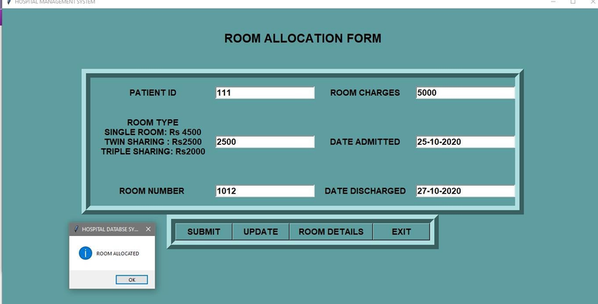
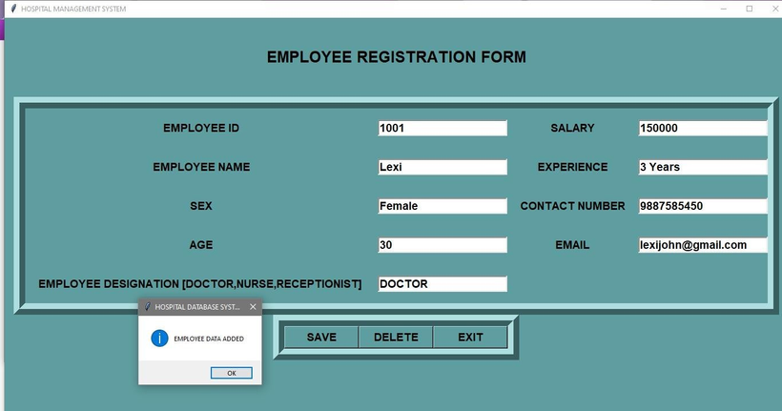
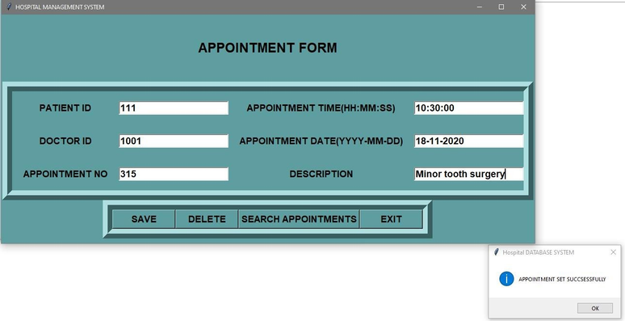
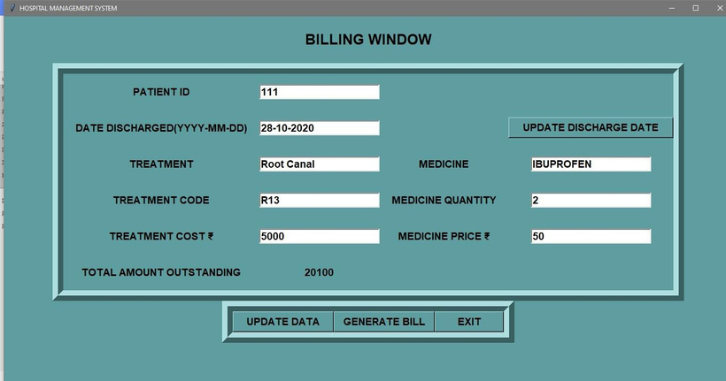
OUTPUTS
ADMIN LOGIN
PASSWORD AUTHENTICATION
MAIN MENU
PATIENT REGISTRATION
PATIENT ROOM ALLOCATION
EMPLOYEE REGISTRATION
PATIENT APPOINTMENT
BILLING

Slide 7
FUTURE ENHANCEMENTS
CREATING A WEB APPLICATION BASED ON THE PROJECT
ADDING PATIENT DIAGNOSIS HISTORY
ADDING FEEDBACK AND SUPPORT FACILITIES
ADDING FUNCTIONALITIES FOR MULTI-USER SCENARIOS BY UPDATING DATABASE (MYSQL AND MONGODB)

Slide 8


Thank you!

