Slide 1
INTERNSHIP PRESENTATION
Data Science Internship
SkillCraft Technology
Adarsh Singh • Roll No. 25SCS1003005017
B.Tech CSE • 3rd Semester • Section 2CSE15
IILM University, Greater Noida • Session 2025–29
19 July 2026 – 19 August 2026 • ID: SCT/JUL26/4532

Slide 2
1. Internship Overview
Internship Details
Student Details
• Organization: SkillCraft Technology
• Role: Data Science Intern
• Duration: 1 Month
• Dates: 19 Jul 2026 – 19 Aug 2026
• Internship ID: SCT/JUL26/4532
• Adarsh Singh
• Roll No.: 25SCS1003005017
• B.Tech Computer Science & Engineering
• 3rd Semester • Section 2CSE15
• Session: 2025–29

Slide 3
2. About SkillCraft Technology
• SkillCraft Technology is the organization identified in the official internship offer letter and completion certificate.
• The internship role is documented as Data Science Intern.
• Internship ID: SCT/JUL26/4532.
• The supplied communication identifies the website as skillcrafttech.com.
• Detailed company history, client portfolio, revenue or achievements are not specified in the supplied documents.

Slide 4
3. Internship Objectives
• Gain practical exposure to the Data Science domain.
• Connect B.Tech CSE concepts with industry-oriented learning.
• Develop professional communication and documentation habits.
• Understand the stages of a typical Data Science workflow.
• Complete the internship requirements and document the experience.

Slide 5
4. Scope of the Internship
Confirmed scope: a one-month internship in the Data Science domain at SkillCraft Technology.
The available official documents do not specify a named project, dataset, application, model, dashboard or deployment target.
Therefore, project-specific claims are intentionally not presented as verified facts.

Slide 6
5. Data Science Overview
What Data Science Does
Why It Matters
• Works with structured and unstructured data.
• Finds patterns, trends and relationships.
• Supports analytical decision making.
• Combines computing, statistics and domain reasoning.
• Turns data into useful information.
• Encourages evidence-based conclusions.
• Uses systematic workflows.
• Requires careful evaluation and communication.

Slide 7
6. Conceptual Data Science Workflow
General academic workflow — illustrative, not a claim about the exact internship project.
Data Collection
Data Cleaning
Exploratory Analysis
Model Building
Evaluation
Reporting

Slide 8
7. Methodology
Conceptual academic framework
1. Understand the problem or analytical requirement.
2. Identify and prepare relevant data.
3. Inspect data quality and perform cleaning.
4. Conduct exploratory analysis.
5. Select an appropriate analytical/modelling approach when required.
6. Evaluate the approach and document findings.

Slide 9
8. Professional Learning Experience
• Exposure to an organizational internship environment.
• Importance of clear communication and documentation.
• Understanding the relationship between academic learning and professional practice.
• Awareness of structured work, time management and responsible reporting.

Slide 10
9. Skills & Knowledge Gained
Professional
Data Science Understanding
• Communication
• Documentation
• Presentation
• Time management
• Structured problem solving
• End-to-end workflow awareness
• Data preparation concepts
• Exploratory analysis concepts
• Evaluation awareness
• Evidence-based reporting

Slide 11
10. Challenges & Problem-Solving Approach
Specific internship challenges are not documented in the supplied official materials.
General problem-solving principles:
• Clarify requirements before implementation.
• Break complex tasks into smaller stages.
• Validate inputs and intermediate results.
• Document assumptions and limitations.
• Review outcomes before presenting conclusions.

Slide 12
11. Outcomes / Results
Confirmed outcome:
• Successful completion of the 1-month Data Science internship at SkillCraft Technology.
• Completion certificate issued for 19 July 2026 – 19 August 2026.
• Internship ID: SCT/JUL26/4532.
No project-specific accuracy, metrics, dataset or business-impact figures are documented in the available official materials.

Slide 13
12. Documentation Limitations
The supplied official documents do not specify:
• A named project or dataset
• Exact programming languages, libraries or frameworks
• Detailed day-to-day tasks
• Project-specific deliverables
• Numerical performance metrics
Accordingly, the presentation avoids unsupported claims.

Slide 14
13. Conclusion
Adarsh Singh successfully completed a one-month Data Science internship at SkillCraft Technology.
The internship provided an industry-oriented context for professional learning and understanding of Data Science.
The available documentation supports the internship identity, role, dates and completion; project-specific technical details are not claimed without evidence.

Slide 15
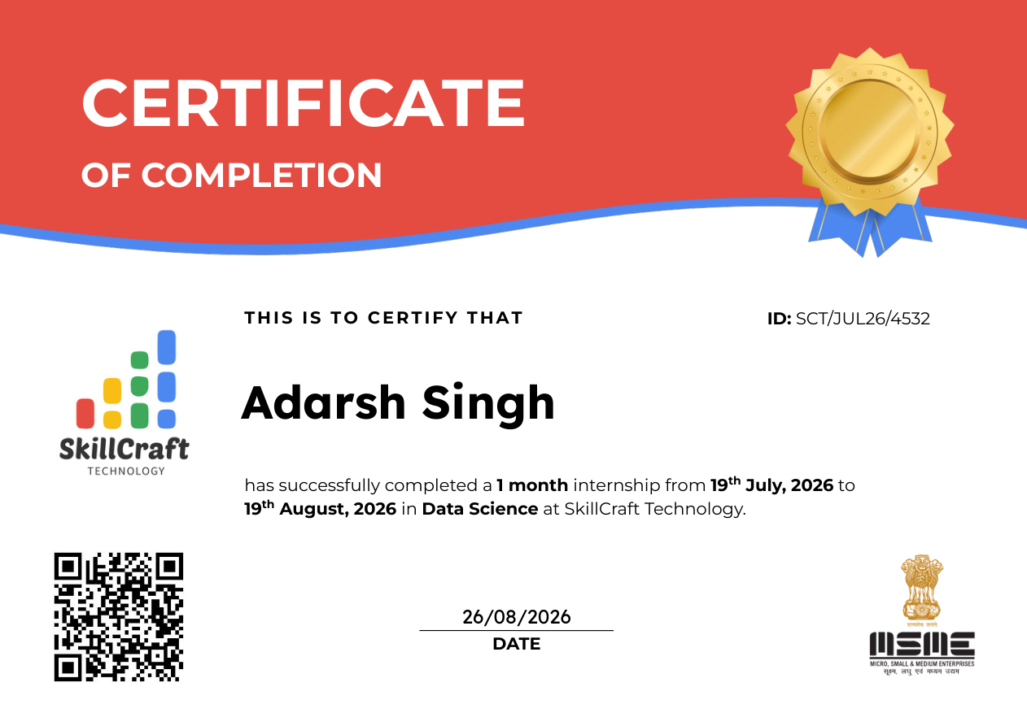
14. Internship Completion Certificate

Slide 16
THANK YOU
Questions & Answers
Adarsh Singh • B.Tech CSE • IILM University

