Slide 1
Prediction of Diabetes onset in women using Machine Learning and Artificial Neural Networks
KAUSTUBH SHARMA
ADARSH PODDAR
KIMAYA GANVEER
SIMRAN SINGH

Slide 2
The Goal:
To build an accurate model that can predict the probability of being diabetic using as basic features as possible.
To build a user-friendly and efficient deployment on the web for public release.

Slide 3
Procedure followed:
Collection of data.
Data cleaning and handling missing data.
Exploratory data analysis.
Designing ML models and Neural Networks.
Hyper-parameter Tuning.
Encapsulating modules, models and data processors.
Building a deployment medium (website).

Slide 4
The Data:
PIMA INDIANS DIABETES DATASET (Source: Kaggle)
This dataset is originally from the National Institute of Diabetes and Digestive and Kidney Diseases. The objective is to predict based on diagnostic measurements whether a patient has diabetes. Several constraints were placed on the selection of these instances from a larger database. In particular, all patients here are females at least 21 years old of Pima Indian heritage.
Acknowledgements:
Smith, J.W., Everhart, J.E., Dickson, W.C., Knowler, W.C., & Johannes, R.S. (1988). Using the ADAP learning algorithm to forecast the onset of diabetes mellitus. In Proceedings of the Symposium on Computer Applications and Medical Care (pp. 261--265). IEEE Computer Society Press.

Slide 5
Key Features of the Data
9 columns including 8 features columns and 1 target variable.
Features: Pregnancies, Glucose, Blood Pressure, Skin Thickness, Insulin, BMI, Diabetes Pedigree Function, Age. (All numerical)
Target variable: Outcome (Binary)
768 rows.
Missing Data: Yes (in the form of 0 values).
Unbalanced: Yes.

Slide 6
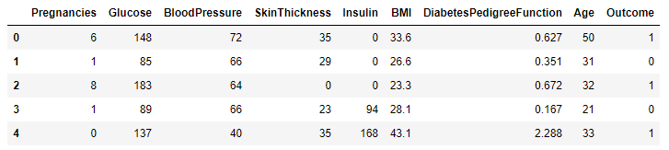
Sample:

Slide 7
Steps taken for cleaning the data:
Replacing missing values (0) with NumPy NaNs.
Filling missing values with respective medians.
Exploring correlation of variables.
Adding new Features. (14 new variables).
Checking correlation and selecting most important features.
Software used: Python 3.8, Pandas, NumPy, MatPlotLib, Plot.ly.

Slide 8
Approach For Classification:
As a team of 4, we divided the task of classification into 2 different approaches. Traditional Machine Learning and Deep Learning (Deep Neural Networks).
Traditional Machine Learning Models are useful as they have been used for several years and updated to the point of near perfection. They can produce reliable and robust results.
Neural Networks being a relatively new concept can be less robust than ML models if designed improperly but they give us the freedom and customizability to design every component of the model as required.

Slide 9
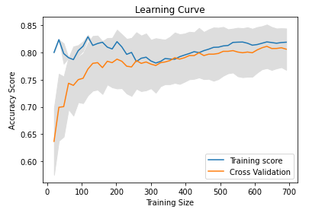
ML Classifiers:
Logistic Regression: It provided an overall accuracy of 75% but after analysing the learning curve ,the accuracy can only be improved if we increase the data size used for training and testing.

Slide 10
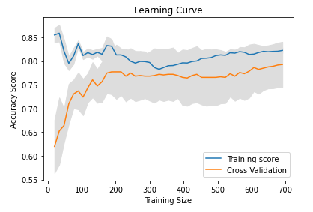
ML Classifiers:
SVC: It provided an overall accuracy of 75% but after analysing the learning curve ,the accuracy can only be improved if we increase the data size used for training and testing.

Slide 11
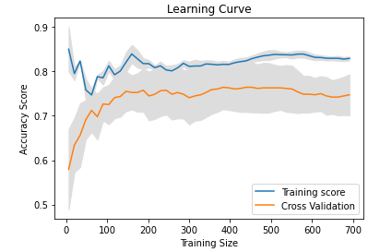
ML Classifiers:
K-Nearest Neighbours: It provided an overall accuracy of 69%
but after analysing the learning curve ,the accuracy cannot be improved even if we increase the data size.

Slide 12
ML Classifiers:
Ensemble classification: Ensemble methods are learning algorithms that construct a set of classifiers and then classify new data points by taking a weighted vote of their predictions.
Random Forest Classifier:As ensemble models usually provide better accuracy compared to other models it was no different case for random forest classifier , it provided an accuracy of 88% and the learning curve shows it acquired this accuracy even with 100 test samples.Giving the impression even a smaller data set would have provided the same result and this model can be used to train for data with less number of samples .

Slide 13
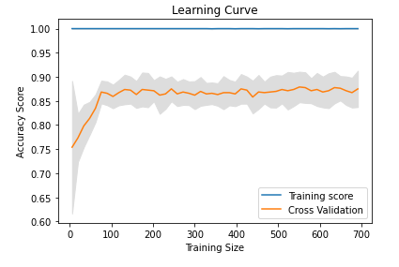
ML Classifiers:
Thus we went ahead using Random forest classifier for our prediction model.

Slide 14
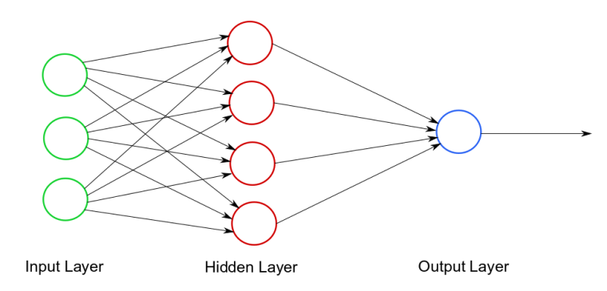
Deep Neural Networks
What is a Neural Network?
A neural network is a series of algorithms that endeavors to recognize underlying relationships in a set of data through a process that mimics the way the human brain operates. In this sense, neural networks refer to systems of neurons, either organic or artificial in nature. Neural networks can adapt to changing input; so the network generates the best possible result without needing to redesign the output criteria.
A Shallow Neural Network

Slide 15
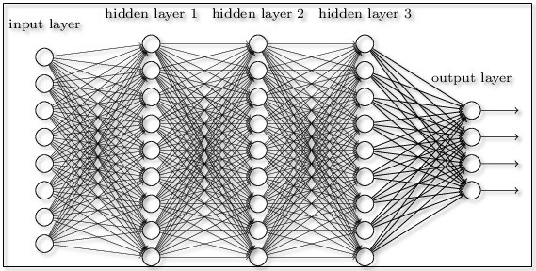
Deep Neural Network:
A Deep Neural Network is a Neural Network that consists of a large number of layers and neurons per layer.

Slide 16
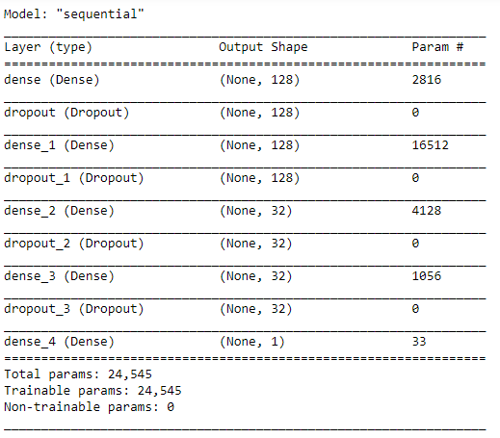
Our Neural Network

Slide 17
Summary:
Activation: ReLu for Hidden Layers, Sigmoid for Output Layer
Loss: Binary Cross-Entropy.
Optimizer: RMS Prop
Batch Size: 16
Trained over 200 epochs.
Training accuracy: 93%
Testing Accuracy: 90%

Slide 18
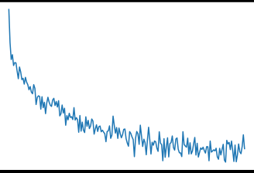
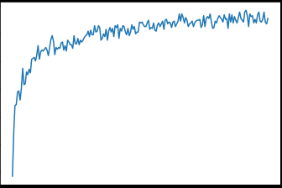
Results:
Loss Convergence
Accuracy Convergence

Slide 19
Software Used for Building the Models:
Python 3.6+
TensorFlow 2
Keras
SciKit Learn
Pandas
MatPlotLib
NumPy

Slide 20
Deployments
Since both models (ML and Neural Net) gave very accurate and fast predictions, instead of choosing one, we decided to build two separate deployments for both the models.
We split the team into 2 and assigned each sub-team with a deployment.
Further, each member was assigned either the back-end or front-end of the deployment.
The result was that we obtained 2 efficient working websites that can be used to predict diabetes accurately.

Slide 21
The ML Model Deployment

Slide 22
Step 1
Step 2
Step 3
Step 4
Select ML Model with highest accuracy.
Save the Model .
Save the Scaler.
Make a Restful API using Flask.
Load saved model and scaler.
Take input of user data, process the input data and send Prediction result as response.
Make Backend Code for Website using Node and Express.
Make Frontend using EJS and CSS.
Code the Backend to receive User input, send it to API ,receive the response and show it on result page.
Deploy the website either locally or online.

Slide 23
RESTFul API:
The RESTFul API was created using python’s Flask and Flask-Restful libraries.
The main purpose of this API is to receive data and send response using HTTP request methods .
This makes the API accessible by any type of interface either it be a mobile app,website etc. using https request methods.
The API takes the user input sent to it by parsing the http body.
Prediction is calculated by scaling the data and passing it to ML model.
The prediction made is sent back as a response to the http request.

Slide 24
Website:
The backend was made using Node.js runtime environment and Express framework. The frontend is made using EJS view engine and CSS.
The backend responds to GET request made at the home web address and provides ‘home page’.
The ‘home page’ consists of a form in which the user inputs the data and makes a POST request to the backend.
The Data received from the POST request is then passed to API from the backend. API sends prediction as response.The backend stores the response and redirects user to ‘result page’.
The ‘result page’ then displays the prediction result passed to it from the stored result in backend.

Slide 25
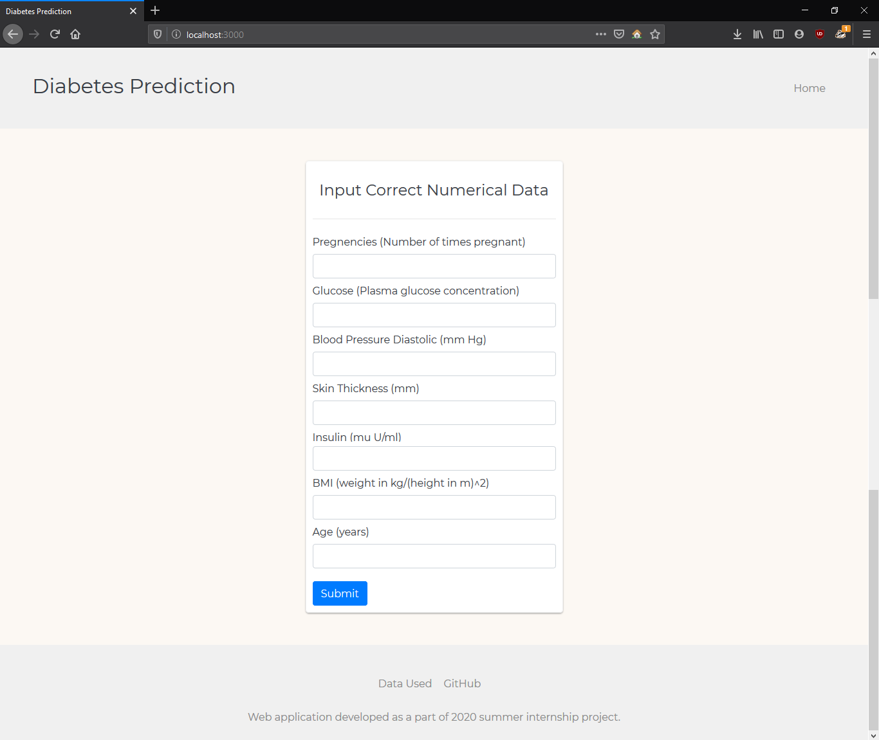

Slide 26
The Neural Network Deployment

Slide 27
Process Flow
Build API
Save Model and Scaler
Create loadable interface
Create a web form that sends data to the Flask API
Send prediction from Flask to Website
Load Model and Scaler
Write the code for data processing and Prediction
Encapsulate
Build Website

Slide 28
The Python API
We built the Python API using a python module named ‘Flask’. Flask is a lightweight WSGI web application framework. It is designed to make getting started quick and easy, with the ability to scale up to complex applications. It began as a simple wrapper around Werkzeug and Jinja and has become one of the most popular Python web application frameworks.
The function of this API is to render HTML templates on the server, receive data from the page, generate predictions using the saved neural network, and display the prediction on the page.

Slide 29
The Website
The website was created using HTML5, CSS and a CSS library called ‘Bootstrap 4’.
It follows a simple material color scheme and provides information on diabetes and provides a form where users can enter their information and receive a prediction based on this data.
The results are displayed on a separate page that is linked to the home page.
The result page is different for both classes of the result and displays information respective to the result.
If the prediction is that the user is diabetic, it displays recommended steps and treatment whereas if it is non diabetic, it displays precautions the user can take in order to prevent diabetes in the future.

Slide 30
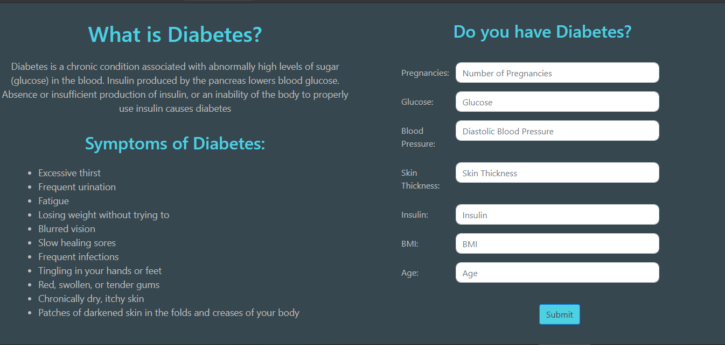

Slide 31
Conclusions
We have successfully designed, developed and tested a Machine Learning model and a Deep Neural Network that can accurately predict the onset of diabetes in a woman with high accuracy (90%).
We have created a working & efficient website where users can test themselves for diabetes and get instant results.
This project is particularly useful for doctors and pathology labs as they can receive instant probability and these results can be used to reduce the number of tests that are conducted.
This is also useful for general users who would like to measure the probability of diabetes onset in themselves and be more informed.

Slide 32
References:

