Slide 1
EE615: Control and Computation Lab
Exp 1: Rotary Inverted Pendulum

Slide 2
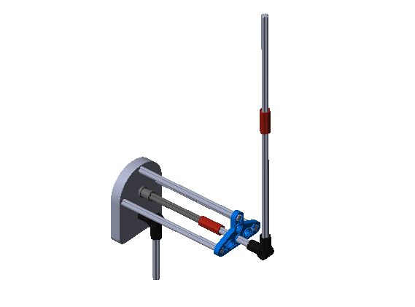
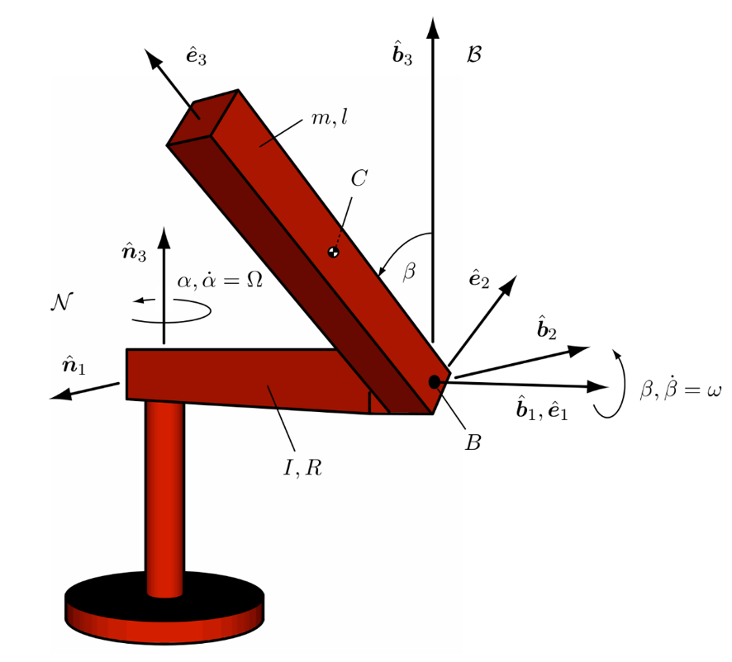
Rotary Pendulum Model

Slide 3
Model Parameters
g = 9.81;
radius_base= 40e-3;
length_base= 10e-3;
radius_vert_cylinder = 10e-3;
length_vert_cylinder = 200e-3;
% RotaryArm
M = 20.3e-3;
R = 109e-3;
me = 0.012; % mass encoder
ma = M - me;
%Rotary Arm Inertia
re = 0.02; % encoder offset
Ino_e = ma*R^2/3; % corrected I without encoder
Itot = Ino_e + me*re^2; % corrected I with encoder
I = Itot;
% Pendulum
m = 3.3e-3;
l = 183.2e-3;
gain_motor = 5.67;

Slide 4
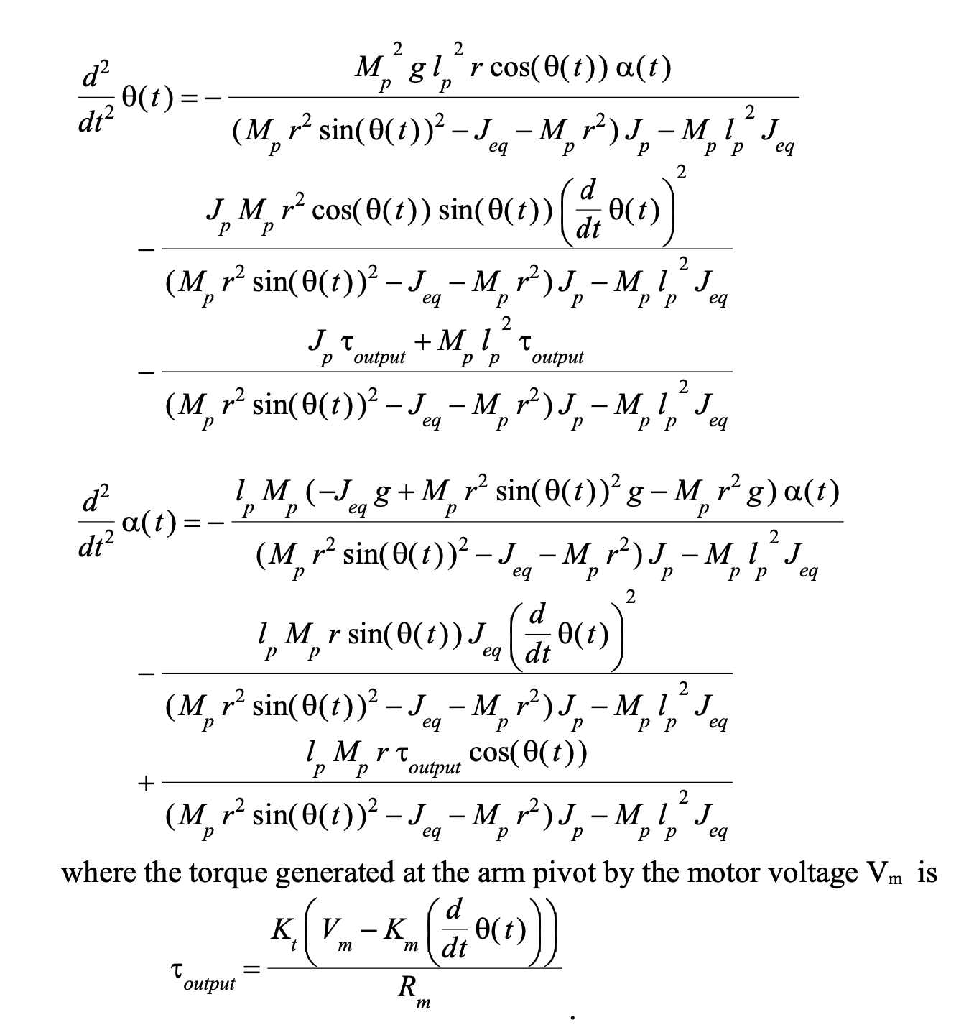
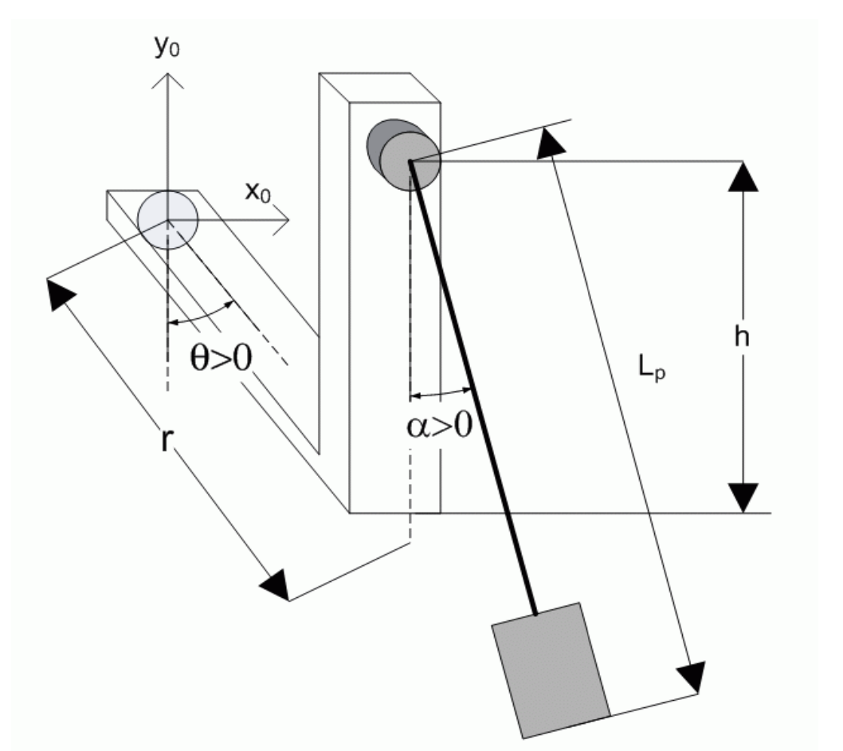
Suggested Steps (your choice)
Derive Non-linear Model

Slide 5
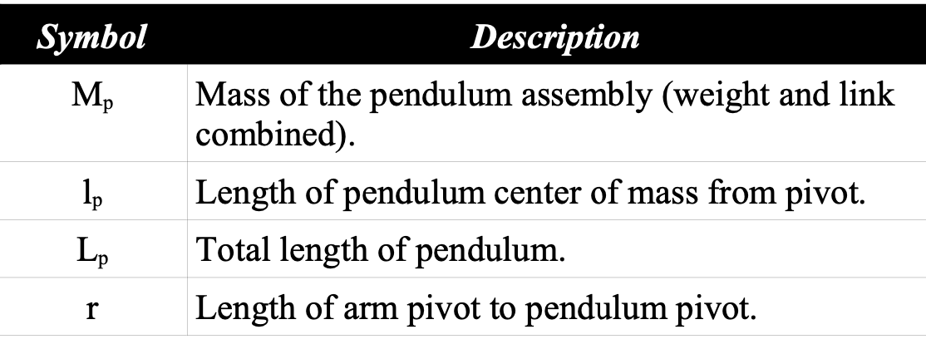
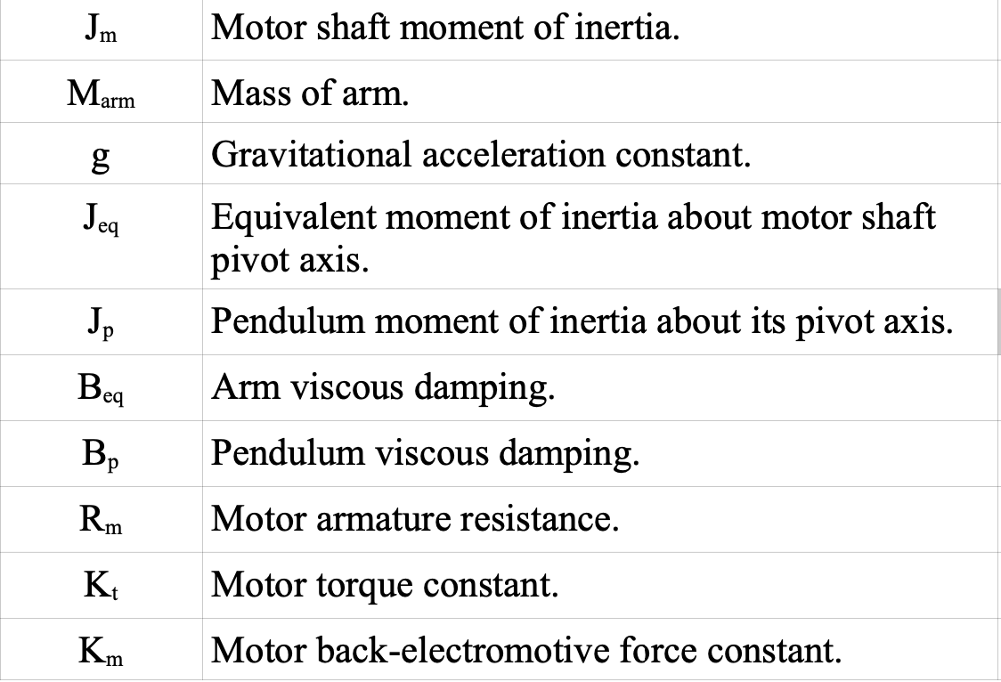
Notation

Slide 6
Design Swing-up control
Method is your choice
Study literature for suitable swing-up control
Energy based Swing-up control (https://web.ece.ucsb.edu/~hespanha/ece229/references/AstromFurutaAUTOM00.pdf)

Slide 7
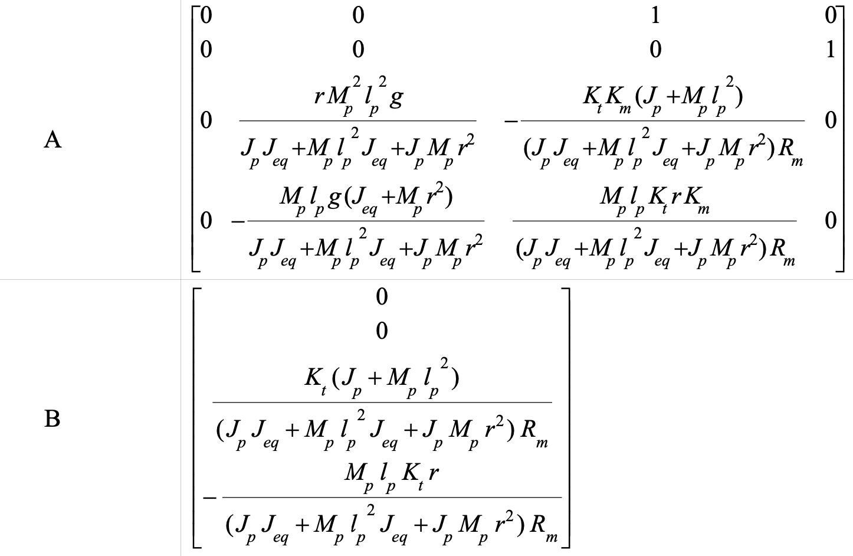
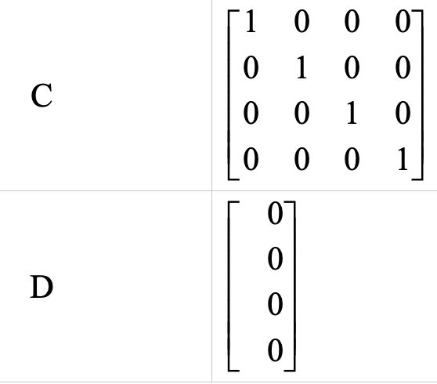
Linearize the model (for stay-up control)

Slide 8
Design state-feedback controller
Either use pole placement
Or use LQR based controller design

