Slide 1
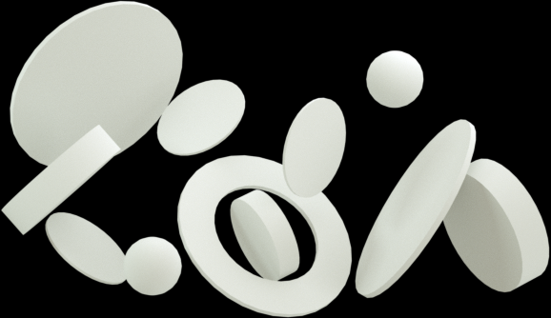

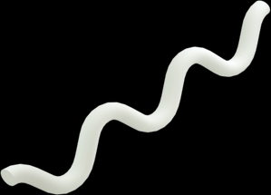

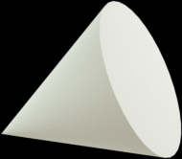

BEHAVIOR ANALYSIS SYSTEM
THE INTERNET OF THINGS
THE BRITISH COLLEGE | UWE
PRESENTED BY ADARSH BIKRAM THAPA

Slide 2
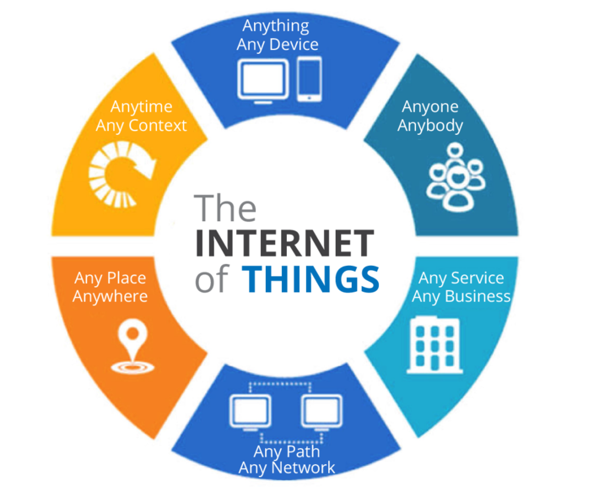
What is IoT?
Combination of Internet, device and sensors to perform tasks without human interaction

Slide 3

Behavior Analysis System
Tracking, monitoring, analyzing and recording human activities through use of IOT devices

Slide 4
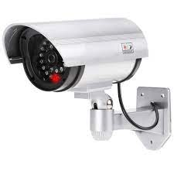
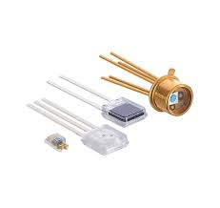
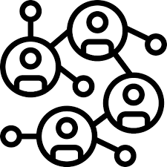
Hardware used
CAMERA
Used to record image data
Sensor
Used to record various other data
Network
Used to transfer data

Slide 5
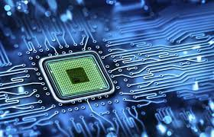

Hardware used
Microprocessor
Used to handle all data
Server
Used to store various data
Network
Used to transfer data

Slide 6
Data Transfer
Transferring data from sensor and devices to data storage device

Slide 7

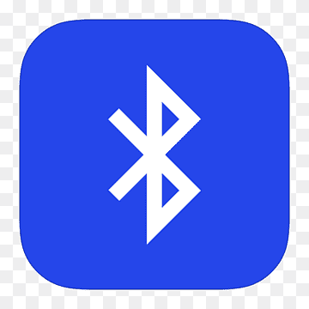
Short range

Slide 8


Long Rage

Slide 9
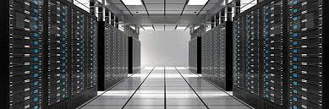
Data Storage
Process of storing data from various sensors into the server

Slide 10
Cloud Based Storage
Edge Based Storage
Cloud computing focuses on storing and processing large amounts of unstructured data at one time
Edge computing focuses on real time data processing and communication between devices.

Slide 11
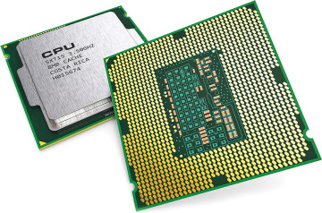
Processors
Processors are the logic circuit that responds and processes the basic instruction for the proper functioning of devices

Slide 12
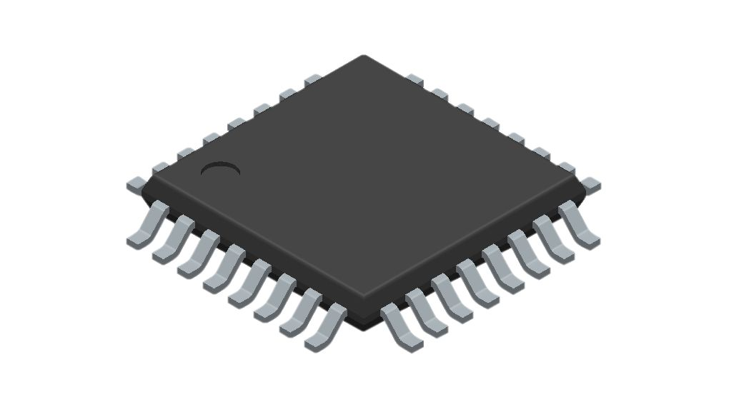
Processors
Different processors are used in a microcontroller depending upon its function and use.
The ARM cortex-M series processors are widely used in microcontrollers for their balance of performance and energy efficiency.
Microcontroller
For more powerful processing or dedicated servers handling extensive data processors like intel core i7 are used

Slide 13
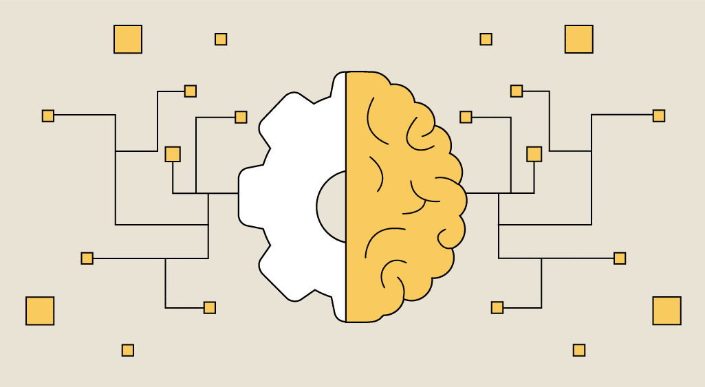
Machine Learning
Utilizing the data from the storage to train the machine to respond to certain scenarios

Slide 14
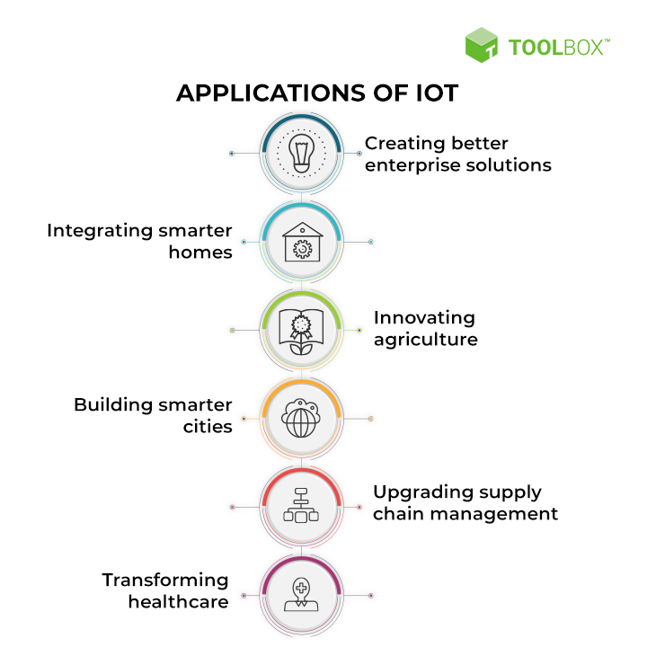
APPLICATION
SECURITY
EDUCATION
HEALTH CARE
STATISTICS

Slide 15
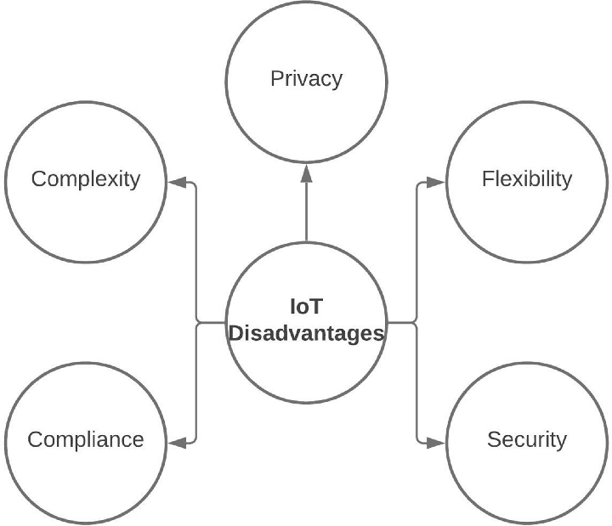
Disadvantages
Lack of privacy
Lack of consent
Need for more experts
Need expensive infrastructure

Slide 16

Fear in Public
People are afraid of constantly being monitored and their privacy invaded

Slide 17
The Future of IoT
Better collection of data
Efficient data collection
Personalised data collection

Slide 18

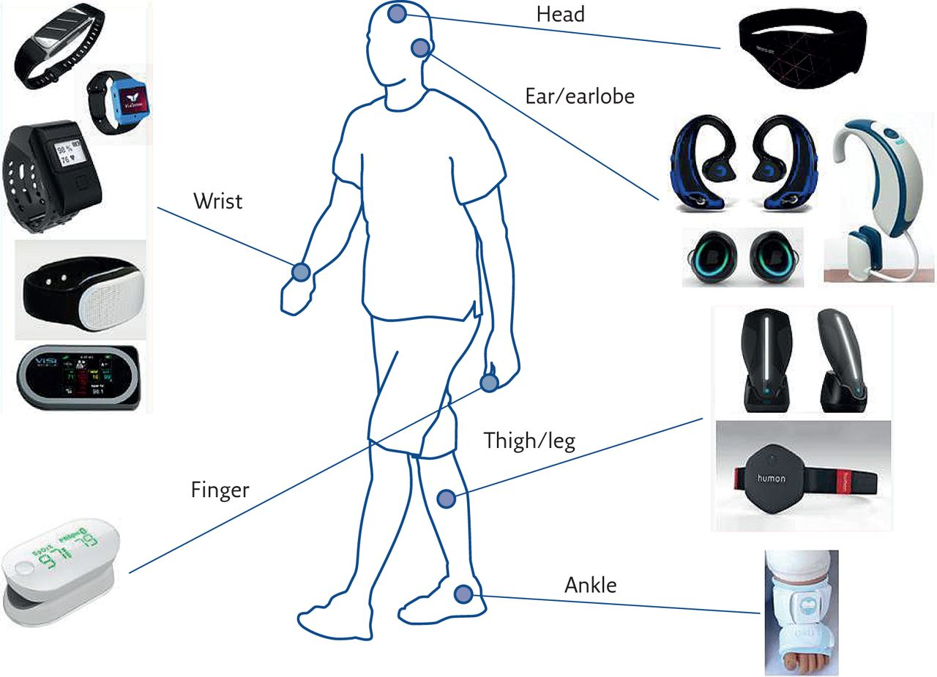
What Is Next?

Slide 19
What Is Next?
Wearables will help to gather personalized and more amount information which in turn will help the system to run properly.

Slide 20
Conclusion
Behavior analysis system is a IOT device with enormous prospect and of risk, how it turns out soley depends on the users and the creators

