Slide 1
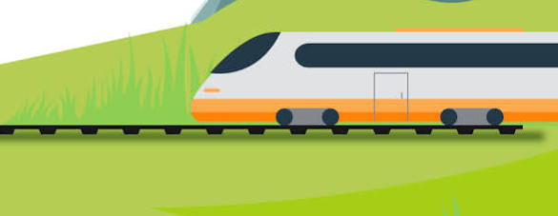
PROJECT PRESENTATION
TrainSmart
Train Selection & Route Analytics System
Smarter Comparisons. Better Journeys.
A data-driven way to compare train options by fare, journey time, stops and class.
Presented by: Adarsh Gupta
01 / 08

Slide 2
01 / CONTEXT
Why TrainSmart?
Choosing a train can mean comparing several details across multiple options.
01
02
03
Too many options
Scattered details
Different priorities
Different trains may vary in timing, fare, route and number of stops.
Comparing several attributes manually can take time and effort.
Travellers may value a lower fare, shorter journey or fewer stops.
Goal: make train comparison clearer, more consistent and easier to navigate.
TRAINSMART • PROJECT OVERVIEW
02

Slide 3
02 / GOALS
Project objectives
Turn train information into a clear comparison and recommendation workflow.
Compare
Select a Route
Compare fares, journey duration and stops across available train options.
Choose source and destination stations using dropdown menus.
Fare • Duration • Stops
Route
Choose a Class
Present
Select the preferred travel class to narrow down train options.
Show recommendations through a simple web interface.
SL , 3AC , 2AC , 1AC , GEN
Streamlit application
TRAINSMART • PROJECT OVERVIEW
03

Slide 4




03 / BUILD
Technology stack
Each tool supports a specific part of the project workflow.
Python
Core programming and application logic
Pandas
Dataset cleaning, transformation and preparation
Scikit-learn
Random Forest model and ranking workflow
Streamlit
Interactive user interface
Pipeline: Data preparation → Feature processing → Ranking → Streamlit results
TRAINSMART • PROJECT OVERVIEW
04

Slide 5
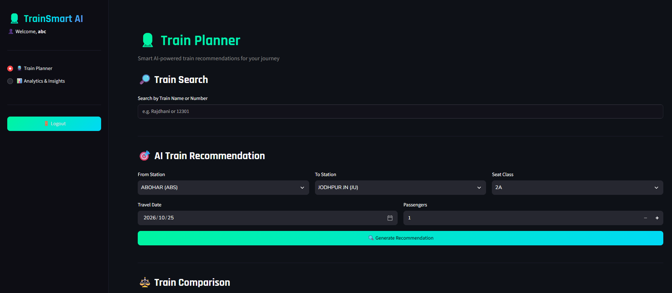
04 / PRODUCT
Core features
A straightforward flow from route selection to train recommendations.
Login page
Entry point for users
Station dropdowns
Choose source and destination
Class selection
Filter by travel class
Recommendation button
Generate ranked options
Train details
Compare fare, time and stops
TRAINSMART • PROJECT OVERVIEW
05

Slide 6
05 / METHOD
How TrainSmart works
A clear pipeline from the train dataset to ranked results.
1
2
3
4
Dataset
→
Prepare
→
Score
→
Recommend
Train records are collected and organised in a structured format.
Clean and transform fields such as fare, duration and stops.
Use the ranking approach to evaluate available train options.
Display ranked options in the Streamlit interface.
Input: route + class | Processing: prepared features + ranking | Output: ordered train options
TRAINSMART • PROJECT OVERVIEW
06

Slide 7
06 / RANKING LOGIC
A consistent way to compare options
The project uses a weighted utility score to balance three key travel factors.
Fare
40%
Journey duration
40%
Number of stops
20%
Lower fare, shorter duration and fewer stops are preferred by the scoring logic.
Weights shown are the project's configured utility weights; validate normalisation and model behaviour against the implementation.
TRAINSMART • PROJECT OVERVIEW
07

Slide 8
07 / WRAP-UP
Making train comparison simpler
TrainSmart brings train attributes, route selection and ranking into one interface.
What the project demonstrates
Future scope
• Structured train data processing
• Feature-based comparison and ranking
• Interactive Streamlit application
• Practical use of Python and machine-learning tools
• Integrate verified live train data
• Add more traveller preferences
• Improve interface and evaluation
Thank you
TRAINSMART • PROJECT OVERVIEW
08

