Slide 1
VACATION STUDENT’S PROGRAMME PROJECT SEMINAR
INTER-UNIVERSITY CENTRE FOR ASTRONOMY AND ASTROPHYSICS
Presented by: Adarsh Mahor Sardar Vallabhbhai National Institute of Technology
Guided by: Prof. Sowgat Muzahid
Date: 29th July 2022

Slide 2
Deriving ISM Properties with Lyman Alpha Emissions

Slide 3
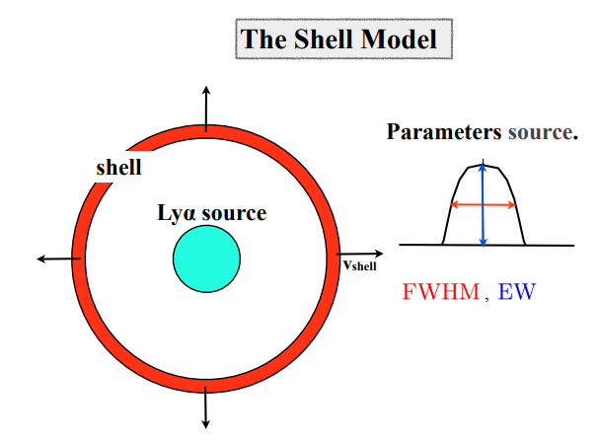
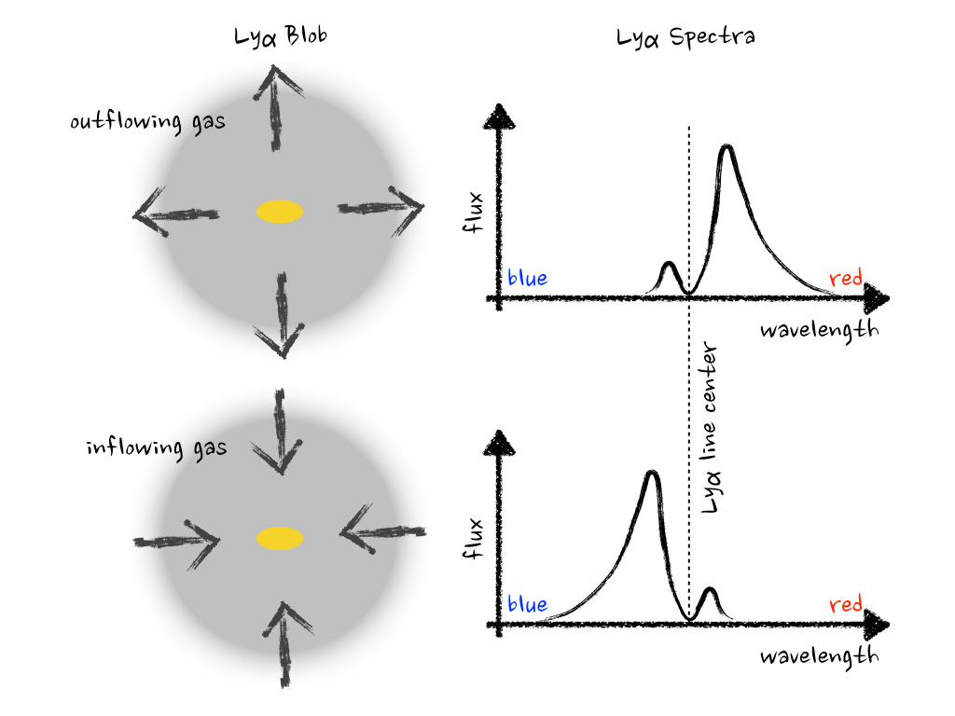
Simplified representation using Thin Shell
Parameter shell.
HI-column density
Outflow velocity

Slide 4
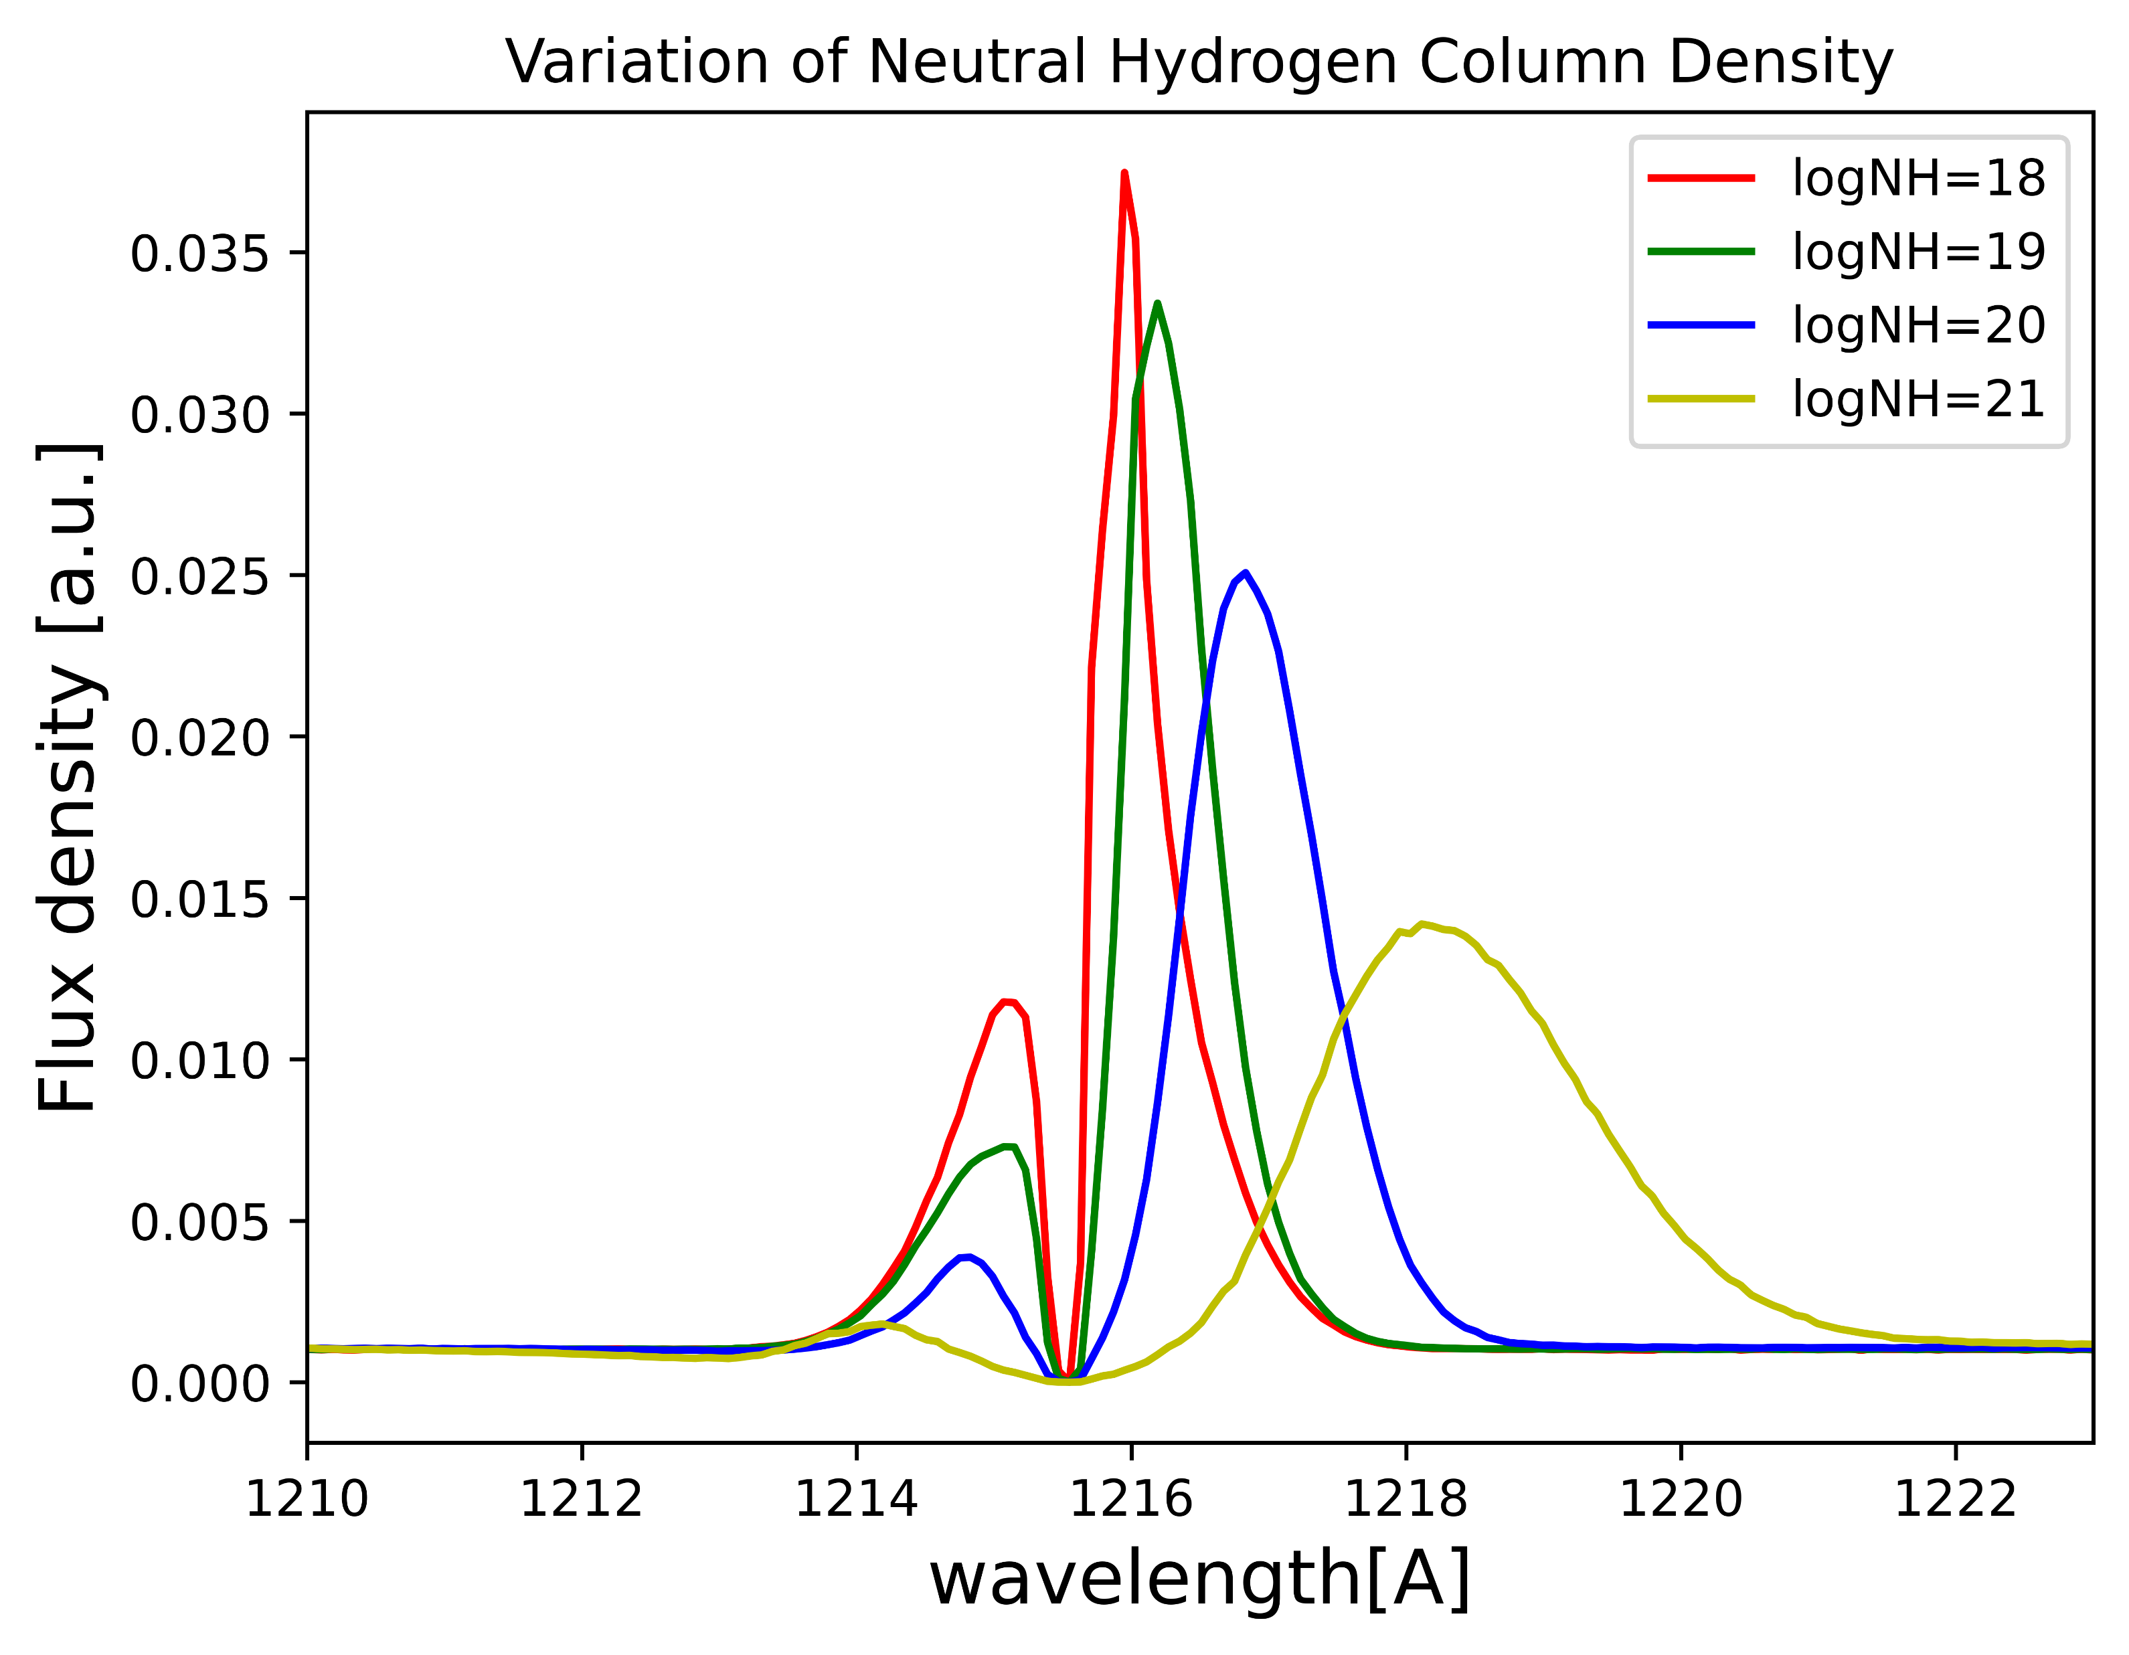
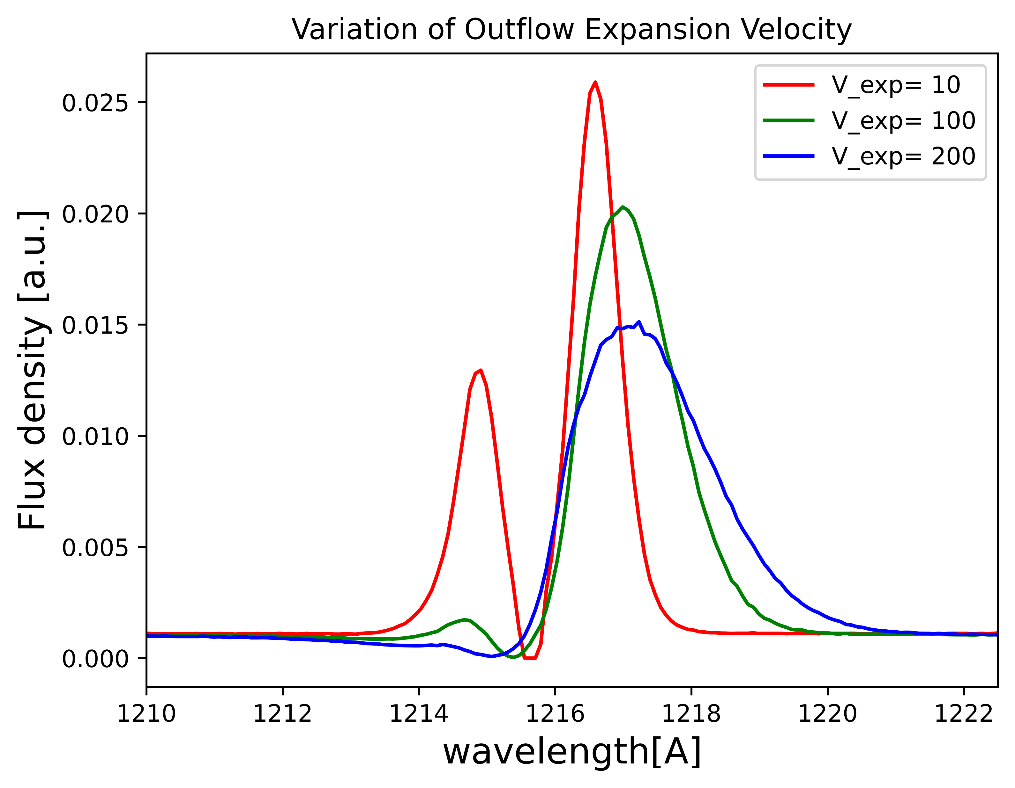
Change in Lyman Alpha Profiles after:

Slide 5
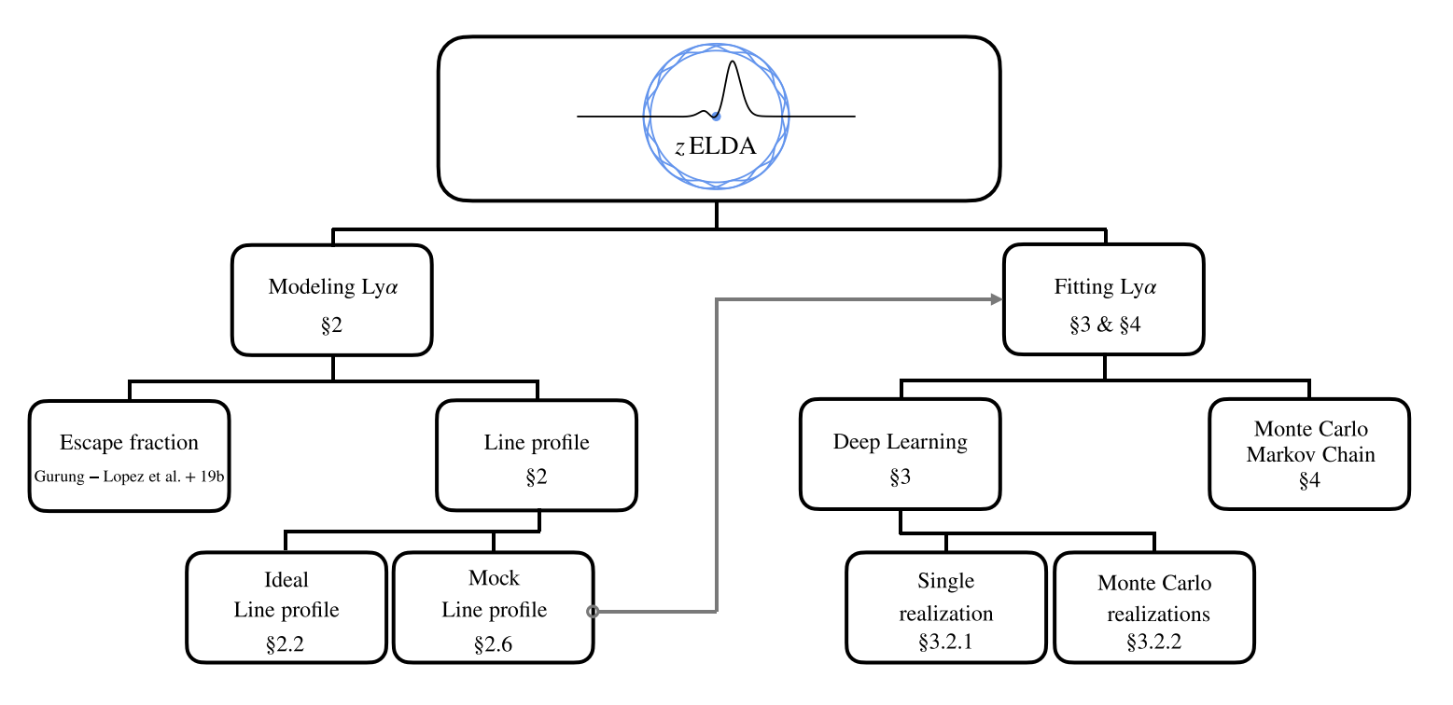
Introduction to zELDA
(redshift Estimator for Line profiles of Distant Lyman Alpha emitters)
Figure is from Gurung-López et al 2021

Slide 6
Work-Flow for the Line Fitting
Data Collection
Lyman Alpha emission profiles obtained from MUSEQuBES Survey
Data Pre-Processing
Fitting Lyman alpha emission using DNN Model
Setting up the spectral resolution of the spectra
Trimming the spectra near the Lyman alpha Emission
Picking Outflow or Inflow Model
Setting up the pixel size of the spectra

Slide 7
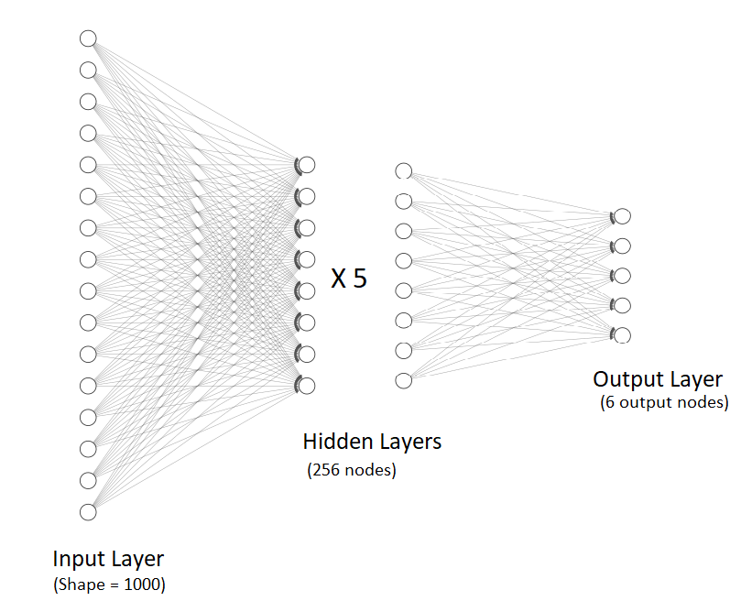
DNN Model Architecture
Outflow Expansion Velocity
Neutral Hydrogen Column Density
Dust Optical Depth
Equivalent Width
Intrinsic Width (FWHM)
Redshift
Range defined for the Regression model
log |Vexp|[km s−1] ∈ [1.0, 3.0],
log NH [cm−2] ∈ [17.0, 21.5],
log τ a ∈ [ − 4.0, 0.0],
log EW in [Å] ∈ [0.7, 2.3],
log W in [Å] ∈ [ − 2.0, 0.7]
z ∈ [0.001, 4.0]
Multi-Layer Perceptron Regression Model

Slide 8
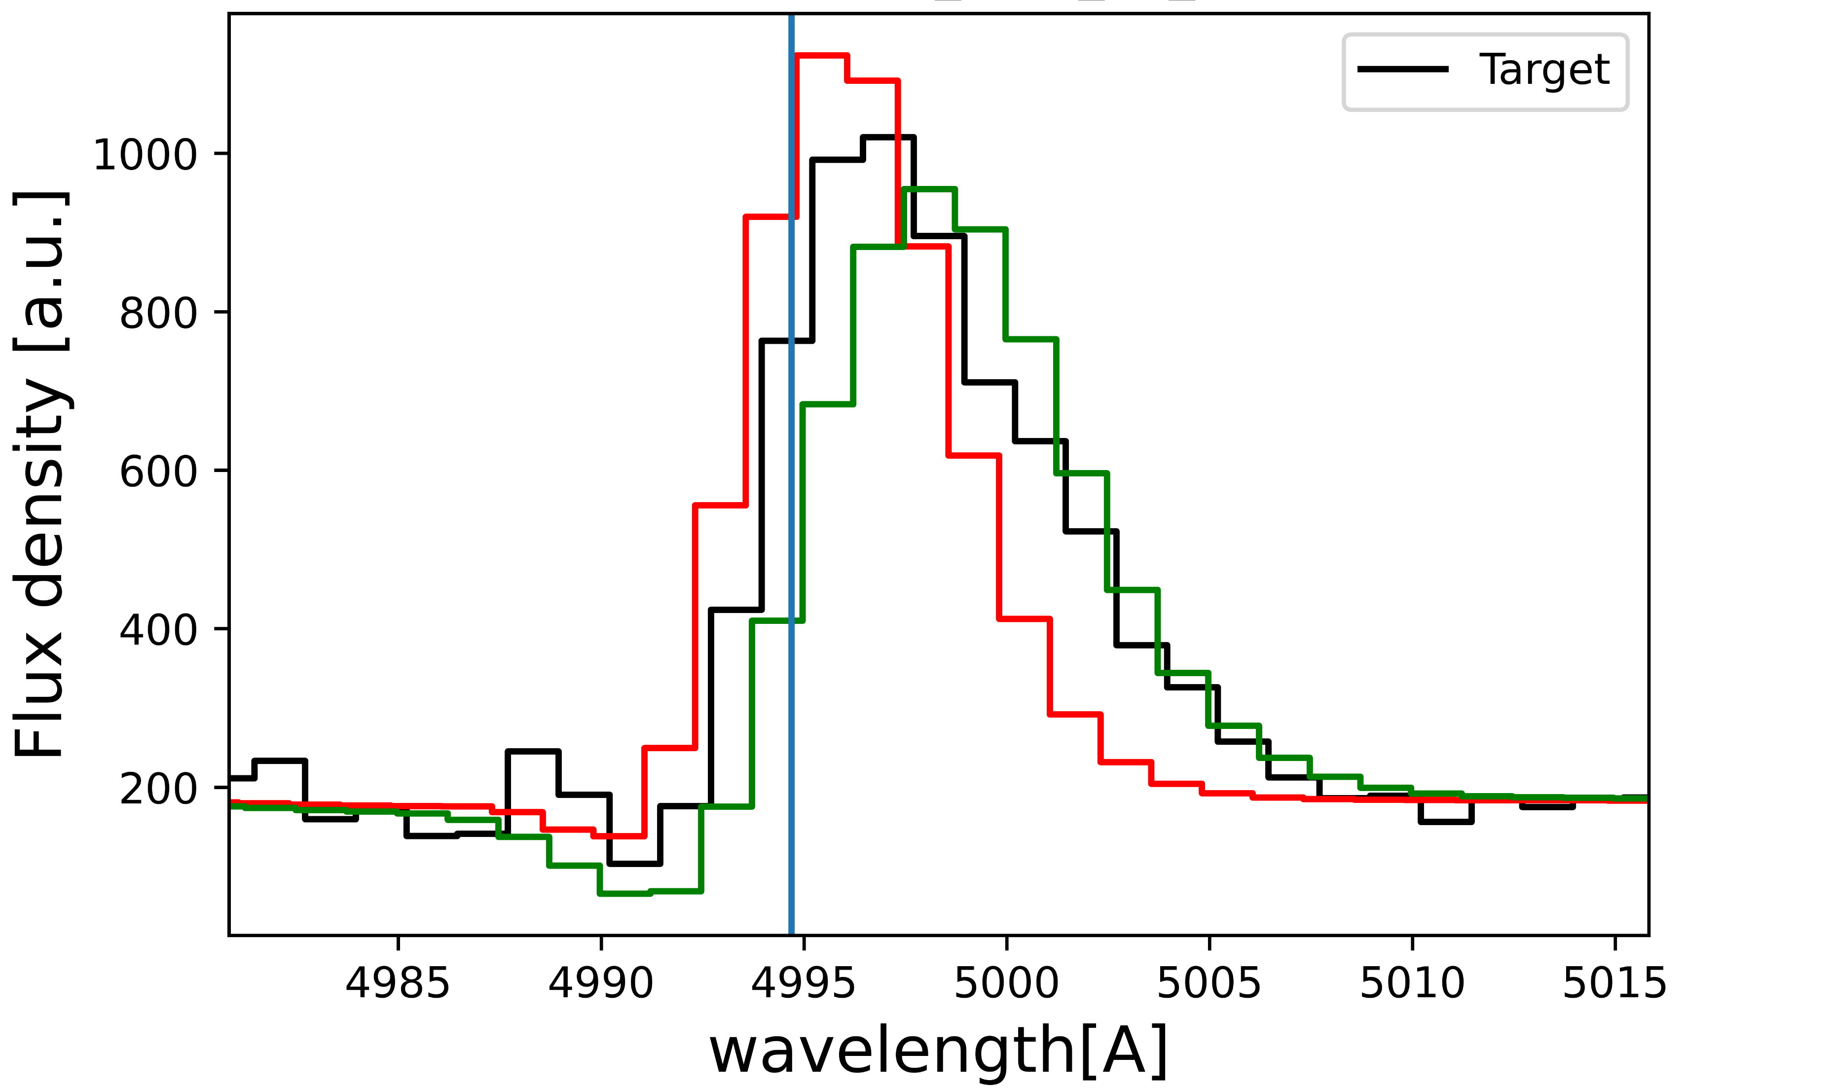
Fitting Line Using DNN with Monte Carlo Perturbations
The error array in the spectra is utilized in this run
The flux density is varied using the error at that point. This process goes on entire spectra
The Deep NN model fits the perturbed lines and predicts the parameters.
The process goes on for number of iteration mentioned in the code.
From the distribution of the nth iteration, the model decides the optimum median value as the final results.

Slide 9
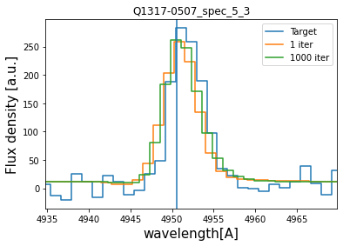
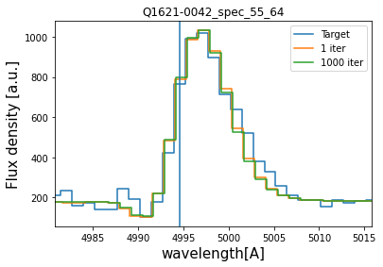
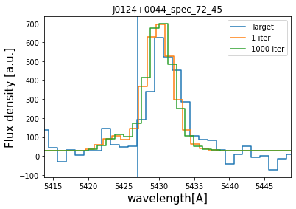
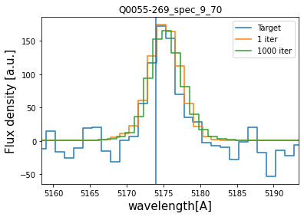
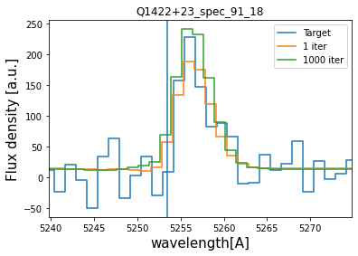
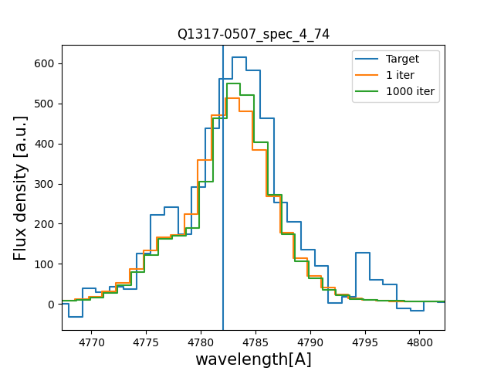
Examples of Line fits on MUSE data

Slide 10
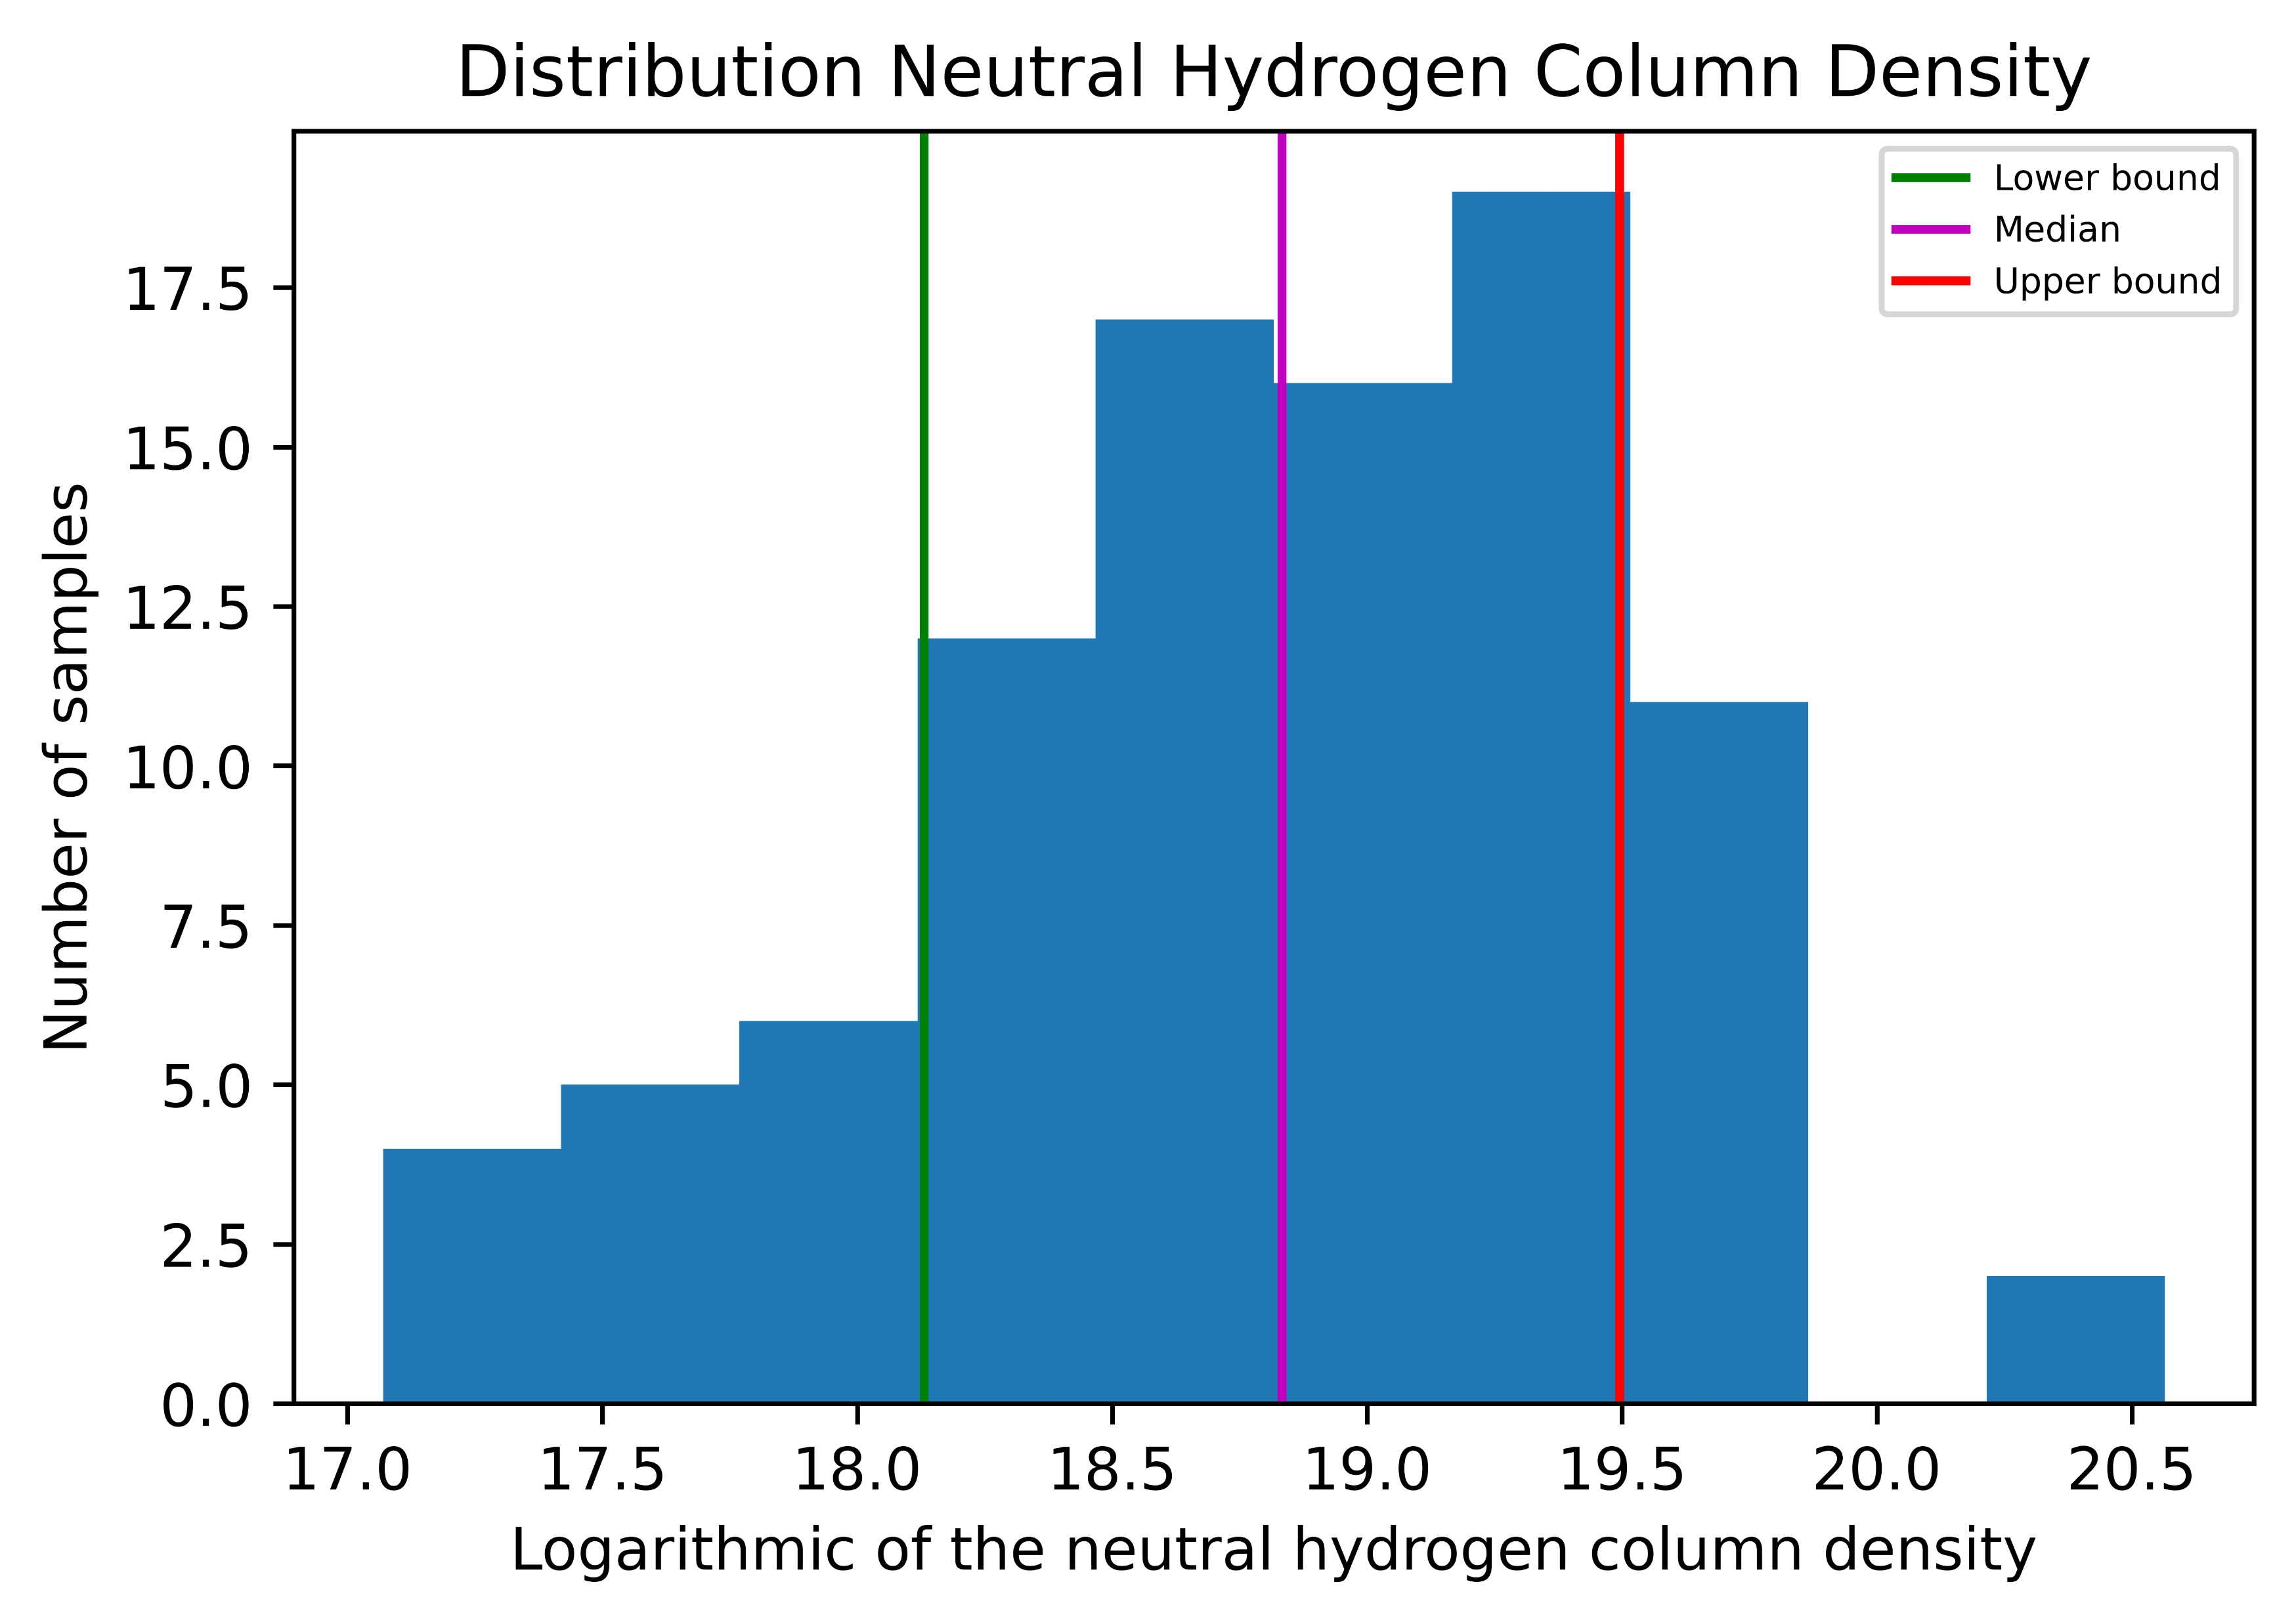
Median of log NH column density is at 18.8 [18.1, 19.5]

Slide 11
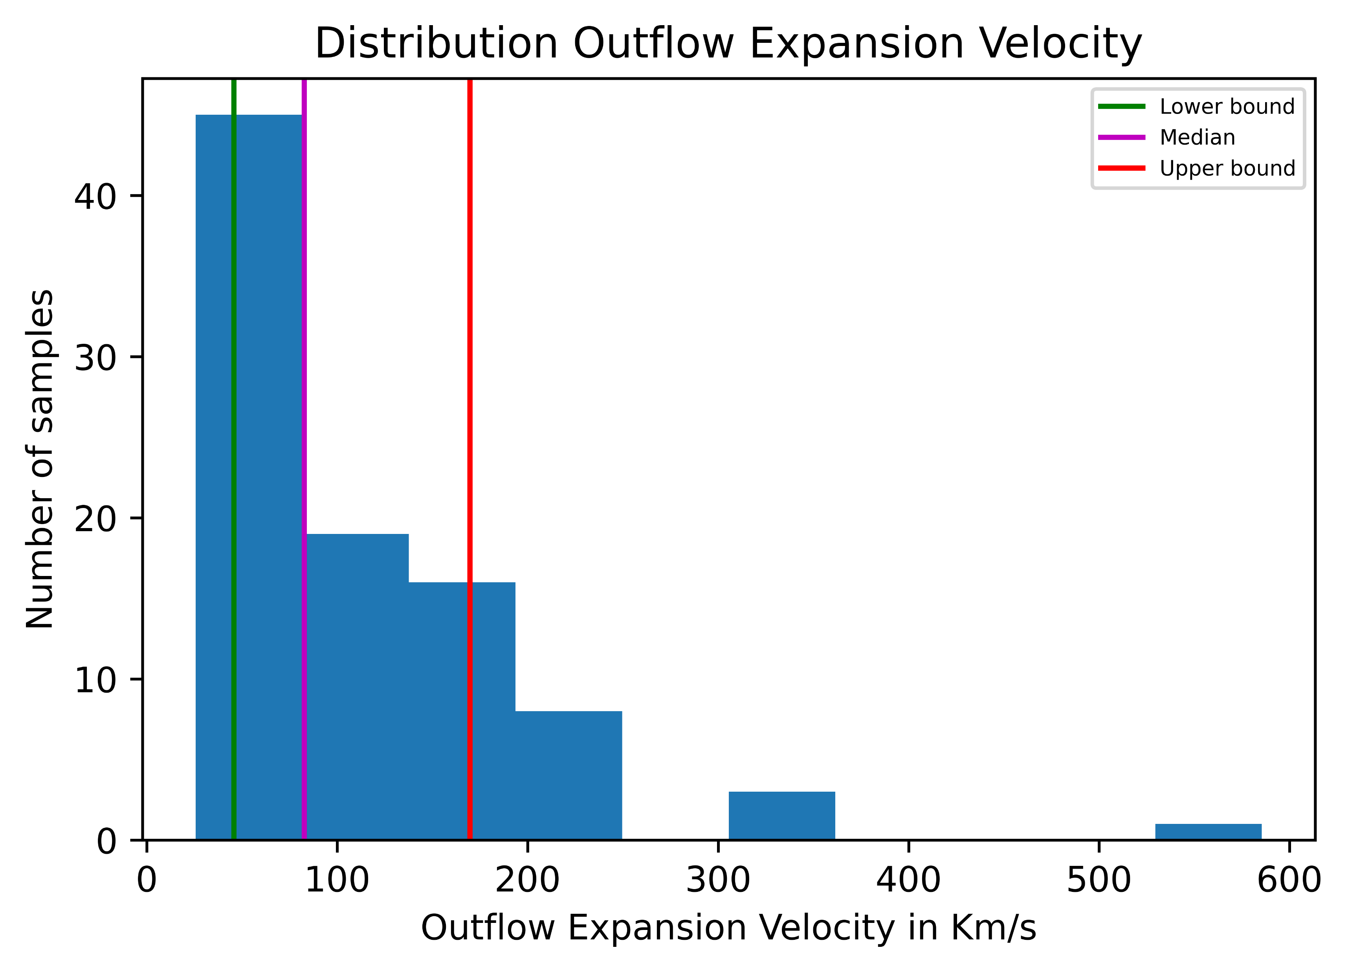
Median of Expansion velocity is at 82 [ 45, 169] km/s

Slide 12
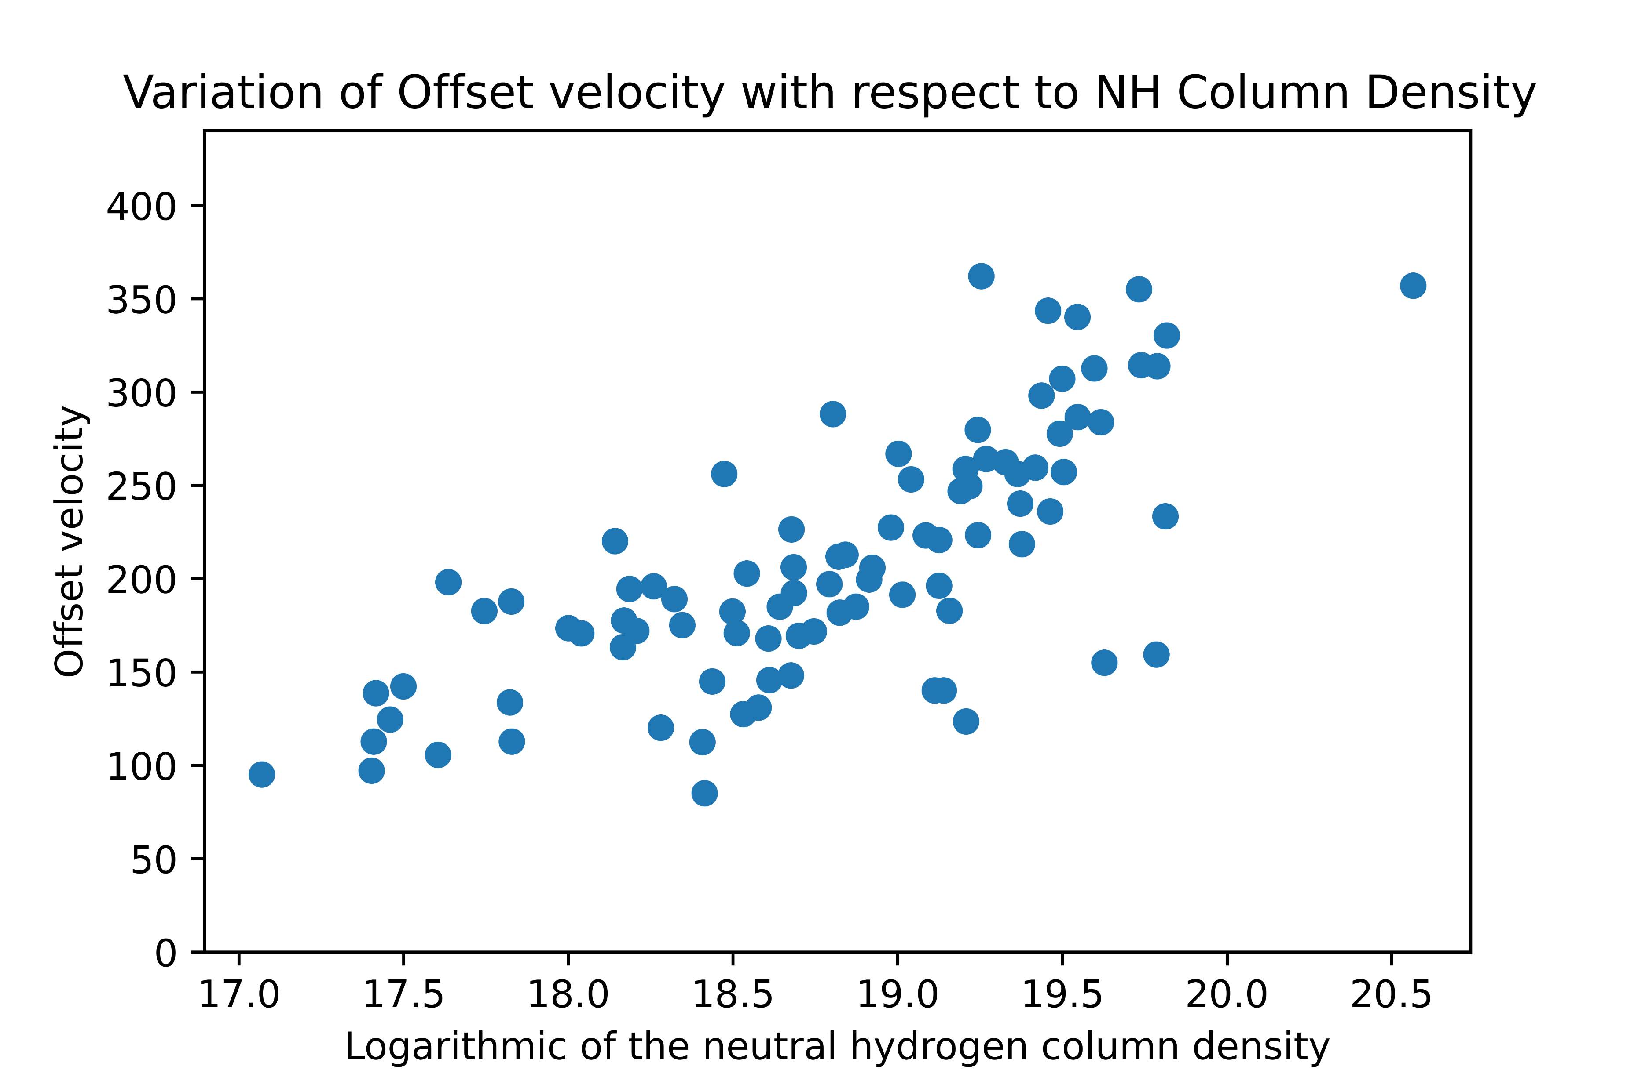

Slide 13
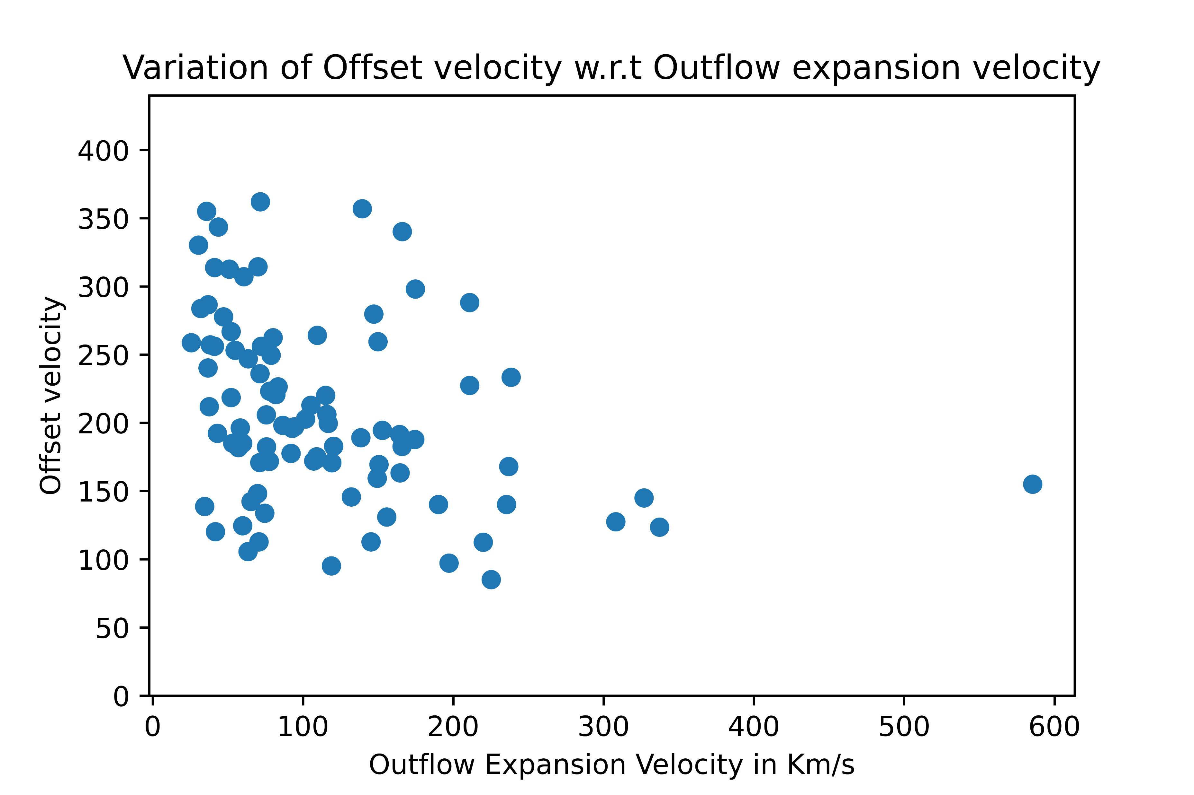

Slide 14
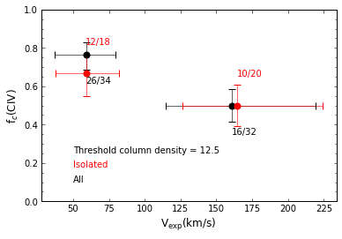
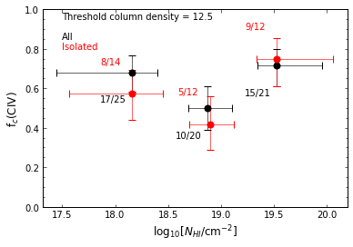
C IV covering fraction as a function of galaxy properties
Covering fraction w.r.t. Expansion Velocity Covering fraction w.r.t. NH column density

Slide 15
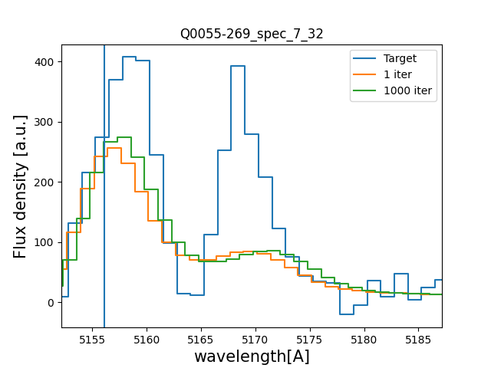
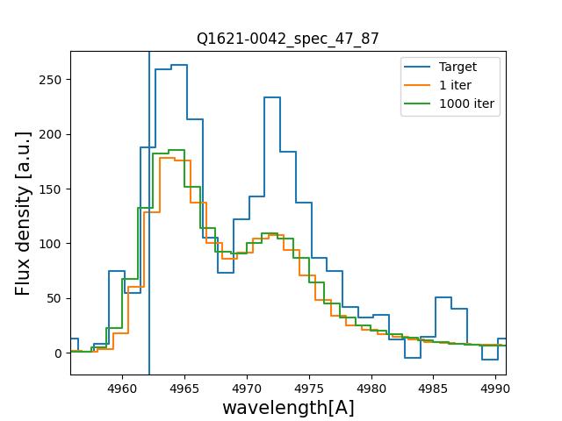
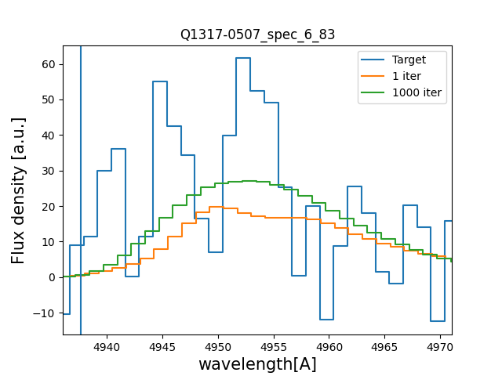
Fits on data which is excluded from this Study

Slide 16
Determining MgII absorption lines in Quasar absorption spectra using Deep Learning

Slide 17
Work-Flow for the Project
Data Collection
Collected data from SDSS DR-7 (~84.5k quasar spectra)
Data Pre-Processing
Data is classified according to presence of MgII absorber
Feeding To DNN Model
Converting the spectrum to the input shape of the model (3841)
Collected the MgII absorptions from JHU-SDSS Metal Absorber Catalog ( ~26.7k)
Removing the Shallow absorption line with 3σ criteria
Removing the Lyman Alpha Forest region from spectra
Eliminating the emissions in the spectra using SDSS-PCA-Continnum

Slide 18
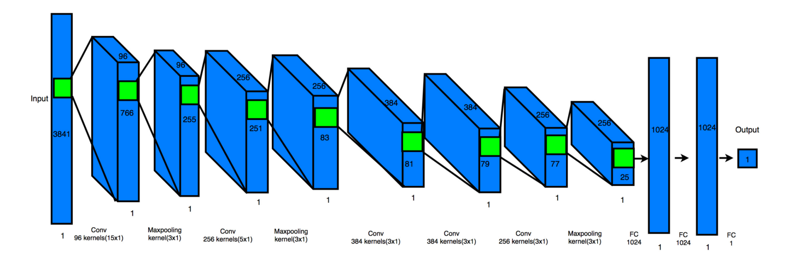
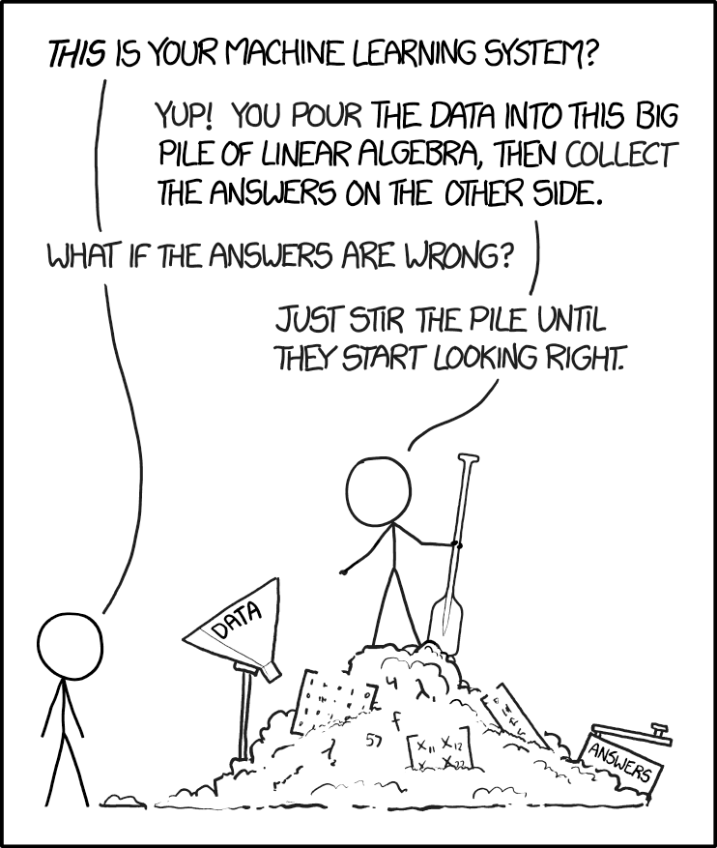
Deep Learning Model Architecture
Figure 1. The architecture of the 1D convolutional neural network aiming at detecting the Mg II absorption lines. The input spectra have 3841 shape and the output spectra have 1 value (1 as yes/0 as no).

Slide 19
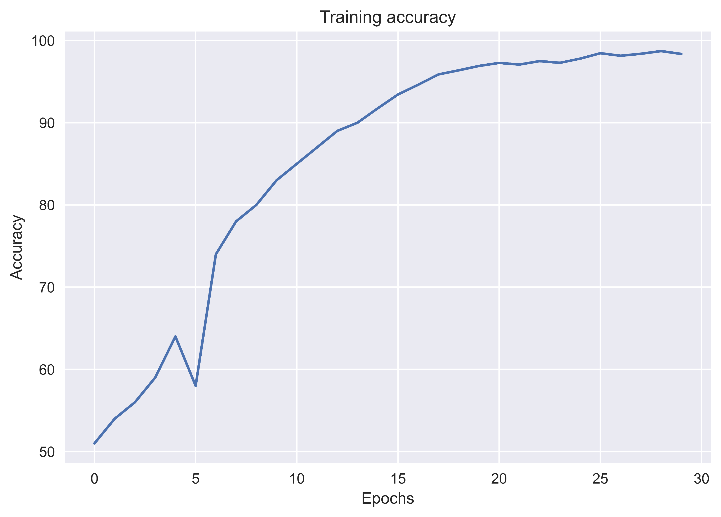
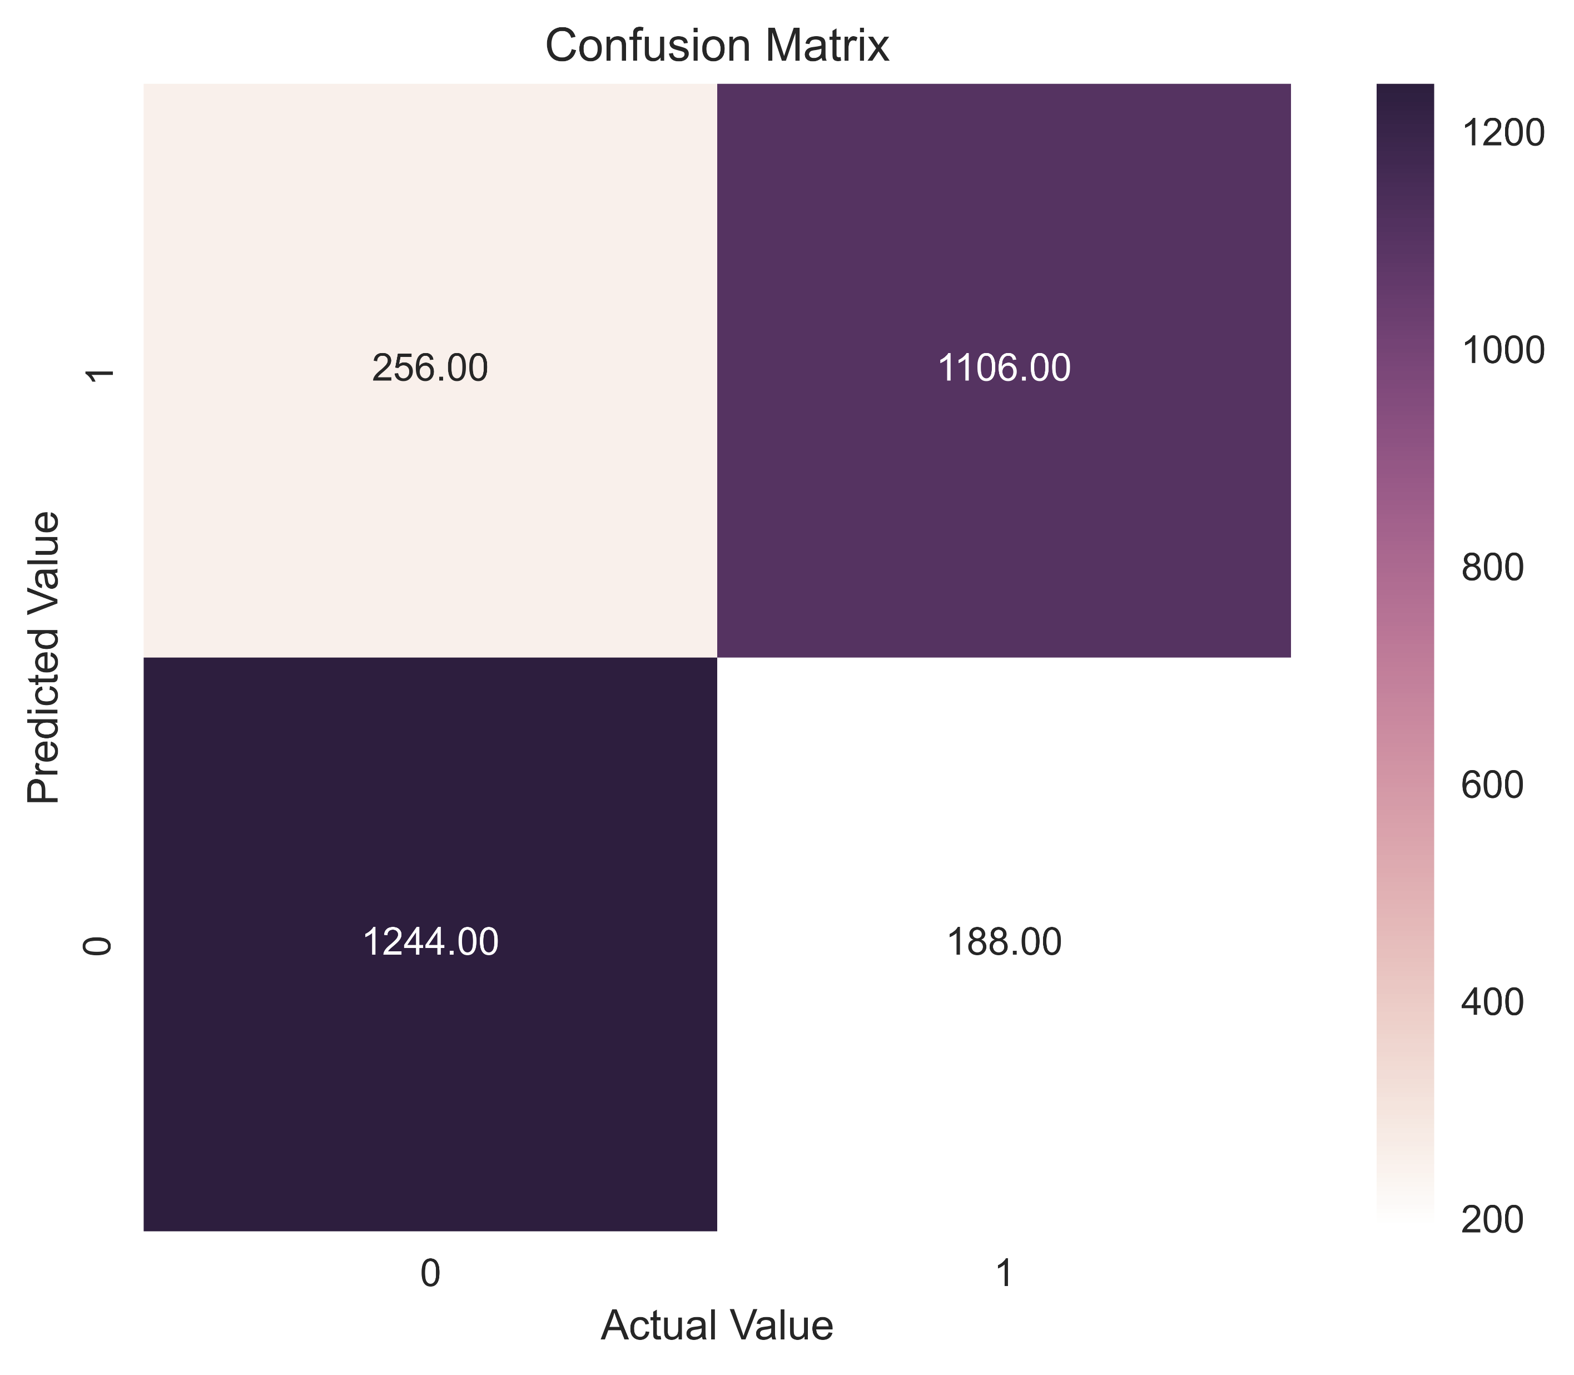
Results

Slide 20
Conclusion:
The model can predict the presence of MgII absorption line in quasar spectra with training accuracy 98.71% and validation accuracy of 84%
Unlike other popular neural network models that use small filter sizes for the first layer, our study shows that filter sizes in the first convolutional layer matching Mg II absorption feature sizes can produce the best detection accuracy. In our Mg II absorption spectra, two Mg II absorption lines typically occupy about 50 pixels. A filter size of ∼20 pixels in the first layers can optimally capture the two absorption line characteristics that will be propagated through the rest of the deep neural network layers to eventually produce positive detections.
Similar studies can be conducted to identify other absorption lines

Slide 21
References
https://attheu.utah.edu/facultystaff/mysterious-ultraviolet-radiation/
Gurung-López, Siddhartha, et al. "zELDA: fitting Lyman alpha line profiles using deep learning." Monthly Notices of the Royal Astronomical Society 510.3 (2022): 4525-4555.
Dijkstra, M. (2019). Physics of Lyα Radiative Transfer. In: Verhamme, A., North, P., Cantalupo, S., Atek, H. (eds) Lyman-alpha as an Astrophysical and Cosmological Tool. Saas-Fee Advanced Course, vol 46. Springer, Berlin, Heidelberg. https://doi.org/10.1007/978-3-662-59623-4_1Wad
Zhao, Yinan, et al. "Identifying Mg II narrow absorption lines with deep learning." Monthly Notices of the Royal Astronomical Society 487.1 (2019): 801-811.

