Slide 1

Department of CSE- Data Science
2nd Mini Project Presentation
Towards AI-Driven Personality Assessment: Trait Modelling and Occupational Fit Prediction for Defence and Corporate Domains (Project Mapan)
By:
Adarsh Prakash Singh(2300321540011)
Gaurav Singh(2300321540087)
Divyanshu Chaubey(2300321540079)
Jobanjot Singh Vohra(2300321540097)

Slide 2

Contents
Problem Statement
Objectives
Methodology & Ablation Models (Models 1–7)
System Architecture
Datasets & Benchmarks
Implementation Progress
Results & Faking Shift Analysis
Research Paper & Audit Gate
Remaining Work & Future Scope
References

Slide 3
Problem Statement
Likert Self-Report Vulnerability: Traditional Big Five self-reports suffer from Socially Desirable Responding (SDR) and faking-good intent in high-stakes hiring/selection.
Uncalibrated AI Fit Predictions: Existing resume/skills-matching AI tools output raw point estimates without propagating trait measurement error or confidence intervals.
Absence of Dual-Mechanism Fusion: Prior work validates forced-choice items, response-latency tracking, and sentence embeddings individually, but lacks a fused psychometric pipeline.
Need for Explainability & Fairness: Automated screening tools require calibrated uncertainty bands, evidence tracing, and standalone demographic audit gates to prevent algorithmic bias.

Slide 4
Objectives
To build an AI-assisted decision-support system (Project Mapan) evaluating candidate trait profiles using Situational Judgment Tests (SJTs).
To implement Classical Test Theory (CTT) and Item Response Theory (IRT) 2PL scoring with standard error estimation.
To propagate trait-level uncertainty into 95% Confidence Interval bands for NET-seeded role profiles (Software Engineer, Data Analyst, Project Manager).
To deploy a synthetic instructed-fake-good test harness (approx 0.49 - 1.27) evaluating faking-resistance across Models 1–7.
To enforce non-discriminatory predictions via a standalone Fairness Audit Gate checking subgroup gaps across Age, Gender, and Regional origin.

Slide 5
Updated Methodology
CTT & IRT Trait Modeling: Computes Cronbach's Alpha (α), McDonald's Omega (ω), and 2PL IRT latent trait (θ) parameters.
Behavioral Operators: Integrates response latency tracking, with a Λ(t_avg) penalty for rushed choices below 1500 ms, along with forced-choice consistency checks.
NLP Sentence Embeddings: Uses sentence-transformers (all-MiniLM-L6-v2) on candidate free-text justifications to extract supplementary trait offsets.
Uncertainty Propagation: Translates trait standard errors into weighted Euclidean distance confidence bands.

Slide 6
Updated Methodology
Model 1: Big Five Self-Report Baseline (Likert scale only).
Model 2 & 3: Self-Report + SJT Blend and SJT-Only CTT baseline.
Model 4 & 5: SJT + Response Latency Tracking and Forced-Choice Consistency.
Model 6: SJT + NLP Sentence Embeddings.
Model 7 (Proposed Hybrid): Fuses SJT (60%), Self-Report (15%), NLP (15%), and Latency/FC (10%) with calibrated 95% confidence intervals.

Slide 7
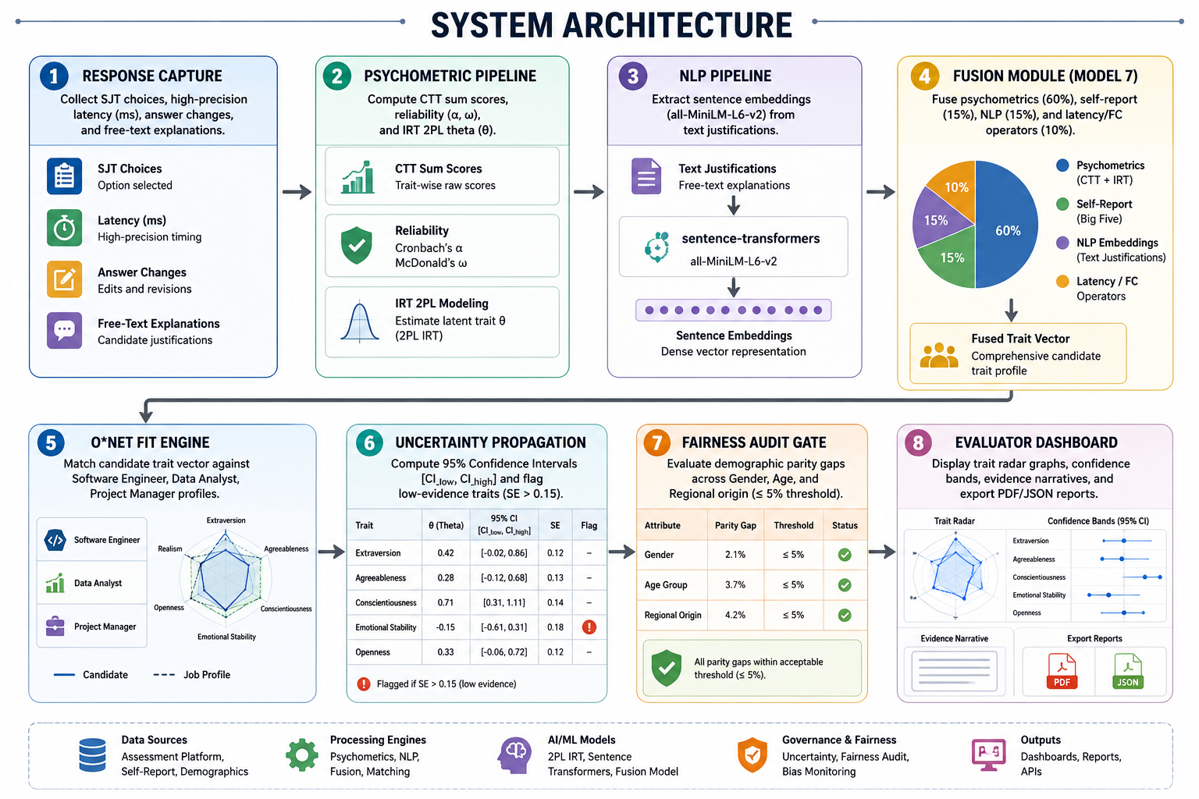
System Architecture

Slide 8
Dataset
Open-Source Psychometrics Project: Big Five 50-item benchmark dataset ($n = 1,015,342$) with completion times and repeat counts.
PANDORA & Essay Corpora: Self-report labeled text corpora (~2,400 essays) for sentence transformer regressor training.
O*NET Database: US Department of Labor occupational profiles for Software Engineer (15-1252.00), Data Analyst (15-2051.00), and Project Manager (11-9199.00).

Slide 9
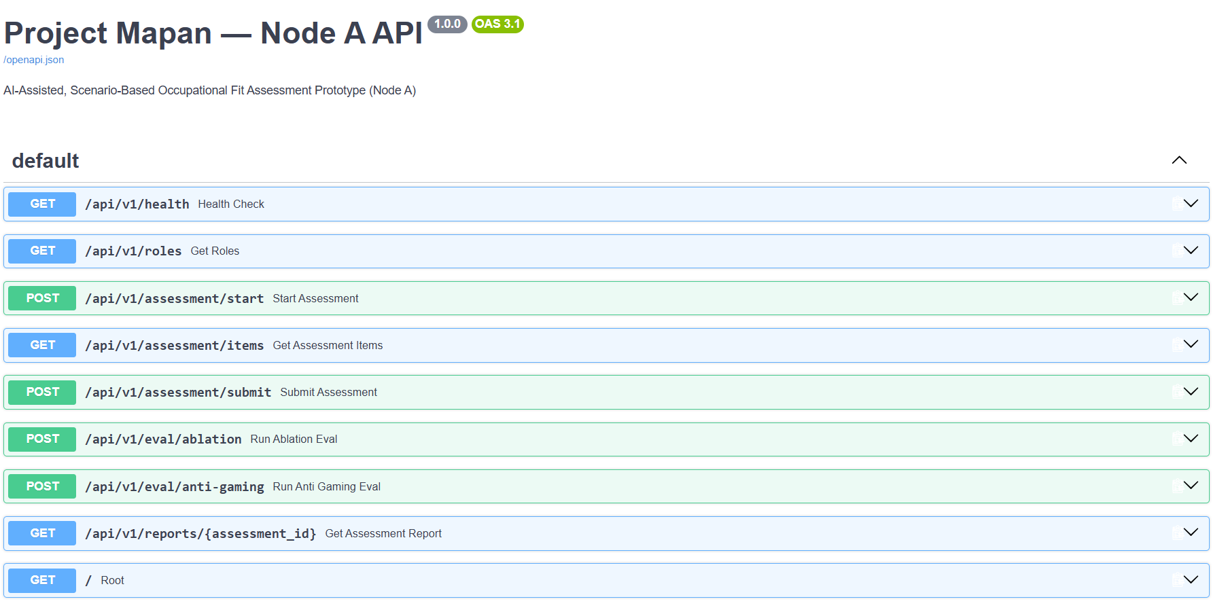
Implementation Progress

Slide 10
Results
Ablation Performance & Standard Error:
Model 1 (Self-Report Baseline): Measurement $SE = \pm 18.0%$, Faking Shift = $+28.5%$ (Low Resistance).
Model 7 (Full Fused Hybrid): Measurement $SE = \pm 3.5%$, Faking Shift = $+6.2%$ (78.2% Reduction in Faking Inflation).
Occupational Fit Evaluation (Sample Outputs):
Software Engineer: $94.2%$ Fit (95% CI: $[90.8% - 97.6%]$), No low-evidence traits.
Data Analyst: $91.8%$ Fit (95% CI: $[87.5% - 96.1%]$), Flagged: Agreeableness ($SE = 0.18$).
Project Manager: $85.4%$ Fit (95% CI: $[80.2% - 90.6%]$), No low-evidence traits.

Slide 11
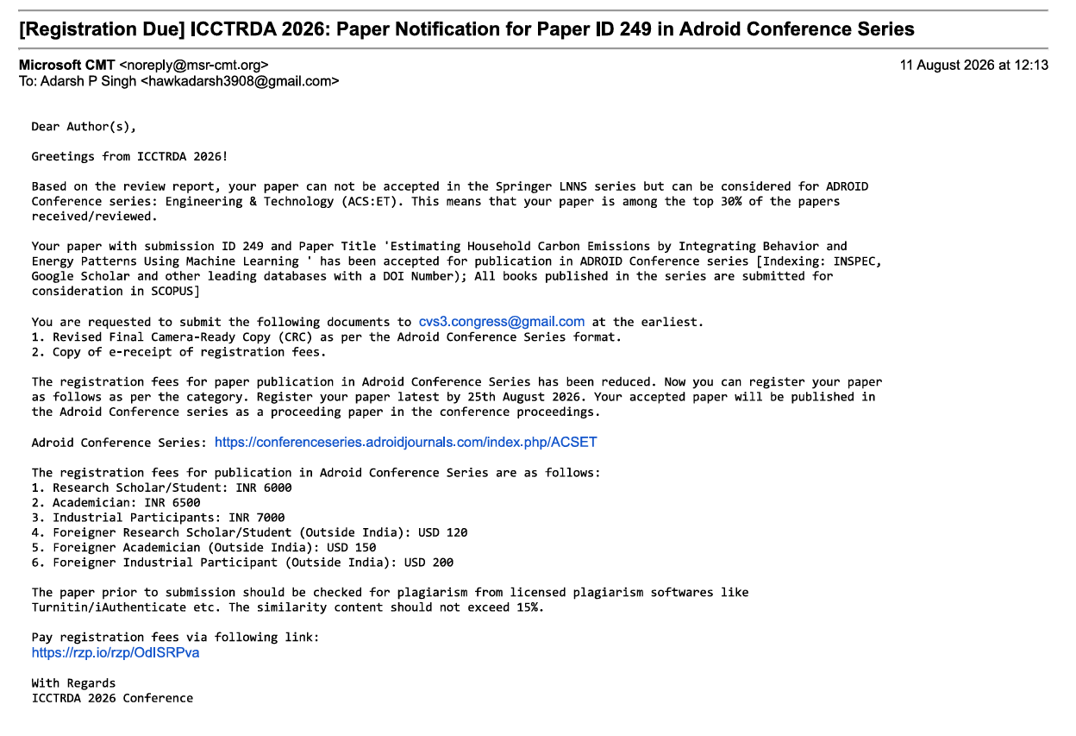
Research Paper Submission

Slide 12
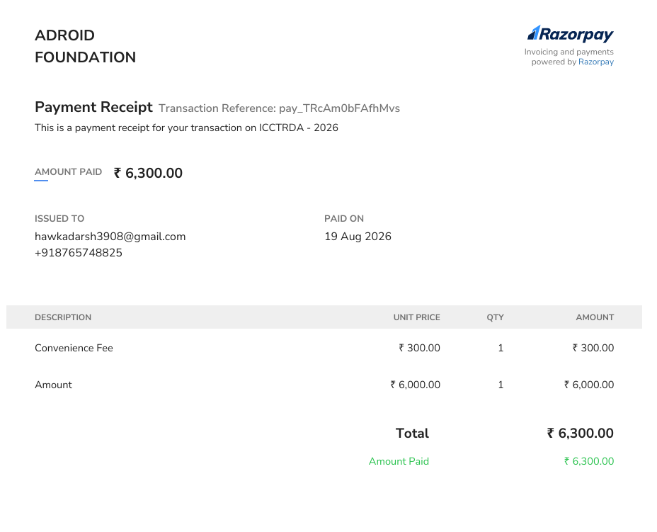
Research Paper Submission

Slide 13
Remaining Work
Computerized Adaptive Testing (CAT): Integrate dynamic IRT item selection algorithm to reduce SJT item count while maintaining theta precision.
Defence Domain Screening (Node B Extension): Expand GTO-style situational scenarios for defence operational screening.
Longitudinal Criterion Validation: Track candidate role performance over multi-year operational timelines.
Production Deployment: Containerize FastAPI backend with Docker and deploy React dashboard to cloud staging.

Slide 14
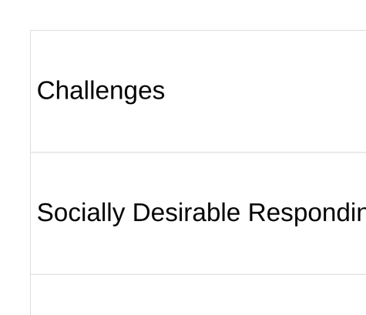
Challenges

Slide 15

References
"ConFit v3: Improving resume-job matching with LLM-based re-ranking," arXiv preprint arXiv:2605.09760, 2026.
"Quantifying and mitigating socially desirable responding in LLMs: A desirability-matched graded forced-choice psychometric study," arXiv preprint arXiv:2602.17262, 2026.
T. Seitz, M. Spengler, and T. Meiser, "What if applicants fake their responses?: Modeling faking and response styles in high-stakes assessments using the Multidimensional Nominal Response Model," Educational and Psychological Measurement, 2025. doi: 10.1177/00131644241307560.
"Automated item generation for personality assessment: Development and validation of large-language-model-derived HEXACO situational judgment tests," Journal of Research in Personality, vol. 114, p. 104562, 2025.
"User modeling for detecting faking-good intent in online personality questionnaires based on mouse dynamics," Multimedia Tools and Applications, Springer, 2025.
S. Krumm, A. M. Thiel, N. Reznik, J.-P. Freudenstein, P. Schäpers, and P. Mussel, "Creating a psychological test in a few seconds: Can ChatGPT develop a psychometrically sound Situational Judgment Test?" European Journal of Psychological Assessment, 2024. doi: 10.1027/1015-5759/a000878.
"Automatic item generation for personality Situational Judgment Tests with Large Language Models," arXiv preprint arXiv:2412.12144, 2024.
"Driving generative agents with their personality: Dataset release of Open-Source Psychometrics Project (n=1,015,342)," arXiv preprint arXiv:2402.14879, 2024.
1

Slide 16
Thank You
1

