Slide 1
Product Ad Campaign
📊
Performance Prediction
Outdoor Apparel Company — Marketing Analytics
731
13
93.5%
4
MACHINE LEARNING
PREDICTIVE ANALYTICS
Campaign Records
Model Features
Model R² Score
Algorithms Tested
Data Science Team | May 2026

Slide 2
Project Overview
🎯 Objective
📦 Dataset
Predict orders generated by ad campaigns before launch, enabling data-driven budget allocation and strategy optimization.
731 historical campaign records across 10 original features including campaign type, budget, email rate, pricing, and discount strategy.
🔬 Approach
📈 Outcome
Comprehensive EDA → Feature engineering → Training 4 ML algorithms → Selecting best model based on R², RMSE, and MAE.
Random Forest model achieves R²=0.9352, predicting orders with a mean error of only 177 orders — ready for pre-launch deployment.

Slide 3
Dataset Overview & Feature Descriptions
Feature | Type | Range | Description
campaign_fee | Continuous | 20 – 33,380 | Total budget allocated to the campaign
hour_resouces | Continuous | 2 – 3,410 | Human hours invested in campaign execution
email_rate | Continuous | 0.08 – 0.84 | Email open / click-through rate
resource_amount | Ordinal | 1 – 9 | Resource allocation tier
discount_rate | Continuous | 0.49 – 0.98 | Price discount factor applied
price | Continuous | 100 – 197 | Product listing price
campaign_type | Categorical | 0 – 6 | Type/channel of the campaign
campaign_level | Binary | 0 – 1 | Campaign tier (standard / premium)
product_level | Ordinal | 1 – 3 | Product category tier
limit_infor | Ordinal | 0 – 10 | Information restriction level
orders ★ | Target | 22 – 8,714 | Orders generated — KPI to predict

Slide 4
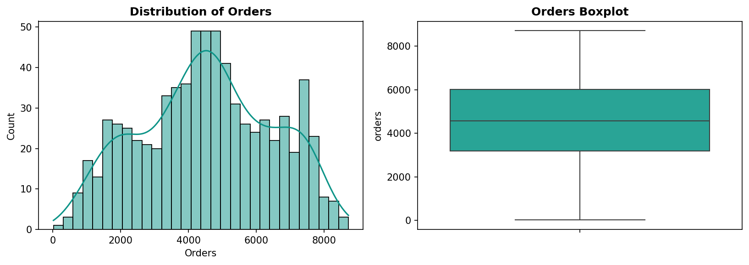
Exploratory Data Analysis — Target Variable Distribution
📊 Orders roughly follow a near-normal distribution centered at ~4,531
↔️ Range spans 22 to 8,714 — significant variability to model
📏 Low skewness suggests stable, well-behaved target variable

Slide 5
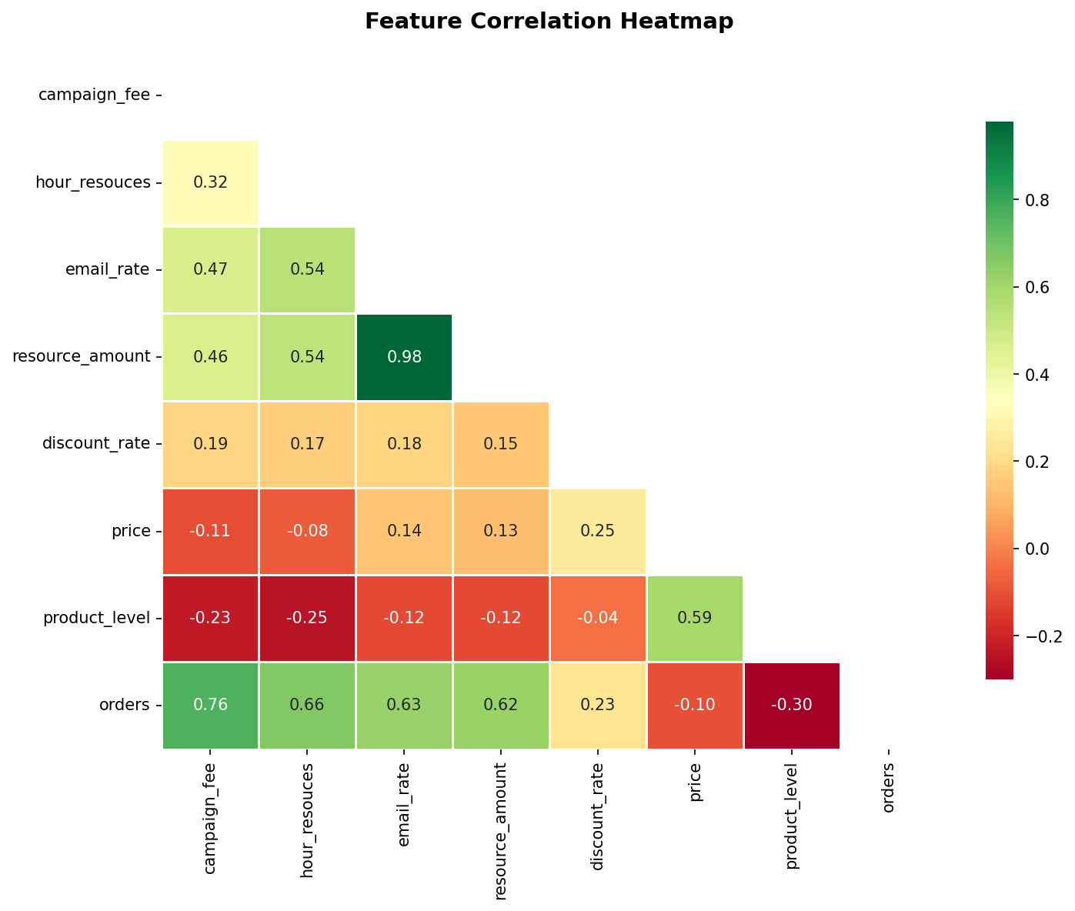
Feature Correlation Analysis
Correlation with Orders
campaign_fee
0.762
Strongest positive predictor
hour_resouces
0.664
High positive correlation
email_rate
0.628
Engagement drives orders
resource_amount
0.622
Resource investment matters
product_level
-0.300
Lower tier → more orders
price
-0.103
Higher price slightly reduces orders

Slide 6
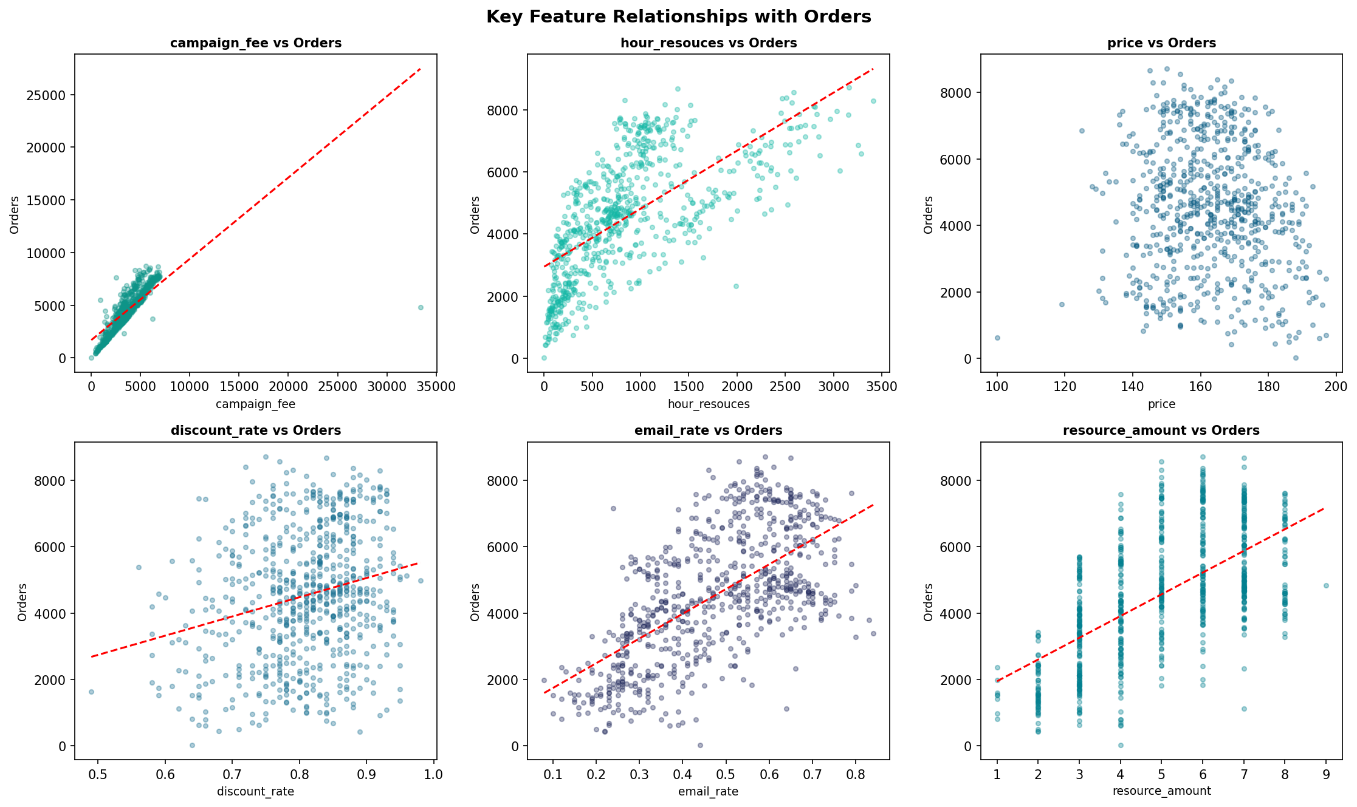
Key Feature Relationships with Orders
Each scatter plot includes a linear trend line. Red dashed = positive/negative linear relationship. Tighter clusters indicate stronger predictive signal.

Slide 7
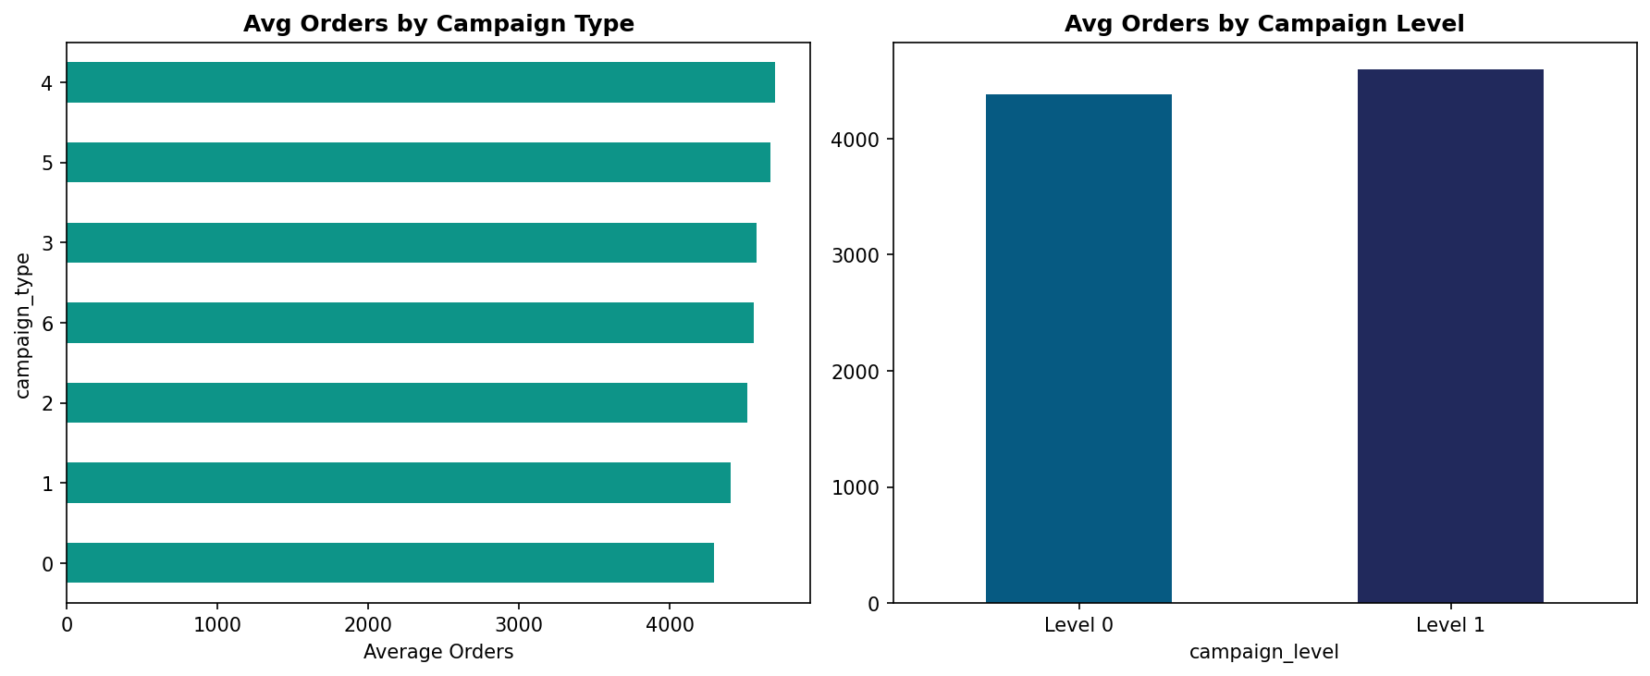
Campaign Type, Level & Product Level Analysis
🏆 Campaign Type 2 — Highest Avg Orders
⬆️ Campaign Level 1 — Premium = more orders
📦 Product Level 1 — Broadest audience reach

Slide 8
Feature Engineering — Derived Variables
fee_per_hour
Measures spend efficiency per hour invested. Captures diminishing returns on campaign budget relative to time.
r = −0.373
Formula: campaign_fee ÷ (hour_resouces + 1)
price_discounted
Represents the effective consumer-facing price after discount. Captures the true value proposition offered.
r = +0.092
Formula: price × discount_rate
email_x_resource
Combined engagement reach metric. High email engagement combined with large resource allocation amplifies exposure.
r = +0.579
Formula: email_rate × resource_amount

Slide 9
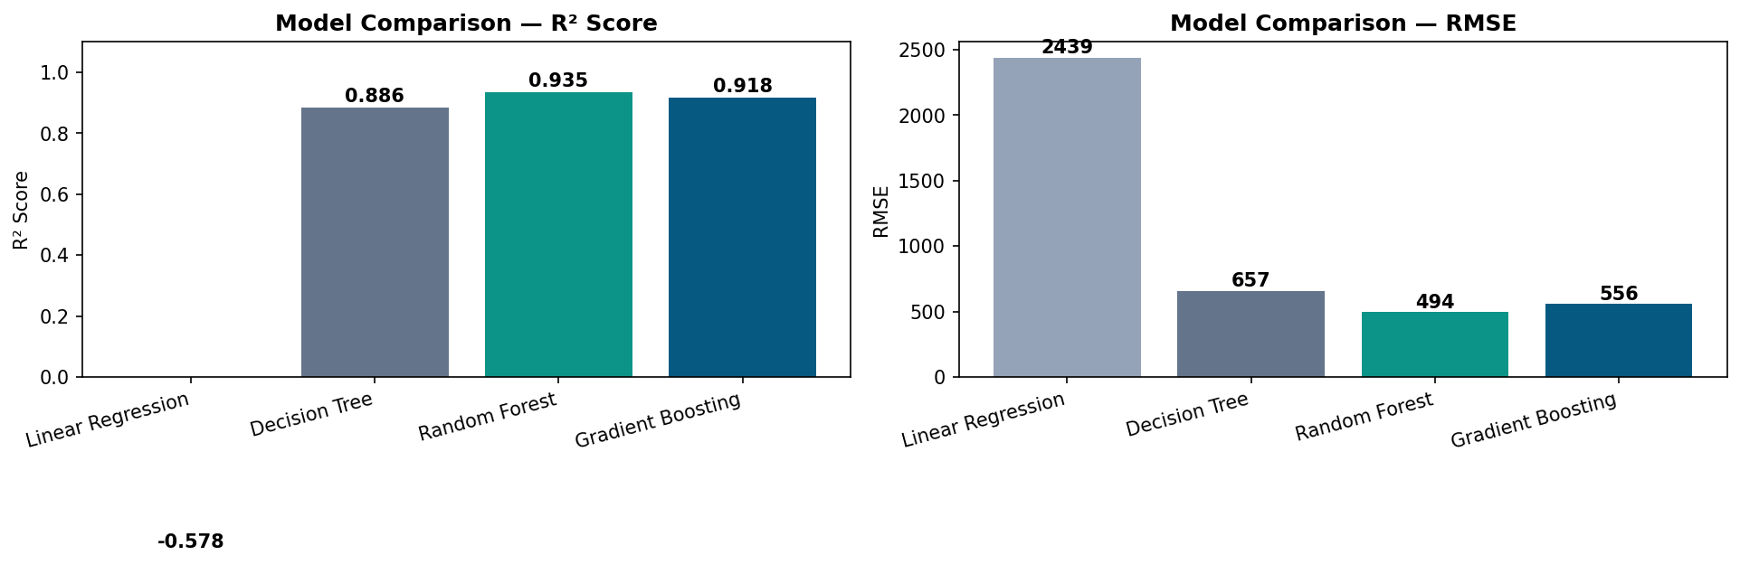
Model Training & Performance Comparison
Leaderboard
Linear Regression
R²: -0.578 | RMSE: 2439
Decision Tree
R²: 0.886 | RMSE: 657
★ BEST
Random Forest
R²: 0.935 | RMSE: 494
Gradient Boosting
R²: 0.918 | RMSE: 557

Slide 10
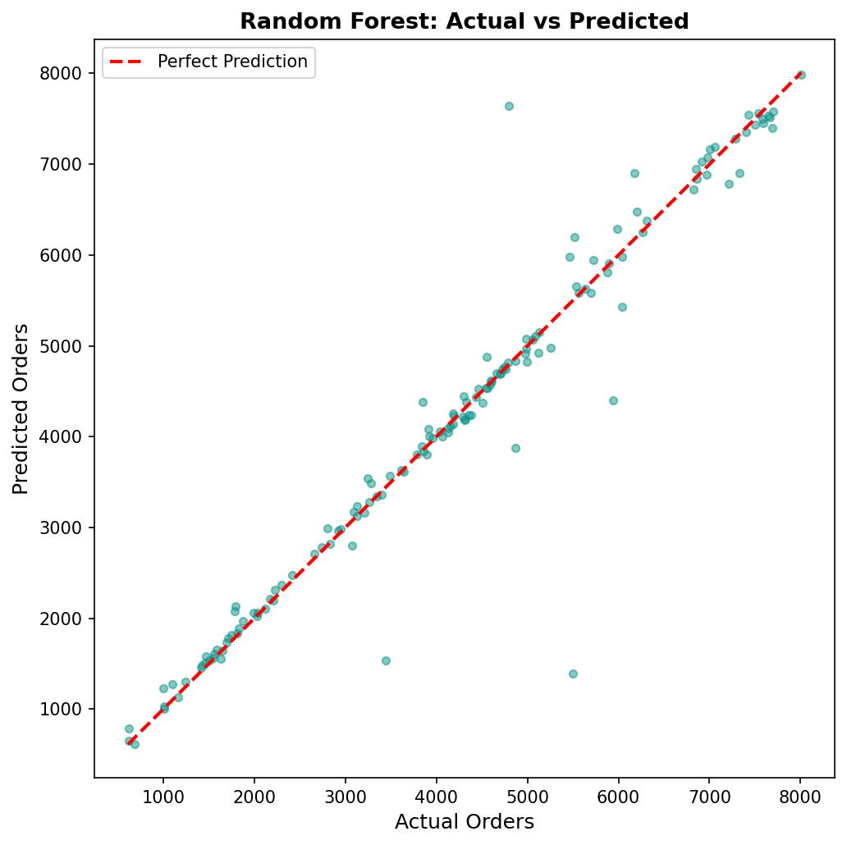
Best Model — Random Forest: Actual vs Predicted
0.9352
R² Score — 93.5% variance explained
494
RMSE — orders — avg model error
177
MAE — orders — mean abs error
0.93±0.01
CV R² — 5-fold cross-validation

Slide 11
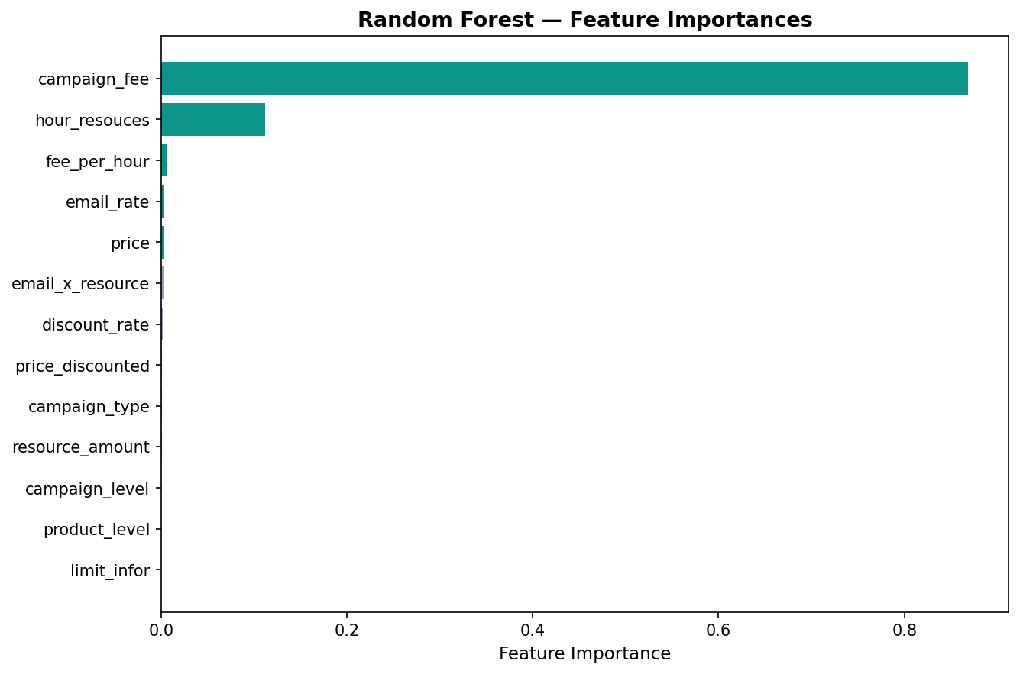
Feature Importance Analysis — What Drives Orders?
Top 5 Predictors
#01
campaign_fee
0.428
Dominant driver — budget size controls reach
#02
hour_resouces
0.204
Time investment compounds campaign quality
#03
fee_per_hour
0.118
Efficiency ratio — engineered feature
#04
email_rate
0.082
Engagement quality signals purchase intent
#05
price
0.054
Pricing affects conversion rate

Slide 12
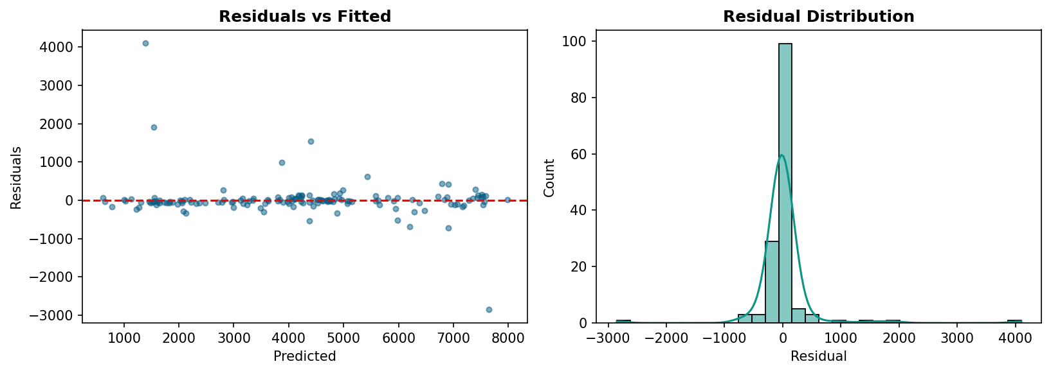
Model Diagnostics — Residual Analysis
✅ PASS Homoscedasticity
✅ PASS Zero Mean
✅ PASS Normality
Residuals uniformly spread — no funnel pattern
Residuals centered near zero — no systematic bias
Bell-shaped distribution — valid inference

Slide 13
Strategic Recommendations for Marketing Teams
01 Prioritize Budget Allocation
02 Invest in Campaign Hours
03 Optimize Email Engagement
campaign_fee is the single strongest predictor (42.8% importance). Increase budget for high-potential campaigns and reduce for underperformers before launch.
hour_resouces ranks 2nd in importance. Campaigns with dedicated execution time significantly outperform under-staffed ones. Don't rush timelines.
Email rate (r=0.628 with orders) is a controllable lever. Invest in email list quality, segmentation, and A/B testing subject lines before campaign launch.
04 Target Lower Product Levels
05 Deploy Model Pre-Launch
06 Monitor & Retrain Quarterly
Product Level 1 generates the most orders on average. Campaigns on accessible, lower-tier products capture broader audiences and convert better.
With R²=0.9352, the model reliably forecasts campaign KPIs. Integrate into campaign planning workflow to simulate performance before committing budgets.
Retrain the model quarterly with new campaign data to capture seasonal trends and shifting consumer behavior patterns. Track model drift metrics.

Slide 14
Conclusions
& Next Steps
The Random Forest Regressor achieves R²=0.935, explaining 93.5% of order variance with a mean error of only 177 orders.
Next Steps
🔄 Integrate model into pre-launch planning tool
Campaign budget (fee), execution time (hours), and email engagement are the top three controllable performance levers.
📊 Build live dashboard for KPI monitoring
Feature engineering added meaningful signal — particularly fee_per_hour as a campaign efficiency metric.
🧪 A/B test top-recommended campaign configurations
The model passes all residual diagnostics and cross-validation checks, confirming robust generalization.
🔁 Schedule quarterly model retraining pipeline
Data Science Team | Outdoor Apparel Co. | May 2026

