Slide 1
Business Performance Summary
Based on Revenue, Quantity, and Customer Insights

Slide 2
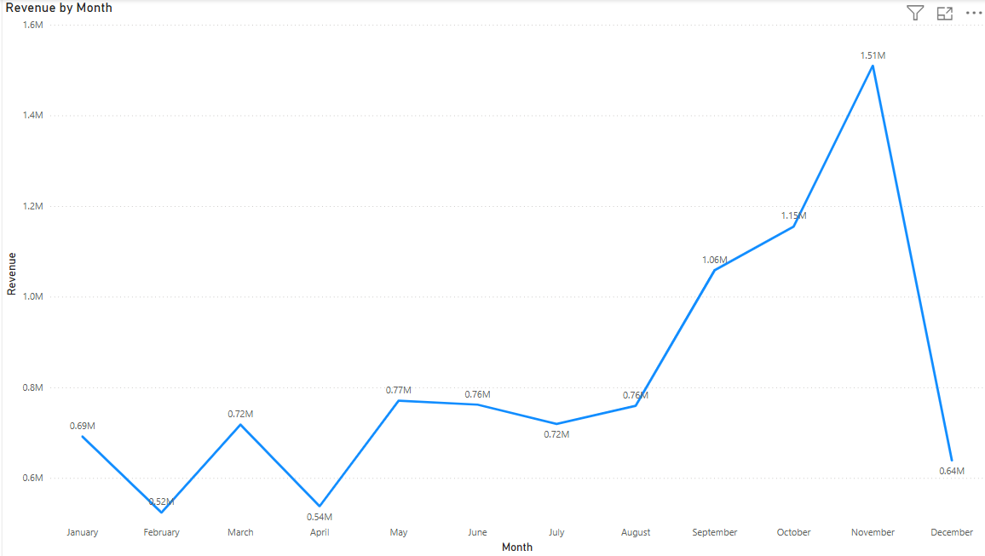
Revenue Trend Across the Year
- Highest Revenue: November ($1.51M)
- Lowest Revenue: February ($0.52M)
- Strong growth observed from August to November
- December dip to $0.64M likely due to year-end seasonality

Slide 3
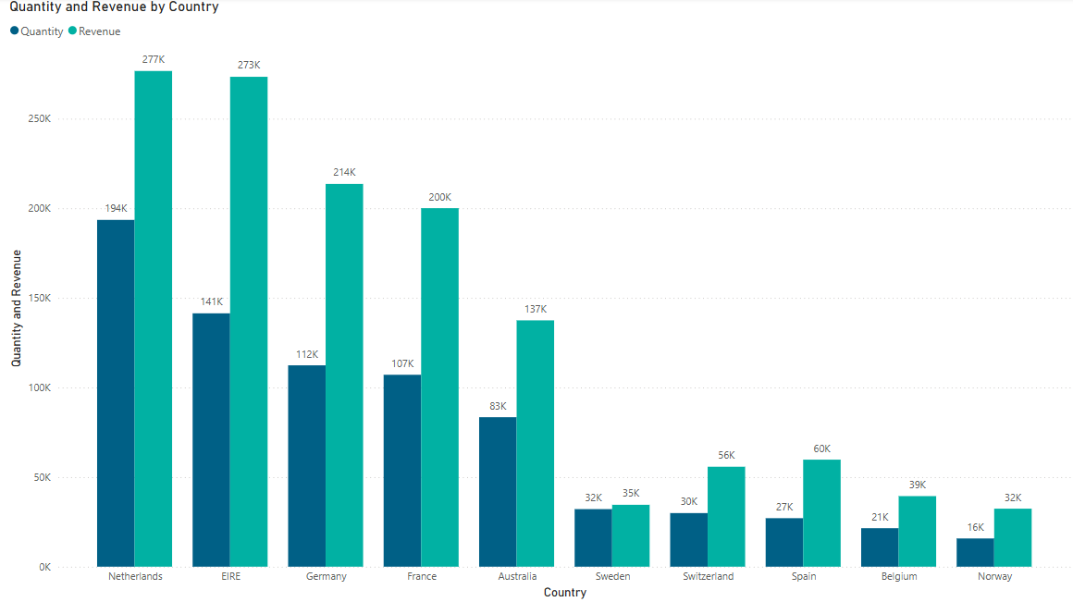
Top Countries by Revenue and Quantity
- Top 3 Revenue Countries:
1. Netherlands: $277K
2. EIRE (Ireland): $273K
3. Germany: $214K
- Lowest contributors: Norway, Belgium, Spain (< $70K)

Slide 4
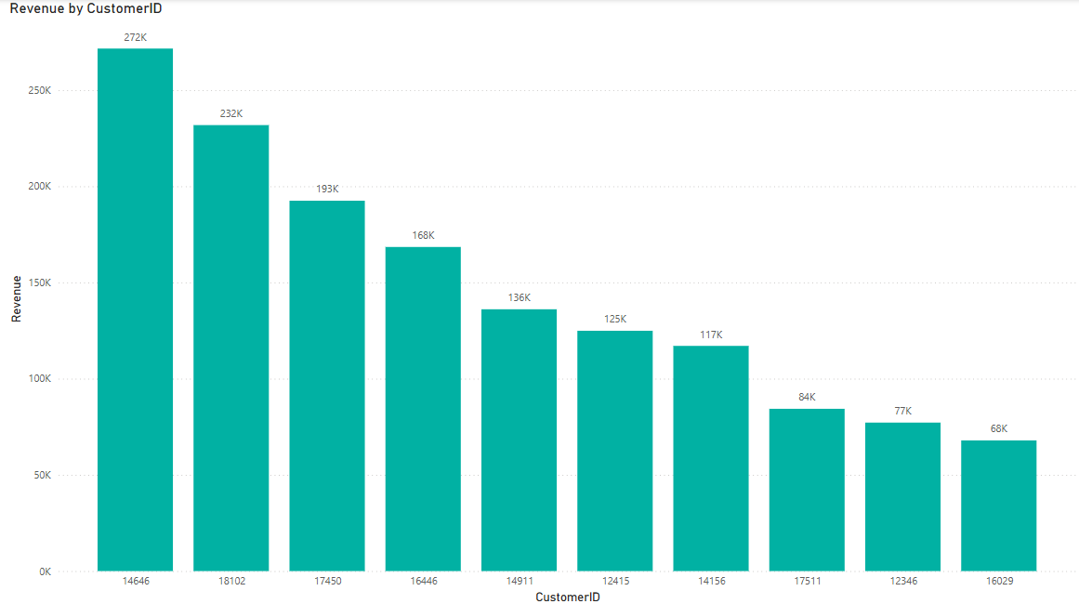
Top Revenue-Generating Customers
- Top Customer (ID: 14646) generated $272K
- Next top customers:
- 18102: $232K
- 17450: $193K
- Few key accounts drive large revenue — focus on relationship management

Slide 5
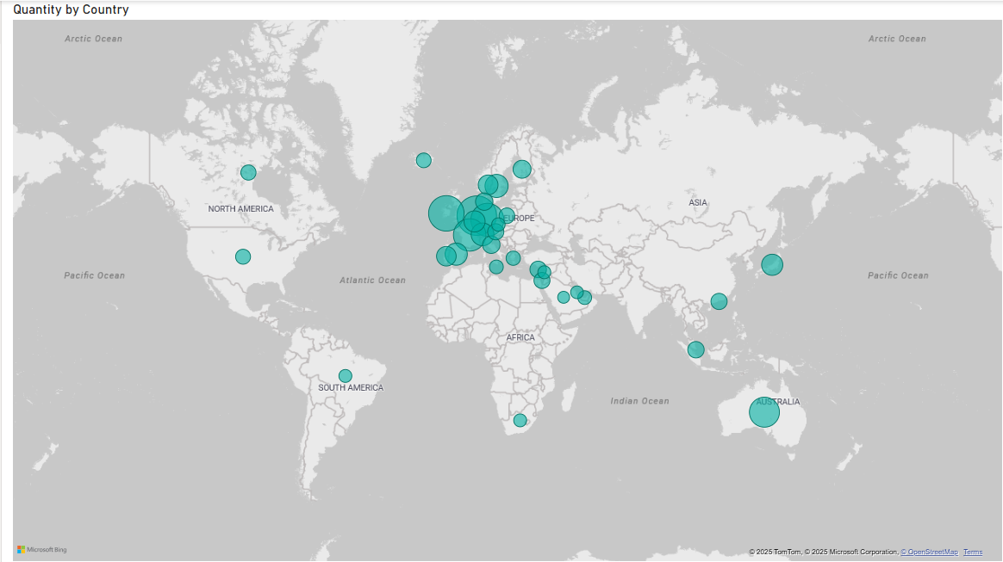
Global Distribution of Sales Quantity
- Europe dominates in quantity
- Notable presence in Australia, North America, Asia
- Expansion opportunity in Africa and South America

Slide 6
Summary & Action Points
Summary:
- Strong Q4 performance
- Revenue concentrated in select countries & customers
Recommendations:
- Strengthen key customer relationships
- Analyze December revenue drop
- Focus on growth in underperforming countries
- Maintain momentum in European markets

