Slide 1
Automatic Speech Recognition System (Group 24)
Team members :
1..Catherine sp.
2..Adarsh singh.
3..Kishan taparia
4..Akash kumar.

Slide 2
Problem Statement
To develop a robust and accurate ASR system capable of converting spoken language into text in real-time.
Accounting for various environmental factors, and languages, to enable seamless human-computer interaction and transcription services across diverse applications.

Slide 3
Introduction
Automatic Speech Recognition (ASR) is a technology that converts spoken language into written text.
It is commonly used in applications such as transcription services, voice assistants, voice commands, and more
ASR systems aim to accurately transcribe spoken words and enable machines to understand and process human speech

Slide 4
Applications
Kaldi's flexibility and powerful toolkit make it suitable for a wide range of ASR applications, and it has been used in both research and commercial settings to develop innovative speech recognition solutions.
Transcription Services:
Voice Assistants:
Customer Support and IVR Systems:
Voice Search:
Voice Biometrics:
Voice Data Mining:

Slide 5
Dataset
It is a popular open-source dataset commonly used for training and evaluating Automatic Speech Recognition (ASR) models for English
Files – 31,858
Size=12.7GB
Sampling rate - 16khz
Time – 300hrs
Transcriptions
Splitting : Training , Development and Testing
Availability : Freely available for non-commercial use
WER(Word Error Rate) – 32.7%

Slide 6
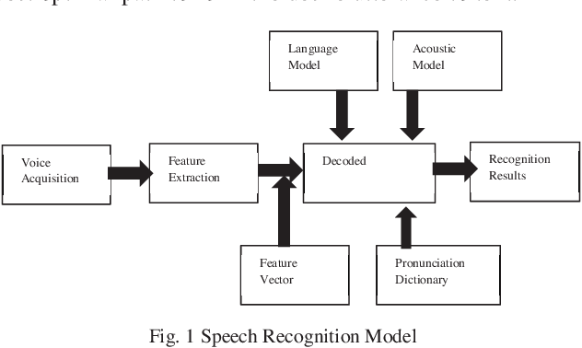
Methodology
A.Using Kaldi
1. started by Installing Kaldi ( You need wsl or linux)
2. Set up of train and test data with the required files wav.scp and text files needed by kaldi structure
3. Preparing Accoustic Data ( wav.scp, text, utt2psk,)
4. Preparing Language Data ( lexicon.txt, nonsilence_phones.txt, silence_phones.txt, optional_silence.txt )
5. Validating the Structure as needed by the kaldi
6.Training the model using Mono and TR1 decoding
7. Mono and Tr1 decoding

Slide 7
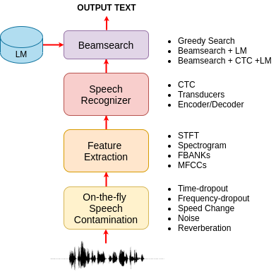
Methodolgy
In Speech Brains:
Transducers augment CTC by adding an autoregressive predictor and a join network. An encoder (usually based on RNNs) transforms the input features into a sequence of encoded representations.
Encoder-Decoder with attention The encoder is fed by a sequence of speech features (or from the raw samples directly) and generates a sequence of states h. The decoder is fed by the last hidden state and outputs the N output tokens.
Beamsearch for encoder-decoder models is often autoregressive. It start from the token and predicts the N most promising next tokens. We then feed these N alternatives into the decoder and select the best N hypothesis. We loop in this way until the token is predicted.

Slide 8
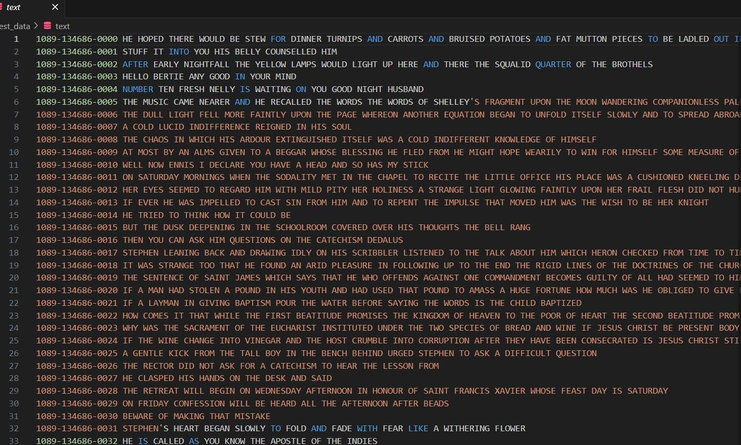
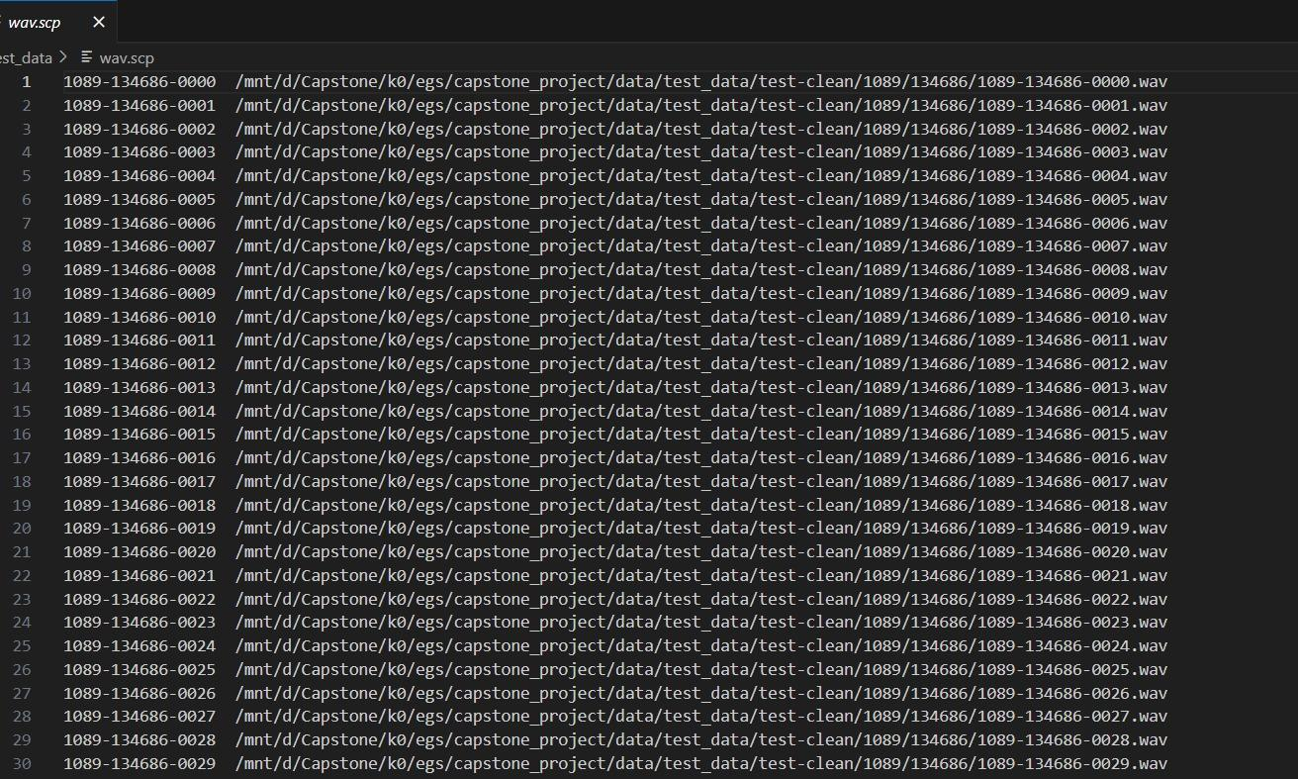
text
Wav.scp

Slide 9
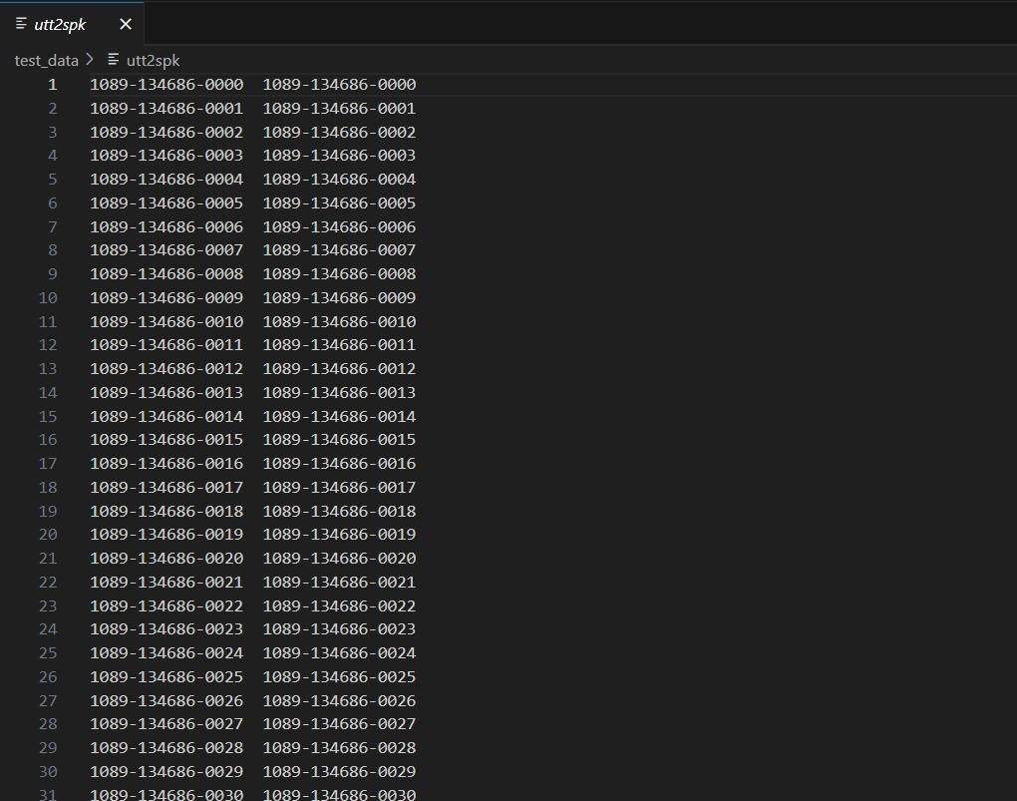
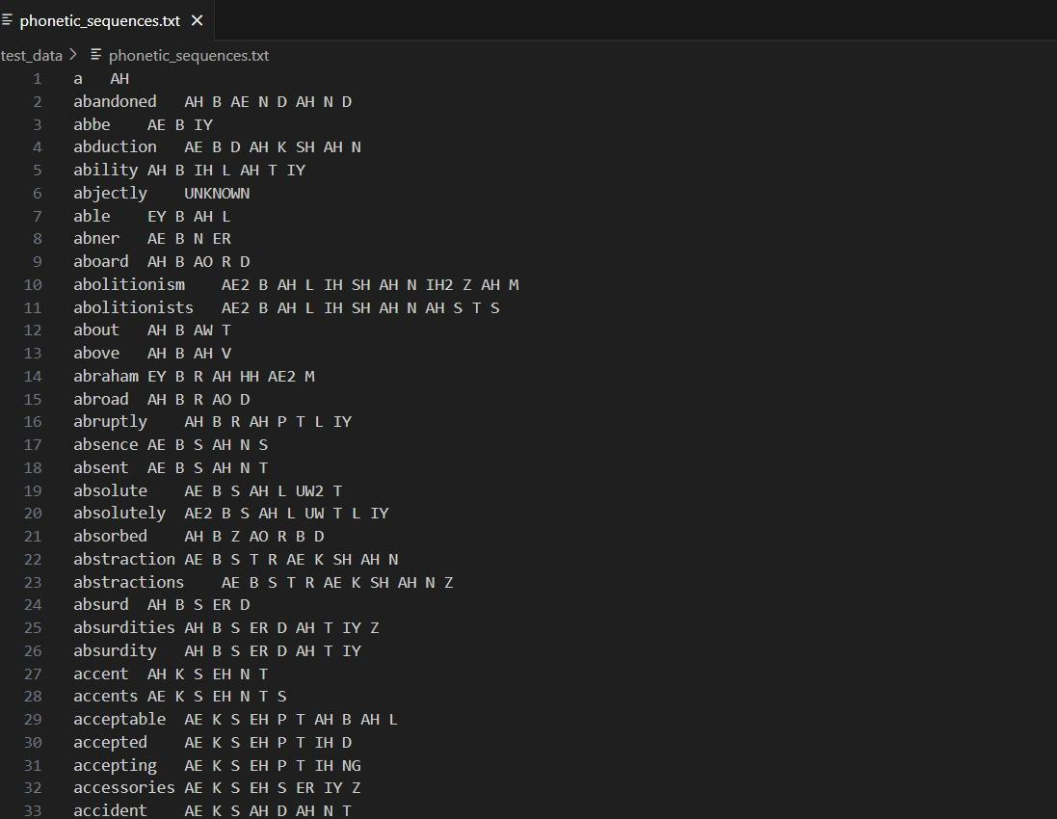
Utt2spk
phonetic_seq

Slide 10

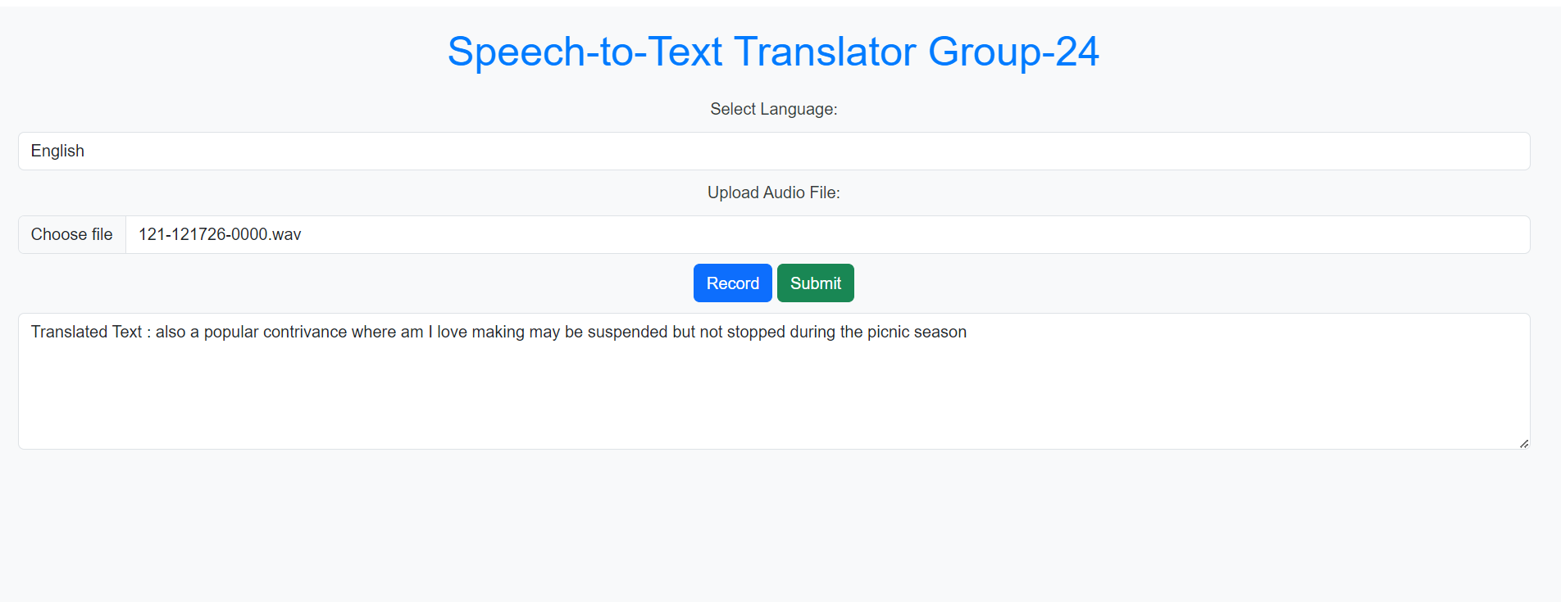
Frontend
URL - https://adarsh8827-speechrecog.hf.space/

Slide 11
Learning
1.Learnt About HMM and GMM Model :
HMM is a statistical model that represents a system as a Markov process with hidden states. It's called "hidden" because we can't directly observe these states.
A GMM is a probabilistic model that represents the probability distribution of a dataset as a mixture of several Gaussian distributions (also called normal distributions).
2. Data Collection and Preposing:
Data Collection: Recording , Transcription , Speaker and Environment Variability Data Preparing: Segmentation, Feature extraction, Language Modelling

Slide 12
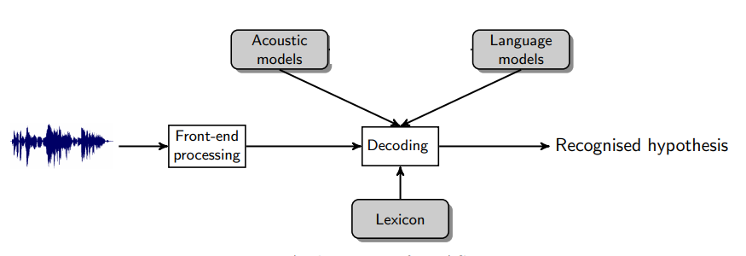
Learnings
3.How things work in kaldi
Kaldi is a comprehensive toolkit for building ASR systems, encompassing data preparation, feature extraction, model training, decoding, and evaluation.
It provides flexibility and customization options, making it a popular choice for ASR research and development.
4.Training the model:
Data
Language Model
Kaldi Installation
5.Creation of Frontend and backend using Fast api
6.Deployment using Hugging Face.

Slide 13
Challenges
Installing of kaldi
Creation of Necessary files like lexicon.txt, non-silence phones.txt
Validation of Structure
Modelling
Generation of final.mdl files
Switching to Ubuntu for installation
Processing Ability

Slide 14


