Slide 1
PEER-TO-PEER SYSTEMS

Slide 2
WHAT IS A PEER?
A peer is a computer on the network that takes part in the process of sharing.
A connection must be established between the peers for this to happen.

Slide 3
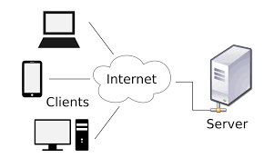
TRADITIONAL CLIENT SERVER SYSTEM
The server component returns response to one or many clients, which initiate requests for services.
Notes:
The client does not have to be concerned with how the server works.

Slide 4
P2P NETWORK
Peer-to-peer (P2P) computing or networking is a distributed application architecture that divides workloads between peers.
Peers are both suppliers and consumers of resources, in contrast to the traditional client-server model where its divided.
Notes:
Peers are equally privileged, equipotent participants in the application.

Slide 5
GIVE ME AN EXAMPLE !
TORRENTS!!
Wait, torrents are illegal right?

Slide 6
Torrents are NOT an illegal way of sharing files
BitTorrent is a communication protocol for P2P file sharing over the Internet.

Slide 7
How does it work?
The file being distributed is divided into segments called pieces.
As each peer receives a new piece of the file, it becomes a source (of that piece) for other peers.
Leechers, Seeders, BitTorrent client
Notes:
Rarest-first approach

Slide 8
DIFFERENCES FROM A NORMAL DOWNLOAD
Instead of single source, “swarm” of hosts.
BitTorrent downloads in a random or in a "rarest-first" approach that ensures high availability, while classic downloads are sequential.

Slide 9
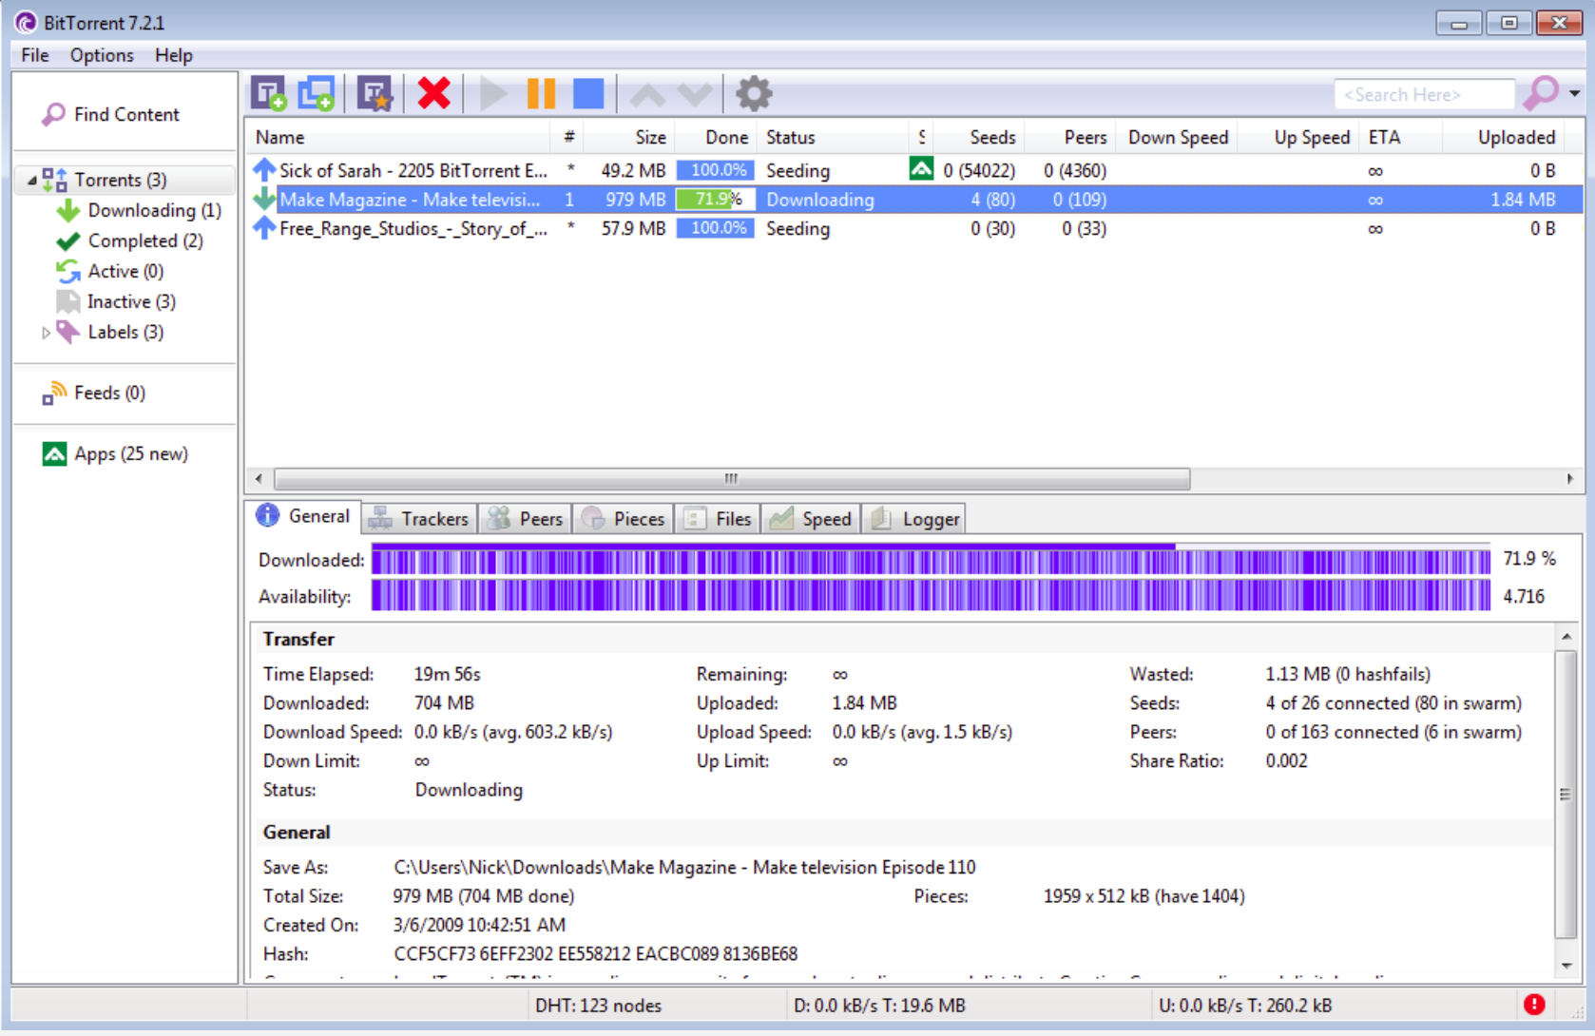

Slide 10
Tit for tat bandwidth usage : Provide blocks to neighbors that provided it the best download rates.
Choking: Limit number of neighbors to which concurrent uploads <= a number (5), i.e., the “best” neighbors.

Slide 11
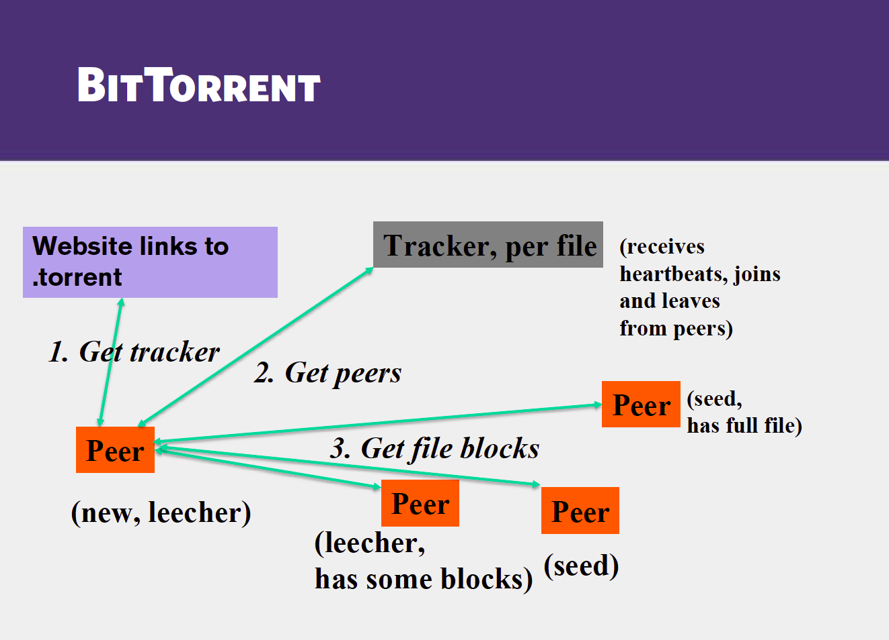

Slide 12
GIVE ME ANOTHER EXAMPLE !
Web Real-Time Communication (WebRTC) is a standard that aims to enable real-time communication among Web browsers in a peer-to-peer fashion.
Provide state of art audio/video communication stack in your browser.

Slide 13
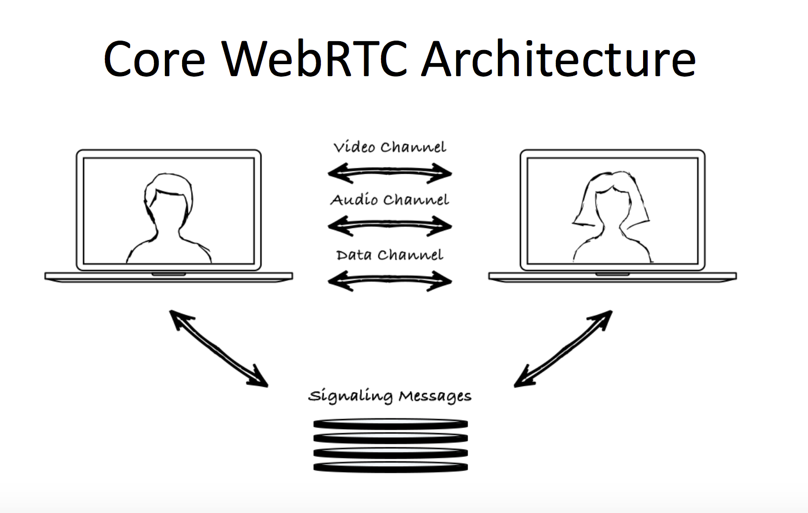

Slide 14
HOW IT WORKS
Connection establishment generally takes place using a signaling server, after which data transfer is done using webRTC protocol.
Notes:
The role of the signaling server is just to establish a connection, after which the peers are able to communicate even in the absence of the server.

Slide 15
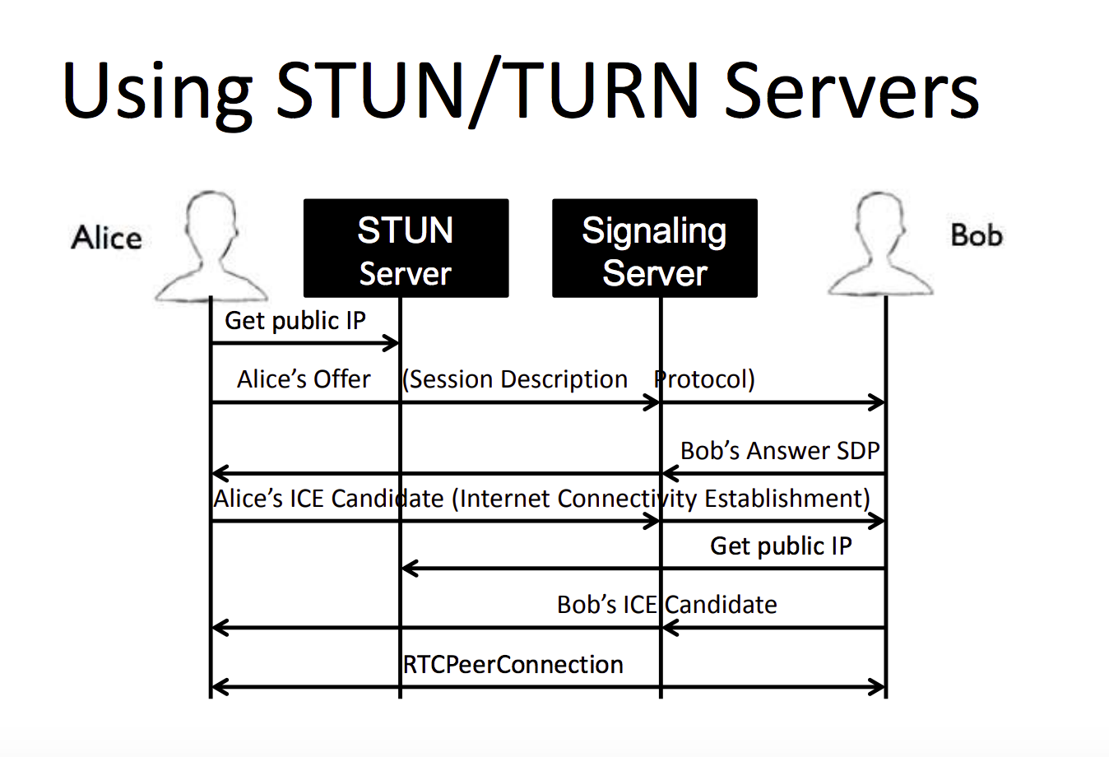

Slide 16
SECURITY
Video/Audio/Data encrypted in-transit
Permissions required for Video/Audio
Under SSL, those permissions are only required once
The DataChannel alone does not require permissions
Screen sharing requires a browser plugin

Slide 17
NEGATIVES OF WEBRTC
Browser support not that great – IE/Safari/Mobile not properly supported.
Scaling webRTC is hard
Practical limit is 6-8 people
Notes:
Your server won’t be burdened, signaling traffic is lightweight, but the peers and network will be burdened as a conversation grows

Slide 18
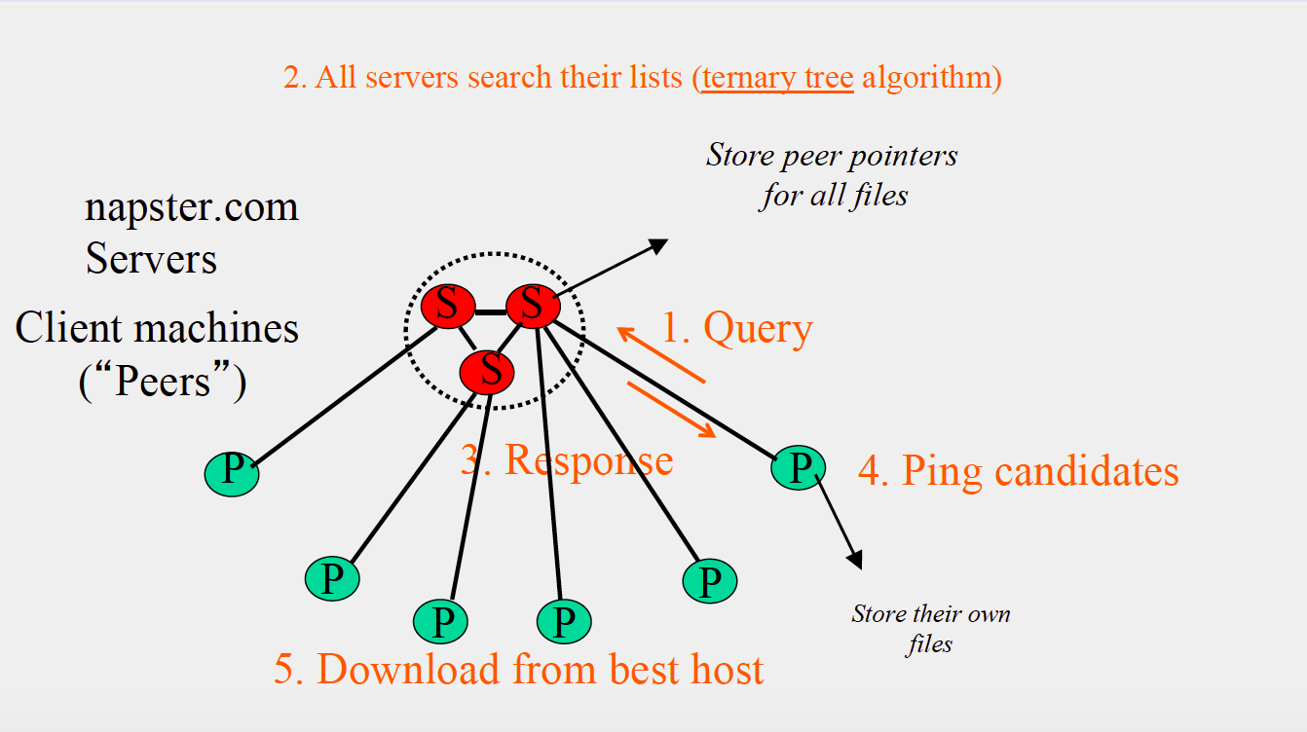
NAPSTER

Slide 19
BRIEF INTRO TO DISTRIBUTED SYSTEMS
A distributed system is a collection of autonomous computing elements that appears to its users as a single coherent system.
Storage replication, load balancing and fault tolerance.

