Slide 1
Snake Game in Graphics.h: A Fun and Interactive Game Tutorial

Slide 2

Contents
Introduction to Snake Game
Setting Up the Development Environment
Understanding the Graphics.h Library
Implementing Snake Movement and Food Generation
Creating the Game Over Condition
Enhancing the Game with Score and Level System
Additional Features: Power-ups and Obstacles
Thank You for Attending!

Slide 3
Introduction to Snake Game
Snake Game is a popular, classic arcade game where players control a snake to eat food and grow longer. This presentation will guide you through the process of creating a Snake Game using the Graphics.h library in C++. Let’s get started!

Slide 4
Setting Up the Development Environment
Requirements for Snake Game Development
1 System Requirements
2 IDE Installation
To develop the Snake Game, you will need a computer with C++ compiler installed and the Graphics.h library.
Install an Integrated Development Environment (IDE) such as Code::Blocks or DevC++ to write and compile the code.
3 Graphics.h Installation
4 Project Conﬁguration
Once you have the IDE set up, download and install the Graphics.h library for C++ from the official website.
Create a new C++ project in your IDE and configure it to use the Graphics.h library.

Slide 5

Understanding the Graphics.h Library
Overview of Graphics.h Library Functions
Text and Font Manipulation
Graphics.h supports the rendering of text with various font styles and sizes.
Drawing Shapes
Graphics.h provides functions to draw basic shapes such as lines, rectangles, circles, and ellipses.
Color Manipulation
You can set colors for drawing objects using RGB values or predefined color constants.

Slide 6

Implementing Snake Movement and Food Generation
Steps to Implement Snake Movement and Food Generation
1
Deﬁning Snake Structure
Create a structure to hold the snake's position and direction.
2 Snake Movement
Implement functions to update the snake's position based on user input.

Slide 7
Creating the Game Over Condition
To create the Game Over condition in the Snake Game, check if the snake collides with itself or the game boundaries. If a collision occurs, end the game and display the final score to the player.

Slide 8
Enhancing the Game with Score and Level System
Adding Score and Level System to the Snake Game
1
Score Tracking
Implement a scoring mechanism to keep track of the player's score.
2 Level Progression
Increase the game's difficulty level as the player achieves higher scores.
3 Displaying Score and Level
Show the current score and level on the game screen during gameplay.

Slide 9
Additional Features: Power-ups and Obstacles
To make the Snake Game more exciting, you can add power-ups that give temporary abilities to the snake and obstacles that the snake needs to avoid. These additional features will enhance the gameplay experience for the player.

Slide 10
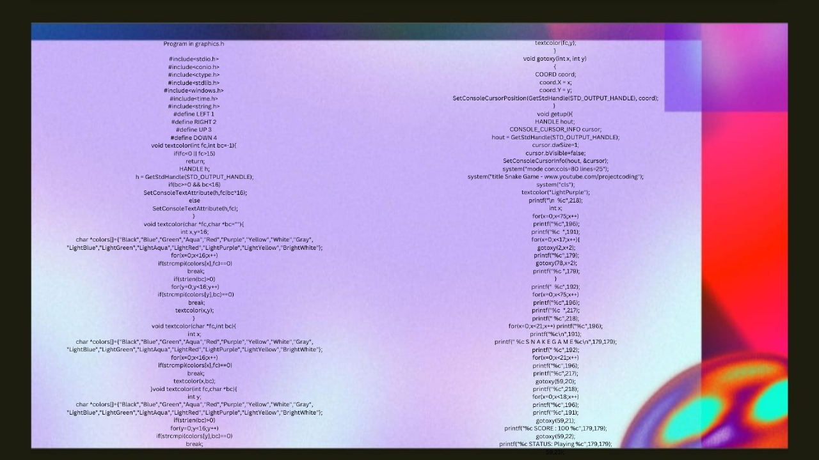

Slide 11


Slide 12
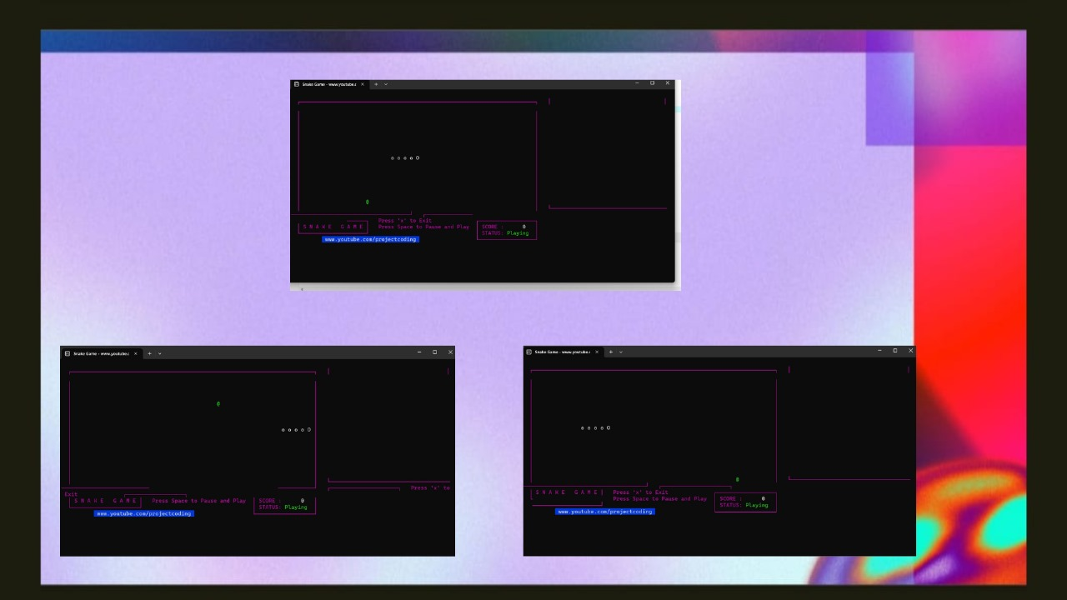

Slide 13


