Slide 1
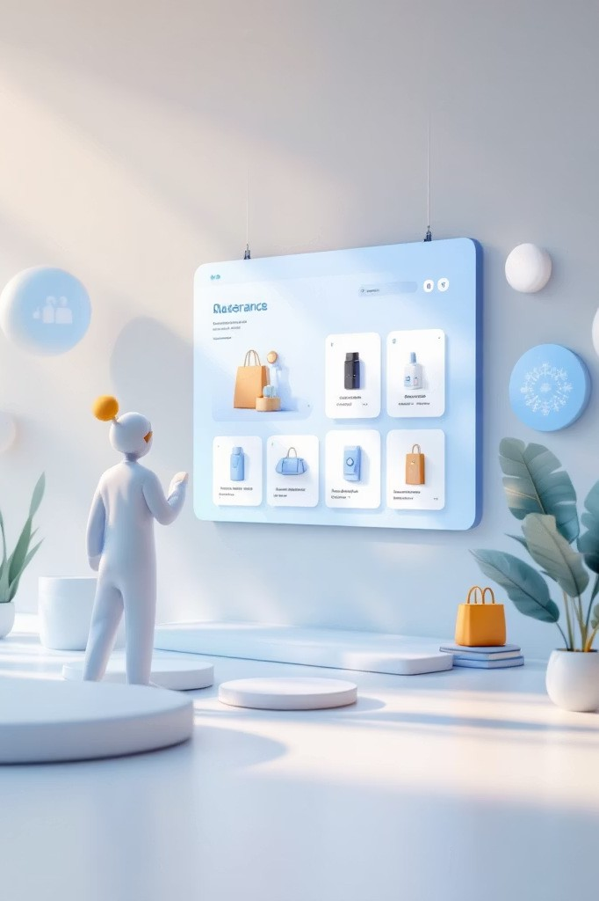

Predictive Analytics Based Student Marketplace
NEXO -AI-Powered Second-Hand Student Marketplace
SUSANTA KUMAR SUTAR (-24C219A34)
SUBHAM KUMAR ROUTRAY (-24C218A14)
RITESH RANJAN PUHAN (-24C216A41)
ADARSHA NANDA (-24C214A01)

Slide 2

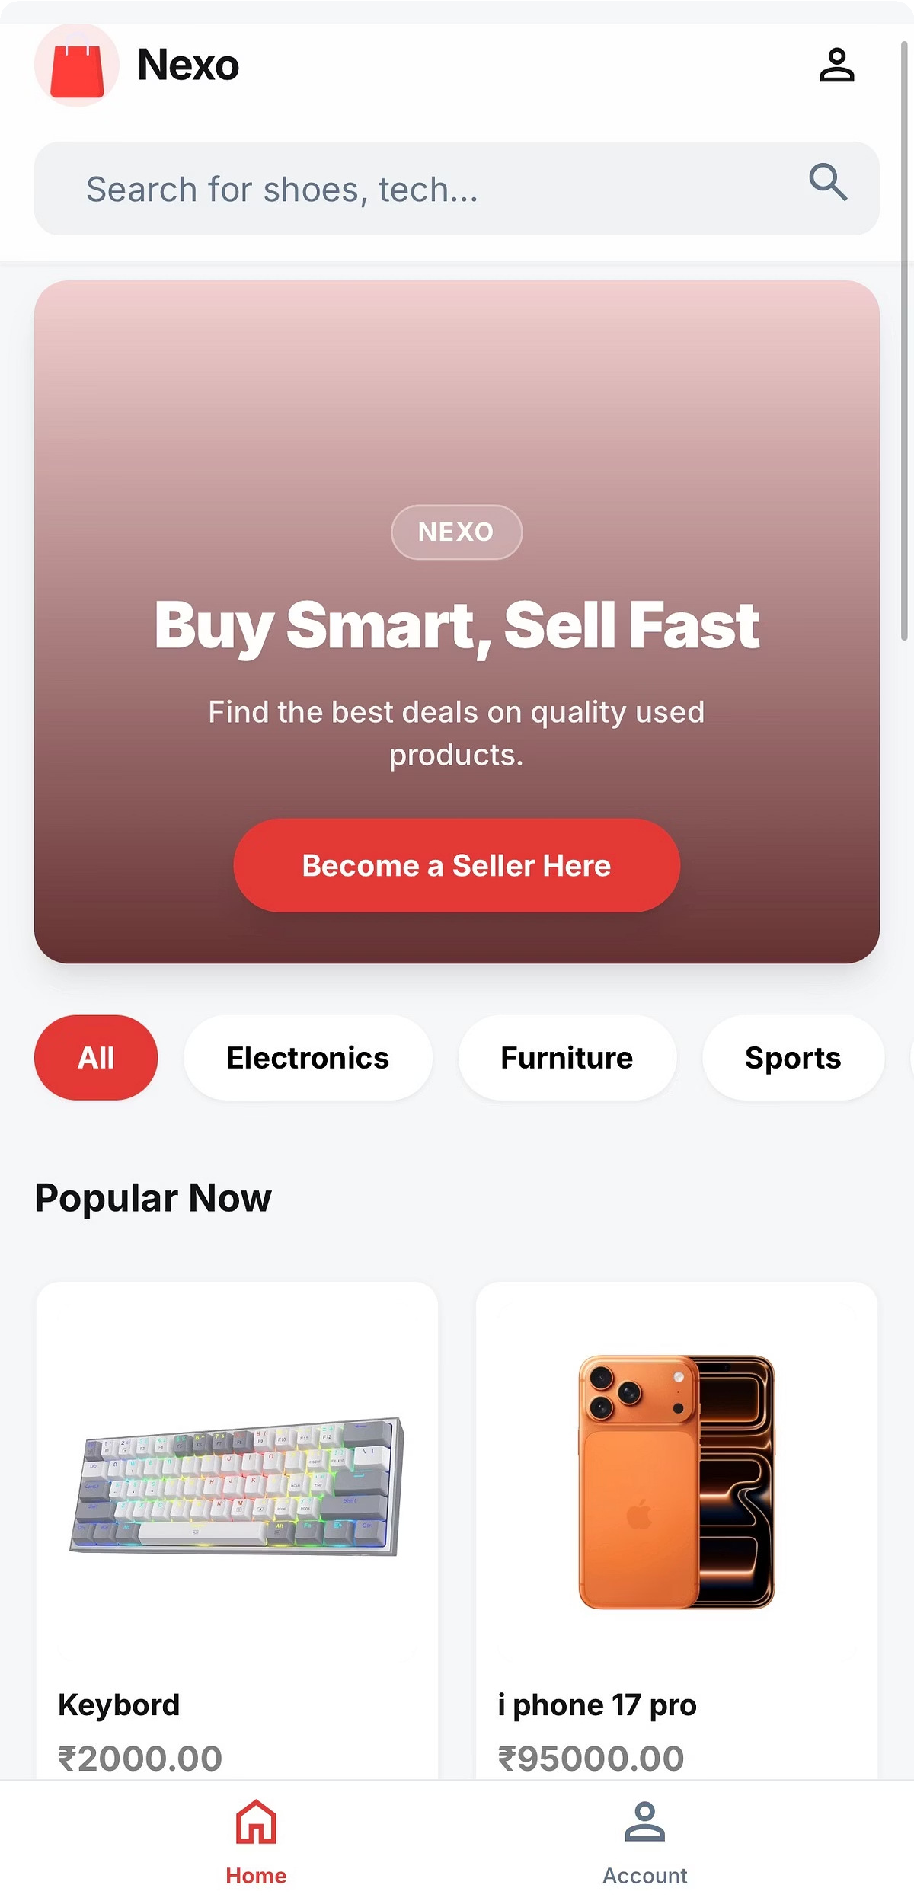
NEXO: Your Smart Second-Hand Marketplace
NEXO is an innovative second-hand product marketplace crafted exclusively for college students. It connects students looking to buy or sell used academic materials, gadgets, and accessories.
Specialized for students: Focuses on the unique needs of the college community.
Affordable essentials: Facilitates access to cost-effective books and tech.
Predictive analytics: Enhances search and product visibility for a seamless experience.
Smarter discovery: Moves beyond basic listings to intelligent product matching.
https://nexo-cvc5.onrender.com/

Slide 3

Robust Architecture for Intelligent Solutions
Frontend
React.js: Dynamic and responsive user interfaces. Tailwind CSS: Utility-first styling for a sleek, modern look.
Backend
Django: Powerful, high-level Python web framework. REST API: Seamless data exchange and integration.
AI/ML Tools
Pandas & NumPy: Efficient data manipulation and numerical operations.
Matplotlib & Seaborn: Advanced data visualization.
NLTK & re: Natural Language Processing for text analysis. Joblib: For efficient model persistence.

Slide 4


Intelligent Models Driving NEXO
AI AT THE CORE
Product Engagement Ranking
Our AI system ranks products based on how users interact with them -like how many times they are viewed, clicked, added to Wishlist, or added to cart.
If a product gets more attention from users, it moves higher in the ranking. This helps show the most popular and relevant products at the top, improving user experience and increasing sales.
Search Success Prediction
This model predicts whether a user’s search will give good results or not.
If the system thinks the search may not show useful products, it suggests better keywords or alternative products. This helps users find what they need faster and reduces frustration.

Slide 5
NEXO: Today's Features, Tomorrow's Vision
INNOVATION & GROWTH
Key Features
ranking system: Ensures relevant products are seen.
Smart search optimization: Guarantees effective product discovery.
Student-focused marketplace: Tailored for university needs.
Predictive analytics engine: Drives intelligent platform functions.
Clean and modern UI: Intuitive and engaging user experience.
Future Scope
Price prediction model: Helps users identify fair pricing.
Personalized recommendations: Custom product suggestions based on user behavior.
Real-time demand analysis: Optimizes inventory and listing strategies.

Slide 6
Thank You

