Slide 1
AR/VR Workshop Introduction
Phillip G. Bradford

Slide 2
Learning plan
Introduction | Overview – outline goals Setting up google cardboard with glitch.com system
A-frame basics | Simple A-frame examples Work with glitch.com
Foundations | JavaScript, DOM, events, Web-Components
A-frame components | Defining A-frame components
Three.JS and A-frame | Basics of Three.js for A-frame
Entity component architecture (ECA) | Three.js and ECA with standard OO paradigm
A-frame and planets | Complex 3D a-frame, work with complex a-frame detail and basic planetary math; illustrate ECA, geometries, controls, etc.
A-frame and animations | Goal: show how to do basic animation
Conclusion | Goal: review our learning

Slide 3

Outline
Overview
No installations needed
What is Glitch.com?
Create a github repo: https://github.com/wonder-phil/urls
Get an account in Glitch.com
Our first VR/AR page

Slide 4
High level view and learning path
Web components
OpenGL
WebXR
Three.JS
A-Frame

Slide 5
Update index.html
<html>
<head>
</head>
<body>
</body>
</html>

Slide 6
Update index.html – some A-frame
<body>
<body>
<a-scene>
<a-sky color="#00E“></a-sky>
<a-text
font="kelsonsans"
color = "#FFF"
value="HELLO A-Frame!!! PGB"
width="6"
position="0 -1 -5"
></a-text>
</a-scene>
</body>
Simple-sky.html
CTRL-O in browser
CTRL-ALT-I in browser

Slide 7
Browser tools
Keys | Function
CTRL-O | Opens a file
<SHIFT>-<CTRL>-I | Debugging console
<CTRL>-<ALT>-I | A-frame Inspector

Slide 8
No installation VR
Nothing installed
We do need to add two accounts
Github.com
Create a short URL with a public repo
2. Glitch.com
Create a free account

Slide 9
Glitch.com Overview
Computer
Github.com
/Me/urls
Mobile phone
Glitch.com

Slide 10
What is glitch?
Cloud-based development environment
Fast development
Gives you a URL for each project
We will use this URL
A-Frame in glitch

Slide 11
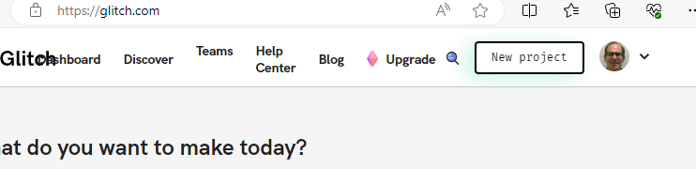
A-Frame in glitch
Create a glitch.com account
I hooked my google account to glitch
New Project

Slide 12
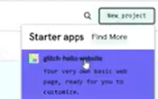
Glitch Hello Website
Select first project

Slide 13
New Glitch.me website
https://certain-crimson-mosquito.glitch.me

Slide 14
Update index.html
<html>
<head>
<script src="https://aframe.io/releases/1.4.1/aframe.min.js"></script>
</head>
<body>
<a-scene>
<a-sky
src="https://cdn.glitch.global/4cb2dafe-67a2-4c7f-b424-b5ef32487f34/Moving_Forest_1050_700.webp?v=1696984169228"
>
</a-sky>
<a-text
font="kelsonsans"
value="HELLO A-Frame!!! PGB"
width="6"
position="-2.5 0.25 -1.5"
></a-text>
</a-scene>
</body>
</html>

Slide 15
Getting a-frame from aframe.io
<head>
<script src="https://aframe.io/releases/1.4.1/aframe.min.js">
</script>
</head>

