Slide 1
AR/VR Workshop A-Frame basic geometric objects
Phillip G. Bradford
University of Connecticut

Slide 2
Learning plan
Introduction | Overview – outline goals Setting up google cardboard with glitch.com & github
A-frame basics | Simple A-frame examples Work with glitch.com
Foundations | JavaScript, DOM, events, Web-Components
A-frame components | Defining A-frame components
Three.JS and A-frame | Basics of Three.js for A-frame
Entity component architecture (ECA) | Three.js and ECA with standard OO paradigm
A-frame and planets | Complex 3D a-frame, work with complex a-frame detail and basic planetary math; illustrate ECA, geometries, controls, etc.
A-frame and animations | Goal: show how to do basic animation
Conclusion | Goal: review our learning

Slide 3
Outline
A-frame scenes
Basic A-frame geometric objects
New web tab:
https://www.w3schools.com/colors/colors_picker.asp

Slide 4
Getting a-frame from aframe.io
<head>
<script src="https://aframe.io/releases/1.4.1/aframe.min.js">
</script>
</head>
Or
<body>
<script src="js/aframe.io_releases_1.4.1_aframe.min.js"></script>

Slide 5
Scenes and geometric objects
Primitive | What | Link
a-scene | Global root object contains all entities | https://aframe.io/docs/1.4.0/core/scene.html
a-text | Text | https://aframe.io/docs/1.4.0/primitives/a-text.html
a-box | 3D Box | https://aframe.io/docs/1.4.0/primitives/a-box.html
a-sphere | 3D Sphere | https://aframe.io/docs/1.4.0/primitives/a-sphere.html

Slide 6
Geometric terms
Mesh or geometry
Vertices, edges and faces defining a 3D object
Texture
Color and appearance of a surface
Full representation: mesh and texture

Slide 7
Textures
https://github.com/aframevr/sample-assets/tree/master/assets/images
Make our own src

Slide 8



A-box – in a scene
$$y$$
<a-box position="-1.5 1 -1.5"
rotation="0 0 0"
color=“blue">
</a-box>
x: pitch
y: yaw
z: roll
a-box.html
$$z$$
$$x$$

Slide 9
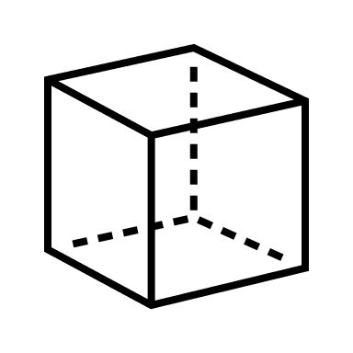
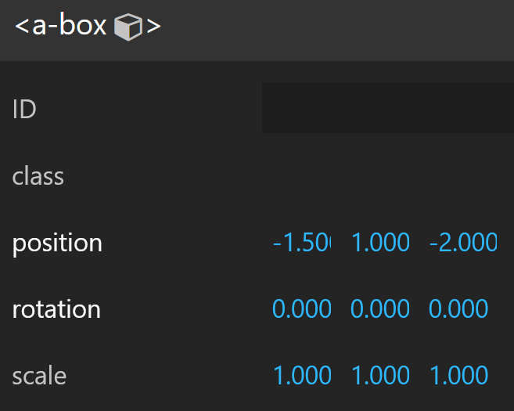
A-box
$$y$$
<a-box position="-1.5 1 -2.0"
rotation="0 0 0"
color=“blue">
</a-box>
$$z$$
-2.0
1
-1.5
$$x$$

Slide 10
VR images / videos
360º images / videos
Put in the camera’s perspective
Camera defaults to (0,1.6,0)

Slide 11
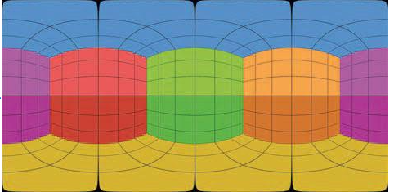
VR Images

Slide 12
A-box
<html>
<head>
<script src="https://aframe.io/releases/1.4.1/aframe.min.js"></script>
</head>
<body>
<a-scene>
<a-box position="0 2 -1.5" rotation="0 0 0" color="green"></a-box>
</a-scene>
</body>
</html>

Slide 13
Several geometric components
<a-box position="-1 0.5 -3" rotation="0 45 0" color=“red">
</a-box>
<a-sphere position="0 1.25 -5" radius="1.25" color=“blue“>
</a-sphere>
<a-cylinder position="1 0.75 -3" radius="0.5" height="1.5" color=“purple">
</a-cylinder>
<a-plane position="0 0 -4" rotation="-90 0 0" width="4" height="4" color=“3cb371"></a-plane>
<a-sky color="#e9f7ff "></a-sky>

Slide 14
Texture 1
<html><head> <script src="https://aframe.io/../aframe.min.js"></script> </head>
<body>
<a-scene>
<a-assets>
<img id="pinktexture" src="pinktexture.png" />
</a-assets>
<a-box position="-1.5 1 -1.5" src=“https://cdn.glitch.global/8d8368d6-c6ab-4980-a31d-4e5719b18320/pinktexture.png?v=1697040308772“></a-box>
</a-scene>
</body> </html>

Slide 15
Texture 2 & movement
<html> <head> <script src="https://aframe.io/releases/1.3.0/aframe.min.js"></script> </head>
<body>
<a-scene>
<a-assets>
<img id="boxTexture" src="https://i.imgur.com/mYmmbrp.jpg">
</a-assets>
<a-box src="#boxTexture" position="0 2 -5" rotation="0 45 45" scale="2 2 2"
animation="property: object3D.position.y; to: 2.2; dir: alternate;
dur: 2000; loop: true"></a-box>
</a-scene>
</body> </html>

Slide 16
Texture 2 & movement
<a-box src="#boxTexture" position="0 2 -5" rotation="0 45 45"
scale="2 2 2"
animation="property: object3D.position.y;
to: 2.2;
dir: alternate;
dur: 2000; loop: true">
</a-box>

