Slide 1
AR/VR Workshop A-Frame basics – textures and static rotations
Phillip G. Bradford
University of Connecticut

Slide 2
Learning plan
Introduction | Overview – outline goals Setting up google cardboard with glitch.com & github
A-frame basics | Simple A-frame examples Work with glitch.com
Foundations | JavaScript, DOM, events, Web-Components
A-frame components | Defining A-frame components
Three.JS and A-frame | Basics of Three.js for A-frame
Entity component architecture (ECA) | Three.js and ECA with standard OO paradigm
A-frame and planets | Complex 3D a-frame, work with complex a-frame detail and basic planetary math; illustrate ECA, geometries, controls, etc.
A-frame and animations | Goal: show how to do basic animation
Conclusion | Goal: review our learning

Slide 3
Outline
More A-frame geometric objects
Positioning and static rotation
New web tabs:
https://github.com/aframevr/sample-assets https://www.shadedrelief.com/natural3/pages/textures.html

Slide 4
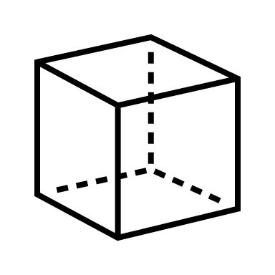
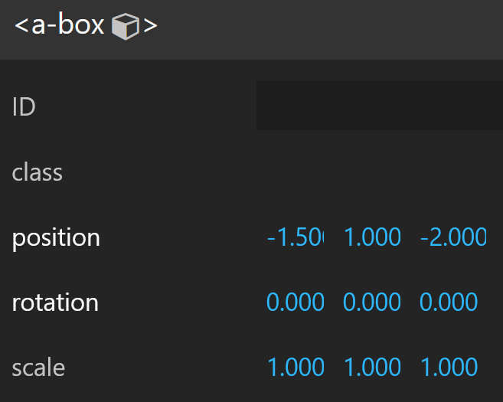



A-box
$$y$$
<a-box position="-1.5 1 -2.0">
</a-box>
A-frame Inspector: <CTRL>-<ALT>-I
$$z$$
-2.0
1
-1.5
$$x$$

Slide 5
Platonic solids
<a-box position="-4.0 1 -2.5" color="green"></a-box> <!-- cube -->
<a-entity position="-2.0 1 -2.5" geometry="primitive: tetrahedron; radius: 1">
</a-entity>
<a-entity position="0 1 -2.5" geometry="primitive: dodecahedron; radius: 1">
</a-entity>
<a-entity position="2.0 1 -2.5" geometry="primitive: octahedron; radius: 1">
</a-entity>
<a-entity position="4.0 1 -2.5" geometry="primitive: icosahedron">
</a-entity>

Slide 6
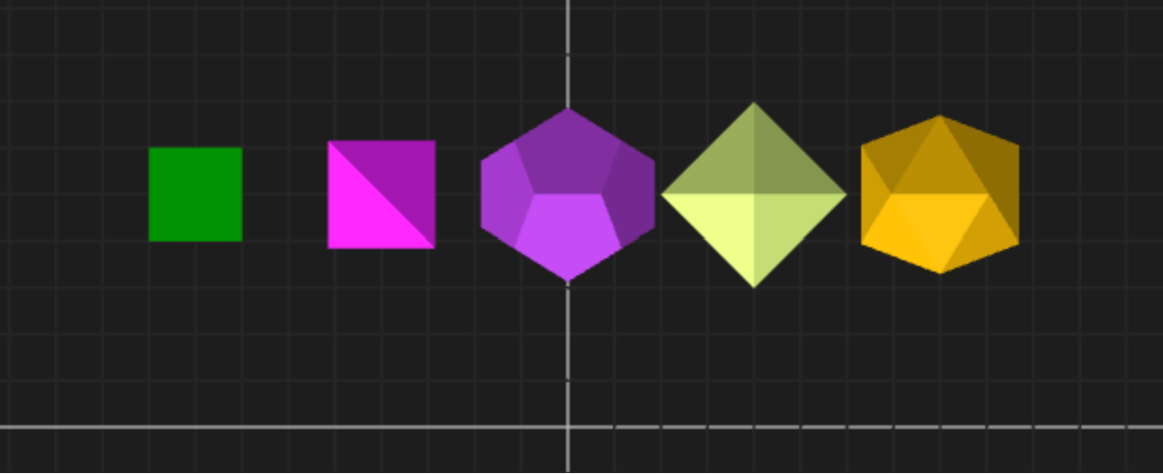
Other views
A-frame Inspector: Top View

Slide 7
A-box – a-Patonic-solids-Rotate
$$y$$
<a-box position=" -4 1 -2.5 "
rotation=“45 45 45" >
</a-box>
x: pitch
y: yaw
z: roll
$$z$$
$$x$$

Slide 8
Full visual representation = mesh + texture
https://www.shadedrelief.com/natural3/pages/textures.html
a-sphere.html
<a-scene>
<a-sphere position="0 3 -5" src="./waternormals.jpg" radius="1">
</a-sphere>
</a-scene>
Notes:
src="./waternormals.jpg”
src="./1_earth_8k.jpg"
https://github.com/aframevr/sample-assets
https://www.shadedrelief.com/natural3/pages/textures.html

Slide 9
Full visual representation = mesh + texture
A-box
<a-scene>
<a-assets>
<img id="boxTexture" src="https://i.imgur.com/mYmmbrp.jpg"
</a-assets>
<a-box position="0 3 -5" src= “#boxTexture" radius="1"></a-box>
</a-scene>
Notes:
src="./waternormals.jpg”
src="./1_earth_8k.jpg"
https://github.com/aframevr/sample-assets
https://www.shadedrelief.com/natural3/pages/textures.html

Slide 10
Texture 2 & movement
<html> <head> <script src="https://aframe.io/releases/1.3.0/aframe.min.js"></script> </head>
<body>
<a-scene>
<a-assets>
<img id="boxTexture" src="https://i.imgur.com/mYmmbrp.jpg">
</a-assets>
<a-box src="#boxTexture" position="0 2 -5" rotation="0 45 45" scale="2 2 2"
animation="property: object3D.position.y; to: 2.2; dir: alternate;
dur: 2000; loop: true"></a-box>
</a-scene>
</body> </html>

Slide 11
Texture 2 & movement
<a-box src="#boxTexture" position="0 2 -5" rotation="0 45 45"
scale="2 2 2"
animation="property: object3D.position.y;
to: 2.2;
dir: alternate;
dur: 2000; loop: true">
</a-box>

