Slide 1
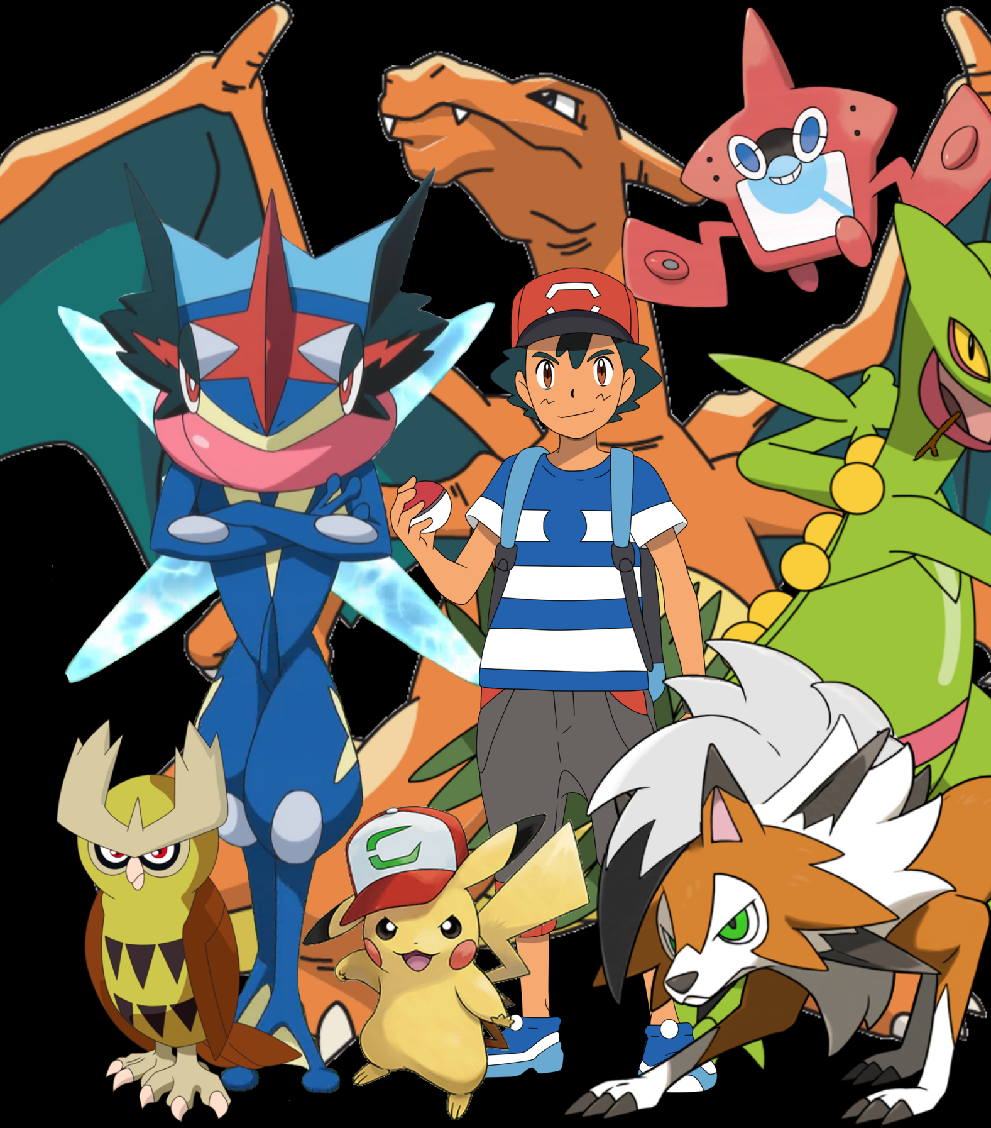
Pokémon Card Match Memory Game Team 15
Ahmed, Aaron, Adarsha, Josh
CPSC 233 – T04 – Dr. Nathaly Verwaal.

Slide 2
Project Description
Card match memory game.
The game generates random pairs of cards. The objective is to allow the interaction of two players taking turns flipping two cards. The cards selected must match to be eliminated from the field of play and a score would be earned. Throughout the alternation of each player, if a player consecutively matches two cards without fail, the player would gain bonus points for each consecutive match until they fail to match the card then the point system would reset back to granting 1 score per match. After all cards have been matched and eliminated from the field of play, the player with the highest number of points will win the game and the message “PLAYER (#), WINS!” is displayed. If both players achieve the same number of points, then the game would display “DRAW!” In the case that the player plays a match against a computer, if computer wins it would display “COMPUTER WINS!”

Slide 3
DEMO 3 Class Diagram 😃😎
Currently game has 14 classes.
The class contains methods in the grid. The Game.java file contains the main string.
The Grid Class would be considered the SUPERCLASS.

Slide 4
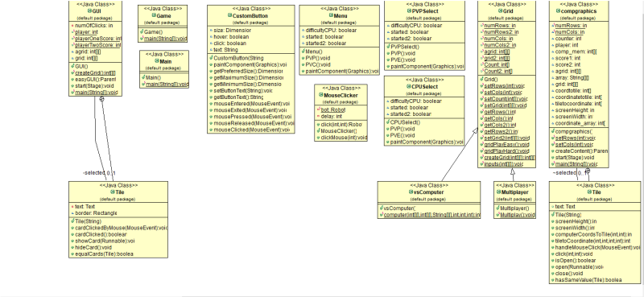

Slide 5
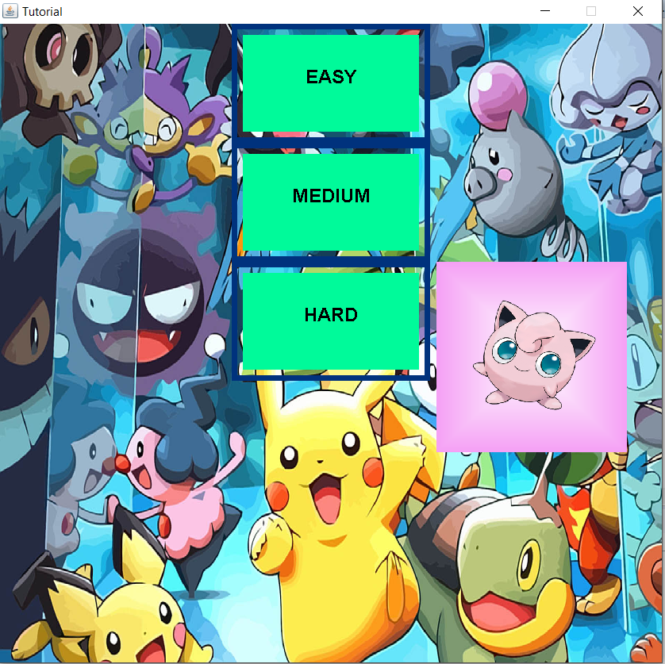
IMPROVEMENTS
IMPROVED MENU
ACCESSING DIFFERENT PARTS OF THE GAME FROM THE MENU

Slide 6
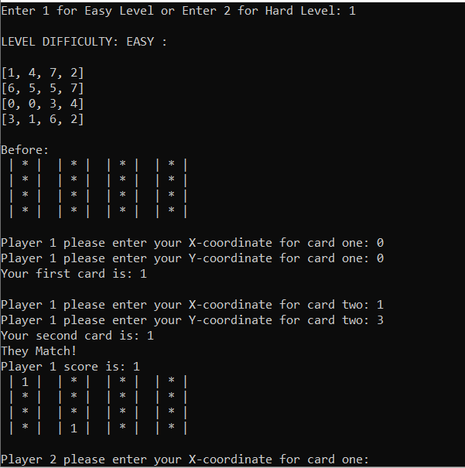
Text-Based Interface
The image portrays the text based interface allowing the user to enter their X coordinate and Y coordinate.
The starting point of the coordinate is (0,0) which is the top left corner of the screen.
The coordinate is (x,y) the incrementation of X would move the coordinate right and the incrementation of Y would move the coordinate down.

Slide 7
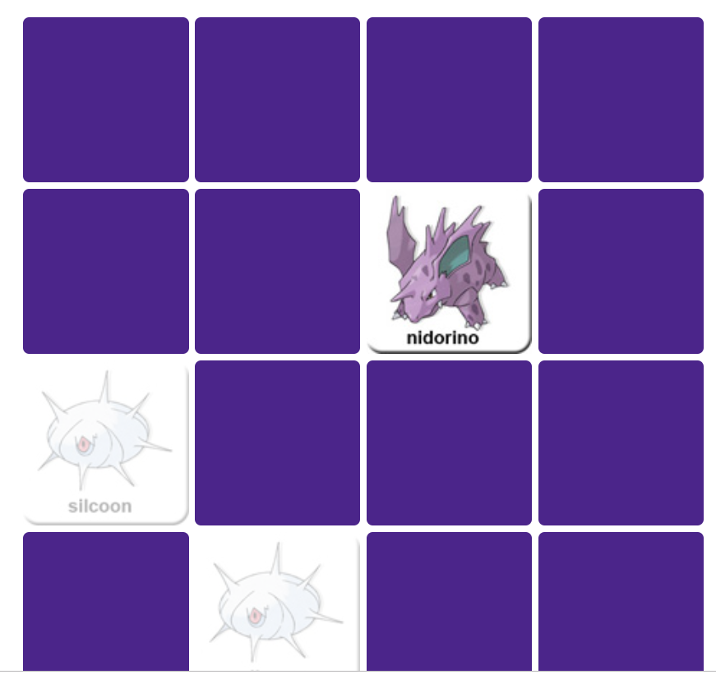
Graphical User Interface
The graphical game portrayed is rather simple. The project our group will create will contain more advance features allowing user to play against computers and other users.
This is the graphical-user interface that would be portrayed in the final project minus some extra features that would soon be added in the game.
Animations and graphics will be implemented in the product.

Slide 8
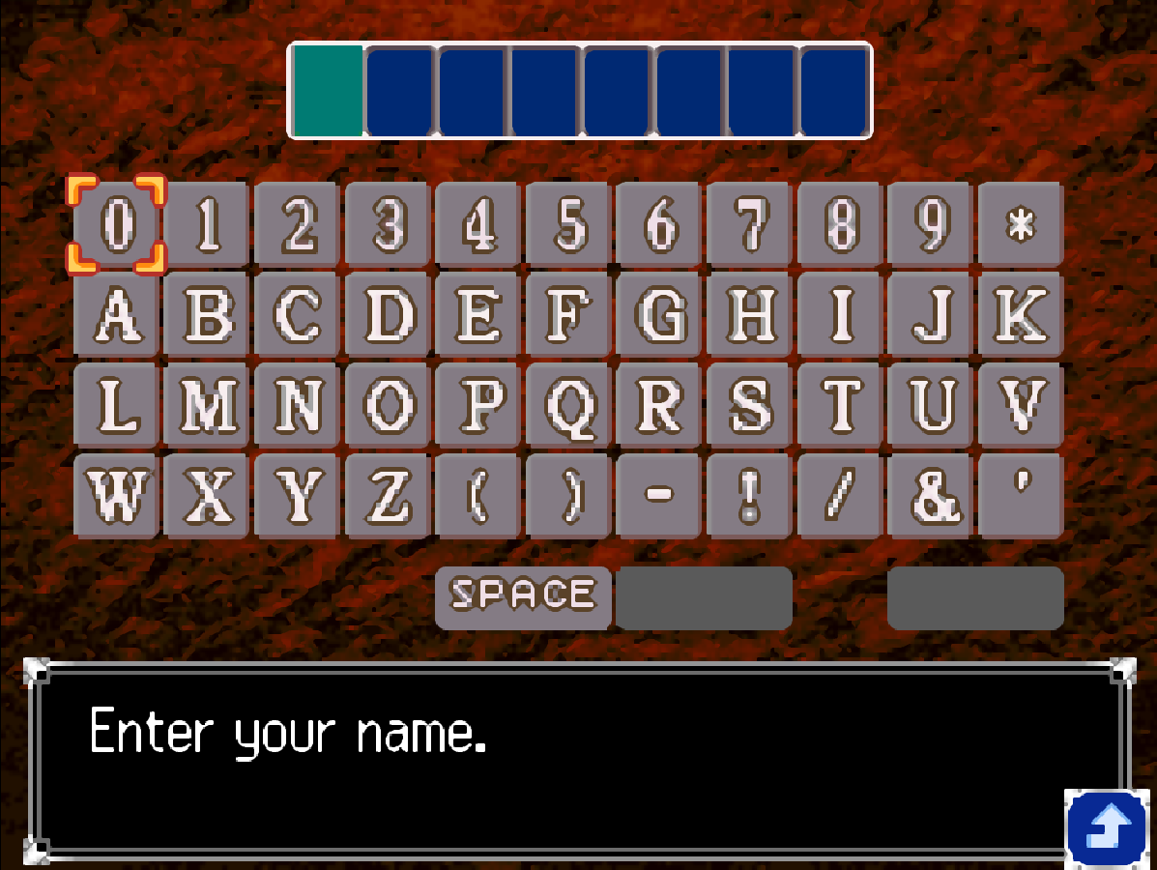
Extra features added to the game.
The game will prompt user for the name. If two player is selected, then it will prompt for the name of player 1 and player 2.
If the user chooses to play against computer, then the game will prompt the user for the name of player 1.

Slide 9
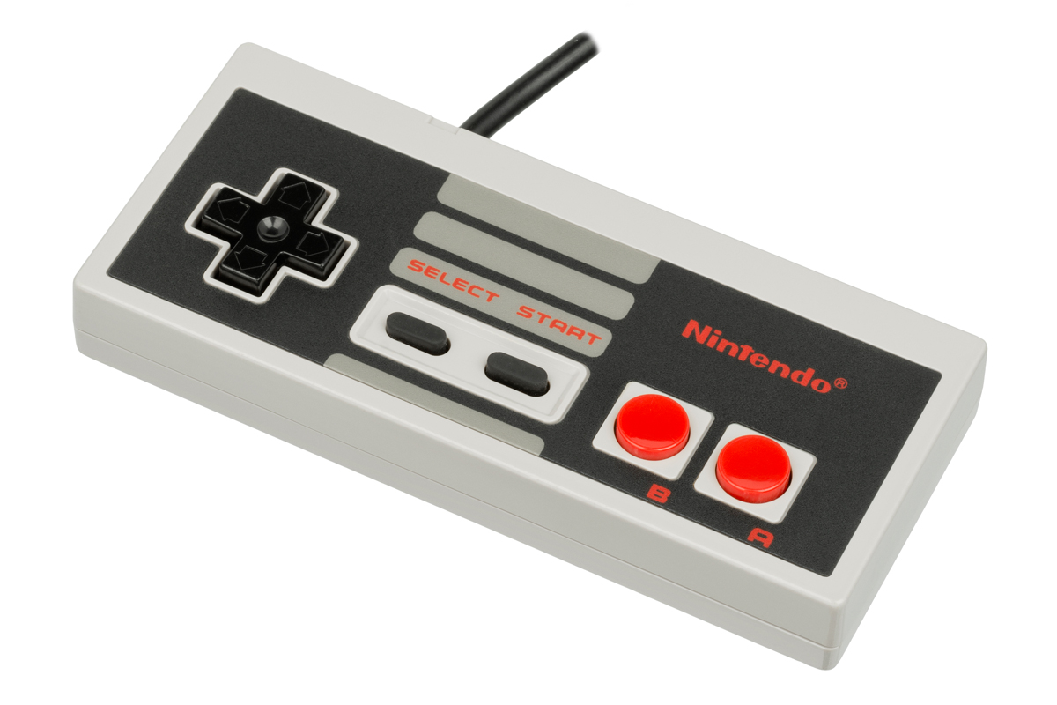
More features for the game.
The game will keep track of consecutive points for the score. As turns alternate, each time a player matches cards and earns a score it would increase by 1 consecutively until a player fails to match a card.
Nintendo Entertainment System (NES) controller will be used for selecting objects on screen.
We will begin by using the keyboard before we move on to the controller testing.

Slide 10
VS. COMPUTER 🛰
Addition of playing with a computer opponent with easy and hard level choices of difficulty.
BUT w/ the addition of the robot mouse, we were able to input the computer choices to the GUI portion of the Card Match Memory Game.

Slide 11
ROBOT MOUSE
We were able to use an automated Mouse Clicker that will be allow the computer to choose tiles by choosing coordinates.
There are still some bugs that are present with the mouse click.

Slide 12
Difficulties
IMPLEMENTING COMPUTER TO THE GUI
GHOST / ROBOT MOUSE

