Slide 1
Web Scraping & Exploratory Data Analysis Project
Website used : www.cardekho.com
Problem statement : Analysis of Data of Used cars from cardekho.com
Presented by
Adarsh Challa
Sandhya CSR
Innomatics Batch 74

Slide 2
Contents
1.Introduction
2.Review of the Data Collected
    Data Scraping method
    Data Cleaning
    Duplicate Data Removal
    Junk data removal
    Data imported to a .csv file
3. Data Investigation & Analysis
    Univariate Analysis
    Bivariate Analysis
    Multivariate Analysis
4. EDA questions & conclusions

Slide 3
Introduction
Problem Statement
Analysis of data of Used Cars from https://cardekho.com/
Domain : Website has “Used Car Sales” data
Related websites : cars24.com, carwale.com, cartrade.com
Reason for choosing cardekho.com :
                Provided more number of features for web scraping
                Website allows for web scraping without any denial of 404 error
                Data can be scrapped using wide range of filters available in it

Slide 4
Review of the Data Collected
Data Scraping Method :
  BeautifulSoup was used to collect the data scrapped from the website. While scraping itself, few variables were handled and cleaned as per the requirement.
Data Cleaning :
  Regex Usage to clean data : The column Fuel_type had to be further cleaned to extract the needed values of km_driven, fuel_used and locality into separate columns. Similarly, column CarName had to be further cleaned and processed to extract Brand column in the data frame. Both these requirements were fulfilled using regex.
Duplicate Data Removal:
  The cities new-delhi,Gurgaon,Noida and Delhi-NCR had same data mentioned across all the cities. Hence deleted 3 cities out of the above four. Only data pertaining to Delhi-NCR were retained.
Junk Data Removal :
  The column owner_type had four options : first, second, third & more and unregistered.
  Unregistered Car meant its New Car, where the problem statement deals with Used Cars. Hence, we had to delete all data pertaining to this junk unregistered value in owner_type column.

Slide 5
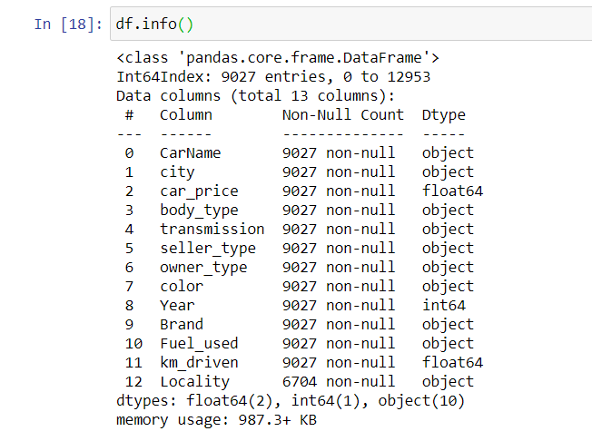
Contd..
After cleaning and removing (duplicate & junk) data and also modifying the columns, the following are the properties of the table derived:
Rows: 9027
Columns: 13
Data imported to a csv file

Slide 6
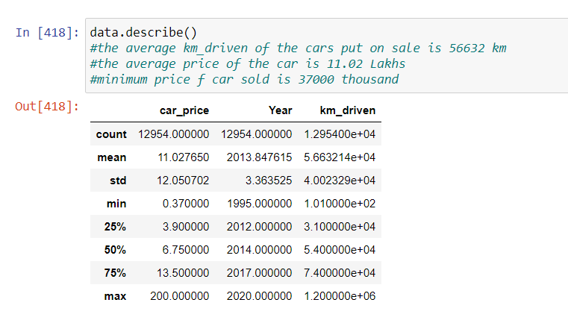
Data Investigation & Analysis
Data description

Slide 7
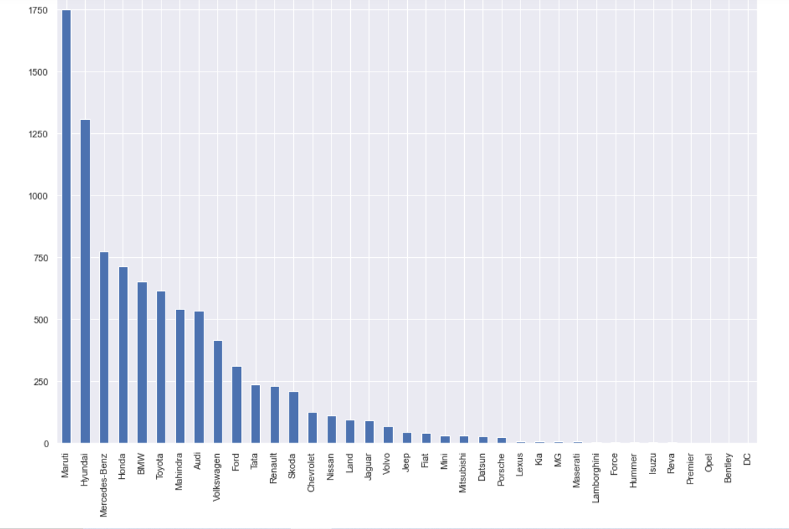
Data Investigation & Analysis
Univariate Analysis
The count of cars according to brands.

Slide 8
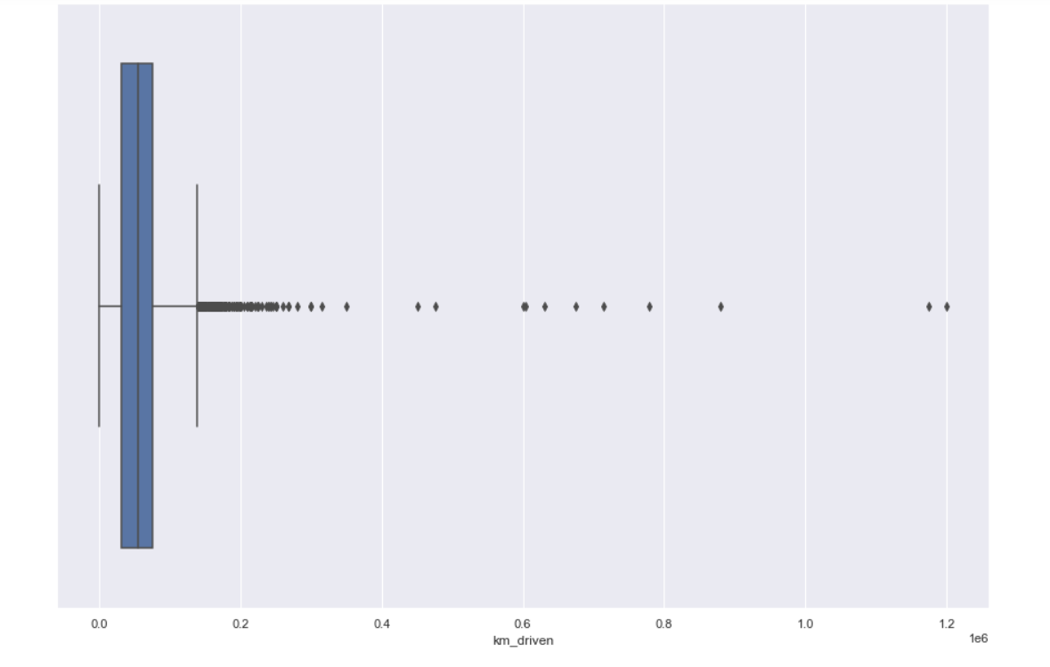
Data Investigation & Analysis
Univariate Analysis
The range of kilometres driven of the cars that were being sold

Slide 9
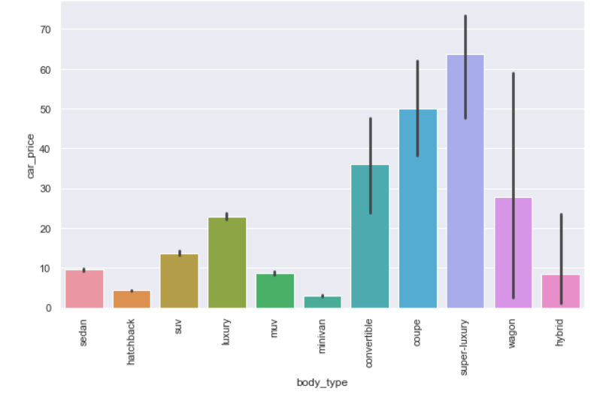
Data Investigation & Analysis
Bivariate Analysis
Minimum, max and mean of the car price according to the body type

Slide 10
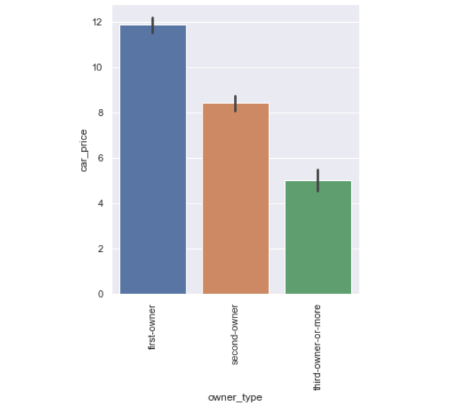
Data Investigation & Analysis
Bivariate Analysis
Car Price for a given type of owner

Slide 11
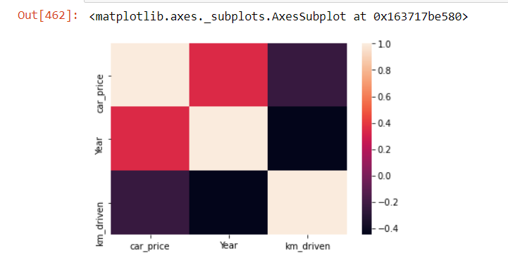
Data Investigation & Analysis
Multivariate Analysis
Correlation (via heatmap) between car_price, Year and Km_driven columns

Slide 12
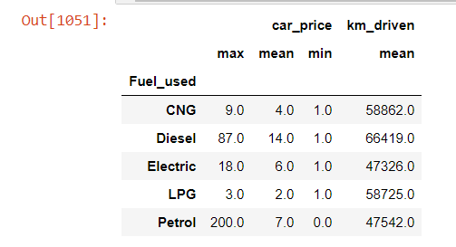
Data Investigation & Analysis
Multivariate Analysis
Car statistics (price, km-driven) for a given owner-type as per the fuel used Code

Slide 13
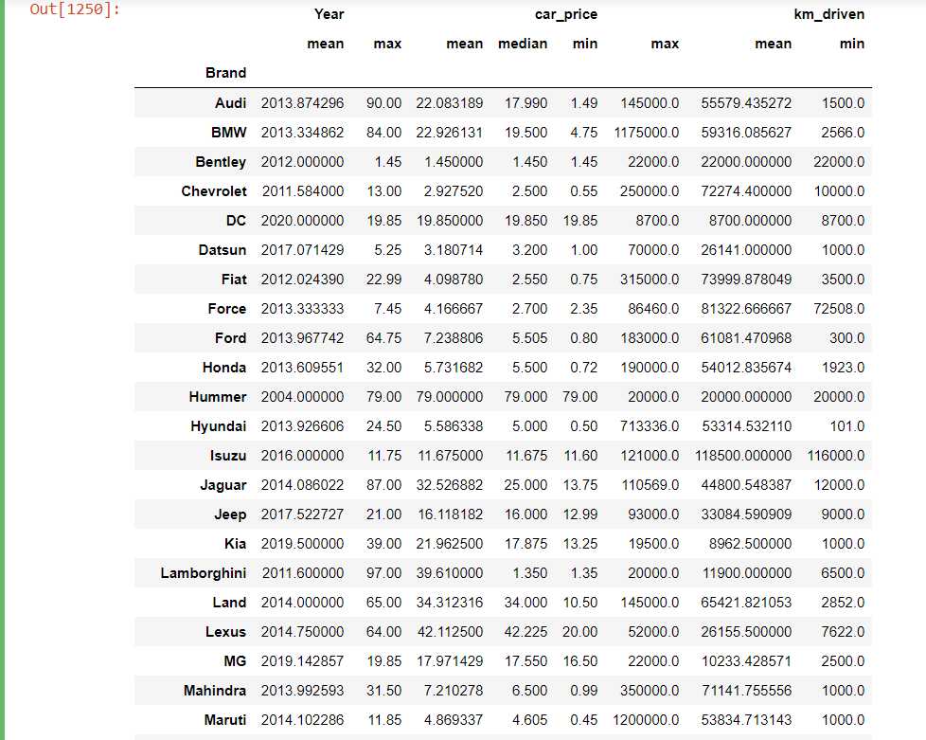
EDA questions & conclusions
Q. The statistics of car_price and km_driven as per the brand
C. For the brand maruti- the minimum and maximum car price is 45000 and 11.85 lakh respectively with an average of 4.86 lakhs and for the same brand maruti - the minimum km_driven is 1000 and maximum is 12 lakh kms and an average of 53800 kms

Slide 14
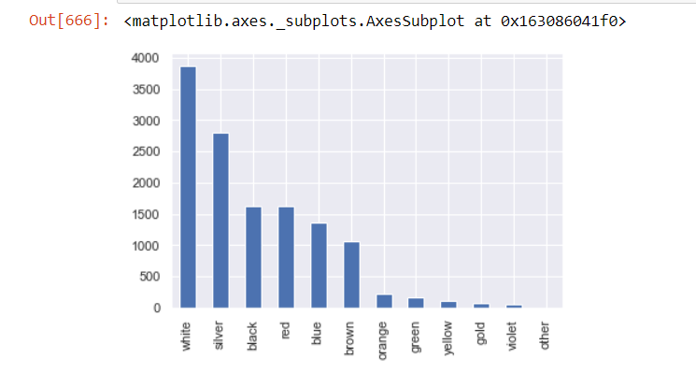
EDA questions & conclusions
Q. The cars sold according to color
C. White cars are the maximum to be sold followed by silver and black where as rare colors of violet , gold , yellow , etc are the least to be sold

Slide 15
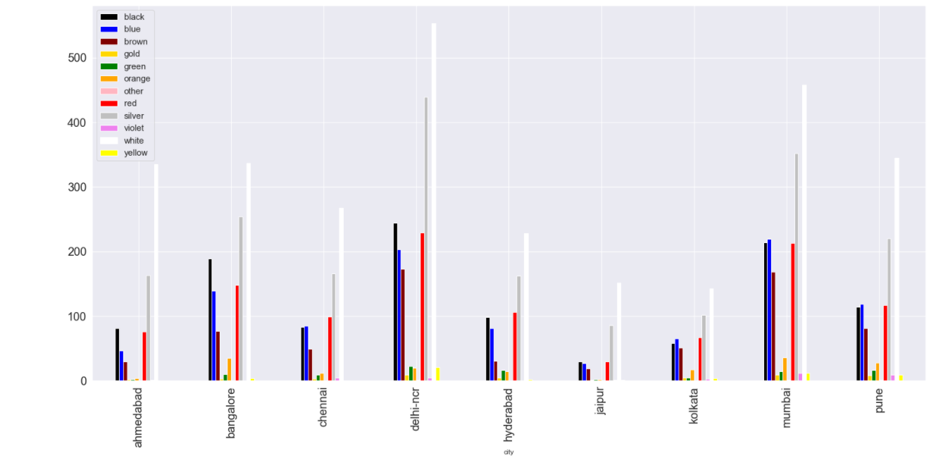
EDA questions & conclusions
Q. The cars available in a particular city according to color
C. white cars are most sold cars across the city

Slide 16
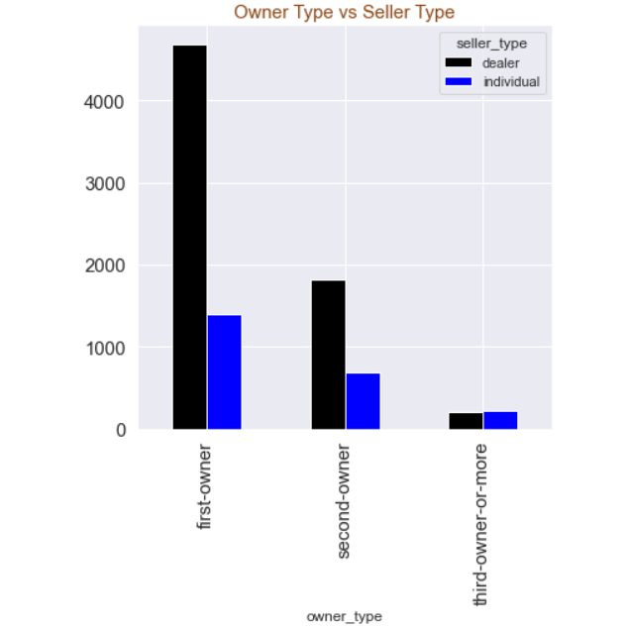
EDA questions & conclusions
Q. The number of cars sold for different owner types based on whether the seller is a dealer or individual
C. People are preferring to sell the car via dealers

Slide 17
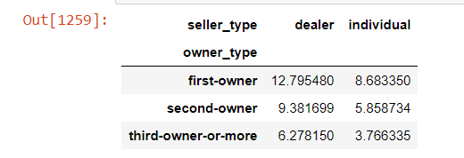
EDA questions & conclusions
Q. The average price of cars being sold for a given owner_type and seller type C. First owner cars sold by a dealer are costly whereas third owner cars sold by individually cost the least. For a customer who is willing to sell a car, irrespective of the owner-type, its preferable that he sells it via a dealer

Slide 18
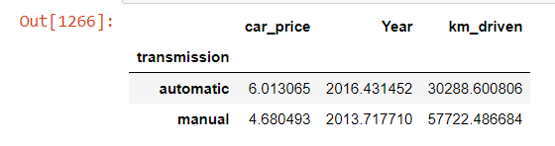
EDA questions & conclusions
Q. Statistical analysis for the most sold car maruthi
C. Manual maruthi cars are used to the maximum extent than automatic cars.

Slide 19
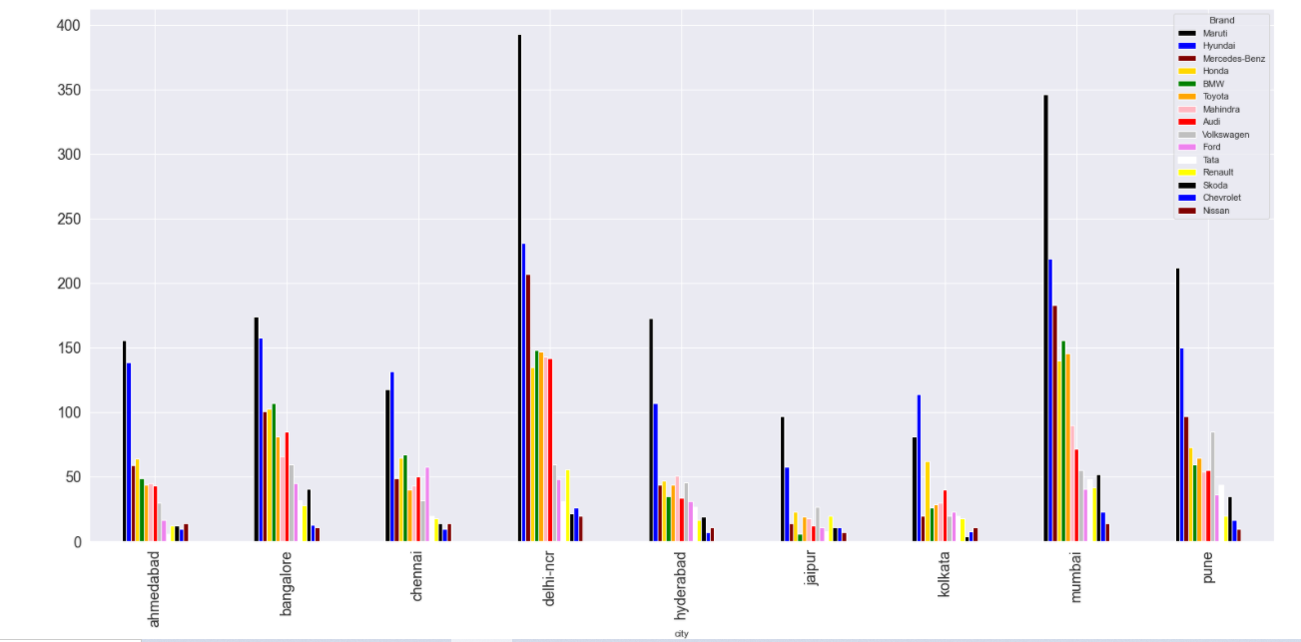
EDA questions & conclusions
Q. Depiction of car brands, sold the maximum according to cities
C Maruti is the highest sold brand followed by Hyundai across cities

Slide 20
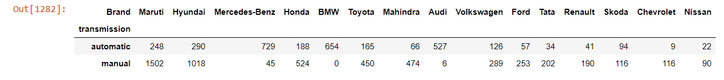
EDA questions & conclusions
Q. Brands sold according to transmission type
C. The luxury cars like mercedes and bmw are mostly having automatic transmission. Audi car has the least manual cars for sale Maruti is the highest sold brand followed by Hyundai across cities

Slide 21
Thank You !!!!!!

