Slide 1

KADI — Karnataka Analytics & Detection Intelligence
AI-Driven Crime Analytics & Visualization Platform for the Karnataka State Police · ಕಡಿ — “a link in a chain”
TEAM NAME
TEAM LEADER
TEAM SIZE
PROBLEM STATEMENT
KadiLabs
Adarsh Dwivedi
1
Challenge 02
59,985 FIRs
85,429 evidence links
578 repeat offenders
100% ground-truth recovery
0.870 best model AUC
13 Catalyst services
Deployed exclusively on Zoho Catalyst · every figure in this deck was read from the deployed API or a test run
Notes:
KADI turns 59,985 siloed FIRs into one connected, explainable graph. Deployed entirely on Zoho Catalyst.

Slide 2

Brief about the solution
The records are not the problem — the walls between them are.
The Problem today
What KADI delivers
FIRs sit in station-level silos — a station sees its own register, nothing else No entity resolution — “Ravi Kumar”, “R. Kumar”, “Ravikumar D” are three people SCRB gets fragmented extracts — no state-wide picture to act on Reporting is retrospective — no early warning, no forecast Paper outruns typing — a seizure memo is re-keyed by hand, or not at all
One living graph — every FIR joined to every other it shares evidence with 578 repeat offenders surfaced from 54,337 accused records Eight ML models that each had to beat the rule a supervisor would use Forecast · hotspots · investigation health each with a recommended action Bilingual grounded assistant — EN / ಕನ್ನಡ, text or voice, always cited
59,985
578
85,429
26,168
100%
FIRs analysed
offenders resolved
typed evidence links
cases flagged for action
ground-truth recovery
One graph. 59,985 FIRs. Every link is evidence an officer can click.
A serial offender working across three districts stops looking like three unrelated cases — because the evidence that joins them is stored, typed, and shown on screen.
19 screens
105 REST endpoints
19 Data Store tables
1,134 Kannada strings
103 automated tests
Every number on this slide was read from the deployed Catalyst API or from a test run on this build — nothing here is illustrative.

Slide 3
The four challenges in the statement — answered
Each hurdle as the problem statement words it, what KADI does about it, and the evidence
1
Data silos & manual processes
2
Lack of advanced analytics
“Records managed in independent silos, heavily reliant on Excel-based reporting rather than integrated, automated systems.”
“Absence of AI-driven approaches, leaving deeper behavioral patterns, social interactions and interconnected criminal networks undiscovered.”
One graph over 19 relational Data Store tables, rebuilt nightly. 85,429 typed links join FIRs that no single station could ever see together, and every link names the attribute it matched on. Nothing is exported to a spreadsheet to be analysed.
Eight ML models ship, and each had to beat the rule a supervisor would already use — twelve candidates did not and were cut. Behaviour, modus operandi and association are modelled and scored, not merely counted.
85,429 typed links
6 edge kinds
0 spreadsheets
8 models shipped
0.870 best AUC
12 candidates cut
3
Information gaps at SCRB
4
Reactive rather than proactive
“SCRB currently receives limited, fragmented information, hindering comprehensive state-wide analysis.”
“Policing remains largely reactive; without systematic exploration of emerging trends, investigators lack tools for proactive strategies.”
SCRB reads state-wide across all 31 districts and 298 stations — the same graph a station sees its own slice of, not a separate extract. Scope is enforced on every read, so one register serves every rank without a second pipeline.
Forecast, hotspots and pendency risk run ahead of the event. Five districts are pulsing red against their own history, 346 hotspots are clustered from location and time, and station pendency is predicted three months out.
31 districts
298 stations
1 register, six ranks
5 districts pulsing red
346 hotspots
3 mo forecast horizon
All four are answered in the deployed build, not on a roadmap. Every figure on this slide was read from the live Catalyst API while this deck was being written. The next slide maps the statement’s six named capabilities onto the exact screen and model that delivers each one.

Slide 4
The six capabilities, requirement by requirement
Every clause of the statement, the screen that serves it, and a number read from the deployed build
REQUIREMENT
WHERE IT SHIPS
THE NUMBER
REQUIREMENT
WHERE IT SHIPS
THE NUMBER
1a · District-level drill-down
Spatiotemporal Map — choropleth over satellite
31 districts · 298 stations
3a · Socio-economic correlation
Socio-economic Insights — per-capita, with p-values
+0.880 urbanisation, p < 0.0001
1b · Spatiotemporal clusters
Map — DBSCAN over location, layered hour × weekday
346 hotspots · 8 time-layered
3b · Predictive risk scoring
React + Forecast — risk bands and horizons
0.870 AUC · 3 months ahead
1c · Emerging trend alerts
Command Dashboard — red-zone pulsing vs own history
5 pulsing · top district +145%
3c · Anomaly detection
Investigation Health — deviation call-outs
1,803 cases · 6 stations flagged
2a · Relationship mapping
Case-Linkage Graph — node canvas, 5 layouts
85,429 links · 6 typed kinds
4 · Pattern & trend discovery
Near-repeat, occasions and concentration curves
93% repeat rate · 400 m / 14 d
2b · Repeat offender + MO
Offender Watchlist — MO across jurisdictions
578 repeat · 52,928 identities
5 · Network & behavioural
Graph + agenda — mo_similarity is a first-class edge
shared MO ranked below offender
2c · Association detection
Clusters — Louvain communities over the graph
100 clusters · largest 172 cases
6 · AI/ML-driven intelligence
Eight models on QuickML and scikit-learn
12 candidates cut · fairness test
Nothing in the statement is unserved
And one thing the statement does not ask for
Twelve requirements, twelve live screens. Capabilities 4 and 5 restate 1b and 2 at a different altitude, so they share the same analyses rather than duplicate them — the next slide shows that layer in full.
Caste, religion and occupation are in the corpus and are excluded from every model by a test that fails the build. A platform that reads “social interactions” has to be told, in code, which social facts it may never learn from.

Slide 5
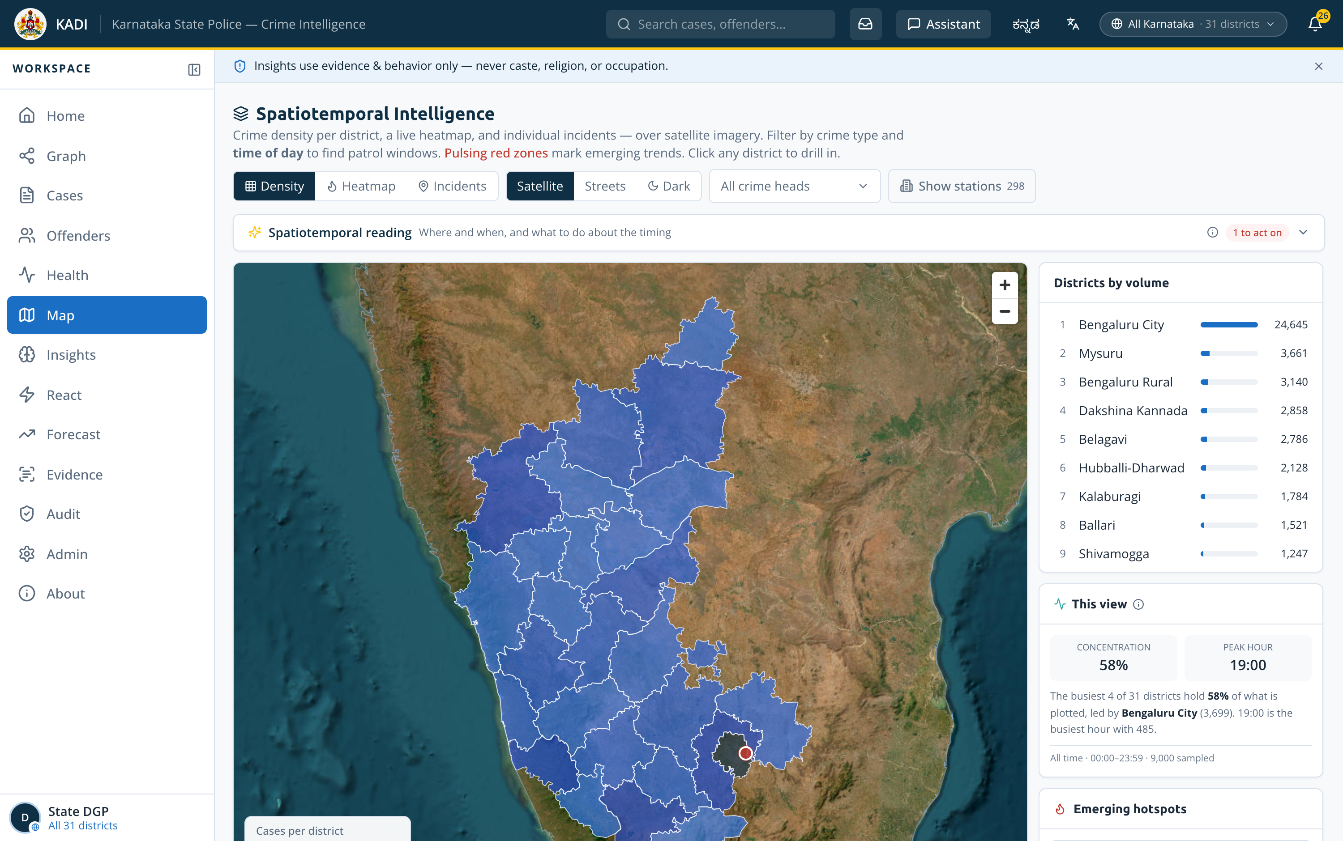
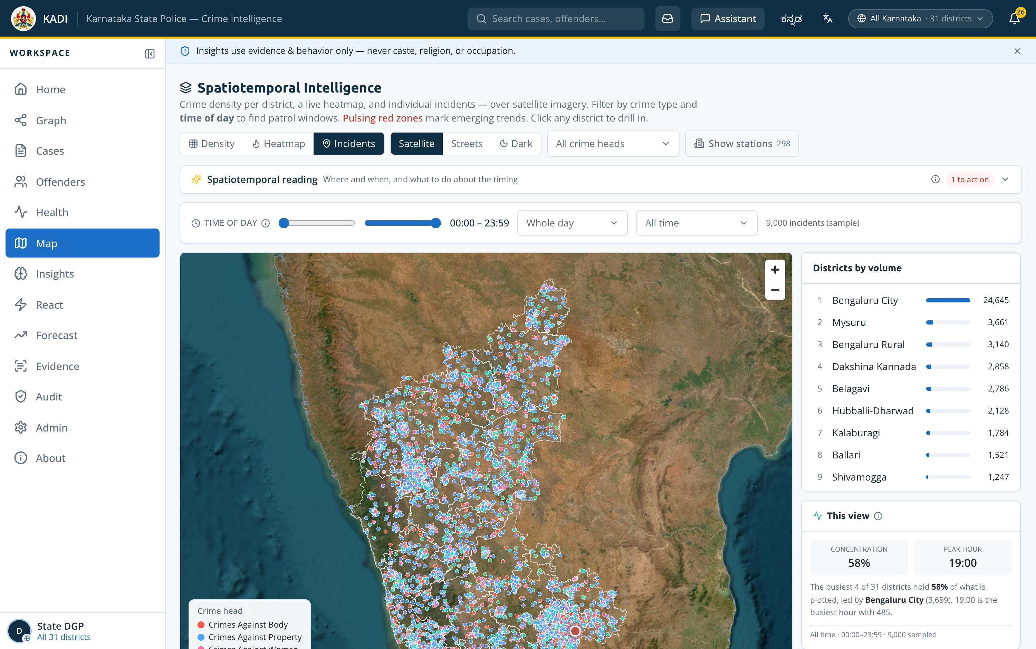
Pattern, trend and hotspot discovery
Capabilities 1b, 1c and 4 in full — how a hotspot is found, and what the concentration curve actually said
Spatiotemporal clusters — DBSCAN
Density clustering over location at eps 0.004° (~450 m), minimum 8 incidents. 346 hotspots statewide; 8 survive when the same clustering is layered with hour and weekday, which is the set worth deploying against.
Near-repeat victimisation
Density
Incidents
An incident with a prior inside 400 m and 14 days. The top cluster runs 70 incidents, 65 of them repeats — a 93% repeat rate at a median gap of 11 days. That is a place being re-targeted, not merely a busy one.
Choropleth per district
9,000 dots by crime head
346 DBSCAN hotspots
8 time-layered clusters
Occasion and day-class effects
Ten occasions scored against a 46.7 cases/day baseline across four day classes. New Year’s Eve runs +34% and shifts the mix toward crimes against body. Festival effects are measured; civic and political ones are marked indicative.
5 districts pulsing red
26 open trend alerts
The concentration curve said something we did not expect
0.583
0.047
0.377
Gini across the 31 districts is 0.583. Across the 298 stations it is 0.047 — the busiest 10% of stations carry just 11.5% of the load, so resource cannot be moved between stations on volume alone.
districts — uneven
stations — nearly flat
clusters — the layer to deploy against
Tip : 0 is perfectly even, 1 is all load in one unit.

Slide 6
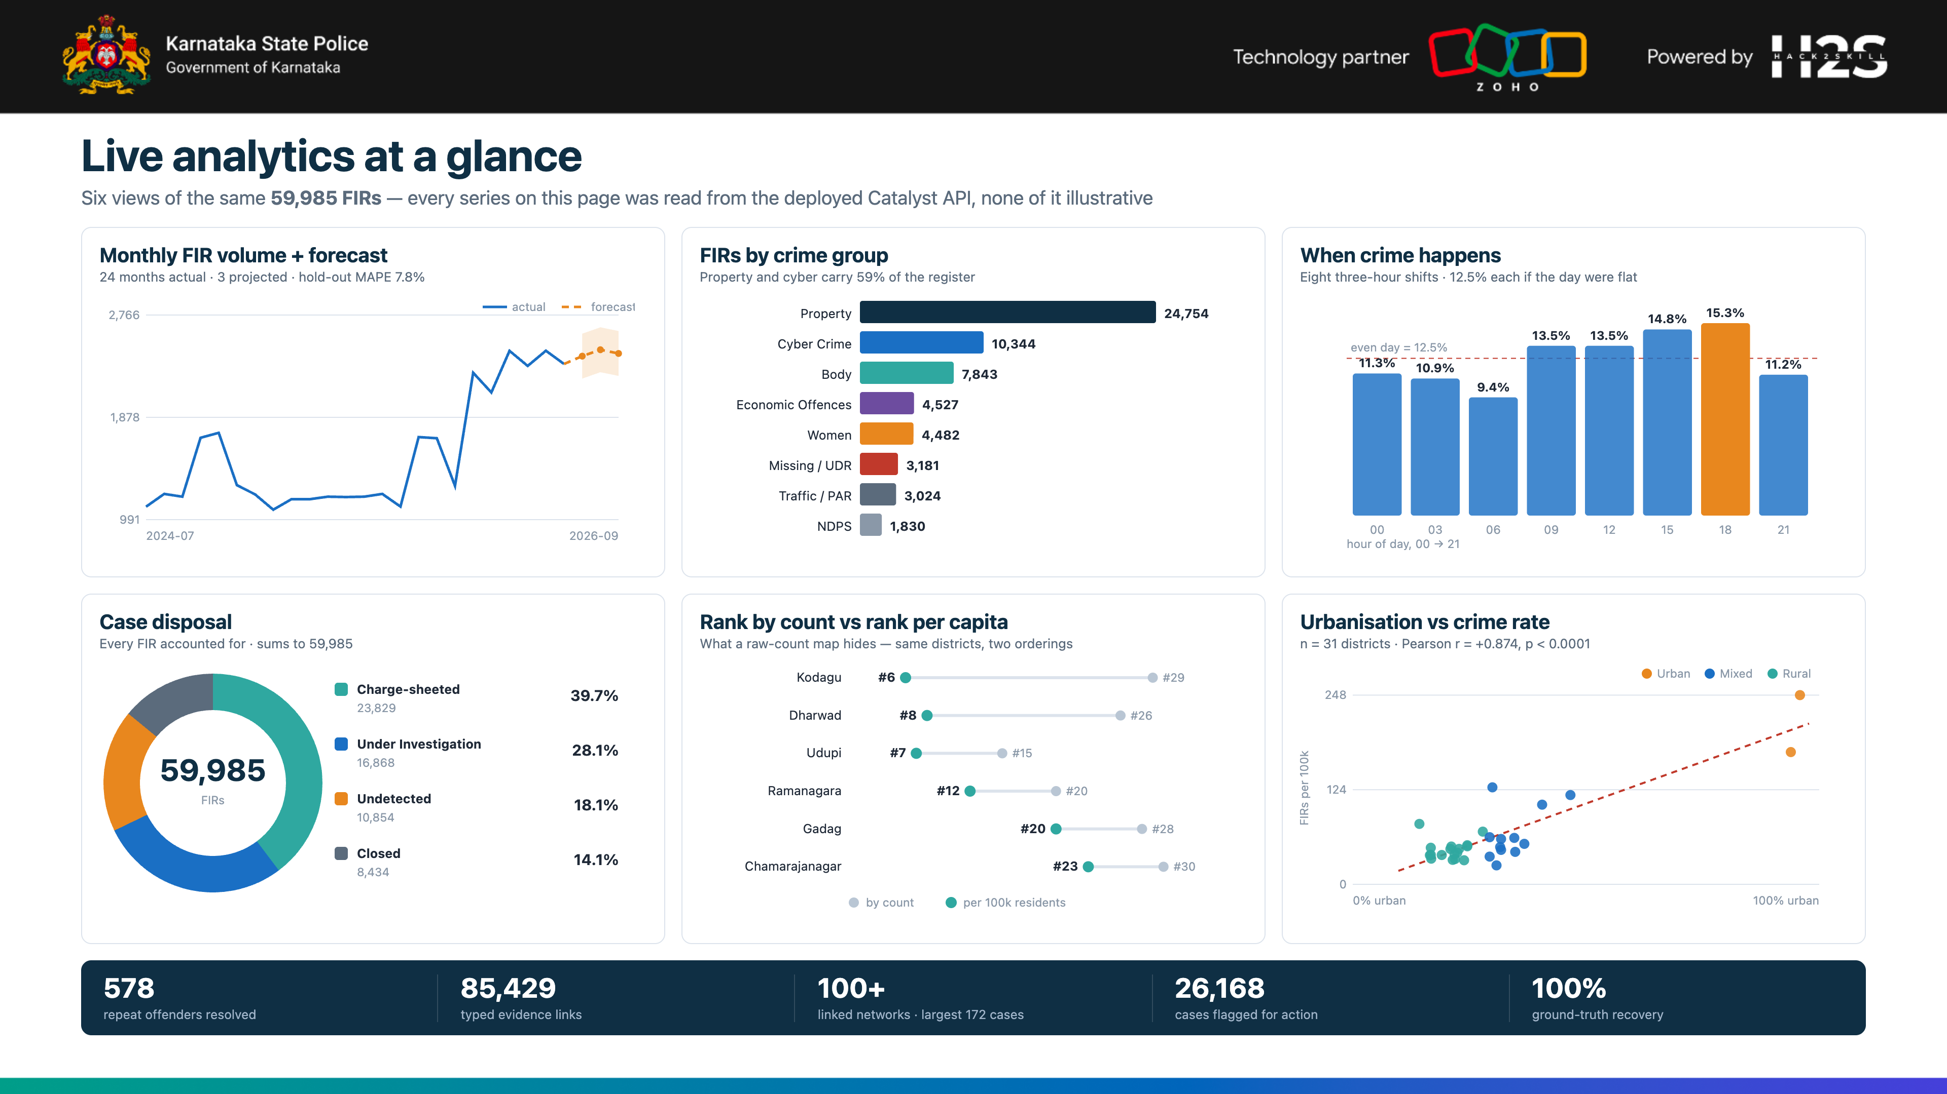

Slide 7
Opportunities
How it differs, how it solves the problem, and the USP
How is it different?
How will it solve it?
USP
Not a dashboard over counts
Breaks the silo, deliberately
Explainable end to end
A graph over evidence. Every edge names the attribute that matched and the FIRs it matched on.
A district officer sees cases linked into their district; a station still sees its own register.
Every edge, every score and every answer cites what it was built from.
Entity resolution comes first
Turns backlog into a queue
Runs on Catalyst alone
54,337 accused records resolved to 52,928 identities before anything is counted.
26,168 flagged cases ranked by severity, each with a recommended next action.
Thirteen services. The 30-second request cap shaped the architecture, not a workaround.
A model must beat the rule
Warns before it happens
Bilingual to the last label
Twelve candidates were built and rejected for not beating the heuristic they replace.
Station pendency +20% in 3 months, predicted at 0.870 AUC against a 0.701 rule.
1,134 Kannada strings, correctable in-product by the officers who read them.
Fairness is a failing test
Removes the retyping
Honest about its limits
Caste, religion and occupation cannot reach a feature set — the build stops.
Photograph a seizure memo; OCR reads it at 99% and files it against the case.
The deck and the app both name what is not wired, and why.
The differentiator is not the chart library. It is that every claim on every screen traces back to the record it came from.

Slide 8
List of features offered by the solution
Twelve capabilities, all live in the deployed build
Case-Linkage Graph
Entity Resolution
Offender Risk
Investigation Health
Six typed edge kinds · 85,429 links · clickable “why linked” evidence
Rarity-weighted fuzzy matching · 54,337 → 52,928 · 578 repeat
Glass-box factor breakdown · six horizons · name variants
26,168 flagged, each with a reason and a recommended action
React — one ranked queue
Spatiotemporal Map
Forecasting
Socio-economic Analytics
Failing cases, active offenders and pulsing stations in one list
Satellite · DBSCAN hotspots · hour × weekday · pulsing red zones
Statistical and ML side by side · MAPE 7.8% on a hold-out backtest
Per-capita rates with p-values, so a weak signal reads as weak
Evidence Reading
Bilingual Assistant
Register & approvals
Fairness & Audit
OCR · barcode · vision · PDF and multi-page · files to the case
EN / ಕನ್ನಡ · text or voice · every answer cites its FIR numbers
A station files an FIR; a supervisor approves it, before and after
Protected attributes excluded by a failing test · every read logged
All twelve ship in the deployed build — none is a roadmap item.
19
105
103
1,134
13
screens
REST
endpoints
automated tests
Kannada
strings
Catalyst services
Every figure on this slide was read from the live Catalyst API.

Slide 9
Process flow
From a FIR register to an investigator acting on a lead
1
FIR intake
2
Entity resolution
3
Link building
4
Analytics
5
Delivery
29 KSP tables · 59,985 FIRs over 43 months
Blocking → rarity-weighted score → union-find merge
Six typed edge kinds · 85,429 links, each with its evidence
Louvain communities · risk · health · DBSCAN · forecast
Precomputed read-model, served to the SPA in under 100 ms
Where each stage runs — and why the platform forces the split
Catalyst Job · nightly 02:00 IST
Function / AppSail · on request
Browser · instant
A 15-minute budget. Entity resolution, graph build, Louvain, risk, health, DBSCAN and forecast — 24.6 s at 738 MB peak.
Node 20, 512 MB. Reads what the Job already wrote and answers in under 100 ms. AppSail returns per-capita and forecast in ~135 ms.
The SPA reads a precomputed read-model. No screen ever waits on a model, because no model runs behind an HTTP request.
The constraint that shaped everything: Catalyst Functions and AppSail both cap a request at 30 seconds — confirmed with the Zoho team in the Datathon workshop, and not raisable. Only Jobs get 15 minutes. So the pipeline runs nightly as a Job and the web tier only ever reads what it wrote. That single decision is why every screen loads instantly instead of waiting on a model.
24.6 s full pipeline run
738 MB peak memory, under the 512 MB cap
135 ms AppSail analytics
< 100 ms typical API response

Slide 10
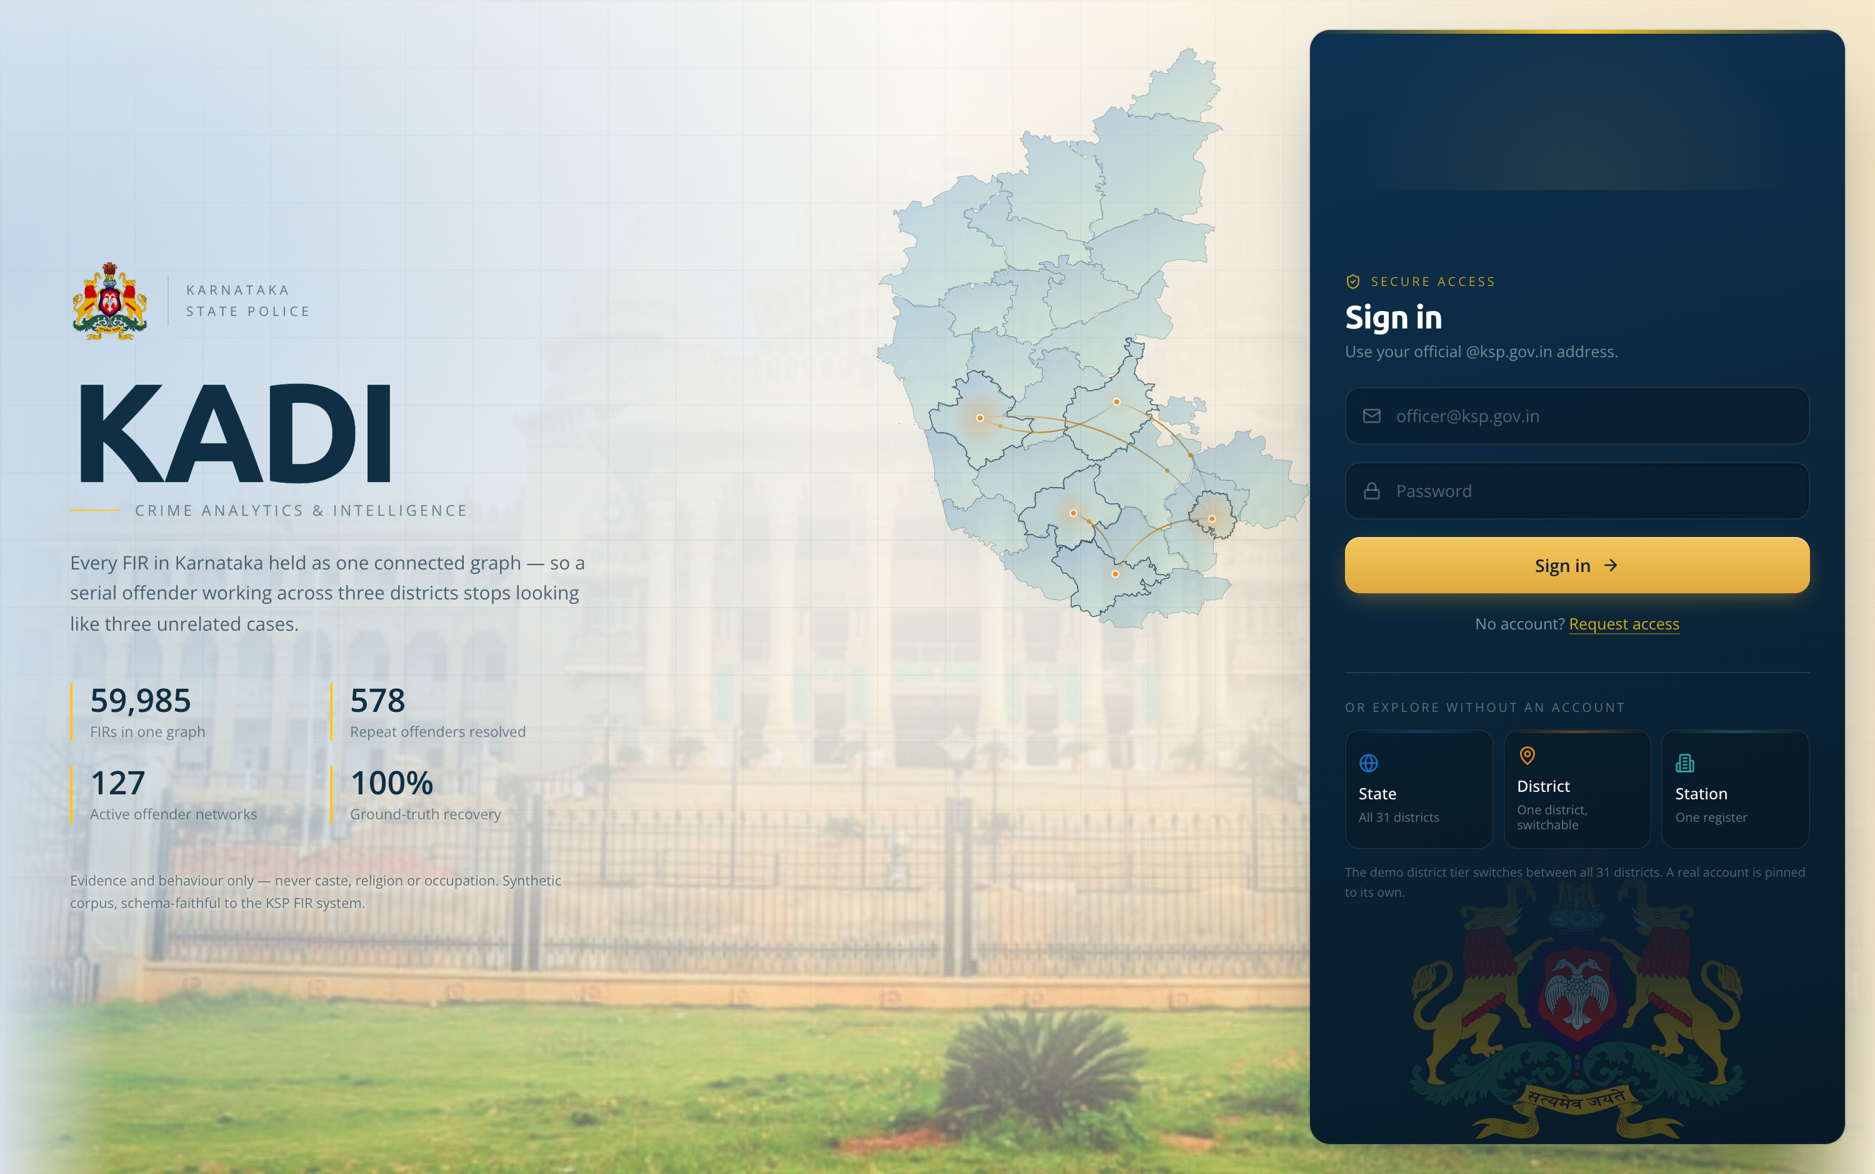
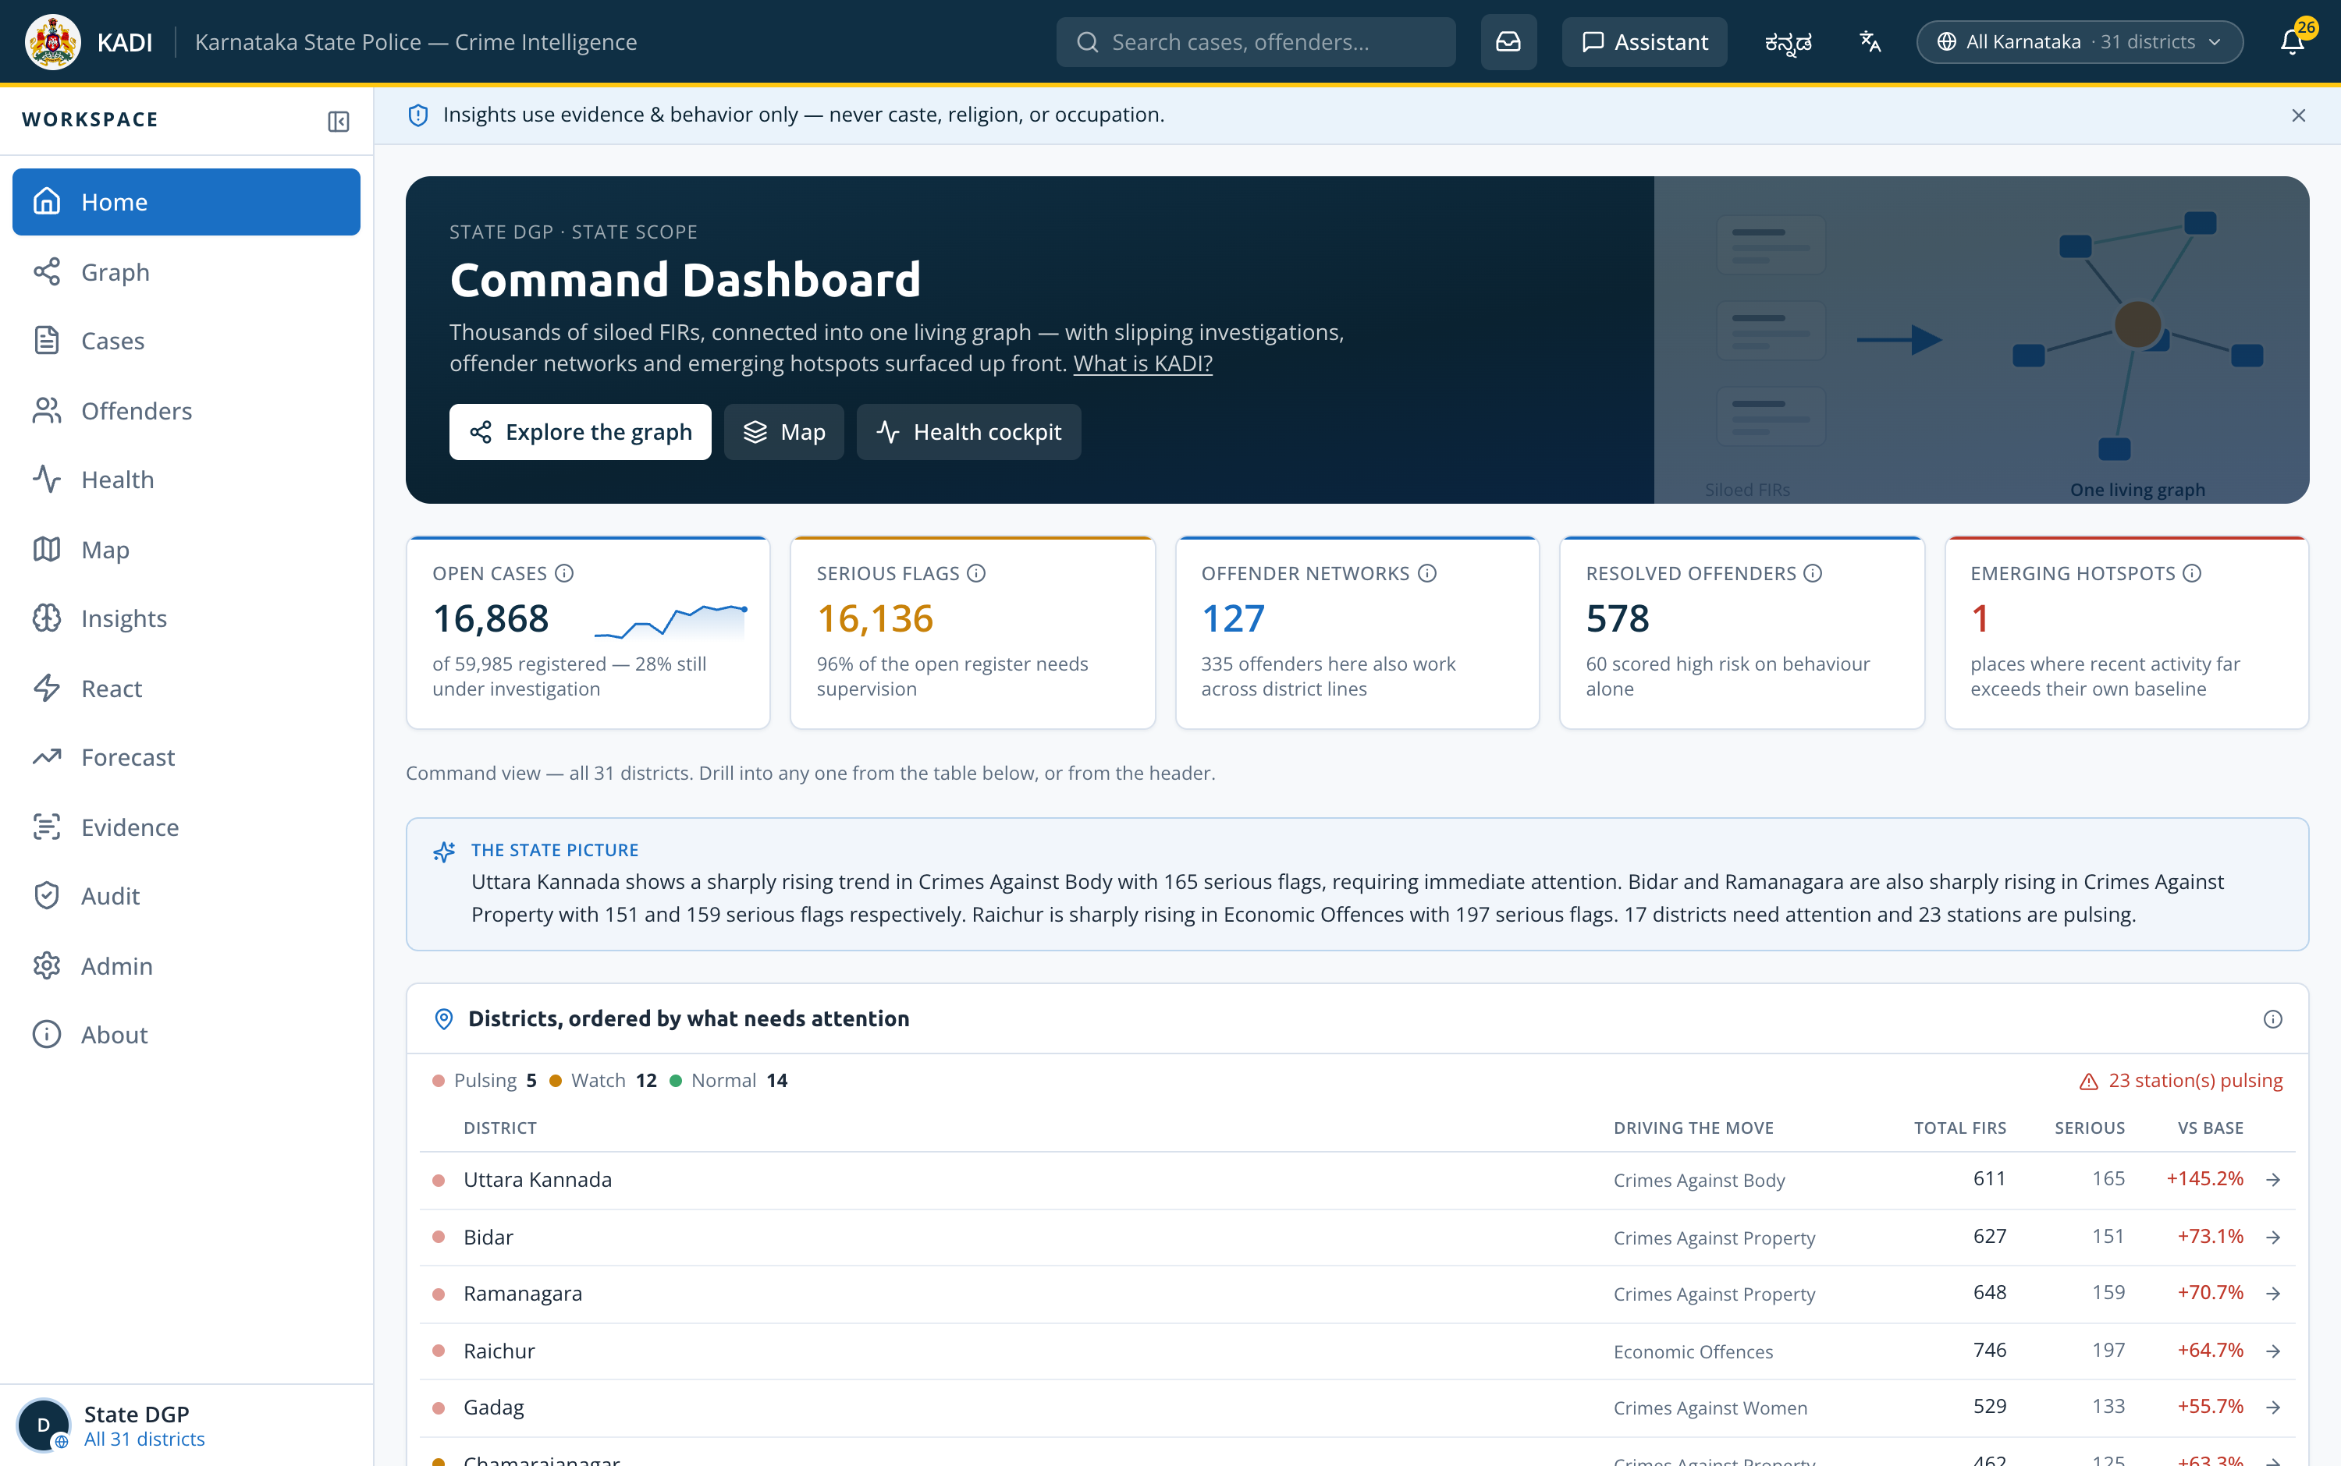
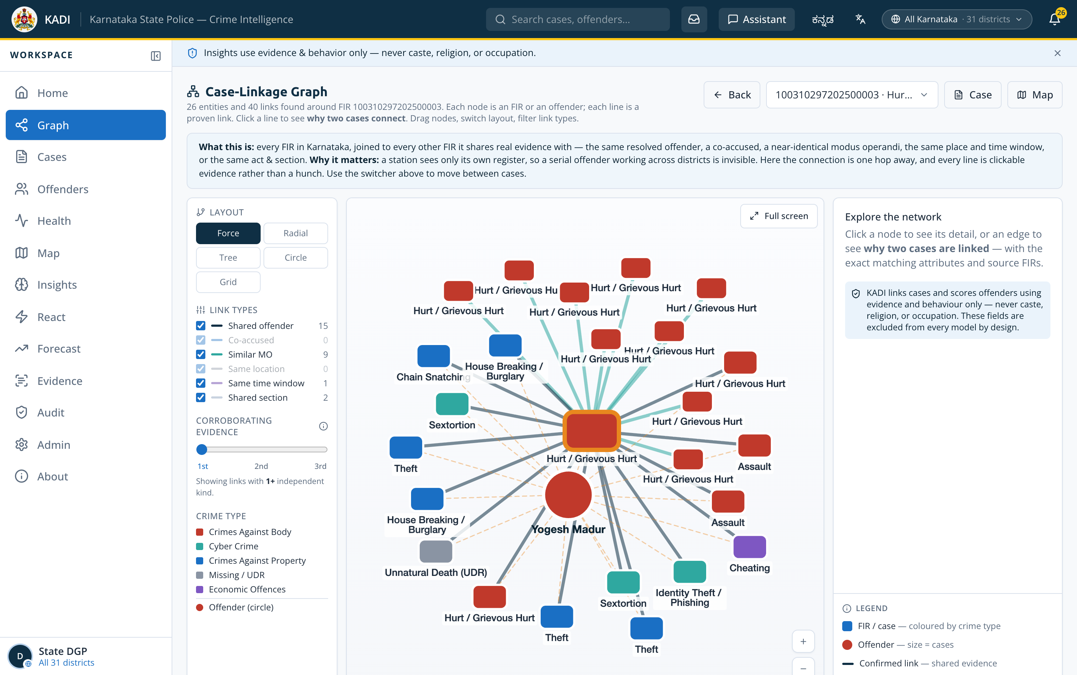
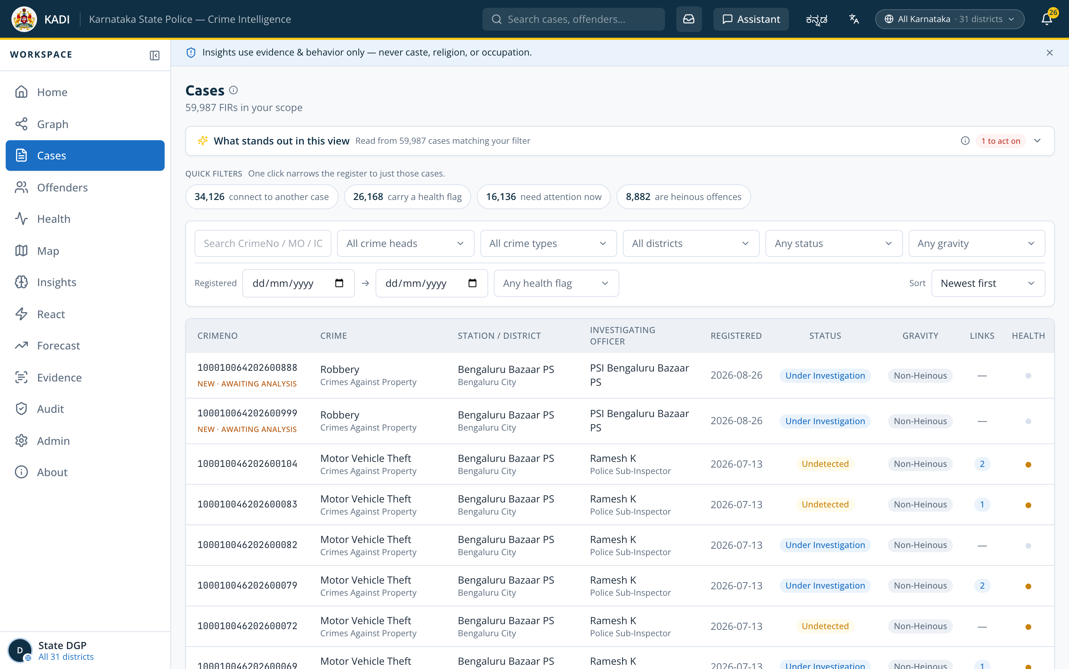
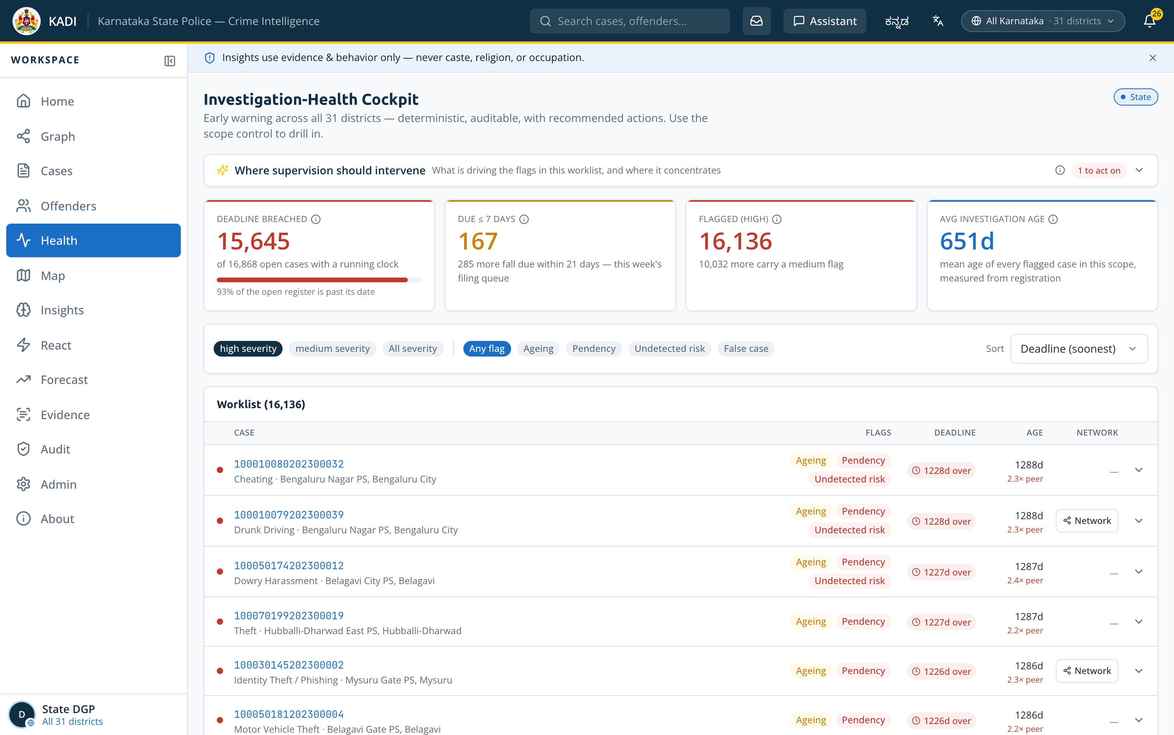
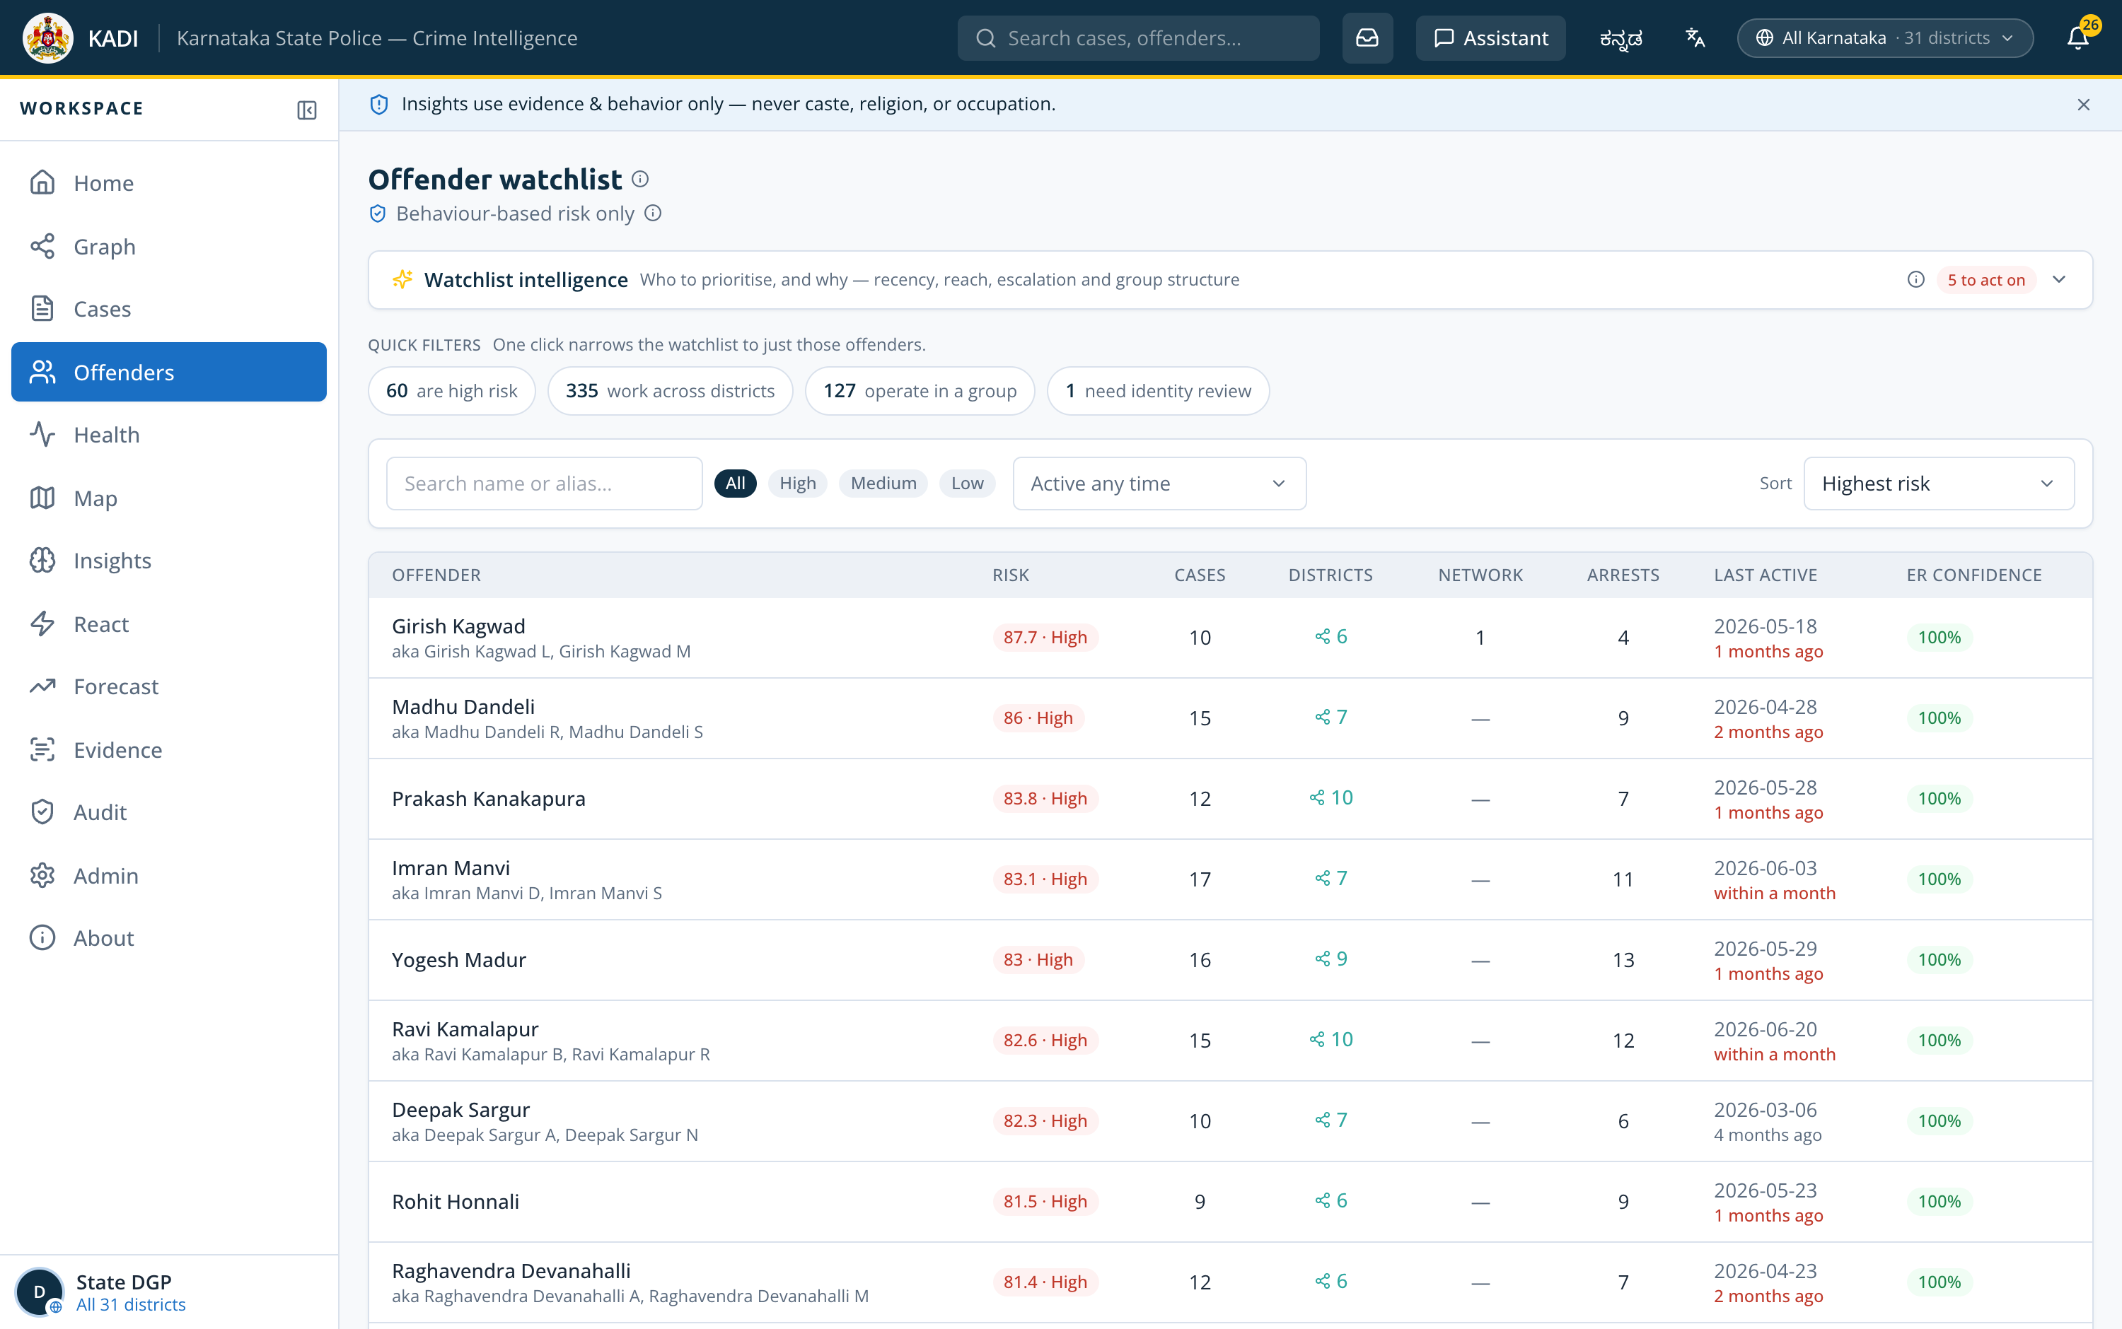
Wireframes of the proposed solution
Not wireframes — the deployed build. Eight of nineteen screens, captured live at 3000 x 1880.
Sign in by rank
Command Dashboard
Case-Linkage Graph
Case Register
Six ranks, no password — scope follows the post
State picture in prose · districts ranked
Ego-network · 5 layouts · 6 link filters
59,987 filed · 59,985 analysed
Investigation Health
Offender Watchlist
Map — density
Map — incidents
26,168 flagged, each with a next action
578 identities · glass-box risk
Choropleth per district over satellite
9,000 plotted dots, coloured by crime head
Every screen above is a live URL, not a mockup. Sign in by rank at the deployed link — no password — and the same scope rules an officer would get are the ones you get. The other eleven screens are on the snapshots slide and in the repository.

Slide 11
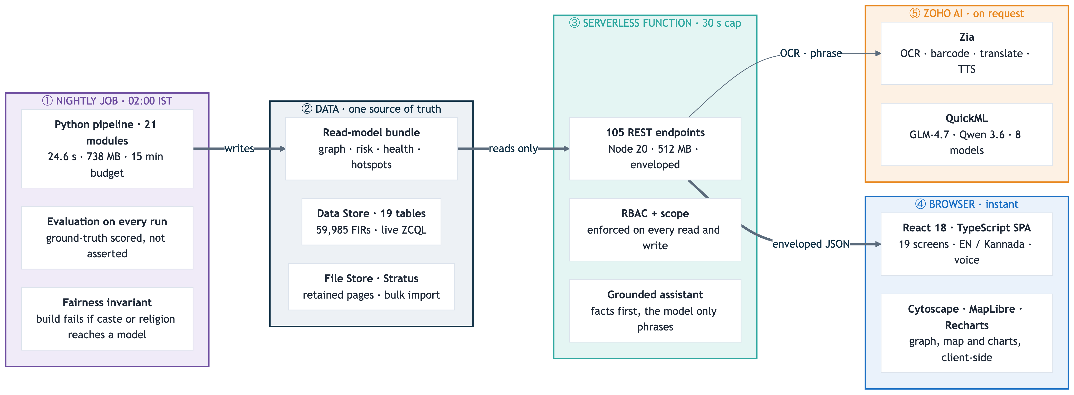
Architecture diagram of the proposed solution
Five tiers on Zoho Catalyst, drawn in the direction the data actually moves — the Job writes, the web tier reads
No heavy compute behind an HTTP request. Functions and AppSail cap at 30 s; only Jobs get 15 minutes.
The model never retrieves. It only phrases. Facts are computed against the register before any LLM is called.

Slide 12
The Eight ML models that ship
Every one had to beat the rule a supervisor would use instead — twelve candidates did not, and were cut
AUC on a time-ordered hold-out, against the rule each model has to beat
The rule that decided everything
For every target there is an obvious heuristic — the most recent offender reoffends, the busiest station falls furthest behind. Each candidate was scored against that rule on the same hold-out.
A model that cannot beat the rule is not a model. It is overhead.
Five tests a candidate has to survive
Beats the rule · overhead dressed as intelligence
Scale-free · has it only learned “big station is big”
Conditional · is one easy component carrying it
Poisson floor · is the spike just counting noise
Best-available baseline · was the rule chosen to flatter
What each model answers
h90 back on a new FIR within 90 days
h180 within 180 days — the default
h365 within a year
new365 next FIR in a district never worked
heinous365 next FIR recorded Heinous
women365 next FIR a crime against women
spike district × crime-head spike next month
pendency station pendency +20% in 3 months

Slide 13
Prototype performance report / benchmarking
Measured on the deployed build — not estimated, and re-scored by the pipeline on every run
Ground-truth recovery seven patterns planted, then found again
Memory, before and after the one change that mattered
Peak fell 1,770 → 738 MB by capping scikit-learn’s working_memory at 32 MB byte-identical output, zero speed cost, and it is what brought the run inside the 512 MB Job budget.
24.6 s
135 ms
< 100 ms
7.8%
12.1 MB
99%
127 ms
full pipeline · 59,985 FIRs
AppSail analytics
typical API response
forecast MAPE, hold-out
graph payload, from 54.9
Zia OCR · 2.0 s
barcode · QR read
103 automated tests · 83 Node + 20 Python · 228 commits over 49 days. They cover the response envelope, RBAC at all three tiers, the scope refusal in both directions, evidence filing and retention, and a set of structural invariants — audit labels, route ordering, ZCQL limits, build output. Plus the fairness invariant, which fails the build if a protected attribute reaches a model’s feature set. Seven patterns are planted by the generator at seed 2026 and re-scored on every run, so the recovery above is produced by the system rather than typed into this deck.

Slide 14
Who sees what — the access model
Six ranks, one register. Scope is enforced on every read and every write, and every privileged access is logged
Three tiers of scope, six+ ranks
Scope on the list AND the detail
State DGP
all 31 districts
A station SI reading the register sees 276 cases. Opening a case in another district is refused — 59,709 of 59,709 out-of-scope cases, verified live. The rule used to exist only in a comment.
SCRB Analyst
all 31 districts
Administrator
all 31, plus accounts
SP · district
one district
Linked is visible, contents are not
DSP · sub-division
one sub-division
A district officer sees that a case elsewhere is linked into their district — that is the product’s thesis. Reading the seizure memo filed against it is not, so evidence stays stricter than the case.
SHO / SI · station
one station register
An account is pinned to its district and unit at sign-in; a query parameter cannot widen it.
The refusal is tested in both directions
Every privileged read and write is logged
Not only that an out-of-scope read is refused, but that an in-scope one still succeeds. A guard that refuses everything passes the first test and fails the job.
Who, what, when, and a human-readable action — not a table of opaque codes. A record that can be read without a key is a record a supervisor will actually audit.
GET /cases/:id as SI — before: 200 with named victims in 6 districts · after: 0 allowed
36 accounts
3 scope tiers
100% privileged calls logged
Why this belongs in a crime-analytics deck: A platform that joins every district’s register into one graph is, by construction, a platform that could show any officer anything. The scope model is the reason it does not. It was also the single worst defect found before submission case detail was unscoped while the list was scoped, so a station SI could open cases in every district sampled. Found by probing the deployment rather than by reading the code, and closed with a test in each direction.

Slide 15
Technologies used in the solution
Each chosen for a constraint, not for the list
Frontend
Backend & API
Data & ML
Platform & quality
React 18 · TypeScript · Vite
Tailwind CSS
Cytoscape.js + fcose — the graph canvas
MapLibre GL — satellite and choropleth
Recharts · Framer Motion
TanStack Query
pdf.js — lazy-loaded, multi-page evidence
Node.js 20 · Catalyst Advanced I/O
Express-compatible routing
105 REST endpoints, enveloped
RBAC scoping on every read and write
Persisted audit trail
Grounded intent engine
Enveloped errors — never a bare 500
Python 3.11 · pandas · NumPy · SciPy
scikit-learn — TF-IDF, DBSCAN, NearestNeighbors
networkx — Louvain communities
RapidFuzz — rarity-weighted matching
Shapely — district polygons
QuickML — 8 tabular models
statsmodels — trend and seasonality
Zoho Catalyst · CLI 1.27
ZCQL over 19 Data Store tables
Zia · QuickML · SmartBrowz
node:test · pytest — 103 tests
Fairness invariant in the build
GitHub — 228 commits, full docs
Puppeteer — screens captured live
What forced it
What forced it
What forced it
What forced it
The graph had to stay interactive at five layouts and six link filters, with no round-trip per redraw.
Advanced I/O takes an Express app unchanged, so the same 105 routes run locally and on Catalyst.
All of it runs inside the nightly Job. Nothing on this list is called from an HTTP request.
The build fails if a protected attribute reaches a feature set. The claim is a test, not a sentence.
Nothing here is exotic — every choice traces to a Catalyst limit, the 30-second cap, the 512 MB Job budget, or the fairness rule. The stack is deliberately boring so the evidence can be interesting.

Slide 16
Catalyst services used in the solution
Thirteen in use — and an honest account of what is not wired
SERVICE
USED FOR
WHY THIS SERVICE
SERVICE
USED FOR
WHY THIS SERVICE
Web Client Hosting
Serves the SPA at /app
Same origin as the API
Stratus
Bulk-import objects
Bulk-write reads its source from a bucket
Serverless Functions
105-endpoint REST API
Advanced I/O takes an Express app
Authentication
36 @ksp.gov.in accounts
An account is pinned to its district and unit
Job Scheduling + Cron
Nightly pipeline, 02:00 IST
Only Jobs get 15 minutes Functions cap at 30 s
Zia
OCR · barcode · translate · TTS · STT
Trained models — no training data of ours
AppSail
Python analytics service
Per-capita and forecast in ~135 ms, stdlib-only build
QuickML
GLM-4.7 · Qwen 3.6 · 8 tabular models
The only place a model runs at request time
Data Store
19 tables · 59,985 FIRs
The FIR schema is genuinely relational
SmartBrowz
Briefing export
Renders the print-ready briefing
File Store
Retained evidence pages
Opt-in; deleted with its reading
Connections
OAuth for QuickML and Zia
Both reject anonymous calls
Not wired — four services attempted, diagnosed and stated rather than quietly skipped
Cache
Zia object / identity
Zia face detection
NoSQL · API Gateway
401 PERMISSION_NEEDED
404 on every path
ZIA_ERROR, always
not provisioned
Adapter written and segment provisioned; writes from a deployed function are refused. Zero user impact — the KPI query recomputes in ~1 ms.
Every REST path tried returns 404 on this project. The vision model covers the same ground and is used in its place.
The endpoint exists and errors on every image tried, including one with a face. Left off rather than shipped as a control that fails.
The read-model ships in the bundle, so NoSQL was never needed. Gateway was enabled once and disabled: with no routes it intercepted all traffic.

Slide 17
Estimated implementation cost
Free-tier today; the shape of a state-wide rollout
SERVICE
PROJECT USAGE
COST TODAY
AT PRODUCTION SCALE
Rs 0 / month today
Web Client Hosting
SPA + assets (~2 MB)
Free tier
Static hosting, negligible at KSP scale
The whole prototype fits inside the Catalyst free tier : 59,985 FIRs, the nightly pipeline, and every screen.
Serverless Functions
2 functions · 512 MB · ~450k invocations/mo
Free tier
Scales on invocations; ~₹0.30 per 1k beyond free
AppSail
1 service · stdlib-only build
Free tier
Analytics on demand · ~135 ms per call
Only Zia and QuickML are usage-priced.
Data Store
19 tables · 59,985 FIRs · ~180 MB
Free tier
Real KSP volume ≈ 10 M FIRs — paid storage tier
At real KSP scale
Stratus + File Store
~8 MB import objects + retained pages
Free tier
Grows with retained evidence, opt-in only
~10 M FIRs, against 59,985 here
Job + Cron
1 nightly run · 24.6 s
Free tier
One scheduled execution per day
~167× the corpus this runs on
Nightly still one Job the pipeline is linear
Zia + QuickML
OCR, translate, TTS, STT, LLM, 8 models
Consumption
Priced per call — the only usage-linked line
Storage the only line that changes tier
What actually changes at 10 M FIRs. One line: Data Store moves to a paid storage tier. The nightly Job stays one Job, the read-model stays one bundle, and the three request tiers keep the same shape the pipeline is linear in corpus size and already clears 59,985 FIRs in 24.6 s. There is no re-architecture priced into this table because none is needed.

Slide 18
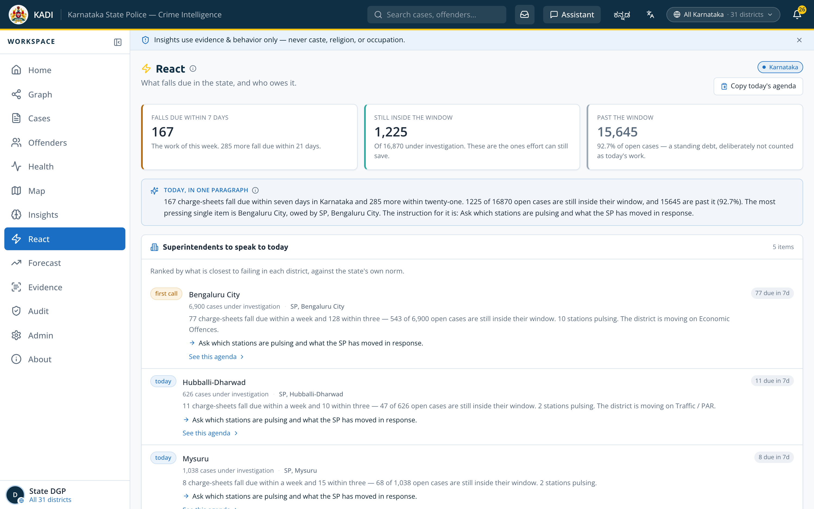
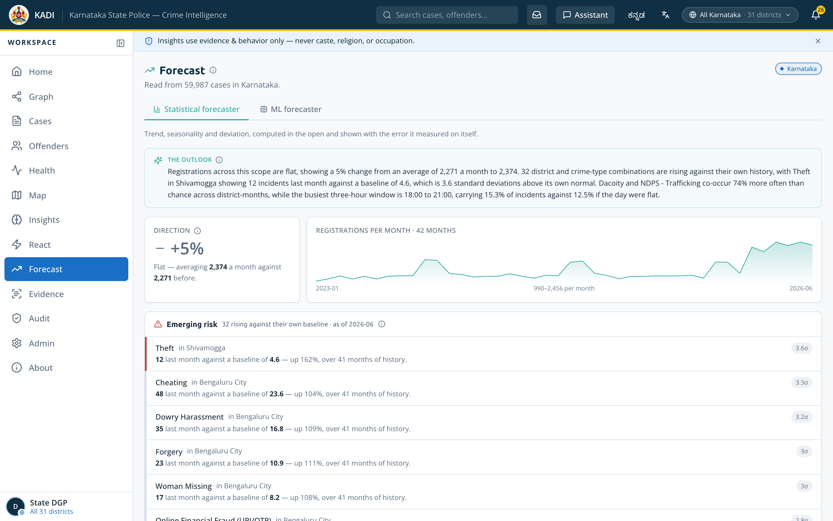
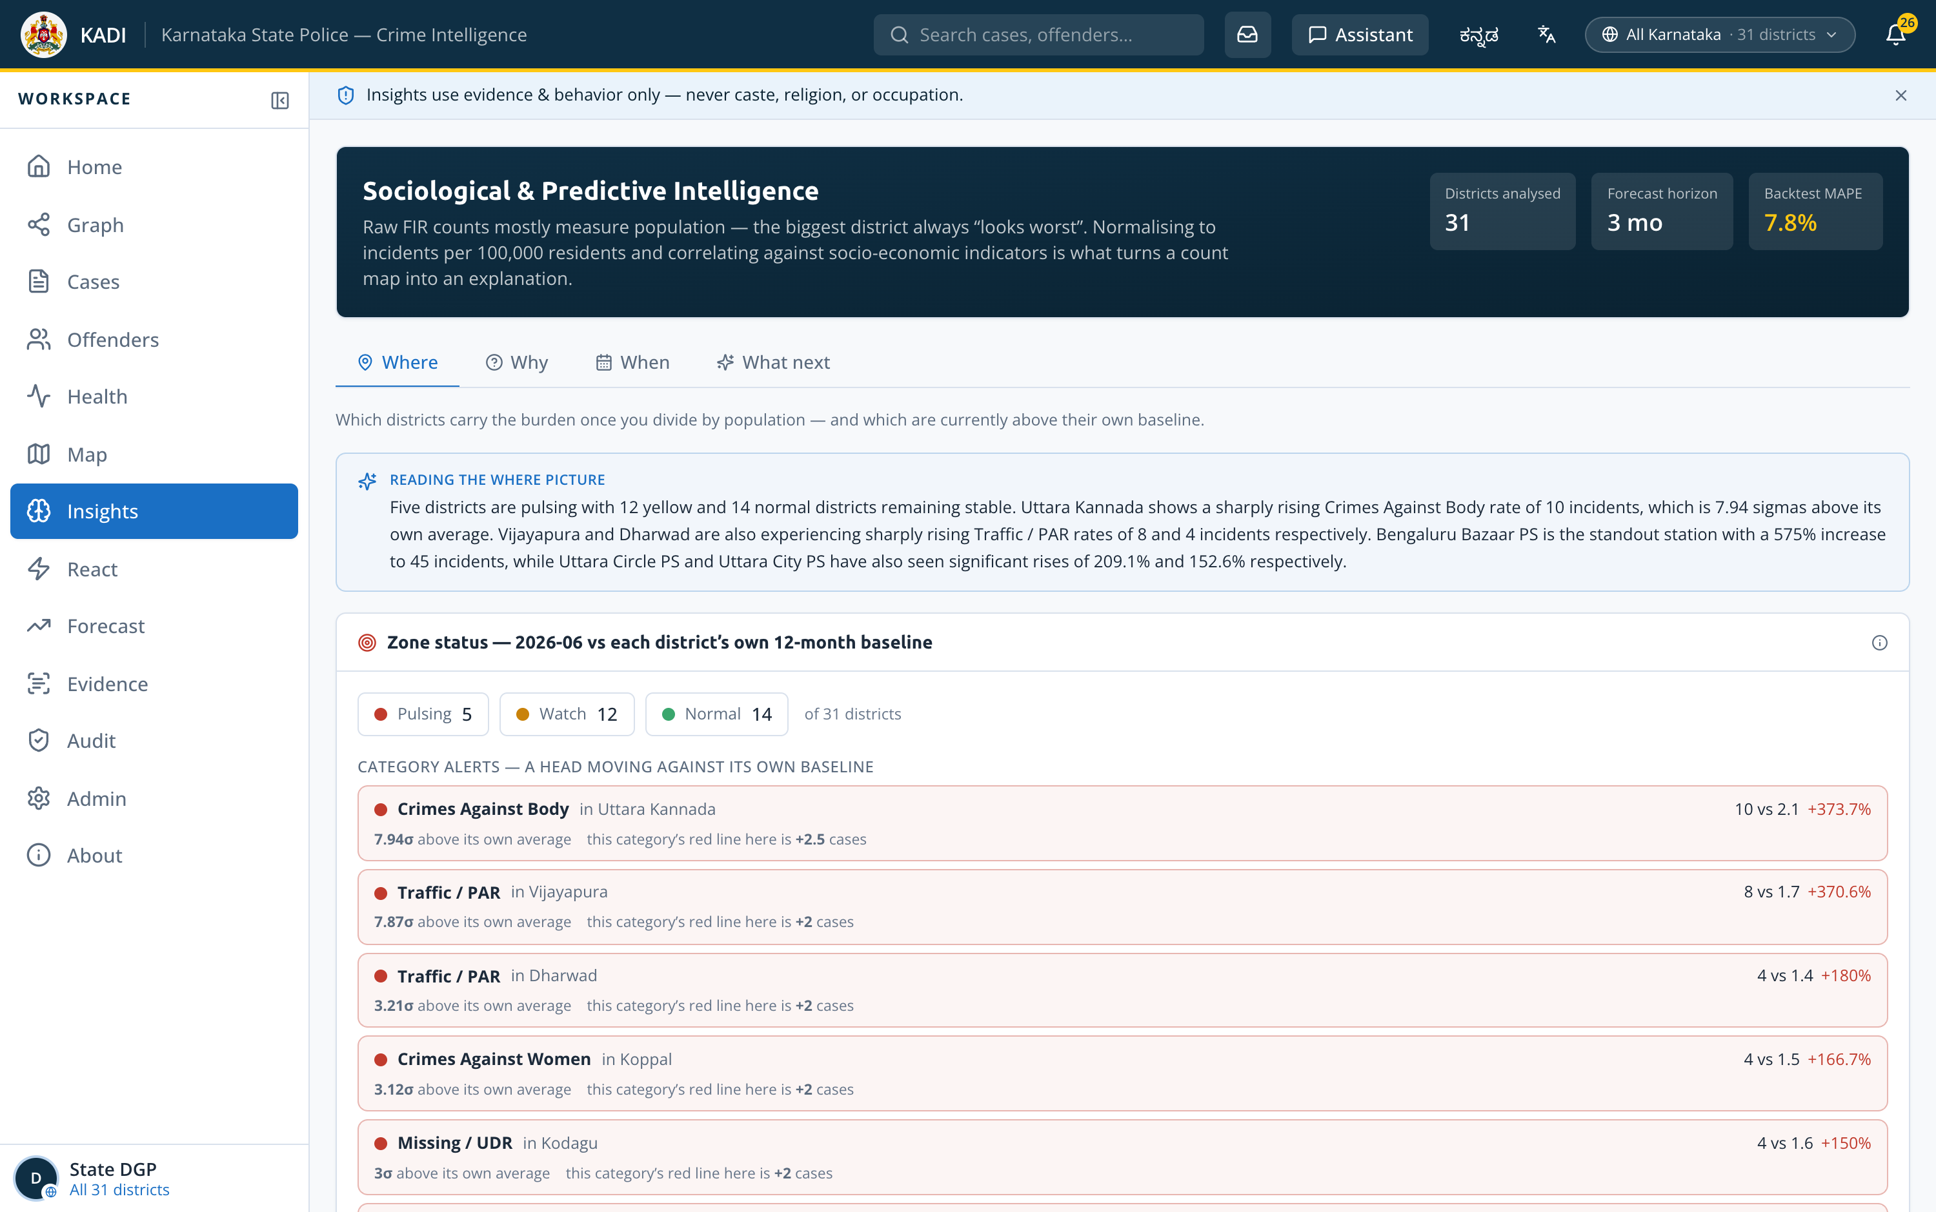
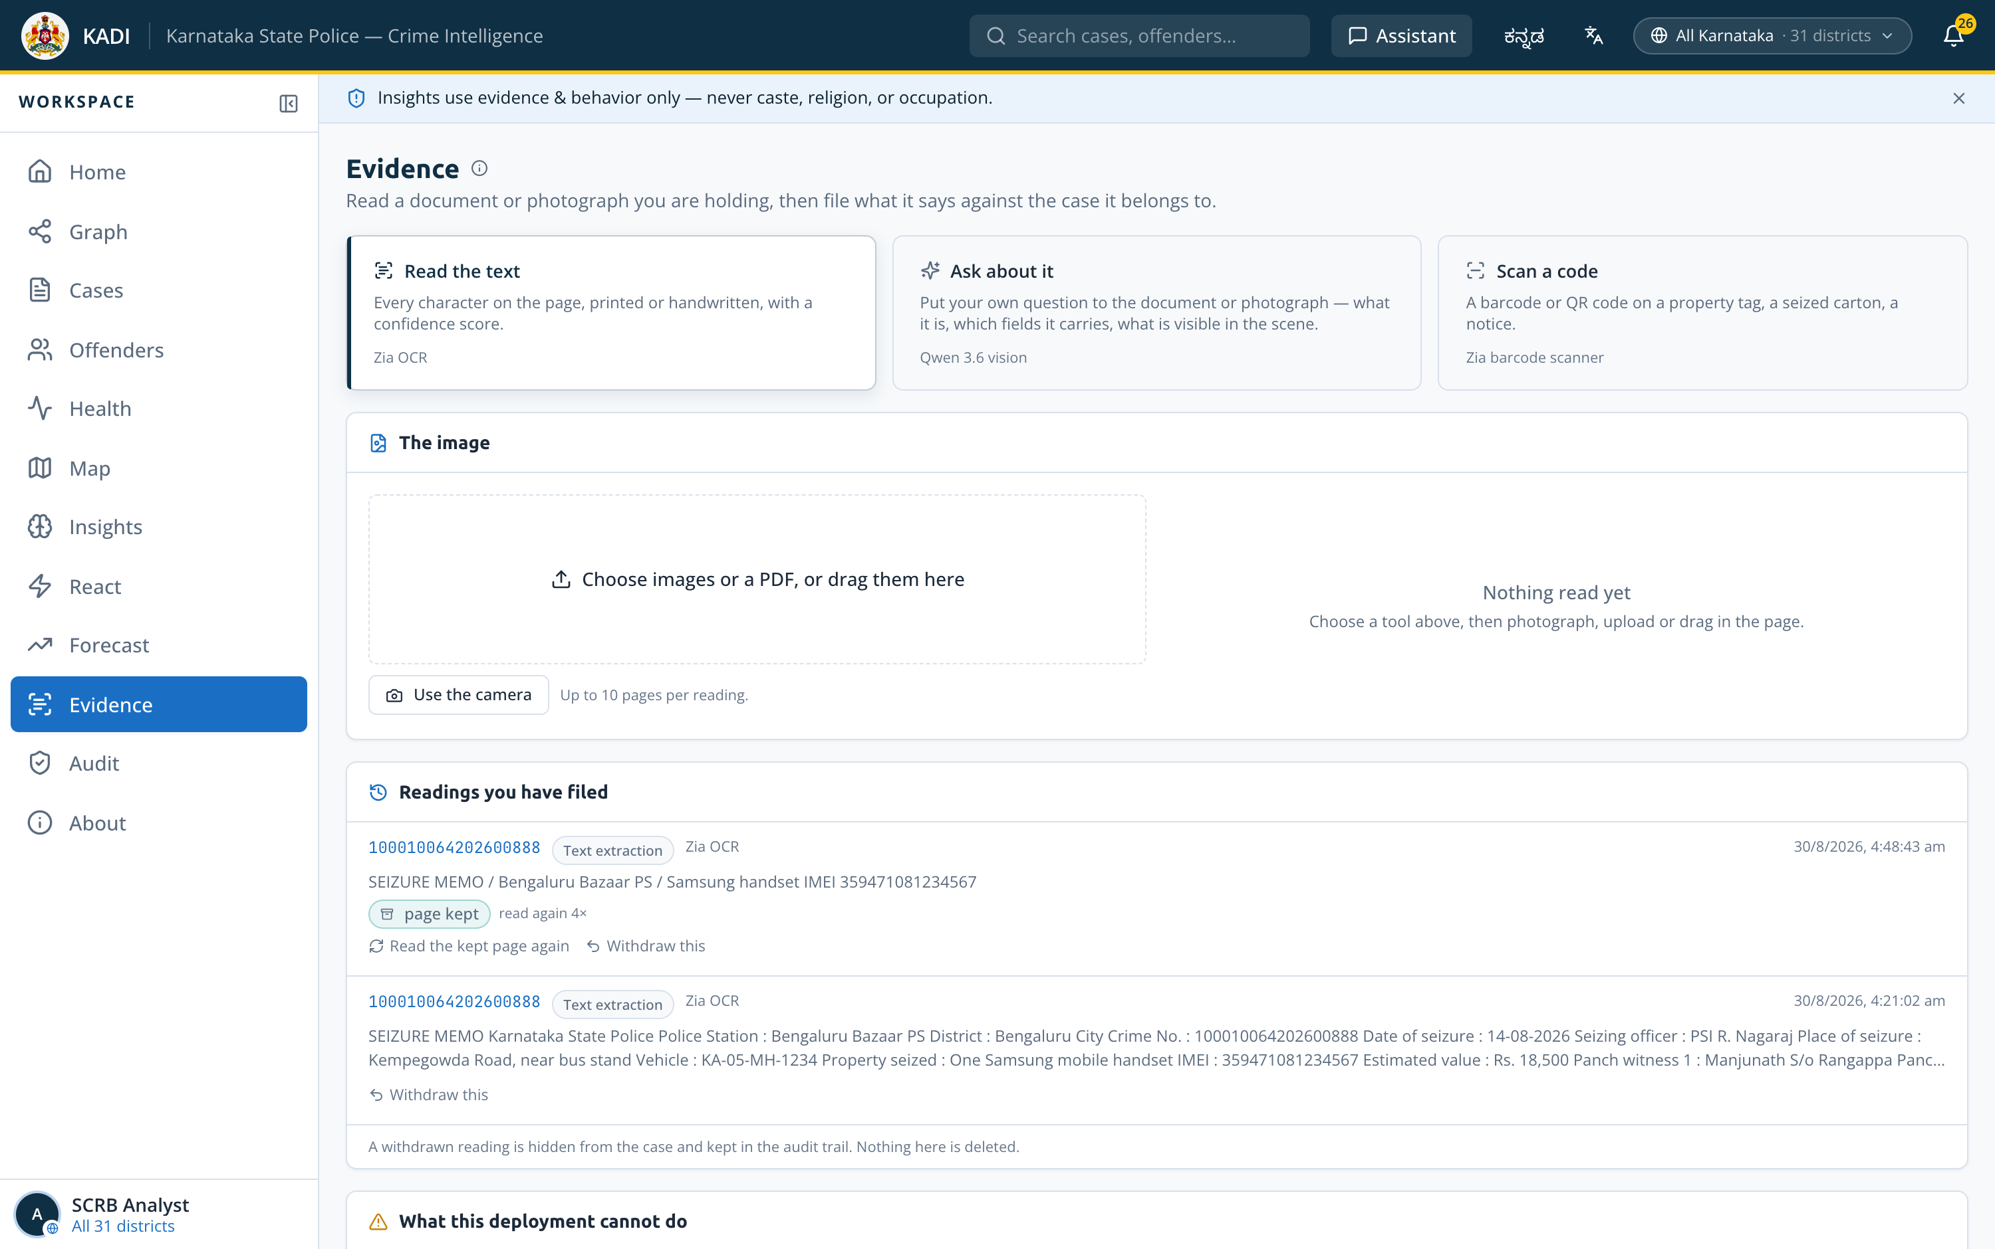
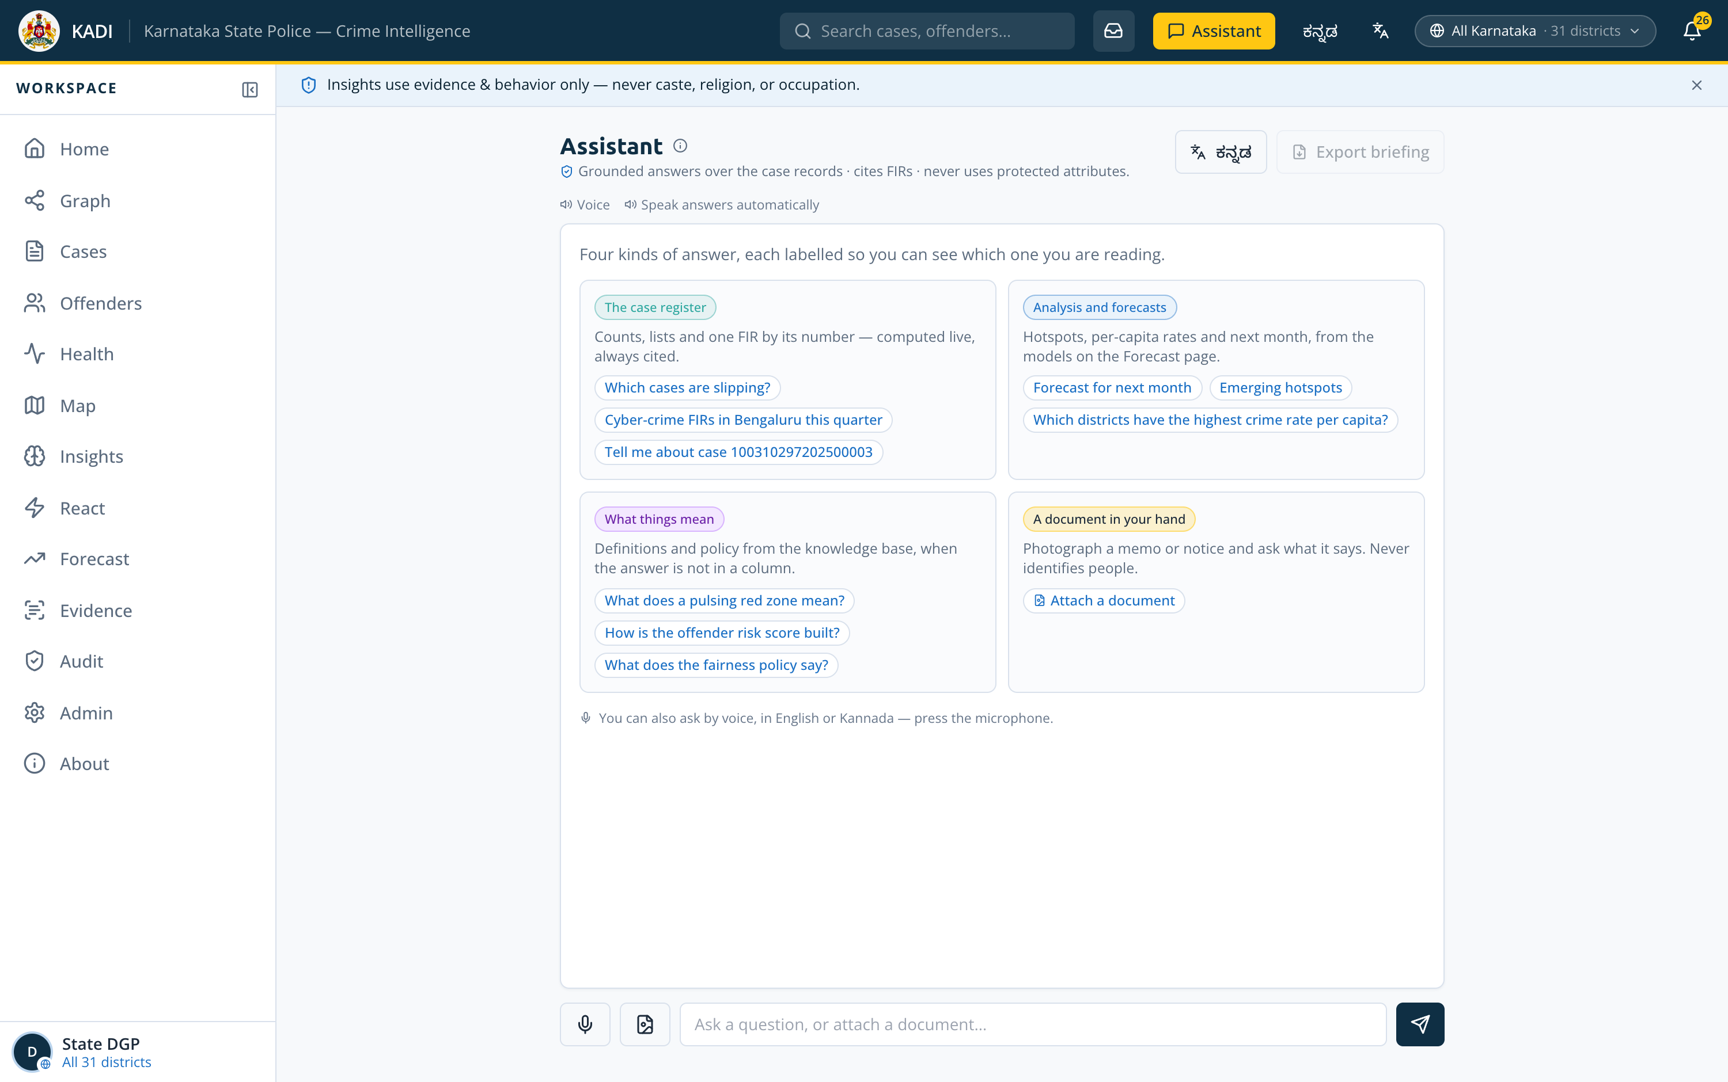
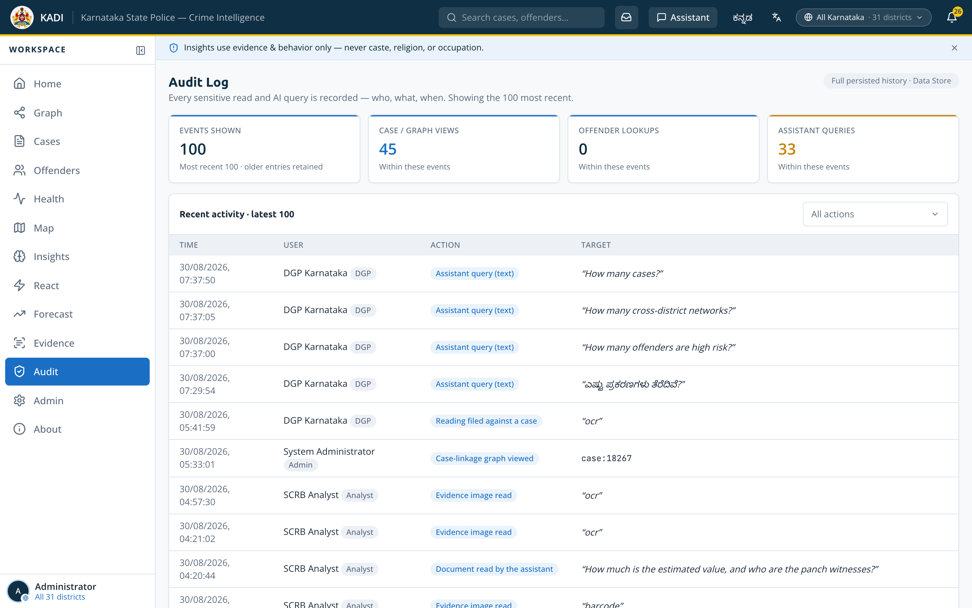
Snapshots of the prototype
The other six screens : Every one captured from the deployed Catalyst URL
React — ranked queue
Forecast
Socio-economic Insights
Failing cases, active offenders, pulsing stations
Statistical and ML forecaster, each with its error
Per-capita rates and rank shift, with p-values
Evidence Reading
Bilingual Assistant
Audit Trail
OCR, barcode and vision — filed against the case
Four kinds of answer, each badged with its source
Every privileged read and write, in plain language

Slide 19
Links
Everything is publicly accessible and independently verifiable
Deployed solution — Catalyst
https://kadilabs-60078029367.development.catalystserverless.in/app/
LIVE APP
Web Client Hosting · sign in by rank, no password needed
Demo video
https://drive.google.com/drive/folders/1WY3KHg1WOEnSNTBXGmTtH2ZoJM1y4cLJ?usp=sharing
VIDEO
Problem overview · working prototype · key workflows
GitHub repository
https://github.com/adarshcod30/Kadi
SOURCE
228 commits over 49 days · full source, README, docs
AppSail analytics service
https://kadi-appsail-50043957273.development.catalystappsail.in/analytics/socio
LIVE API
Live JSON — per-capita rates and correlations
Verify the whole claim in five minutes
Built in the open, entirely on Catalyst
1
Sign in as State DGP
2
Open a case on the Graph
3
Sign back in as a station SI
228
49
103
16
no password — pick the rank
click an edge; it names what matched
the same case is now refused
commits
days
tests
docs
Client, API, Python analytics, nightly job, database and file storage are all Catalyst services.

Slide 20
Additional details & future development
Six items, in priority order — each one a swap behind an interface that already exists
1
Read the register from Data Store
NEXT
2
Native-speaker Kannada review
READY
3
Incremental recompute on insert
DESIGNED
The 59,985 FIRs are already in Data Store and queryable via ZCQL — ?source=datastore proves it live. The default path serves a precomputed bundle for sub-100 ms response; swapping it sits behind the existing store interface.
The instrument exists and is live: any officer can correct a string in ten seconds and it applies for everyone, attributed and reversible. What remains is the review itself, not the tooling.
The pipeline rebuilds nightly in 24.6 s. Signals on FIR insert would move that to incremental, so a case registered at 14:00 is linked by 14:01 instead of by 02:00.
4
Extend the graph
MODEL READY
5
Retain every page, read the text layer
SCOPED
6
Configure API Gateway routes
BLOCKED
Vehicle registrations, phone and IMEI, and bank accounts as additional typed link kinds. The edge model already supports them; this corpus does not yet carry the columns.
A multi-page reading keeps only its first page today, and PDFs are rasterised rather than having their existing text extracted. Both are storage and parsing, not architecture.
Enabled once and disabled again: with no routes configured it intercepted all traffic. It needs a route table before it can go back on — stated here rather than left off the list.
Impact at real KSP scale
~10 M
~167×
0
The rollout question is storage tier, not architecture.
FIRs at production scale, against 59,985 here
the corpus this already runs on in 24.6 s
rewrites needed — the pipeline is linear in corpus size
Nothing on this list is a rewrite. Every item is a swap behind an interface that already exists — the store interface, the translation table, the edge model, the retention flag, the route table. That is what shipping the boring version first buys you: the next six things are configuration and data, not a second architecture.

Slide 21
The dataset, the fairness rule, and the finding
Synthetic FIRs, generated against a real skeleton and what the analysis surfaced
The corpus
Fairness is an invariant, not a policy
What the analysis surfaced
59,985 FIRs analysed · 43 months
Caste, religion and occupation never enter entity resolution, linkage, risk scoring or any prediction and the guarantee is executable.
Raw counts mostly measure population. Normalising to incidents per 100,000 residents changes the map entirely.
31 / 298 districts / police stations
PROTECTED_COLUMNS = {ReligionID,
CasteID, OccupationID, …}
raise ValueError(FAIRNESS VIOLATION)
Kodagu
30th by count
6th by rate
54,337 accused → 52,928 identities
Dharwad
23rd by count
7th by rate
85,429 typed evidence links
7 ground-truth patterns planted
Tumakuru
10th by count
24th by rate
A unit test fails the build if any protected column reaches a model’s feature set. The claim is a test, not a paragraph of policy.
Synthetic FIRs only — no real case or person appears. Generated against the real KSP schema, geography and statistics.
335 FIRs looks unremarkable beside Bengaluru City’s 16,895 — until you divide by Kodagu’s 648,787 residents. A count map would never surface it.
Socio-economic correlation across all 31 districts, with p-values so a weak signal reads as weak
+0.871
+0.880
+0.546
5.4×
population density
urbanisation
literacy
urban vs rural rate
p < 0.0001 · strong
p < 0.0001 · strong
p = 0.0018 · moderate
163.6 against 30.1 per 100k
Stated openly: the generator weights urban crime upward, so the urbanisation correlation is partly circular.
The method is sound and runs unchanged on real KSP data — but on this corpus it is confirmation, not discovery. We say so here rather than let an evaluator find it. The same honesty runs through the app: three Zia image services do not answer on this project, and the Evidence screen says which and why instead of mocking them.

Slide 22
How the models were evaluated
The margin over the rule, and what happens to the best model when the ground is moved under it
Margin over the rule — every model clears it
Station pendency, re-scored five ways
Why the margin is the number that matters
The robustness checks are the honest half
An AUC of 0.87 sounds strong until you learn the obvious heuristic scores 0.70 on the same split. The bar that counts is the gap, and twelve candidates were cut for having none.
Strip every absolute volume feature and it holds at 0.860 — so it has not merely learned that a big station is big. Move the split earlier or later and it holds. That is what makes it deployable.
Read the spike margin honestly. +0.057 is thin. The target — 40% above the trailing mean — is easier to hit on a small base, and the Poisson floor test is what keeps that from being mistaken for signal.

Slide 23

Notes:
Team KadiLabs · Adarsh Dwivedi · Challenge 02 · Deployed on Zoho Catalyst.

