Slide 1
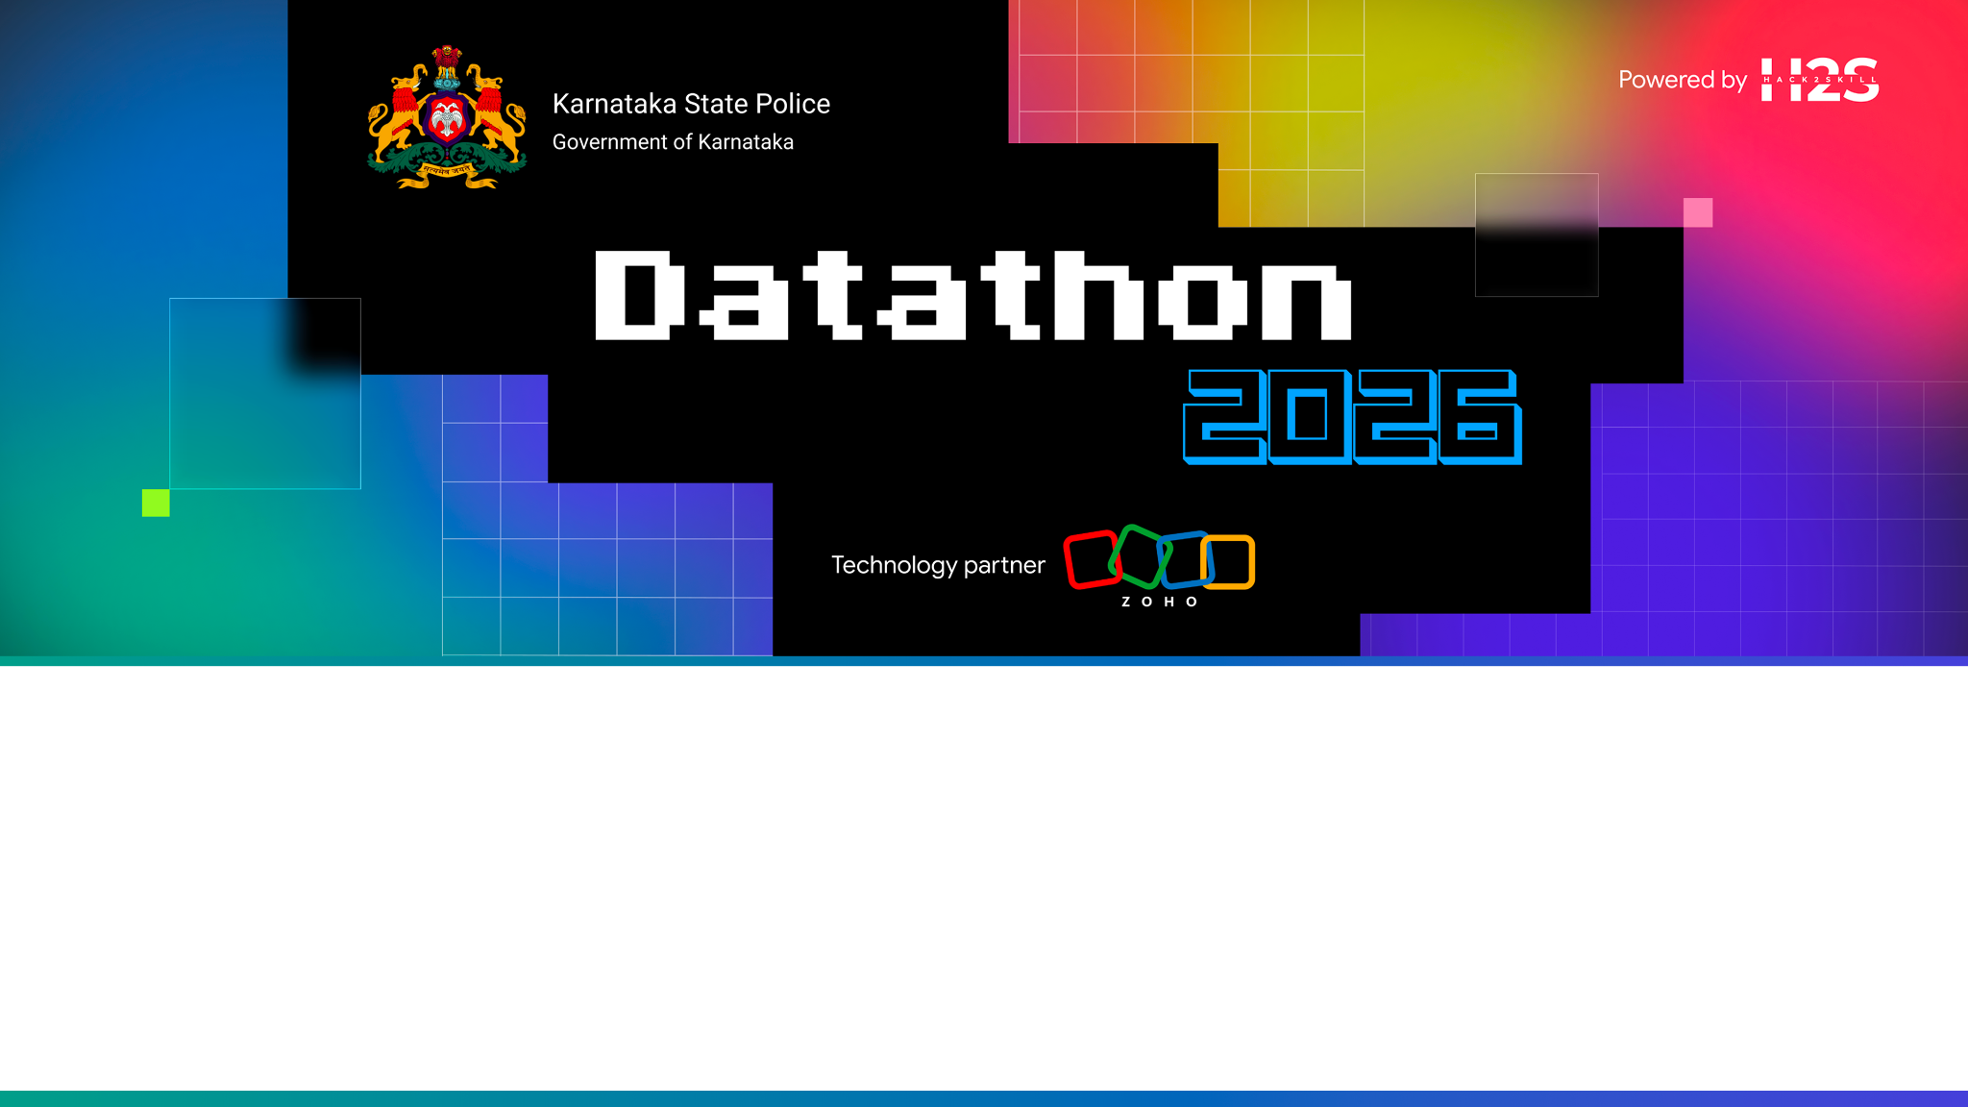
KADI — Karnataka Analytics & Detection Intelligence
AI-Driven Crime Analytics & Visualization Platform for the Karnataka State Police
Team name
KadiLabs
Team leader
Adarsh Dwivedi
Team size
1
Problem Statement
Challenge 02 — AI-Driven Crime Analytics & Visualization Platform
Notes:
KADI turns 40,836 siloed FIRs into one connected, explainable intelligence picture. Deployed end-to-end on Zoho Catalyst.

Slide 2
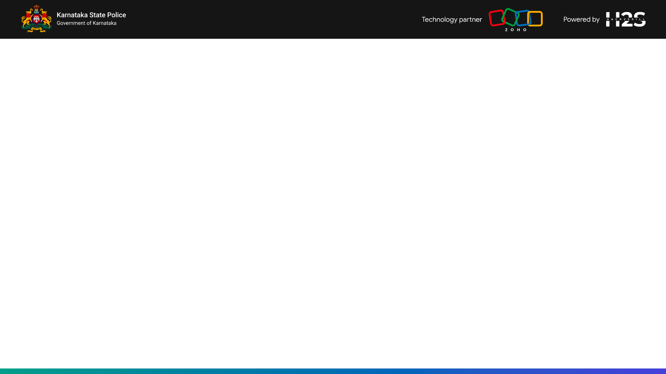
Brief about the solution
What is broken today, and what KADI does about it
The problem today
What KADI delivers
FIRs sit in station-level silos; analysis is Excel
A serial offender across districts is invisible
SCRB gets fragmented extracts, not a state picture
Policing stays reactive — no early warning
No link from a Bengaluru case to a Kalaburagi gang
One graph: every FIR joined by proven evidence
36,890 name records resolved to 300 real people
Per-capita analytics explain why, not just where
Forecasts, hotspots, investigation-health alerts
One audited source the SI and SCRB both read
40,836
300
68,808
100%
3.9%
FIRs analysed
Offenders resolved
Typed evidence links
Ground-truth recovery
Forecast MAPE
One graph. 40,836 FIRs. Every link is evidence an officer can click.
Every figure above is read live from the deployed Catalyst API — nothing on this slide is illustrative.
Notes:
Lead with the silo problem. The 300-from-36,890 number is the entity-resolution story in one line.

Slide 3
Opportunities
How it differs, how it solves the problem, and the USP
How is it different?
How does it solve it?
USP
Not a dashboard over counts — a graph over evidence
Every link is clickable proof: which attribute matched, on which FIRs
Rates per 100,000 residents, not raw counts that merely track population
Fairness enforced by a failing unit test, not a paragraph of policy
Kannada is first-class throughout, not a translation bolted on at the end
Entity resolution merges spelling variants into one offender identity
Six typed link kinds connect FIRs no single station could ever join
Investigation-health flags cases slipping past their peer median
DBSCAN hotspots + 3-month forecast move policing from reactive to planned
A bilingual assistant answers in plain language and cites the FIRs it used
100% recovery of planted gangs, chains and identities — measured every run
Forecast accuracy is a hold-out backtest (MAPE 3.9%), not an in-sample claim
Bilingual EN / ಕನ್ನಡ, voice-capable, every answer cites real FIR numbers
Runs end-to-end on eight Zoho Catalyst services, with nothing third-party
What did not work is documented too — every claim is checkable on the live URL
Where a conventional crime dashboard stops — and KADI starts
Counts by district
A hunch that two cases relate
A monthly Excel extract
"Trust the risk score"
Rates per 100,000, with p-values
A typed edge naming the matching attribute
A nightly, auditable rebuild
Read the factor breakdown behind it
Notes:
The USP column is the one to dwell on: everything there is measured, not asserted.

Slide 4
List of features offered by the solution
Nine capabilities, all live in the deployed build
Case-Linkage Graph
Entity Resolution
Offender Risk
Ego-network per FIR across six typed link kinds, with a click-through evidence trail on every edge.
Rarity-aware fuzzy matching folds 36,890 accused records into 300 real people.
Glass-box score with a full factor breakdown; protected attributes excluded by construction.
Investigation Health
Spatiotemporal Map
Socio-economic Analytics
Flags ageing, pendency, undetected-risk and false-case patterns against peer medians.
Satellite basemap, district choropleth, DBSCAN hotspots, hour x weekday layering.
Per-capita rates correlated with urbanisation, literacy and density, with p-values.
Crime Forecasting
Bilingual Assistant
Fairness & Audit
Three-month district projections with a 95% interval and a measured backtest.
Grounded EN / ಕನ್ನಡ Q&A over the records, by text or voice; always cites FIRs.
Caste, religion and occupation excluded — asserted in tests; sensitive reads audited.
All nine ship in the deployed build — none of them is a mockup or a roadmap item.

Slide 5
Process flow
From a raw FIR register to an investigator acting on a lead
STEP 1
STEP 2
STEP 3
STEP 4
STEP 5
FIR intake
Entity resolution
Link building
Analytics
Delivery
29 KSP tables — FIRs, parties, acts & sections, arrests, chargesheets
Blocking + rarity-aware fuzzy match; 36,890 records to 300 identities
Six typed edges: offender, co-accused, MO, location, time, section
Louvain communities, risk, health, DBSCAN hotspots, per-capita, forecast
Precomputed read-model served to the SPA in under 100 ms
Where each stage runs — and why the platform forces that split
Catalyst Job — 15 minutes
Function / AppSail — 30 s cap
Browser — instant
Entity resolution, MO similarity, graph build, communities, DBSCAN and the forecast all run here. Peaks at 738 MB and 24.6 s. Triggered nightly by Cron at 02:00 IST. A 15-minute budget is the only place on the platform where this legally fits.
Confirmed by the Zoho team in the workshop Q&A, and not raisable. Neither runtime may host the pipeline, so the web tier only ever reads what the Job has already written. That one cap shaped every other decision in the architecture.
Every screen reads a precomputed read-model. No officer ever waits on a model to finish, and no request can time out mid-analysis. The payload is interned to 12.1 MB so the first paint stays under 100 ms.
Notes:
The 30-second cap on both Functions and AppSail was confirmed by the Zoho team in the workshop Q&A — it is the reason the pipeline lives in a Job.

Slide 6
Use-case view
Five ranks, one dataset, and exactly what each is entitled to see
Sub-Inspector
Inspector
ACP / DySP
SCRB Analyst
Administrator
Own station
Own station
Whole district
Entire state
State + governance
Their unit's FIRs and worklist
Plus arrest & chargesheet detail
Cross-station networks, audit log
All 40,836 FIRs, forecasting
Fairness report, pipeline status
What the rank can actually query
SI
Insp
ACP
Analyst
Admin
FIRs registered at their own station
✓
✓
✓
✓
✓
Every FIR in the district
—
—
✓
✓
✓
All 40,836 FIRs, state-wide
—
—
—
✓
✓
Case-linkage graph + why-linked evidence
✓
✓
✓
✓
✓
Arrest and chargesheet detail
—
✓
✓
✓
✓
Per-capita analytics, forecasting, anomalies
—
—
—
✓
✓
Audit log and fairness report
—
—
✓
✓
✓
Scoping is enforced server-side on every query — an out-of-scope read is refused, not merely hidden in the UI. Catalyst Authentication is provisioned; the demo build presents a role chooser so an evaluator can exercise all five scopes without five accounts.

Slide 7
Architecture
Five layers, every runtime component a Catalyst service
ZOHO CATALYST — ONE PROJECT, ONE ORIGIN, NO THIRD-PARTY RUNTIME
PRESENTATION
React 18 + TypeScript SPA
Graph · Map · Charts
EN / ಕನ್ನಡ + voice
What the officer sees
Web Client Hosting · /app
Cytoscape.js · MapLibre GL · Recharts
Web Speech API, client-side
API
21 REST endpoints
RBAC on every query
Audit + grounded assistant
Read-only, rank-scoped
Serverless Function · Node 20 · 512 MB
Refuses out-of-scope reads server-side
Cites the FIR numbers it drew from
COMPUTE
Analytics service
Nightly pipeline
Scheduler
Heavy work lives here
AppSail · Python · ~135 ms per call
Job · 15-min budget · peaks 738 MB
Cron · 02:00 IST · full recompute
DATA
40,836 FIRs · 11 tables
Bulk-import objects
KPI segment
One source of record
Data Store · queried with ZCQL
Stratus bucket · ~9 MB
Cache · adapter written, see slide 10
PLATFORM
Sign-in and role model
OAuth out to QuickML
Deploy and rollback
Identity, secrets, delivery
Authentication · provisioned
Connections · deployment.READ
Catalyst CLI 1.27.0
Design rule that shaped every box above: no heavy compute may sit behind an HTTP request. The pipeline peaks at ~740 MB and ~25 s against a hard 30 s cap, so it runs as a Job and the web tier reads only what the Job wrote. The graph payload is interned before shipping — 54.9 MB of adjacency becomes 12.1 MB with identical evidence text.

Slide 8
Technologies used
Each chosen for a constraint, not for the list
Frontend
Backend & API
React 18 · TypeScript · Vite
Tailwind CSS on the KSP palette
Cytoscape.js + fcose — the linkage graph
MapLibre GL — satellite and choropleth
Recharts — trends, mix, funnels
Framer Motion — interaction polish
Node.js 20 — Advanced I/O Function
Express-compatible routing, 21 endpoints
Role-based access control per query
In-request audit trail on sensitive reads
Deterministic grounded assistant engine
Interned read-model, lazily rehydrated
Data & ML
Platform & quality
Python 3.11
scikit-learn — TF-IDF, NearestNeighbors, DBSCAN
networkx — multigraph and Louvain communities
RapidFuzz — rarity-aware name matching
pandas / NumPy / SciPy
Shapely — in-polygon rejection sampling
Zoho Catalyst — the deployment mandate
Catalyst CLI 1.27.0
ZCQL for Data Store queries
Git / GitHub, Conventional Commits
19 automated tests — 8 Node, 11 Python
A fairness test that fails the build
Nothing here is exotic — every choice traces back to a Catalyst limit: the 30 s request cap, the 512 MB ceiling, the stdlib-only AppSail container.

Slide 9
Catalyst services in the solution
Eight services, each answering a specific constraint
Service
Used for
Why this service
Web Client Hosting
Serves the SPA at /app
Same origin as the API; deep links use a 404-to-shell fallback
Serverless Functions
21-endpoint REST API + nightly Job
Advanced I/O accepts an Express app; raised to 512 MB
AppSail
Python analytics service
Per-capita and forecast in ~135 ms; stdlib-only build
Data Store
11 tables · 40,836 FIRs · live ZCQL
The FIR schema is genuinely relational, so a relational store fits
Stratus
Object storage for bulk import
Data Store bulk-write reads its source from a bucket
Job Scheduling + Cron
Nightly analytics revalidation, 02:00 IST
Only Jobs get 15 minutes; Functions and AppSail both cap at 30 s
Connections
OAuth for QuickML (deployment.READ)
QuickML rejects anonymous calls outright
Authentication
Provisioned; role model shown at sign-in
RBAC scoping is enforced server-side on every query
8 / 8
services live in the deployed build
21
REST endpoints, all returning 200
0
third-party runtimes or hosting
Notes:
All eight are live in the deployed build, not aspirational.

Slide 10
What we did not wire — and exactly why
Listed deliberately: each was attempted and diagnosed
Cache
Adapter written, segment provisioned. Writes from inside a deployed function return 401 PERMISSION_NEEDED. Ruled out: segment id, SDK, scope API, table permissions. Zero user impact — the KPI query recomputes in ~1 ms.
QuickML (GLM-4.7 + RAG)
Endpoint, model id, org header and a valid OAuth token all in place; the endpoint rejects our body with 400 PATTERN_NOT_MATCHED. The assistant runs a deterministic intent engine instead — which cannot hallucinate an FIR number.
Zia (STT / TTS / translate)
Not enabled on the project. The adapter includes the recommended degradation (translate to English, then speak). Voice today runs on the browser Web Speech API, client-side.
NoSQL / SmartBrowz
The graph read-model is served from the function bundle; briefing export returns print-ready HTML rather than claiming a PDF pipeline that does not exist.
API Gateway
Enabled once, then disabled: with no routes configured it intercepted all traffic and the site returned INVALID_URL. Needs route config before it is safe to turn on.
Stating this plainly is a deliberate choice: an evaluator can verify every claim on the live URL.

Slide 11
The dataset
Synthetic FIRs, generated against a real skeleton
Every FIR is synthetic — no real case, person or complainant appears anywhere. Real KSP records cannot leave KSP, so the corpus is generated against the real schema, real geography and real published statistics.
40,836
31
298
50,656
300
7
FIRs · 43 months
districts
police stations
victim records
resolved offenders
planted patterns
How it is generated
Where the synthetic origin shows
Real skeleton: 31 districts, 298 stations, IPC / BNS / IT / NDPS sections, KSP taxonomy
Volume follows published statistics — Bengaluru City ~16,900 FIRs against a few hundred rural
Coordinates rejection-sampled inside real district polygons — 100% land, inside Karnataka
Kannada name pool carrying spelling variants, initials and transliteration drift
Deterministic under seed 2026 — the corpus regenerates byte-for-byte
MO narratives are template-drawn — cleaner and more uniform than real free text
The urbanisation correlation is partly circular: the generator weights urban crime upward
Names come from a finite pool, making resolution slightly easier than reality
No missing fields, typos or duplicate registrations — real registers are messier
Census 2011 population, literacy and urbanisation are real, and used as the denominator

Slide 12
Estimated implementation cost
Free-tier today; the shape of a state-wide rollout
Service
Prototype usage
Cost today
At production scale
Web Client Hosting
SPA + assets (~2 MB)
Free tier
Static hosting, negligible at KSP scale
Serverless Functions
2 functions · 512 MB · ~50k req/mo
Free tier
Scales per invocation; no idle cost
AppSail
1 service · stdlib runtime
Free tier
Analytics on demand, ~135 ms per call
Data Store
40,836 FIRs across 11 tables
Free tier
Real KSP volume is ~20x — paid tier
Stratus
~9 MB of import objects
Free tier
Grows with exports and briefings
Job + Cron
1 nightly run, under a minute
Free tier
One scheduled execution per day
QuickML / Zia
Not yet enabled
Hackathon credits
Per-token / per-call once wired
Rs 0 / month today
~800,000 FIRs a year
Only tokens are usage-priced
the whole prototype fits inside the free tier
the real KSP register the same code would carry
compute stays flat; QuickML is the variable line

Slide 13
Snapshots of the prototype
Nine screens, all live at the deployed URL right now
Command Dashboard
Case-Linkage Graph
Intelligence
KPIs, monthly trend, hour x weekday heatmap, disposal funnel and the rank-shift finding.
Ego-network with a layout switcher, six link-type filters and a "why linked" evidence panel.
Per-capita ranking, correlation scatter, crime mix by band, forecast with its interval.
Spatiotemporal Map
Investigation Health
Offender Watchlist
Satellite basemap, district choropleth, DBSCAN hotspots and a time-of-day filter.
Worklist of 19,006 flagged cases, each with a reason and a recommended action.
Risk gauge, glass-box factor breakdown, name variants and every linked FIR.
Bilingual Assistant
Cases Register
About & Audit
EN / ಕನ್ನಡ Q&A by text or voice, every answer citing real FIR numbers.
All 40,836 FIRs, filterable by head, district, status, gravity and health flag.
Full platform, dataset and fairness documentation; audited sensitive reads.
Best seen live: Home -> Intelligence (Kodagu) -> Graph (click an edge) -> Map -> Assistant. Sign-in is a role chooser — no password needed.
Notes:
Walk the live URL rather than reading this slide: Home, Intelligence (Kodagu), Graph (why-linked), Map, Assistant.

Slide 14
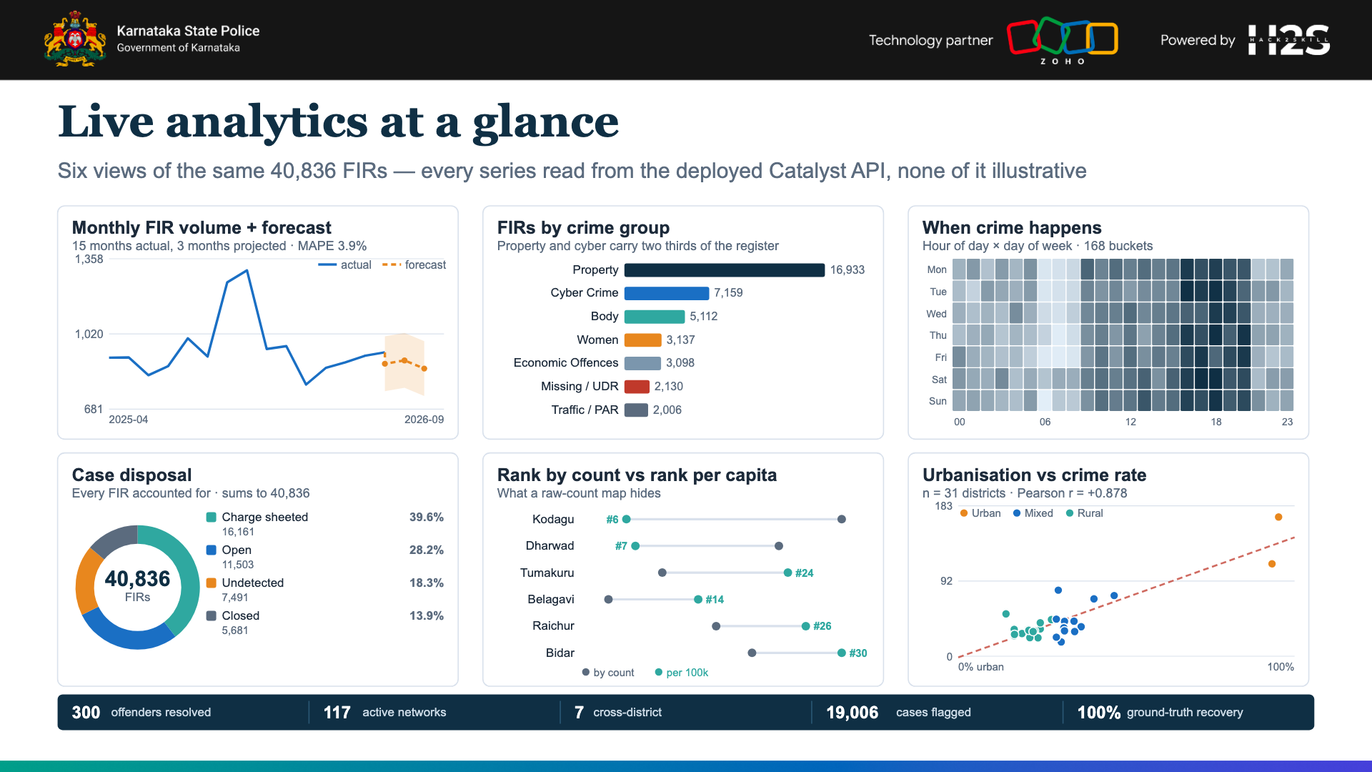
Notes:
Every series is read from deck/data/*.json, captured live from the deployed API. Six views: volume + forecast, crime mix, hour x weekday, disposal, rank shift, urbanisation correlation.

Slide 15
Performance & benchmarking
Measured on the deployed build — and here is exactly how
Ground-truth recovery (%)
24.6 s
738 MB
Pipeline runtime
Peak memory
full recompute, 40,836 FIRs
was 1,770 MB before tuning
135 ms
12.1 MB
AppSail analytics
Graph payload
against a 30 s request cap
interned down from 54.9 MB
3.9%
19 / 19
Forecast MAPE
Test suite
3-month hold-out backtest
8 Node + 11 Python, all green
How these figures were obtained
Recovery %
Runtime & memory
Latency & MAPE
The generator plants 7 known patterns and writes them to _ground_truth.json before the pipeline starts. The pipeline never reads that file. eval.py scores the recovered clusters against it after every single run.
/usr/bin/time -l over the full 40,836-FIR pipeline — the same script the Catalyst Job executes. 1,770 MB before sklearn working_memory was capped at 32 MiB; 738 MB after, with byte-identical output.
The 135 ms is the median of 20 sequential calls to the deployed AppSail endpoint. MAPE is a hold-out backtest: 3 months withheld, model fitted on the rest, then scored against the withheld actuals.

Slide 16
The finding that changes the map
Why counts mislead, and what per-capita analysis reveals
Kodagu is 30th in Karnataka by raw FIR count — and 6th per 100,000 residents.
335 FIRs looks unremarkable beside Bengaluru City's 16,895 — until you divide by 648,787 residents. A count map would never surface it. Tumakuru moves the other way: 10th by count, 24th by rate. Same register, opposite conclusion.
Rank by raw count vs rank per 100,000 residents
Socio-economic correlation (n = 31 districts)
Urbanisation
r = +0.878
p < 0.0001 · strong
Literacy
r = +0.538
p = 0.0018 · moderate
Population density
r = +0.889
p < 0.0001 · strong
Crime rate per 100,000 by urbanisation band
Urban
2 districts
163.6 / 100k
18,279 FIRs
Mixed
12 districts
46.7 / 100k
12,368 FIRs
Rural
17 districts
30.1 / 100k
10,189 FIRs
What this changes operationally: deployment follows rate, not volume — and the caveat is stated openly.
A district ranked 30th by count draws no extra staffing; ranked 6th by rate, it does. On this corpus the generator weights urban crime upward, so the urbanisation correlation is partly circular — the method is sound and runs unchanged on real KSP data, but here it is confirmation, not discovery.

Slide 17
Fair by construction — and proven
The hardest question a jury asks, answered with a test
What is excluded, and how it is enforced
Explainability
Caste, religion and occupation never enter entity resolution, linkage, risk scoring or any prediction. A unit test fails the build if any protected column appears in a model feature set — the guarantee is executable, not editorial.
Every edge names the attribute that matched, and the FIRs it matched on
Every risk score shows its factor breakdown, not just a number
Every assistant answer cites the FIR numbers it drew from
Sensitive reads are written to an audit trail
Ground-truth evaluation — recomputed on every pipeline run
Cross-district chain-snatching gang
cluster
100%
recovered
Serial burglary chain
cluster
100%
recovered
Cyber-fraud ring (UPI/OTP)
cluster
100%
recovered
Offender entity resolution (single-person avg)
identity
100%
recovered
Repeat offender out on bail
risk
100%
recovered
Overall ground-truth recovery 100% · identity resolution 100% · every figure recomputed by eval.py after each run, never hand-entered.

Slide 18
Links
Everything is publicly accessible and independently verifiable
Deployed solution (Catalyst)
https://kadilabs-60078029367.development.catalystserverless.in/app/
Web Client Hosting · sign in by role, no password needed
Demo video
https://drive.google.com/drive/folders/1WY3KHg1WOEnSNTBXGmTtH2ZoJM1y4cLJ?usp=sharing
Problem overview · working prototype · key workflows
GitHub repository
https://github.com/adarshcod30/Kadi
Full source, README, setup and execution instructions
AppSail analytics service
https://kadi-appsail-50043957273.development.catalystappsail.in/analytics/socio
Live JSON — per-capita rates and correlations
Deployment is exclusively on the Zoho Catalyst platform, as the challenge requires — no part of the running system is hosted elsewhere.

Slide 19
Additional details & future development
What ships next, in priority order
1. Bind Catalyst Authentication
2. Read the API from Data Store
3. Complete QuickML + Zia
Replace the role header with a verified JWT inside userFromRequest — one function, nothing else changes.
Swap the bundled read-model for ZCQL reads behind the existing store interface.
Settle the request-body contract with Zoho support, then enable Kannada STT / TTS server-side.
4. Persist the audit trail
5. Ingest live KSP data
6. Extend the graph
Move the in-memory ring buffer into a Data Store table for real accountability.
Signals on FIR insert for incremental recompute instead of a nightly full rebuild.
Vehicle numbers, phone / IMEI and bank accounts as first-class link types.
Impact at real KSP scale
7
cross-district networks surfaced that no single station could see
19,006
investigations flagged as drifting past their peer median
~800,000
FIRs a year in the real register the same code would carry
Applied to Karnataka's real register, the same code turns a monthly Excel exercise into a nightly, auditable intelligence picture that a Sub-Inspector and the SCRB both read from one source — with the fairness guarantee enforced by a test, not a promise.

Slide 20


