Slide 1
Sales Performance Dashboard – Task 4
Created by: Adarsh H
Data Analyst Intern – Task Submission

Slide 2
Objective of the Dashboard
• Analyse overall sales performance
• Identify high-performing product lines
• Compare sales across countries and regions
• Understand the impact of different deal sizes
• Provide insights using interactive filters

Slide 3
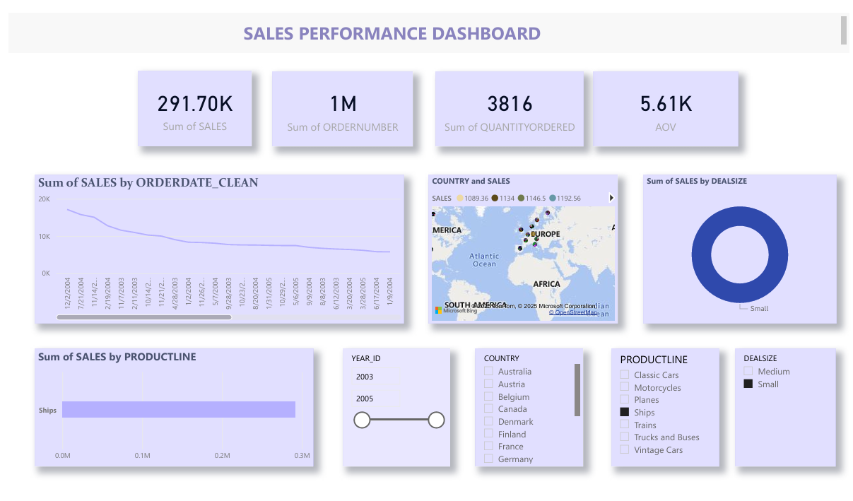
Sales Dashboard Overview

Slide 4
Key Insights
• Classic Cars is the highest-selling product category
• USA and Europe generate the largest revenue
• Medium deal-size accounts for the majority of total sales
• Sales trend shows ups and downs with seasonal variations
• Strong demand observed in automotive-themed product lines

Slide 5
Tools & Dataset Used
• Microsoft Power BI
• Data Transformation using Power Query
• Visual Analytics through Power BI charts
• Sales Dataset from Kaggle (Sales Data Sample)

Slide 6
Thank You
For Queries:
Adarsh H

